Slide 1
R for Biologists
Focus:
Create/maintain graphics used in Quarto slide decks

Slide 2
Color Reference
Scheduling
Learning Objectives
Coding Practice
Supporting Information
Class Discussion

Slide 3
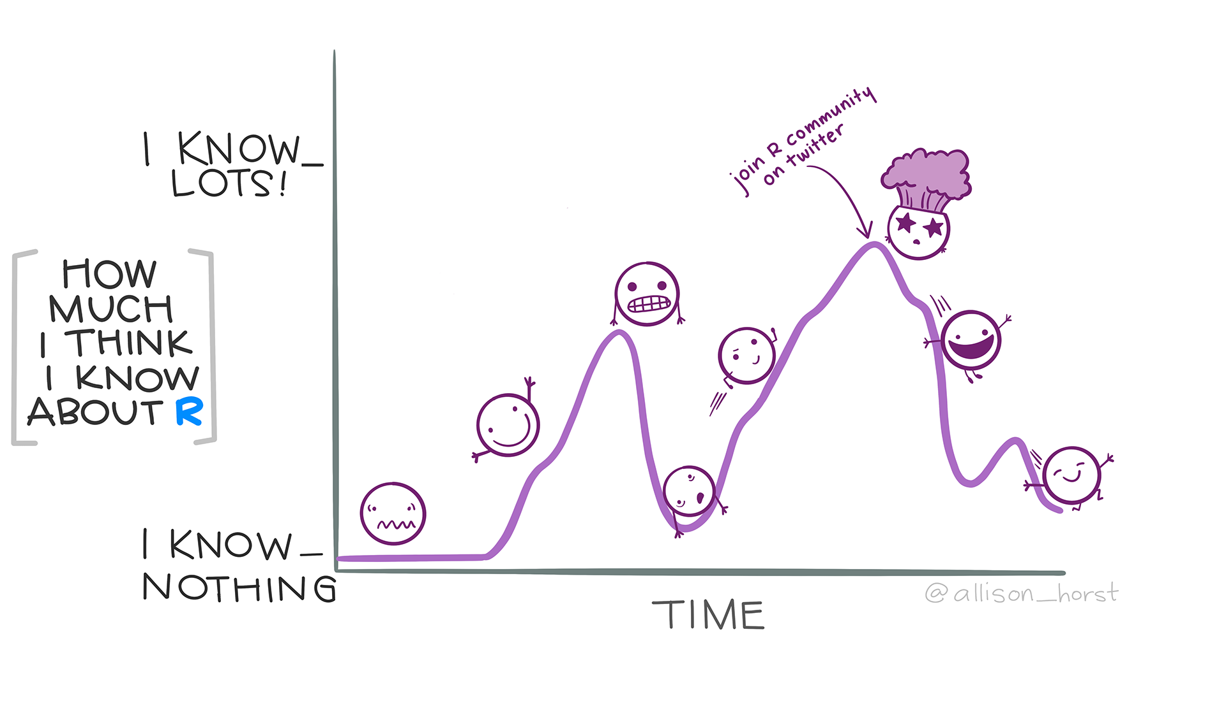
Slides 1A + 8B -- r-knowledge.png
You at End of Class

Slide 4


Slides 1A -- file-path.png
~
Documents
BIO 101
BIO 316
BIO316-Notes-Week 1.docx
Downloads

Slide 5
Slides 1B -- rstudio-layout.png
”Source”
Your Choice!
“Console”
Your Choice!

Slide 6

Slides 3A -- code-chunk.png

Slide 7
Slides 3A -- code-chunk-annotated.png
Code Language
Run this Chunk
Chunk start
Chunk Options
Run all chunks above this one
Chunk Name
Chunk end

Slide 8


Slides 3A -- code-chunk-options.png
Option
Chunk Code in
Finished File
Chunk Outputs in Finished File
Chunk Messages in Finished File
`include = FALSE`
`echo = FALSE`
`message = FALSE`
`warning = FALSE`

Slide 9



Slides 3B -- shape-long.png
Treatment
Butterfly Type
Count
#
#
#
#
#
#

Slide 10
Slides 3B -- shape-arrows.png
Reshape Wider
Reshape Longer

Slide 11
Slides 3B -- shape-wide.png
Treatment
#
#
#
#
#
#

Slide 12
Slides 4A -- graphic-join-left.png
ID
X
ID
Y
ID
X
Y
A
A
A
B
C
B

Slide 13
Slides 4A -- graphic-join-right.png
ID
X
ID
Y
ID
X
Y
A
A
A
B
C
C

Slide 14
Slides 4A -- graphic-join-inner.png
ID
X
ID
Y
ID
X
Y
A
A
A
B
C

Slide 15
Slides 4A -- graphic-join-outer.png
ID
X
Y
ID
X
ID
Y
A
A
A
B
B
C
C

Slide 16

Slides 4A -- graphic-join-anti.png
ID
X
ID
Y
ID
X
Y
A
A
B
B
C
C

Slide 17


Slides 4B -- sunflower-hypothesis.png
Regular Soil
+N Soil

Slide 18
Slides 4B -- stats-roadmap-v0.png
Response (Y)
Explanatory
(X)
Categorical
Continuous
Categorical
Continuous

Slide 19
Slides 4B -- stats-roadmap-v1.png
Response (Y)
Explanatory
(X)
Categorical
Continuous
Categorical
Chi-Square Test
(χ²)
Analysis of Variance
(ANOVA)
Continuous
Generalized Linear Model
Regression

Slide 20
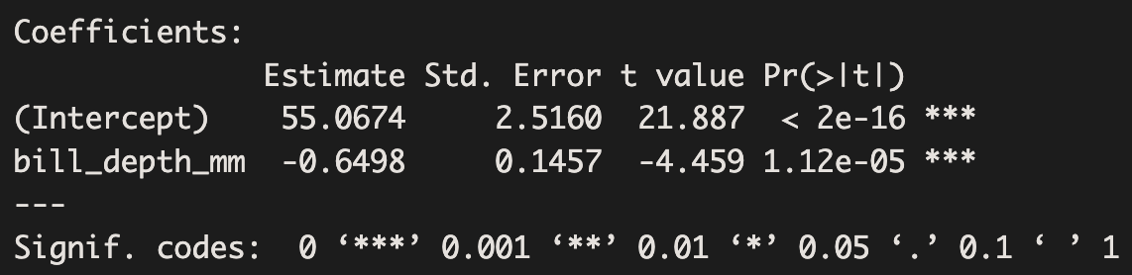
Slides 4B -- regression-table.png

Slide 21
Slides 4B -- regression-table-annotated.png
Test Statistic
p values
Y-Intercept
p value asterisks
Smaller p = more ***
Explanatory variable
Slope of line
p value asterisks legend

Slide 22
Slides 4B -- chi-square-table.png
No Change
Cured
Placebo
35
6
Treatment
2
104

Slide 23
Slides 5A -- stats-roadmap-v2.png
Response (Y)
Explanatory
(X)
Categorical
Continuous
Categorical
Chi-Square Test
(χ²)
Analysis of Variance
(ANOVA)
Continuous
Generalized Linear Model
Regression
Multiple (Separate)
n-way ANOVA

Slide 24


Slides 5A -- interactions-visual.png
Student Enjoyment
Talking about Statistics
Visuals are Good

Slide 25
Slides 5A -- stats-roadmap-v3.png
Response (Y)
Explanatory
(X)
Categorical
Continuous
Categorical
Chi-Square Test
(χ²)
Analysis of Variance
(ANOVA)
Continuous
Generalized Linear Model
Regression
Multiple (Separate)
n-way ANOVA
Multiple (Interacting)
Analysis of Co-Variance (ANCOVA)

Slide 26
Slides 6A -- graph-base-plot.png

Slide 27
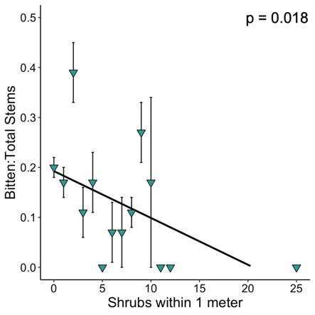
Slides 6A -- graph-ggplot2.png

Slide 28
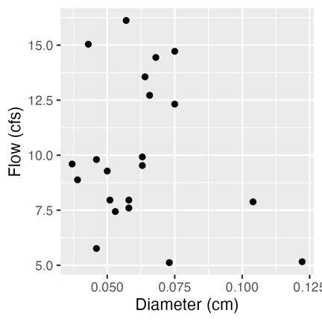
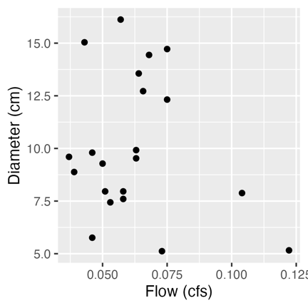
Slides 6A -- graph-bad-labels.png

Slide 29
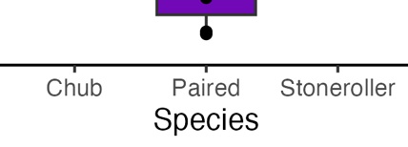
Slides 6B -- graph-title-v-text.png

Slide 30
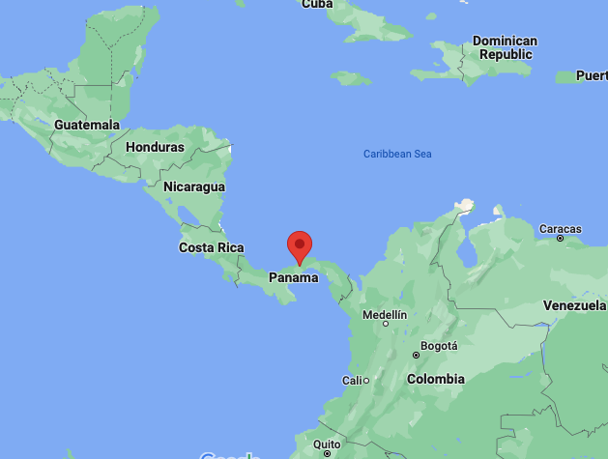
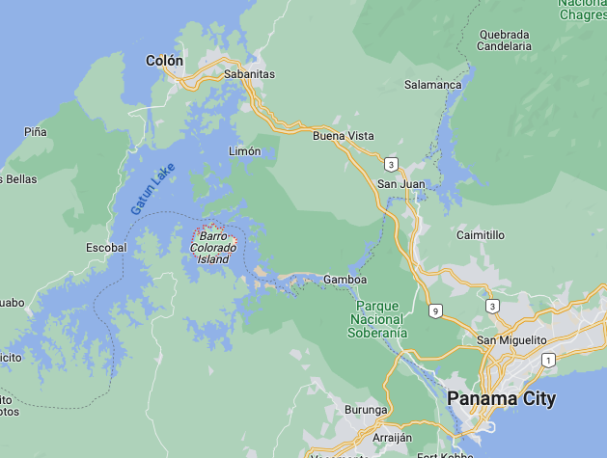
Slides 8B -- map-bci.png

