Slide 1
tidy-data.png
Observation
Data
Point
Variable
Data
Point

Slide 2
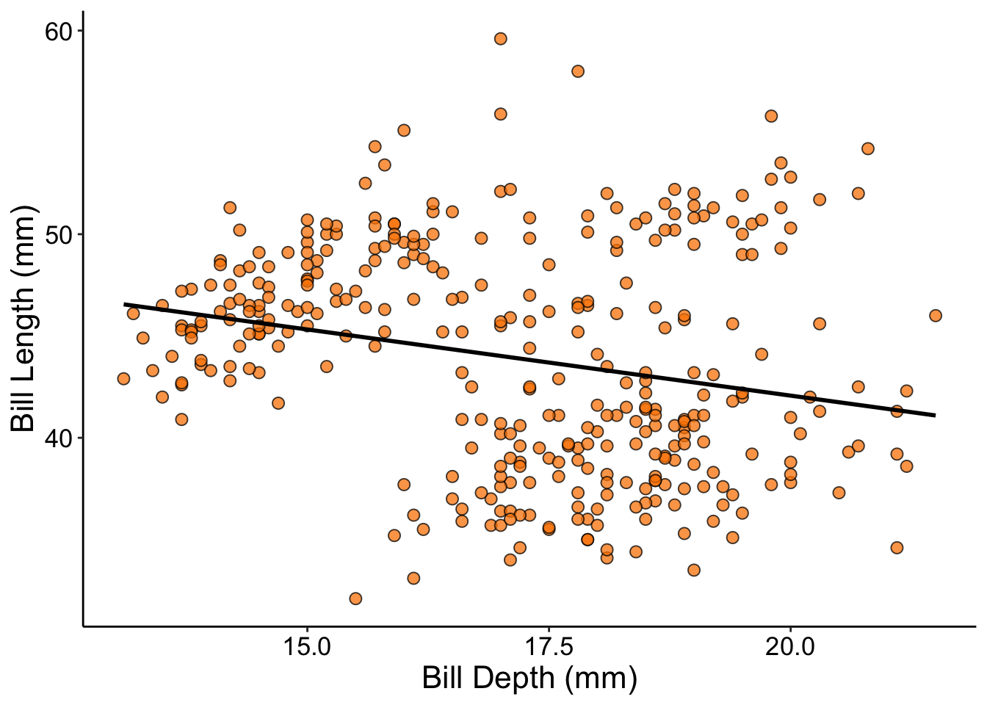
graph-anatomy-02.png
Plot Area
Y Axis
Response Variable
X Axis
Explanatory Variable

Slide 3
graph-anatomy-03.png
Axis Label
Tick Labels
Tick Marks

Slide 4
viz-roadmap-01.png
Is my explanatory variable categorical?
Yes
No
Is the range of the data what’s important?
Do I care about the trend?
Yes
No
Yes
No
Boxplot /
Violin Plot
Bar Graph
Scatterplot + ”Best Fit” Line
Scatterplot

Slide 5
viz-roadmap-02.png
Is my explanatory variable categorical?
Yes
No
Is the range of the data what’s important?
Do I care about the trend?
Yes
No
Yes
No
Boxplot /
Violin Plot
Bar Graph
Scatterplot + ”Best Fit” Line
Scatterplot

Slide 6
viz-roadmap-03.png
Is my explanatory variable categorical?
Yes
No
Is the range of the data what’s important?
Do I care about the trend?
Yes
No
Yes
No
Boxplot /
Violin Plot
Bar Graph
Scatterplot + ”Best Fit” Line
Scatterplot

Slide 7
viz-roadmap-04.png
Is my explanatory variable categorical?
Yes
No
Is the range of the data what’s important?
Do I care about the trend?
Yes
No
Yes
No
Boxplot /
Violin Plot
Bar Graph
Scatterplot + ”Best Fit” Line
Scatterplot

Slide 8
viz-roadmap-05.png
Is my explanatory variable categorical?
Yes
No
Is the range of the data what’s important?
Do I care about the trend?
Yes
No
Yes
No
Boxplot /
Violin Plot
Bar Graph
Scatterplot + ”Best Fit” Line
Scatterplot

