Slide 1
Shooting Range Locator
Noah Martin

Slide 2
Project Idea
Find shooting ranges near user
Allow for saving of desert shooting locations
Created to allow for easy tracking and saving of various spots to shoot

Slide 3
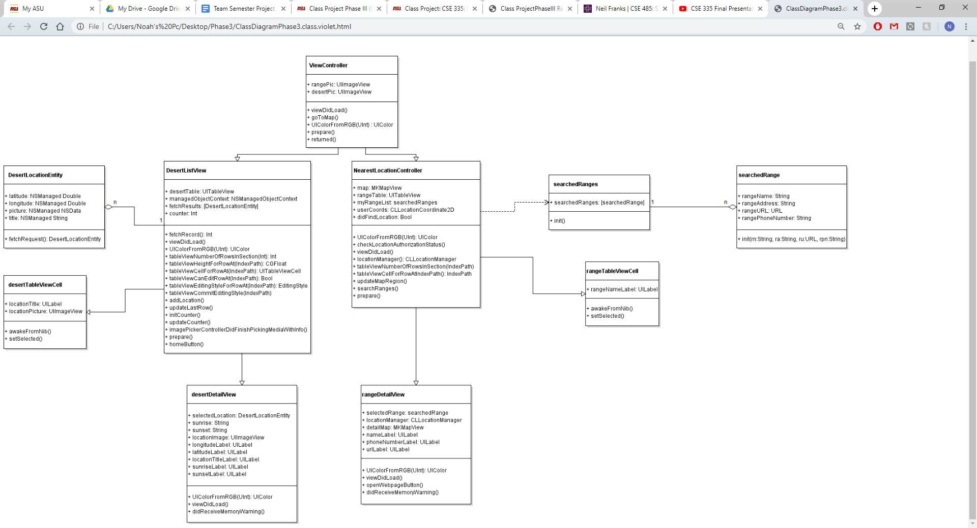
Class Diagram

Slide 4
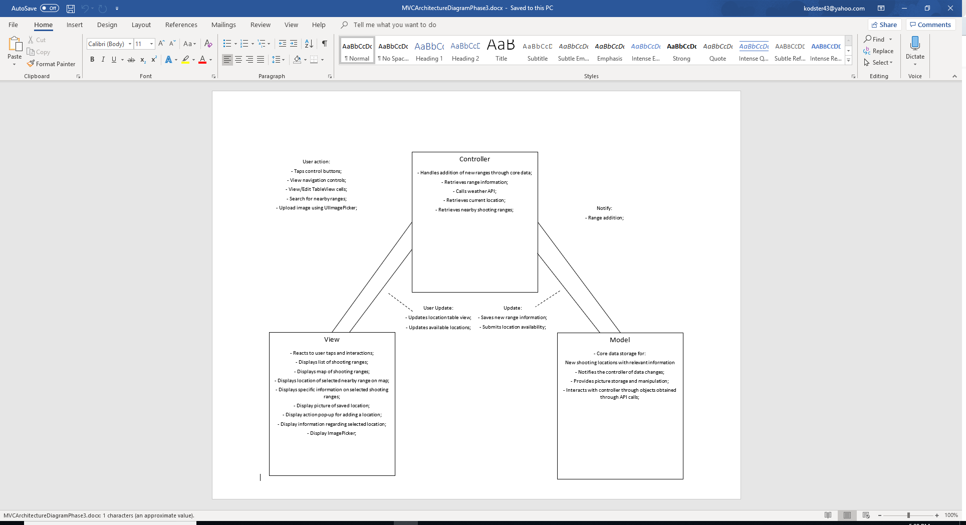
MVC Diagram

Slide 5
Capabilities
Nearby shooting ranges can be found by based on current location.
Can select from any range found in the table views.
Once a range is selected, various information will appear regarding that specific range.
Locations can be saved via coordinates for later access.
Once a saved location is selected, the coordinates and sunrise and sunset times will be displayed along with the image selected for the location.
Can add/delete locations.

Slide 6
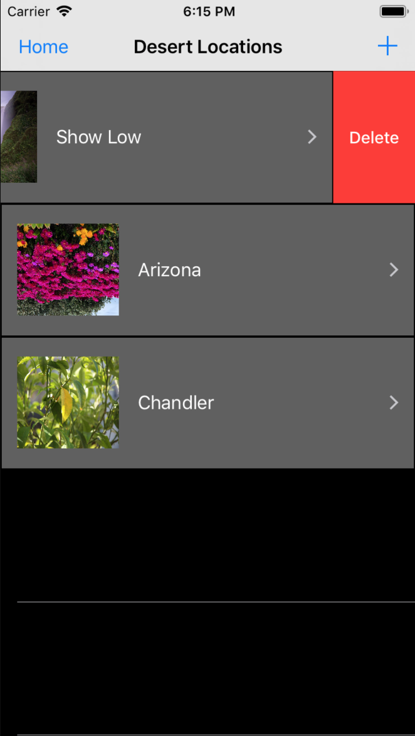
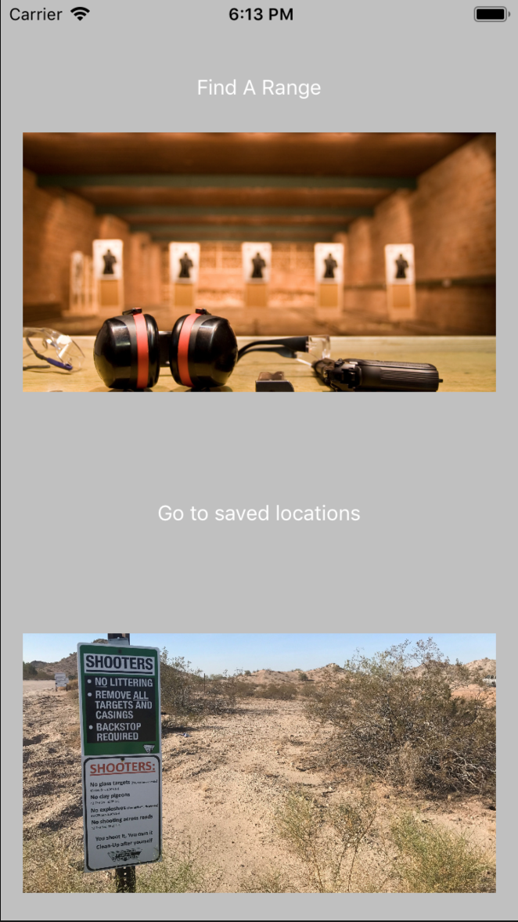
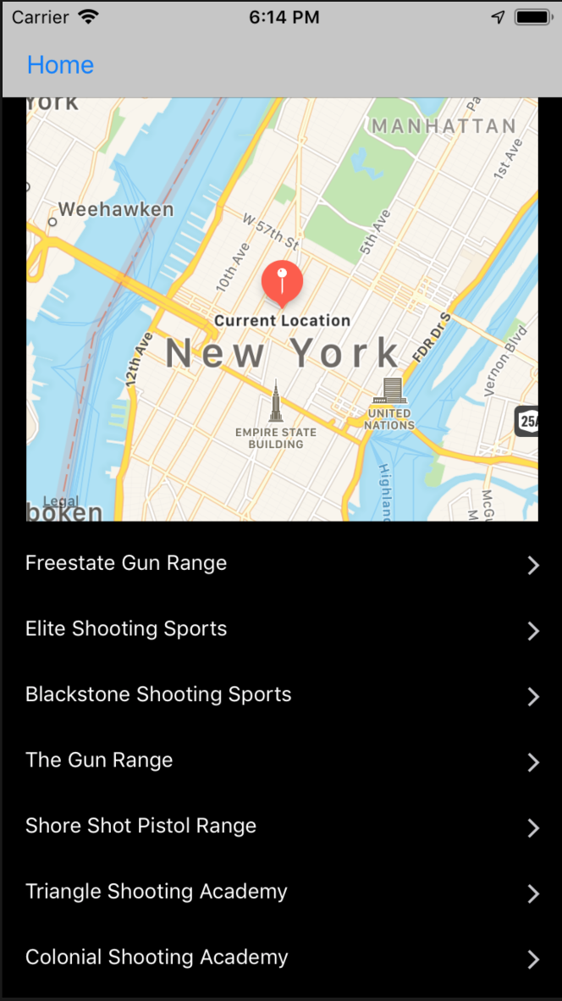
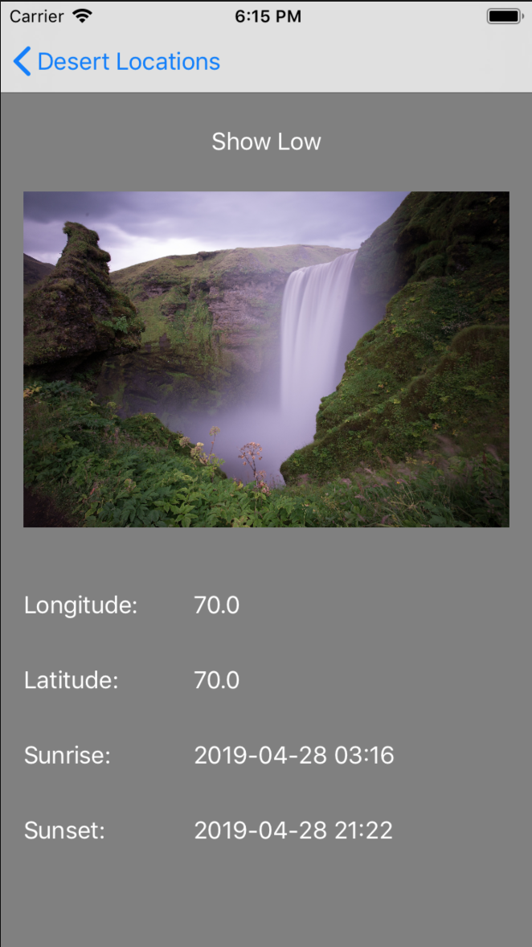
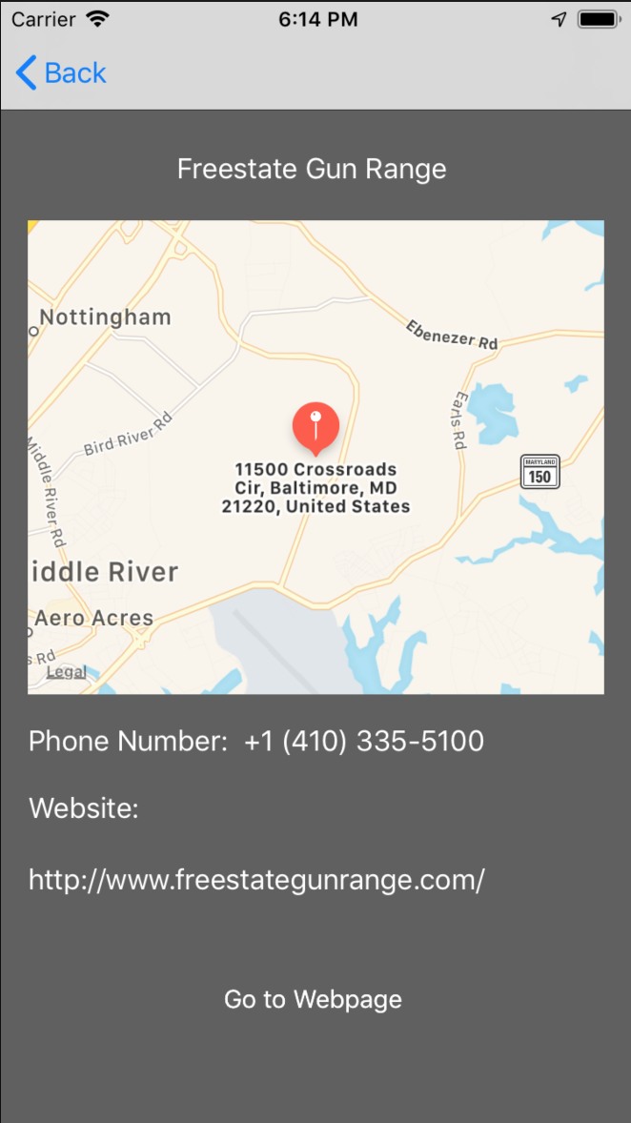
Flow of application

Slide 7
Limitations
Saved locations cannot be edited.
Saved locations cannot be viewed on a map.
Searches can only be done via current location.
Location permissions cannot be updated after user has given permission.

Slide 8
Lessons Learned
UIButtons can conflict with prepare functions.
Implement a design iteratively as new ideas are introduced.
How to process Json results.
How to change colors of everything in a view (besides navigation bar).

Slide 9
Suggestions for class/project
Spend more time on the aesthetics of applications
Talk about a wider array of API’s that can be used
Accommodate example code for new and old versions of XCode

