Slide 1
CS 3733 Operating Systems
Topics: Threads
(SGG, Chapter 04)
(USP, Chapter 12)
Instructor: Dr. Turgay Korkmaz
Department Computer Science
The University of Texas at San Antonio
Office: NPB 3.330
Phone: (210) 458-7346
Fax: (210) 458-4437
e-mail: korkmaz@cs.utsa.edu
web: www.cs.utsa.edu/~korkmaz
These slides are prepared based on the materials provided by the textbook [SGG] .

Slide 2
Chapter 4: Threads
Overview *
Multithreading Models *****
Thread Libraries ****
  Pthreads and Java threads
Threading Issues ***
Operating System Examples *
Windows XP Threads *
Linux Threads *

Slide 3
Objectives
To introduce the notion of a thread
  a fundamental unit of CPU utilization that forms the basis of multithreaded computer systems
To examine issues related to multithreaded programming
To discuss the APIs for the Pthreads and Java threads libraries (optional Win32)

Slide 4
Motivation: Example 1: Recall monitoring multiple FDs?
Methods you should know about (USP book):
  Separate processes
    each monitors one file descriptor (Program 4.11)
  A single process with
    select (Program 4.12 and Program 4.14)
    poll (Program 4.17)
    Nonblocking I/O with polling (Example 4.39)
    POSIX asynchronous I/O (Program 8.14 and Program 8.16)
A New approach: THREADS
  A single process with separate threads
    each monitors one file descriptor (Section 12.2)

Slide 5
A program that monitors two files by forking a child process (Program 4.11)
int main(int argc, char *argv[]) {
int bytesread;
int childpid;
int fd, fd1, fd2;
if (argc != 3) {
fprintf(stderr, "Usage: %s file1 file2\n", argv[0]);
return 1;
}
if ((fd1 = open(argv[1], O_RDONLY)) == -1) {
fprintf(stderr, "Failed to open file %s:%s\n", argv[1], strerror(errno));
return 1;
}
if ((fd2 = open(argv[2], O_RDONLY)) == -1) {
fprintf(stderr, "Failed to open file %s:%s\n", argv[2], strerror(errno));
return 1;
}
if ((childpid = fork()) == -1) {
perror("Failed to create child process");
return 1;
}
if (childpid > 0) /* parent code */
fd = fd1;
else
fd = fd2;
bytesread = copyfile(fd, STDOUT_FILENO);
fprintf(stderr, "Bytes read: %d\n", bytesread);
return 0;
}
#include <errno.h>
#include <fcntl.h>
#include <stdio.h>
#include <string.h>
#include <unistd.h>
#include "restart.h"
+ Easy to program
- Sharing data between processes is hard

Slide 6
Single process with select:
A function that blocks until one of two file descriptors is ready
#include <errno.h>
#include <string.h>
#include <sys/select.h>
int whichisready(int fd1, int fd2) {
int maxfd;
int nfds;
fd_set readset;
if ((fd1 < 0) || (fd1 >= FD_SETSIZE) ||
(fd2 < 0) || (fd2 >= FD_SETSIZE)) {
errno = EINVAL;
return -1;
}
maxfd = (fd1 > fd2) ? fd1 : fd2;
FD_ZERO(&readset);
FD_SET(fd1, &readset);
FD_SET(fd2, &readset);
nfds = select(maxfd+1, &readset, NULL, NULL, NULL);
if (nfds == -1)
return -1;
if (FD_ISSET(fd1, &readset))
return fd1;
if (FD_ISSET(fd2, &readset))
return fd2;
errno = EINVAL;
return -1;
}
- Coding is getting complicated.
+ Sharing data is easy

Slide 7
A single process with separate Threads for monitoring two FDs.
When creating a thread, you indicate which C function the thread should execute.
When a new thread is created, it runs concurrently with the creating process/thread. This is in contrast to function call!
#define BUFSIZE 1024
void *processfd(void *arg);
main(){
int error;
int fd1, fd2;
pthread_t tid1, tid2;
/* open files… */
if (error = pthread_create(&tid1, NULL, processfd, &fd1))
fprintf(stderr, "Failed to create thread: %s\n", strerror(error));
if (error = pthread_create(&tid2, NULL, processfd, &fd2))
fprintf(stderr, "Failed to create thread: %s\n", strerror(error));
}
So what is the benefit?
+ Easy to program
+ Easy to share data
void docommand(char *cmd, int cmdsize);
void *processfd(void *arg) { /* process commands read from file descriptor */
char buf[BUFSIZE];
int fd;
ssize_t nbytes;
fd = *((int *)(arg));
for ( ; ; ) {
if ((nbytes = r_read(fd, buf, BUFSIZE)) <= 0)
break;
docommand(buf, nbytes);
}
return NULL;
}
A function that is used as a thread must have a special format.
It takes a single parameter of type pointer to void and returns a pointer to void.
The parameter type allows any pointer to be passed.
This can point to a structure, so in effect, the function can use any number of parameters.

Slide 8
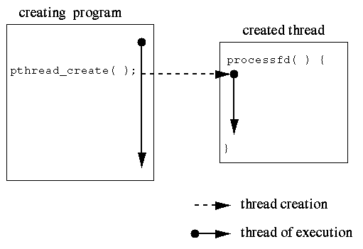
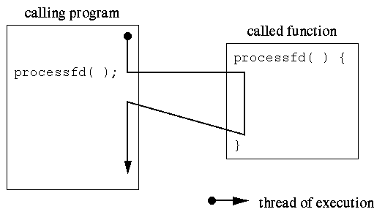
Function Call vs. Thread
****
processfd(&fd1); // vs.
pthread_create(&tid1, NULL, processfd, &fd1));
a single thread of execution
a separate thread of execution for function

Slide 9
Then the benefits are ….
Running multiple tasks/threads concurrently
Sharing data between threads is easy (like a single process)
while
coding is also easy (like multiple processes)…
Best of the both worlds…

Slide 10

Example 2: A Multi-Activity Text Editor
.
Process approach on data
  P1: read from keyboard
  P2: format document
  P3: write to disk
When in the Course of human events, it becomes necessary for one people to dissolve the political bands which have connected them with another, and to assume among the powers of the earth, the separate and equal station to which the Laws of Nature and of Nature's God entitle them, a decent respect to the opinions of mankind requires that they should declare the causes which impel them to the separation.
We hold these truths to be self-evident, that all men are created equal, that they are endowed by their Creator with certain unalienable Rights, that among these are Life, Liberty and the pursuit of Happiness.--That to secure these rights, Governments are instituted among Men, deriving their just powers from the consent of the governed, --That whenever any Form of Government becomes
destructive of these ends, it is the Right of the People to alter or to abolish it, and to institute new Government, laying its foundation on such principles and organizing its powers in such form, as to them shall seem most likely to effect their Safety and Happiness. Prudence, indeed, will dictate that Governments long established should not be changed for light and transient causes; and accordingly all
The processes will actively access
the same set of data.
How do the processes
exchange data?
Kernel
Context Switch for Processes- costly
Notes:
. Improve application responsiveness;
. More natural program structure;
. IPC and Synchronization are very costly: user-kernel-user;

Slide 11
Ideal Solution for the Text Editor
Threads
.
Three activities within one process
  Single address space
  Same execution environment
  Data shared easily
Switch between activities
  Only running context
  No change in address space
When in the Course of human events, it becomes necessary for one people to dissolve the political bands which have connected them with another, and to assume among the powers of the earth, the separate and equal station to which the Laws of Nature and of Nature's God entitle them, a decent respect to the opinions of mankind requires that they should declare the causes which impel them to the separation.
We hold these truths to be self-evident, that all men are created equal, that they are endowed by their Creator with certain unalienable Rights, that among these are Life, Liberty and the pursuit of Happiness.--That to secure these rights, Governments are instituted among Men, deriving their just powers from the consent of the governed, --That whenever any Form of Government becomes
destructive of these ends, it is the Right of the People to alter or to abolish it, and to institute new Government, laying its foundation on such principles and organizing its powers in such form, as to them shall seem most likely to effect their Safety and Happiness. Prudence, indeed, will dictate that Governments long established should not be changed for light and transient causes; and accordingly all
Kernel
Notes:
. Multiple threads within a process will share: The address space, Open files, Other resources;
. Potential for efficient and close cooperation

Slide 12
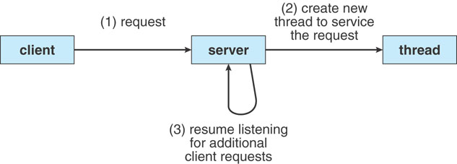
Another Example: Web servers

Slide 13

Thread vs. Process
Both are methods for Concurrency and Parallelism
Processes
  Independent execution units use their own states, address spaces, and interact with each other via IPC
  Traditional Processes have single flow of control (thread)
Thread
  Flow of control (activity) within a process
  A single process on a modern OS may have multiple threads
  All threads share the code, data, and files while having some separated resources
  Threads directly interact with each other using shared resources
Concurrency vs. Parallelism?
Notes:
. Each thread can be in any one of the several states, just like processes.
. Each thread has its own stack;
. All threads in the process have exactly the same address space
. When a multithreaded process is run on a single CPU system, the threads take turns running
A thread has its own program counter and stack, but shares a number of resources with its process and other threads of the process
THREAD
address space: code and global variables
open files
semaphores
signals
timers
process ID

Slide 14
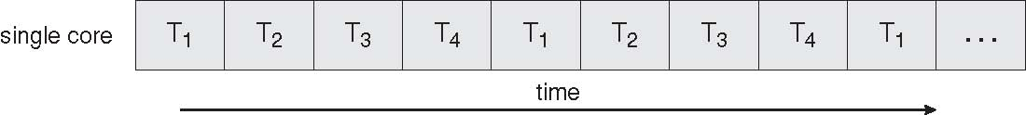
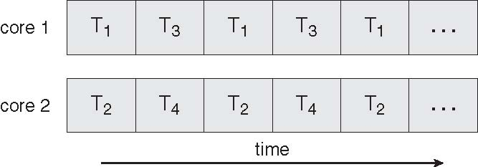
Benefits
Responsiveness
  Interactive application
Resource sharing
  Address space and other resources
Economy: less overhead
  Solaris: process creation 30X overhead than thread;
  Context switching threads within a process 5X faster
Scalability
  Better utilization of multiprocessor/multicore systems
Concurrent Execution on a Single-core System
Parallel Execution on a Multicore System

Slide 15
Threads vs. Processes
Threads and processes: similarities
  Each has its own logical control flow
  Each can run concurrently with others
  Each is context switched (scheduled) by the kernel
Threads and processes: differences
  Threads share code and data, processes (typically) do not
  Threads are less expensive than processes
    Process control (creation and exit) is more expensive than thread control
    Context switches for processes are more expensive than that for threads

Slide 16
Pros and Cons of Thread-Based Designs
+ Easy to share data between threads
  e.g., logging information, file cache
+ Threads are more efficient than processes
– Unintentional sharing can introduce subtle and hard-to-reproduce errors!

Slide 17
Multicore Programming
OPT
Multithreaded programming provides a mechanism for efficient use of multicore systems
Programmers face new challenges
  Dividing activities
  Balance
  Data splitting
  Data dependency
  Testing and debugging
Multicore programming will require entirely new approach to design SW

Slide 18
An Example: testthread.c
.
#include <pthread.h>
#include <stdio.h>
#include <stdlib.h>
#define NUM_THREADS 5
void *PrintHello(void *threadid);
int main(int argc, char *argv[]){
pthread_t threads[NUM_THREADS];
int rc;
long t;
for(t=0;t<NUM_THREADS;t++){
printf("In main: creating thread %ld\n", t);
rc = pthread_create(&threads[t], NULL, PrintHello, (void *)t);
if (rc){
printf("ERROR; return code from pthread_create() is %d\n", rc);
exit(-1);
}
} // wait for other threads
for(t=0;t<NUM_THREADS;t++) pthread_join(threads[t], NULL);
}
void *PrintHello(void *threadid){
int i;
long tid;
tid = (long)threadid;
printf("Hello World! It's me, thread #%ld!\n", tid);
for(i=0; i < 10; i++) printf("It's thread #%ld and i=%d\n", tid, i);
pthread_exit(NULL);
}
To compile, link with the pthread library.
> gcc testthread.c -o testthread -lpthread
Give the possible outputs….
In main: creating thread 0
In main: creating thread 1
Hello World! It's me, thread #0!
It's thread #0 and i=0
It's thread #0 and i=1
Hello World! It's me, thread #1!
It's thread #1 and i=0
It's thread #0 and i=2
It's thread #0 and i=3
It's thread #0 and i=4
It's thread #1 and i=1
It's thread #1 and i=2
It's thread #1 and i=3
In main: creating thread 2
It's thread #0 and i=5
Hello World! It's me, thread #2!
It's thread #2 and i=0
It's thread #0 and i=6
It's thread #0 and i=7
….
{int c=1000; while(c--); printf … }
Notes:
Test
WITHOUT FOR LOOP IN PRINTHELLO
In main: creating thread 0
In main: creating thread 1
Hello World! It's me, thread #0!
In main: creating thread 2
Hello World! It's me, thread #1!
In main: creating thread 3
Hello World! It's me, thread #2!
In main: creating thread 4
Hello World! It's me, thread #3!
Hello World! It's me, thread #4!
WITHOUT FOR LOOP IN PRINTHELLO
In main: creating thread 0
In main: creating thread 1
Hello World! It's me, thread #0!
It's thread #0 and i=0
It's thread #0 and i=1
It's thread #0 and i=2
It's thread #0 and i=3
It's thread #0 and i=4
It's thread #0 and i=5
It's thread #0 and i=6
It's thread #0 and i=7
It's thread #0 and i=8
It's thread #0 and i=9
In main: creating thread 2
Hello World! It's me, thread #1!
It's thread #1 and i=0
It's thread #1 and i=1
It's thread #1 and i=2
It's thread #1 and i=3
It's thread #1 and i=4
It's thread #1 and i=5
In main: creating thread 3
It's thread #1 and i=6
It's thread #1 and i=7
It's thread #1 and i=8
It's thread #1 and i=9
In main: creating thread 4
Hello World! It's me, thread #3!
It's thread #3 and i=0
It's thread #3 and i=1
It's thread #3 and i=2
It's thread #3 and i=3
It's thread #3 and i=4
It's thread #3 and i=5
It's thread #3 and i=6
It's thread #3 and i=7
It's thread #3 and i=8
It's thread #3 and i=9
Hello World! It's me, thread #2!
It's thread #2 and i=0
It's thread #2 and i=1
It's thread #2 and i=2
It's thread #2 and i=3
It's thread #2 and i=4
It's thread #2 and i=5
It's thread #2 and i=6
It's thread #2 and i=7
It's thread #2 and i=8
It's thread #2 and i=9
Hello World! It's me, thread #4!
It's thread #4 and i=0
It's thread #4 and i=1
It's thread #4 and i=2
It's thread #4 and i=3
It's thread #4 and i=4
It's thread #4 and i=5
It's thread #4 and i=6
It's thread #4 and i=7
It's thread #4 and i=8
It's thread #4 and i=9
IF i is GLOBAL
In main: creating thread 0
In main: creating thread 1
Hello World! It's me, thread #0!
It's thread #0 and i=0
It's thread #0 and i=1
In main: creating thread 2
It's thread #0 and i=2
Hello World! It's me, thread #1!
It's thread #1 and i=0
Hello World! It's me, thread #2!
It's thread #2 and i=0
It's thread #0 and i=3
In main: creating thread 3
It's thread #2 and i=1
It's thread #2 and i=3
In main: creating thread 4
It's thread #0 and i=2
Hello World! It's me, thread #3!
It's thread #2 and i=4
It's thread #0 and i=5
Hello World! It's me, thread #4!
It's thread #1 and i=1
It's thread #4 and i=0
It's thread #2 and i=1
It's thread #1 and i=2
It's thread #0 and i=2
It's thread #1 and i=3
It's thread #2 and i=6
It's thread #2 and i=7
It's thread #2 and i=8
It's thread #2 and i=9
It's thread #4 and i=2
It's thread #3 and i=1
It's thread #1 and i=6
It's thread #0 and i=6

Slide 19
Exercises on testthread.c
What if you make i in the function global?
How would you pass an array of doubles to this thread? Thread will add all and print the sum
How about passing an integer, a double, and a character as parameters to this thread? Thread will simply print them.
What if we wanted to get some results back from that thread, what would you do?

Slide 20
MULTI-THREADING MODELS
How to implement threads?

Slide 21
Thread Implementations: Issues
.
Process usually starts with a single thread and creates others
Thread management operations (similar to process management)
  Creation: procedure/method for the new thread to run
  Scheduling: runtime properties/attributes
  Destruction: release resources
  Thread Synchronization
    join, wait, etc.
Who manages threads and where
  User space: managed by applications using some libraries
  Kernel space: managed by OS
    all modern OSes have kernel level support (more effective, parallel exec)

Slide 22
User-Level Threads
.
User threads: thread library at the user level
Run-time system provides support for thread creation, scheduling and management
Run-time system
Thread
Process
User
Space
Kernel has NO knowledge of threads!
Thread table
Kernel
Space
Kernel
Process Table
Notes:
Kernel has no knowledge of threads, just processes;
supported above the kernel

Slide 23
User-Level Threads (cont.)
.
Each process needs its own private thread table to keep track of the threads in that process.
The thread-table keeps track of the per-thread items (program counter, stack pointer, register, state..)
When a thread does something that may cause it to become blocked locally (e.g. wait for another thread), it calls a run-time system procedure.
If the thread must be put into blocked state, the procedure performs thread switching
Advantages
  Fast thread switching: no kernel activity involved
  Customized/flexible thread scheduling algorithm
  Application portability: different machines with library
Problems/disadvantages:
  Kernel only knows process
  Blocking system calls: kernel blocks process, so one thread blocks all activities (many-to-one mapping)
  All threads share one CPU, so cannot use multi-proc./core

Slide 24
Kernel-Level Threads
.
Supported directly by OS
Kernel performs thread creation, scheduling & management in kernel space
Process
Thread
User
Space
Kernel
Space
Thread table
Process Table
Notes:
. Kernel solution: The whole idea is to have the kernel contain the implementation of a thread package.
This does mean that all operations return as system calls

Slide 25
Kernel-Level Threads (cont.)
.
Advantages
  User activity/thread with blocking I/O does NOT block other activities/threads from the same user
  When a thread blocks, the kernel may choose another thread from the same or different process
  Multi-activities in applications can use multi-proc/cores
Problems/disadvantages
  Thread management could be relatively costly:
    all methods that might block a thread are implemented as system calls
  Non-flexible scheduling policy
  Non-portability: application can only run on same type of machine
What is the relationship between user level and kernel level threads?
How to map user level threads to kernel level threads?

Slide 26



Mapping: User → Kernel Threads
Many-to-one
  Many user threads → one kernel thread (-/+ are same as in user-level threads)
  Examples: Solaris Green Threads, GNU Portable Threads
One-to-One
  One user thread → one kernel thread;
  + more concurrency
  - limited number of kernel threads
  Examples: Windows NT/XP/2000, Linux, Solaris 9 and later
Many-to-Many
  Many user threads → many kernel threads
  + no limit on the number of user threads
  - not true concurrency because kernel has limited number of threads
  Examples: Solaris prior to version 9, Windows NT/2000 with the ThreadFiber package

Slide 27
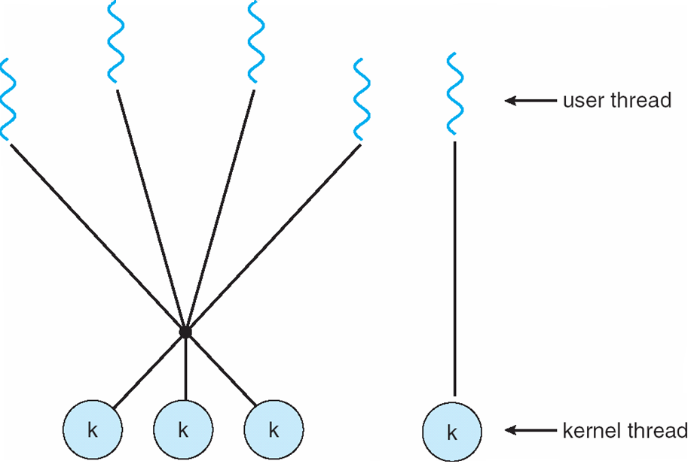
Two-level Model
Similar to M:M, except that it allows a user thread to be bound to kernel thread
Examples
  IRIX
  HP-UX
  Tru64 UNIX
  Solaris 8 and earlier

Slide 28
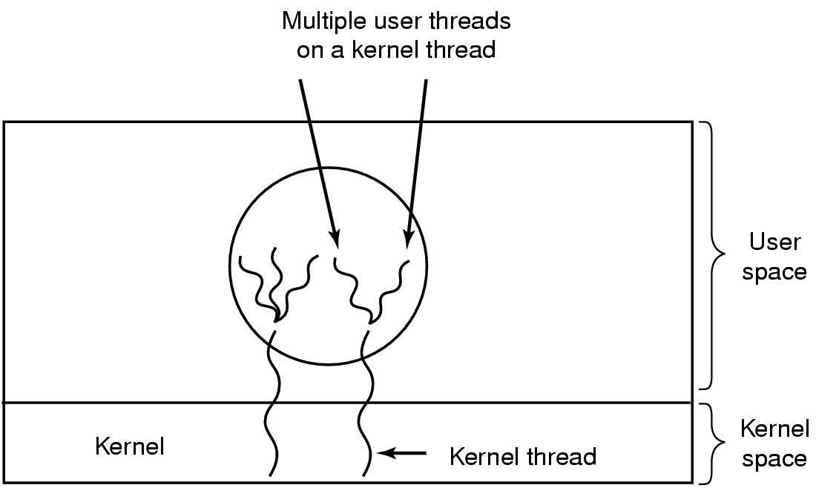
Hybrid Implementation
*
combine the best of both approaches
Use kernel-level threads, and then multiplex user-level threads onto some or all of the kernel threads.
Notes:
Scheduler activation approaches for allocate kernel threads to processes

Slide 29
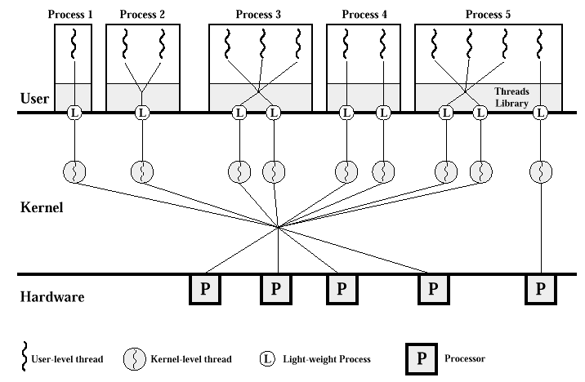
Light-Weight Process (LWP)
.
OPT
Lightweight process (LWP): intermediate data structure
  For user-level threads, LWP is a Virtual processor
  Each LWP attaches to a kernel thread
Multiple user-level threads → a single LWP
  Normally from the same process
A process may be assigned multiple LWPs
  Typically, an LWP for each blocking system call
OS schedules kernel threads (hence, LWPs) on the CPU
Notes:
[wiki] A LWP runs in user space on top of a single kernel thread and shares its address space and system resources with other LWPs within the same process. Multiple user level threads, managed by a thread library, can be placed on top of one or many LWPs - allowing multitasking to be done at the user level, which can have some performance benefits.
In some operating systems there is no separate LWP layer between kernel threads and user threads. This means that user threads are implemented directly on top of kernel threads. In those contexts, the term "light-weight process" typically refers to kernel threads and the term "threads" can refer to user threads

Slide 30
LWP: Advantages and Disadvantages
OPT
+ User level threads are easy to create/destroy/sync
+ A blocking call will not suspend the process if we have enough LWP
+ Application does not need to know about LWP
+LWP can be executed on different CPUs, hiding multiprocessing
- Occasionally, we still need to create/destroy LWP (as expensive as kernel threads)
- Makes upcalls (scheduler activation)
  + simplifies LWP management
  - Violates the layered structure

Slide 31
THREAD LIBRARIES
Provide programmers with API for creating and managing threads

Slide 32
Thread Libraries
Thread Libraries can be implemented in two ways:
  User-level library
    Entirely in user space
    Everything is done using thread related function calls (no syscalls)
  Kernel-level library supported by the OS
    Code and data structures for kernels are in kernel space
    Thread related function calls result in system calls to kernel
Three primary thread libraries:
  POSIX Threads Pthread (either a user-level or kernel-level)
  Win32 threads (kernel-level)
  Java threads (JVM manages threads by using host system threads)
    Threads are fundamental model of prog exec,
    Java provides rich set of features for thread creation and mng.

Slide 33
POSIX Threads: Pthread
POSIX
  Portable Operating System Interface [for Unix]
  Standardized programming interface
Pthread
  A POSIX standard (IEEE 1003.1c) API for thread creation and synchronization
  API specifies behavior of the thread library, implementation is up to development of the library (Defined as a set of C types and procedure calls)
  Common in UNIX operating systems (Solaris, Linux, Mac OS X)
Implementations
  User-level vs. kernel-level
More information about Pthread programming
https://computing.llnl.gov/tutorials/pthreads/
Notes:
https://docs.oracle.com/cd/E19455-01/806-5257/index.html

Slide 34
Pthread APIs: Four Groups
.
Thread management
  Routines for creating, detaching, joining, etc.
  Routines for setting/querying thread attributes
Mutexes: abbreviation for "mutual exclusion"
  Routines for creating, destroying, locking/unlocking
  Functions to set or modify attributes with mutexes.
Conditional variables
  Communications for threads that share a mutex
  Functions to create, destroy, wait and signal based on specified variable values
  Functions to set/query condition variable attributes
Synchronization
  Routines that manage read/write locks and barriers
Thread Call | Description
pthread_create | Create a new thread in the caller’s address space
pthread_exit | Terminate the calling thread
pthread_join | Wait for a thread to terminate
pthread_mutex_init | Create a new mutex
pthread_mutex_destroy | Destroy a mutex
pthread_mutex_lock | Lock a mutex
pthread_mutex_unlock | Unlock a mutex
pthread_cond_init | Create a condition variable
pthread_cond_destroy | Destroy a condition variable
pthread_cond_wait | Wait on a condition variable
pthread_cond_signal | Release one thread waiting on a condition variable
USP
C
h
13
-
SGG
Ch
5

Slide 35
Thread Creation
int pthread_create(pthread_t *restrict thread, const pthread_attr_t *restrict attr, void *(*start_routine)(void *), void *restrict arg);
.
#include <pthread.h>
1st argument is the ID of the new thread
2nd argument is a pointer to pthread_attr_t
3rd argument is thread (function/method) name
4th argument is a pointer to the arguments for the thread’s method/function
When successful, returns 0
pthread_t threadID;
pthread_create (&threadID, NULL, methodName, *para);

Slide 36
An Example: testthread.c
.
#include <pthread.h>
#include <stdio.h>
#include <stdlib.h>
#define NUM_THREADS 5
void *PrintHello(void *threadid){
long tid;
tid = (long)threadid;
printf("Hello World! It's me, thread #%ld!\n", tid);
pthread_exit(NULL);
}
int main(int argc, char *argv[]){
pthread_t threads[NUM_THREADS];
int rc;
long t;
for(t=0;t<NUM_THREADS;t++){
printf("In main: creating thread %ld\n", t);
rc = pthread_create(&threads[t], NULL, PrintHello, (void *)t);
if (rc){
printf("ERROR; return code from pthread_create() is %d\n", rc);
exit(-1);
}
}
for(t=0;t<NUM_THREADS;t++)
pthread_join(threads[t], NULL); // wait for other threads
pthread_exit(NULL); //to return value;
}
To compile, link with the pthread library.
> gcc testthread.c -o test –lpthread
> test
In main: creating thread 0
In main: creating thread 1
Hello World! It's me, thread #0!
In main: creating thread 2
Hello World! It's me, thread #1!
In main: creating thread 3
Hello World! It's me, thread #2!
In main: creating thread 4
Hello World! It's me, thread #3!
Hello World! It's me, thread #4!

Slide 37
Associated Function: Work for the Thread
Need to have a special format
void *ThFunc(void *arg);
Take a single parameter (void *)
  Allow any pointer to be passed
  Point to a structure (with any number of parameters)
Return void *
void *ThFunc(void *arg){
long tid;
tid = (long) arg;
printf("My ID %ld!\n", tid);
// do something
pthread_exit(NULL);
}
int error; int fd; pthread_t tid;
if (error=pthread_create(&tid, NULL, ThFunc, &fd))
fprintf(stderr, "Failed to create thread: %s\n", strerror(error));
When successful, returns 0

Slide 38
Thread ID
Each thread has an ID of type pthread_t
  It is just an integer (like a process ID) on most systems
Retrieve a thread’s own ID with pthread_self
Thread IDs can be compared with pthread_equal
pthread_t pthread_self(void);
int pthread_equal(thread_t t1, pthread_t t2);

Slide 39
Thread: Join
A thread normally exits when its function returns
Some resources of a thread stay around when it exists until it has been joined (waited for) or its process terminates
A thread waits for (kid) threads with pthread_join
int pthread_join(pthread_t thread,
void **value_ptr);
Why do we need double pointer here?

Slide 40
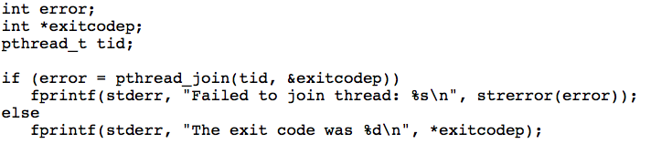
Return Value of A Thread
The pthread_join function suspends the calling function until a specific thread has completed
A thread can pass a value to another thread in a process through its return value
The return value is a pointer to arbitrary data
  Threads in a process share an address space

Slide 41
Thread: Detach
By default a thread is attached to the parent thread
  Parent should wait (join) to release child thread’s resources
But it is possible to detach a thread
  make it release its own resources when it terminates
  A detached thread cannot be joined.
Detach a thread with pthread_detach
int pthread_detach(pthread_t thread);

Slide 42
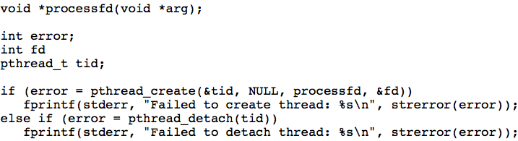
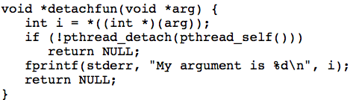
Examples: Detach A Thread
Example 1: Create and detach a thread
Example 2: A thread detach itself

Slide 43
Process Exit and Thread Exit
A process terminates when
  it calls exit directly
  one of its threads calls exit
  it executes return from main
  it receives a signal
When a process terminates, all its threads terminate
Thread exit/cancellation
  Call return from its main thread function or pthread_exit
  void pthread_exit(void *value_ptr);
  Can request another thread exit with pthread_cancel
  int pthread_cancel(pthread_t thread);
  More about thread cancellation later…

Slide 44
Parameters and Return Values of Threads
*****
Parameter: a void pointer
  to an array of same-type parameters,
  to a structure of different-type parameters,
  type cast long as pointers
Return value: a void pointer
  Terminating thread passes a pointer to the joining thread
  The threads share the same address space.
  The return value must exist after the thread terminates; Must not use the address of automatic variable in thread for return value
void *ThFunc(void *arg){
// get some data
// do some work…
// return some data
}
long t=200, ret;
long *ptrret;
pthread_create(&tid, NULL,
ThFunc,(void *)t);
t=300;
…
pthread_join(tid, &ptrret);
ret = *ptrret
void *ThFunc(void *arg){
long myt;
myt = (long) arg;
printf("ID %ld!", myt);
pthread_exit(NULL);
}

Slide 45
Parameters of Threads (long) – special case
*****
long t=200;
pthread_create(&tid, NULL,
ThFunc,(void *)t);
t=300;
…
void *ThFunc(void *arg){
long myt;
myt = (long) arg;
printf("ID %ld!", myt);
pthread_exit(NULL);
}

Slide 46
Parameters of Threads (long) – general case
*****
long t=200;
pthread_create(&tid, NULL,
ThFunc,(void *)&t);
t=300;
…
void *ThFunc(void *arg){
long myt;
myt = *((long *) arg);
printf("ID %ld!", myt);
pthread_exit(NULL);
}
long t=200, *ptrt;
ptrt = (long *) malloc(sizeof(long));
if (ptrt == NULL) exit();
*ptrt = t;
pthread_create(&tid, NULL,
ThFunc,(void *) ptrt);
t=300;
……

Slide 47
Parameters of Threads (double) – general case
*****
double t=200.5;
pthread_create(&tid, NULL,
ThFunc,(void *) &t);
t=300.5;
…
void *ThFunc(void *arg){
double myt;
myt = *((double *)arg);
printf(“I got %lf!", myt);
pthread_exit(NULL);
}
double t=200.5, *ptrt;
ptrt = (double *) malloc(sizeof(double));
if (ptrt == NULL) exit();
*ptrt = t;
pthread_create(&tid, NULL,
ThFunc,(void *) ptrt);
t=300.5;
……

Slide 48
Return Values of Threads (long) - special case
*****
long t=200, ret;
long *ptrret;
pthread_create(&tid, NULL,
ThFunc,(void *)t);
t=300;
…
pthread_join(tid, (void **)&ptrret);
ret = (long) ptrret;
void *ThFunc(void *arg){
long myt, myret;
myt = (long) arg;
printf("ID %ld!", myt);
myret = ……;
pthread_exit((void *)myret);
}

Slide 49
Return Values of Threads (long) – general case
*****
long t=200, ret;
long *ptrret;
pthread_create(&tid, NULL,
ThFunc,(void *)t);
t=300;
…
pthread_join(tid, (void **)&ptrret);
ret = *ptrret;
void *ThFunc(void *arg){
long myt, myret;
myt = (long) arg;
printf("ID %ld!", myrt);
myret = ……;
pthread_exit((void *)&myret);
}
// NO! WHY?

Slide 50
Return Values of Threads (long) – general case
*****
long t=200, ret;
long *ptrret;
pthread_create(&tid, NULL,
ThFunc,(void *)t);
t=300;
…
pthread_join(tid, (void **)&ptrret);
ret = *ptrret;
void *ThFunc(void *arg){
long myt, myret;
myt = (long) arg;
printf("ID %ld!", myrt);
myret = ……;
pthread_exit((void *)&myret);
}
// NO! WHY?
void *ThFunc(void *arg){
long myt, myret, *myptrret;
myt = (long)arg;
printf(“I got %lf!", myt);
myret = ……;
myptrret = (long *)
malloc(sizeof(long));
if (myptrret==NULL)exit();
*myptrret = myret;
pthread_exit((void *)myptrret);
}

Slide 51
Return Values of Threads (double) – general case
*****
double t=200.5, ret;
double *ptrret;
pthread_create(&tid, NULL,
ThFunc,(void *) &t);
t=300.5;
…
pthread_join(tid, (void **)&ptrret);
ret = *ptrret;
void *ThFunc(void *arg){
double myt, myret;
myt = *((double *)arg);
printf(“I got %lf!", myt);
myret = ……;
pthread_exit((void *)&myret);
}
// NO! WHY?
void *ThFunc(void *arg){
double myt, myret, *myptrret;
myt = *((double *)arg);
printf(“I got %lf!", myt);
myret = ……;
myptrret = (double *)
malloc(sizeof(double));
if(myptrret == NULL) exit();
*myptrret = myret;
pthread_exit((void *)myptrret);
}

Slide 52
Exercises on passing parameters and returning values
DO quiz11 (parameter pass/return long, double),

Slide 53
How to Pass STRUCT to Threads
*****
typedef struct param {
int x; double y; char z;
} param_t;
param_t t={4, 5.6, ‘a’};
pthread_create(&tid, NULL,
ThFunc,(void *) &t);
…
void *ThFunc(void *arg){
param_t myt, *myptrt;
myt = *((param_t *)arg);
myptrt = (param_t *)arg;
printf(“Got %lf!", myt.y);
printf(“Got %lf!", myptrt->y);
}
typedef struct param {
int x; double y; char z;
} param_t;
param_t t={4, 5.6, ‘a’}, *ptrt;
ptrt = malloc(…); // if NULL
*ptrt = t;
pthread_create(&tid, NULL,
ThFunc,(void *) ptrt);
t.x=2;
…

Slide 54
How to Return STRUCT from Threads
*****
typedef struct param {
int x; double y; char z;
} param_t;
param_t t={4, 5.6, ‘a’}, ret;
param_t *ptrret;
pthread_create(&tid, NULL,
ThFunc,(void *) &t);
…
pthread_join(tid, (void **)&ptrret);
ret = *ptrret;
void *ThFunc(void *arg){
param_t myt, *myptrt;
param_t myret, *myptrret;
myt = *((param_t *)arg);
myptrt = (param_t *)arg;
printf(“Got %lf!", myt.y);
printf(“Got %lf!", myptrt->y);
myret.x = ……;
myptrret = (param_t *)
malloc(sizeof(param_t));
if(myptrret == NULL) exit();
*myptrret = myret;
pthread_exit((void *)myptrret);
}

Slide 55
How to Pass an ARRAY to Threads
*****
a_type arr[100];
pthread_create(&tid, NULL,
ThFunc,(void *) arr);
…
void *ThFunc(void *arg){
a_type *myarr;
myarr = (a_type *)arg;
myarr[i] ......
}

Slide 56
How to Return an ARRAY from Threads
*****
a_type arr[100], *ret;
a_type **ptrret;
pthread_create(&tid, NULL,
ThFunc,(void *) arr);
…
pthread_join(tid, (void **)&ret);
ret[i] ........
void *ThFunc(void *arg){
a_type *myarr, myret[5], *myptrret;
myarr = (a_type *)arg;
myarr[i] ......
myret[i] = ……;
myptrret = (a_type *)
malloc( 5 * sizeof(a_type));
if(myptrret == NULL) exit();
myptrret[i] = myret[i]; ………
pthread_exit((void *)myptrret);
}

Slide 57
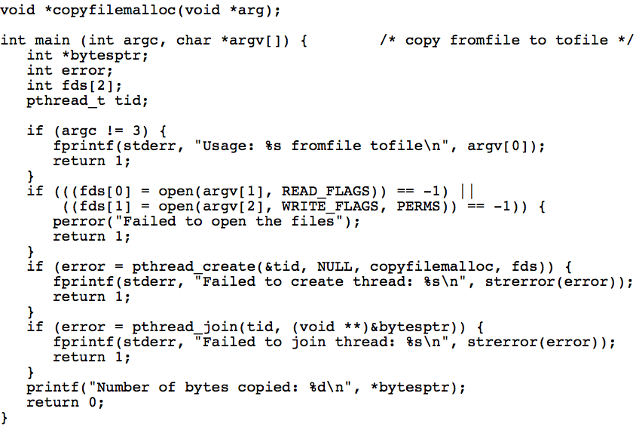
Exercise: An example to pass an array of int and get return an int value from a thread!
What will happen if we don’t use pthread_join(…)?
Notes:
Where is the number of bytes copied stored?
It cannot be in an automatic variable in copyfilemalloc.
copyfilemalloc calls malloc to create space for the value.
The calling program must free this space if it is going to run for a long time.

Slide 58
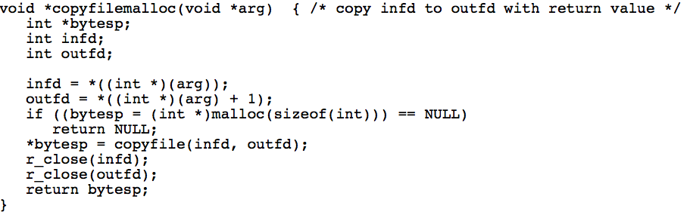
int *arr;
arr = (int *) arg;
infd = arr[0];
outfd = arr[1];
Notes:
Where is the number of bytes copied stored?
It cannot be in an automatic variable in copyfilemalloc.
copyfilemalloc calls malloc to create space for the value.
The calling program must free this space if it is going to run for a long time.

Slide 59
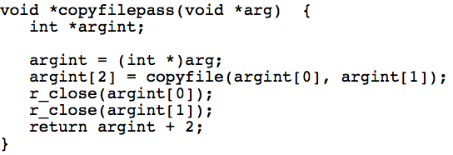
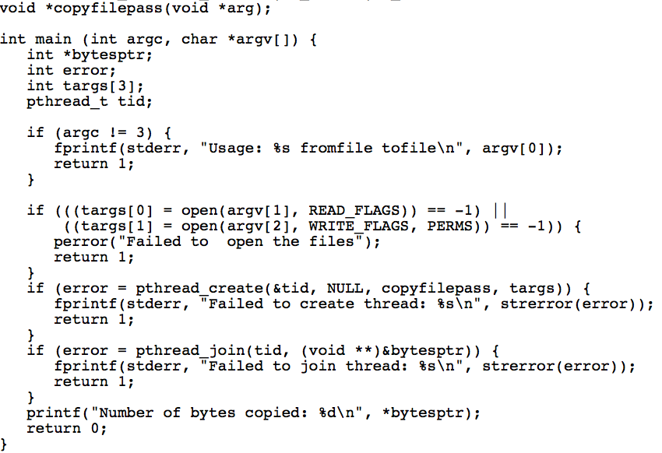
An Alternate Approach
OPT
Calling thread pre-allocate the space for return value

Slide 60
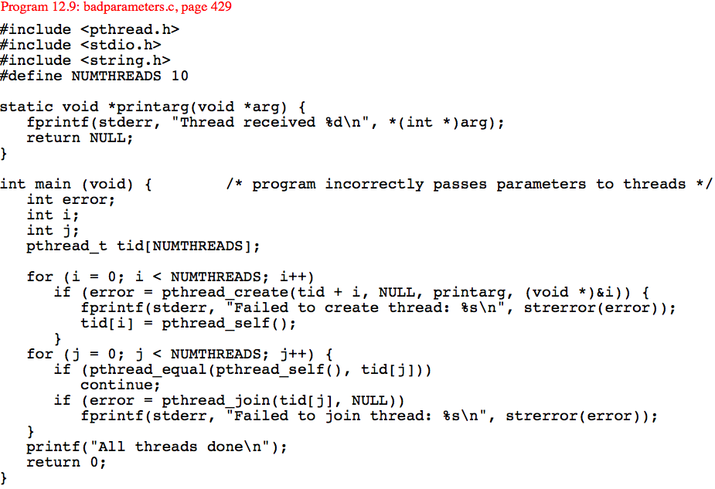
Exercise: What can be the output?
Bad Parameters
Notes:
Main thread can send t=5 but before new thread starts executing the first inst the main thread may change t to 6 and the child thread will get 6 as id not 5!
Pass it as value
Or dynamically allocate memory save value there and then pass that address
Make sure main thread do not change data after it passes the reference, which is not the case in the current implementation!

Slide 61
Exercise: What can you return from this thread?
What can be put instead of NULL in the last line?
void *whichexit(void *arg) {
int n;
int np1[1];
int *np2;
char s1[10];
char s2[] = "I am done";
n = 3;
np1[0] = n;
np2 = (int *)malloc(sizeof(int));
*np2 = n;
strcpy(s1, "Done");
return( NULL );
}
n
&n
(int *)n
np1
np2
s1
s2
"This works"
strerror(EINTR)
Suppose we have
char *s2 = "I am done";
10. s2 vs. number 7

Slide 62
Solution to Exercise…
1. The return value is a pointer, not an integer, so this is invalid.
2. The integer n has automatic storage class, so it is illegal to access it after the function terminates.
3. This is a common way to return an integer from a thread. The integer is cast to a pointer. When another thread calls pthread_join for this thread, it casts the pointer back to an integer. While this will probably work in most implementations, it should be avoided. The C standard [56, Section 6.3.2.3] says that an integer may be converted to a pointer or a pointer to an integer, but the result is implementation defined. It does not guarantee that the result of converting an integer to a pointer and back again yields the original integer.
4. The array np1 has automatic storage class, so it is illegal to access the array after the function terminates.
5. This is safe since the dynamically allocated space will be available until it is freed.
6. The array s1 has automatic storage class, so it is illegal to access the array after the function terminates.
7. The array s2 has automatic storage class, so it is illegal to access the array after the function terminates.
8. This is valid in C, since string literals have static storage duration.
9. This is certainly invalid if strerror is not thread-safe. Even on a system where strerror is thread-safe, the string produced is not guaranteed to be available after the thread terminates.

Slide 63
Exercises on passing parameters and returning values
See quiz exercises
  quiz12 (parameter pass/return struct, array)

Slide 64
THREAD SAFETY
***
A hidden problem with threads is that they may call library functions that are not thread-safe, possibly producing faulty results.

Slide 65
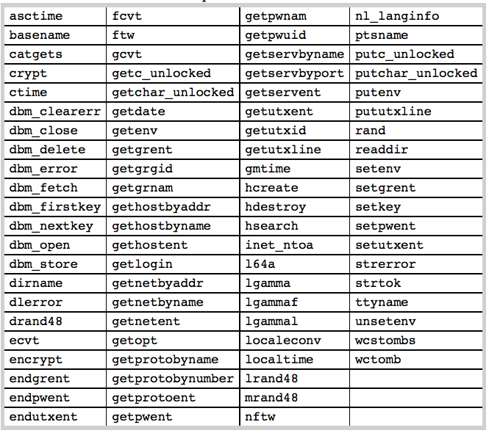
Thread Safety: Allow Threads Re-Entry
REF
Allow multiple threads to execute the functions at the same time;
Almost all system
and library functions
are safe for threads;
Except the ones in the right table:

Slide 66
Example
int count=0; char *next_label() { static char b[10]; count++; sprintf(b,"Fig. %d", count); return b; } | char *next_label() { static int count=0; char *b; b = malloc(10); if (!b) exit(); count++; sprintf(b,"Fig. %d", count); return b; }
How about count++? Is there anything wrong with that statement?

Slide 67
JAVA THREADS
THIS PART (slides 78-87)
IS FOR SELF-STUDY
Threads are fundamental model of program execution in Java. So,
Java provides a rich set of features for thread creation and management
http://docs.oracle.com/javase/7/docs/api/java/lang/Thread.html

Slide 68
How to Create Threads in Java (1)
There are two ways in Java:
1. Create a class MyTh that directly extends Thread class
  The code in MyTh.run() will be the new thread
  Then in a driver program
    MyTh th = new MyTh( … );
    th.start(); // not th.run();
  Not recommended (why?)
    A bad habit for industrial strength development
    The methods of the worker class and the Thread class get all tangled up
    Makes it hard to migrate to Thread Pools and other more efficient approaches
public class MyTh
extends Thread {
public MyTh(…){
…
}
public void run() { //overwrite this …
}
}
public class Thread {
…
public String getName();
public void interrupt();
public boolean isAlive();
public void join();
public void setDaemon(boolean on);
public void setName(String name);
public void setPriority(int level);
public static Thread currentThread();
public static void sleep(long ms);
public static void yield();
}

Slide 69

How to Create Threads in Java (2)
2. Define a class MyTh that implements Runnable interface
  The code in MyTh.run() will be the new thread
  Then in a driver program
    Thread th = new Tread( new MyTh(…) );
    th.start(); // not th.run(); why? What happens?
public class MyTh
implements Runnable {
public MyTh(…){
…
}
public void run() { //overwrite this …
}
}

Slide 70
Example 1: Extend Thread Class
.
public class SimpleThread extends Thread {
String msg;
int repetition;
public SimpleTread(String msg, int r){
this.msg = msg;
this.repetition = r;
}
public void run() {
//overwrite run method
for (int i = 0; i < repetition; i++)
System.out.println("[" + i + "]" + msg);
}
}
public class SimpleThreadMain {
public static void main(String[] args) {
SimpleThread t1 = new SimpleThread("T1", 100);
t1.start();
SimpleThread t2 = new SimpleThread("T2", 100);
t2.start();
}
}

Slide 71
Example 2: Implement Runnable interface
.
public class SimpleRunnable implements Runnable {
String msg;
int repetition;
public SimpleRunnable(String msg, int r) {
this.msg = msg;
this.repetition = r;
}
public void run( ) {
//overwrite run method
for (int i = 0; i < repetition; i++)
System.out.println("[" + i + "]" + msg);
}
}
[0]T1
[0]T2
[1]T1
[1]T2
[2]T1
[2]T2
[3]T1
[3]T2
[4]T1
…
public class SimpleRunnableMain {
public static void main(String[] args) {
SimpleRunnable r1 = new SimpleRunnable("T1", 100);
Thread t1 = new Thread(r1);
t1.start( );
SimpleRunnable r2 = new SimpleRunnable("T2", 100);
Thread t2 = new Thread(r2);
t2.start( );
}
}

Slide 72
Use join() to wait for a thread to finish
.
The join method of Thread throws InterruptedException and must be placed in a try-catch.
http://docs.oracle.com/javase/7/docs/api/java/lang/Thread.html
…
try {
t1.join( );
t1.join( );
} catch (InterruptedException e) {}
System.out.println("Both are done ");
main
[0]T1
[0]T2
[1]T1
main
[1]T2
[2]T1
[2]T2
[3]T1
main
[3]T2
[4]T1
……
Both are done
[0]T1
[0]T2
[1]T1
[1]T2
[2]T1
[2]T2
[3]T1
[3]T2
[4]T1
……
main
main
main
……
Both are done
for (int i = 0; i < 100; i++)
System.out.println(“main”);

Slide 73
Java Thread Example - Output
public class ThreadExample implements Runnable {
public void run() {
for (int i = 0; i < 3; i++)
System.out.println(i);
}
public static void main(String[] args) {
new Thread( new ThreadExample()).start();
new Thread( new ThreadExample()).start();
System.out.println("Done");
}
}
What are the possible outputs?
0,1,2,0,1,2,Done // thread 1, thread 2, main()
0,1,2,Done,0,1,2 // thread 1, main(), thread 2
Done,0,1,2,0,1,2 // main(), thread 1, thread 2
0,0,1,1,2,Done,2 // main() & threads interleaved
Why doesn’t the program quit as soon as “Done” is printed?
JVM shuts down when all non-daemon threads terminate!
In pthread, when main quits all threads are terminated!
Notes:
From http://www.cs.umd.edu/class/spring2006/cmsc132/Slides/lec34.pdf
Java threads types:
User
Daemon Provide general services Typically never terminate
Call setDaemon() before start()
Program termination
If all non-daemon threads terminate, JVM shuts down.

Slide 74
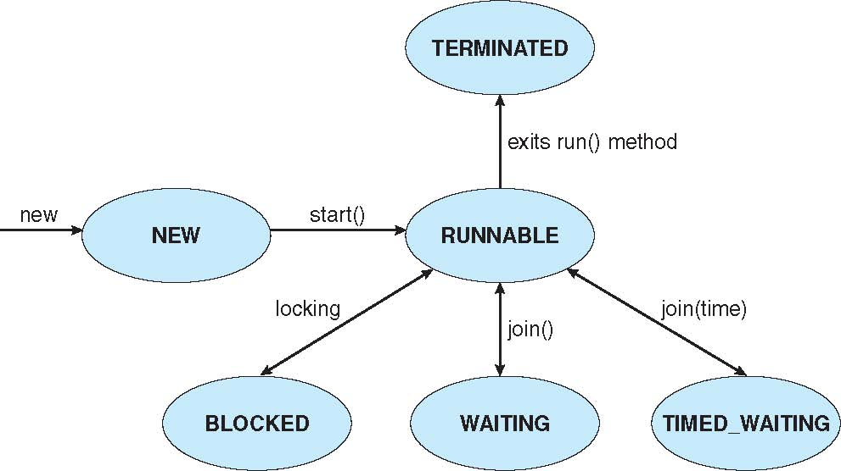
Life-Time of Java Threads
When are the thread objects created?
When do they run?
When does the program finish?
A thread object exists when it is constructed, but it doesn't start running until the start method is called.
A thread completes (or dies) when its run method finishes or when it throws an exception. The object representing this thread can still be accessed.
Notes:
New: the Thread object has been created using new,
but start() has not yet been called for it.
– Runnable: It is able to run, but currently some other
thread is being executed.
– Running: it is currently running, i.e. executing
instructions on the computer (start() has been called).
– Blocked: The thread cannot proceed until something
happens. For example, it might have called sleep() (or
it might have called wait() - see later).
– Dead: The run() method has terminated.
we can find out some information about the state of a thread at
any time thus:
if (ball.isAlive()) { ... }
• The method isAlive() returns true if the thread is running,
runnable or blocked, and returns false if it is new or dead.
– There is no way to distinguish between a new thread and a dead
thread unless the object deliberately sets a variable to say
that it has finished running!
• Also, when the run() method of a thread has terminated, we
cannot restart the thread by calling its start() again. Such a call
has no effect.
– Such a thread is dead. If we wish to “do it again”, then we must
create another new thread object (and call start() for it).

Slide 75
Transitions between Threads
Transitions between states caused by
  Invoking methods in class Thread
    start(), yield(), sleep(), wait(), join()
    The join, wait, and sleep methods of Thread throw InterruptedException and must be placed in a try-catch.
Other (external) events
  Scheduler, I/O, returning from run()…
Scheduler (ch5)
  Determines which runnable threads to run
  Part of OS or Java Virtual Machine (JVM)
  Many computers can run multiple threads simultaneously (or nearly so)

Slide 76
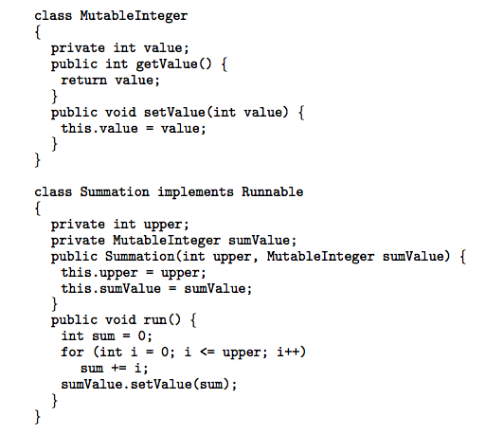
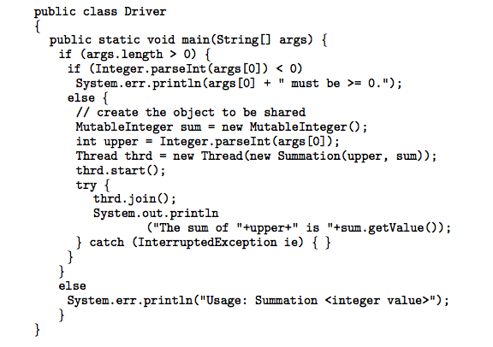
Another Example: Java Threads
Define a class that implements Runnable interface

Slide 77
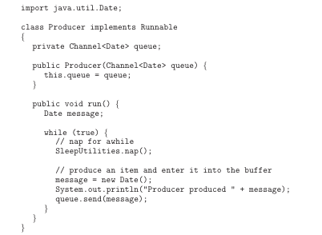
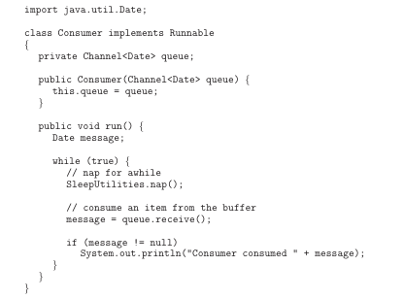
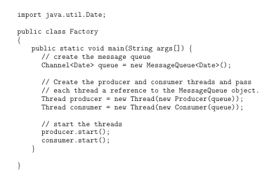
Another Example: Producer-Consumer
Define a class that implements Runnable interface

Slide 78
Java thread pool example
.
class Task implements Runnable
{
public void run() {
System.out.println("I am working on a task.");
}
}
import java.util.concurrent.*;
public class TPExample
{
public static void main(String[] args) {
int numTasks = Integer.parseInt(args[0].trim());
// create the thread pool
ExecutorService pool =
Executors.newCachedThreadPool();
// run each task using a thread in the pool
for (int i = 0; i < 5; i++)
pool.execute(new Task());
// sleep for 5 seconds
try { Thread.sleep(5000); }
catch (InterruptedException ie) { }
pool.shutdown();
}
}
Work queue
  Fixed number of threads
Possible problems
  Deadlock
  Resource thrashing
  Thread leakage
  Overload

Slide 79
THREAD ATTRIBUTES
*
REF

Slide 80
Thread Attributes
REF
pthread_t threadID;
pthread_attr_t attr;
…
pthread_create (&threadID, NULL, methodName, *para);
----------------------------------- &attr -----------------------------
Attributes of a thread behave like objects, which can be created or destroyed
  Create an attribute object (initialize with default properties)
  Modify the properties of the attribute object.
  Create a thread using the attribute object.
  It can be changed/reused without affecting thread.
  It affects the thread only at time of thread creation.
  int pthread_attr_destroy(pthread_attr_t *attr);
  int pthread_attr_init(pthread_attr_t *attr);

Slide 81
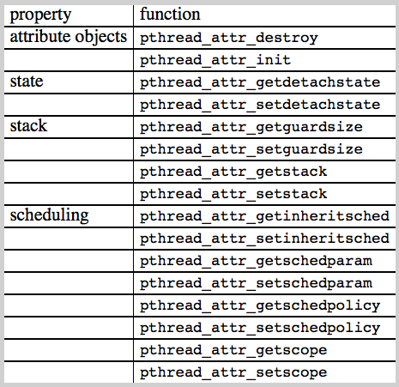
Thread Attributes (cont.)
REF
Settable properties
of thread attributes

Slide 82
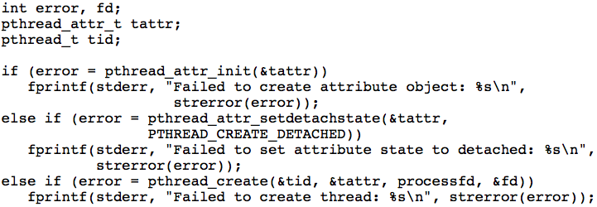
Thread States
REF
States of a thread
  PTHREAD_CREATE_JOINABLE (the default)
  PTHREAD_CREATE_DETACHED
Get/set the state of a thread
int pthread_attr_getdetachstate(const pthread_attr_t *attr, int *detachstate);
int pthread_attr_setdetachstate(pthread_attr_t *attr, int detachstate);

Slide 83
Stack of A Thread
REF
Set the location and size for the thread stack
int pthread_attr_getstack(const pthread_attr_t *restrict attr, void **restrict stackaddr, size_t *restrict stacksize);
int pthread_attr_setstack(pthread_attr_t *attr, void *stackaddr, size_t stacksize);
Set a guard for stack to protect overflow
int pthread_attr_getguardsize(const pthread_attr_t *restrict attr, size_t *restrict guardsize);
int pthread_attr_setguardsize(pthread_attr_t *attr, size_t guardsize);

Slide 84
Contention Scope of A Thread
REF
The contentionscope of a thread
  PTHREAD_SCOPE_PROCESS
  PTHREAD_SCOPE_SYSTEM
  Determines whether thread competes with other threads within a process or with other processes in the system
Get/set contentionscope of a thread
int pthread_attr_getscope(const pthread_attr_t *restrict attr, int *restrict contentionscope);
int pthread_attr_setscope(pthread_attr_t *attr, int contentionscope);

Slide 85
Thread Scheduling
REF
Inheritance of scheduling policy:
  PTHREAD_INHERIT_SCHED: the attribute object’s scheduling attributes are ignored and the created thread has the same scheduling attributes of main thread.
  PTHREAD_EXPLICIT_SCHED: the scheduling is taken from the attribute.
Get/set Inheritance of scheduling policy
int pthread_attr_getinheritsched(const pthread_attr_t *restrict attr, int *restrict inheritsched);
int pthread_attr_setinheritsched(pthread_attr_t *attr, int inheritsched);

Slide 86
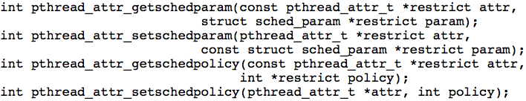
Thread Scheduling (cont.)
REF
Typical scheduling policies:
  SCHED_FIFO
  SCHED_RR and
  SCHED_OTHER
  Support is system dependent
Scheduling parameters for each policy are stored in struct sched_param: priority or quantum value

Slide 87
OTHER THREADING ISSUES
THE REST WILL BE COVERED AT THE END OF SEMESTER IF TIME PERMITS…
*
Semantics of fork() and exec() system calls
Thread cancellation of target thread
Signal handling
Thread pools
Thread-specific data
Scheduler activations

Slide 88
Semantics of fork() and exec()
What will happen if one thread in a process call fork( ) to create a new process?
  Does fork() duplicate only the calling thread or all threads?
  How many threads in the new process?
Duplicate only the invoking thread
  exec(): will load another program
  Everything will be replaced anyway
Duplicate all threads
  If exec() is not the next step after forking
  What about threads performed blocking system call?!

Slide 89
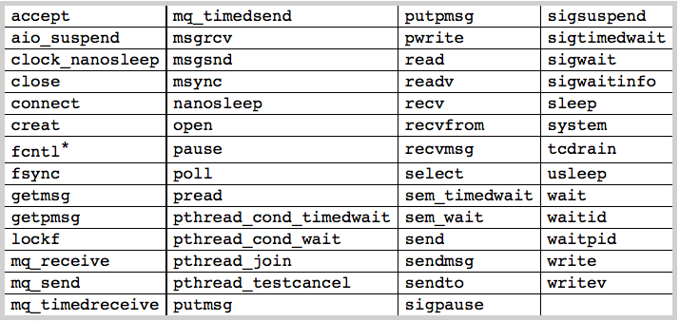
Thread Cancellation
Terminating a thread before it has finished
  Examples
    Threads search in parallel of database:
    one finds → others stop
    Stop fetching web contents (images)
Two general approaches:
  Asynchronous cancellation terminates the target thread immediately
    - Thread resources and data consistency
  Deferred cancellation allows the target thread to periodically check if it should be cancelled
    + Wait for self cleanup → cancellation safety points

Slide 90
Thread Cancellation (cont.)
After making the request
  pthread_cancel returns
  Does not mean the target thread has terminated
Thread’s and states
  PTHREAD_CANCEL_ENABLE : default state
  PTHREAD_CANCEL_DISABLE
  A thread receives cancel request if it enters enable state
A thread can change its state with
int pthread_setcancelstate(int state,
int *oldstate);

Slide 91
Thread Cancellation (cont.)
Possible cancellation types
  PTHREAD_CANCEL_ASYNCHRONOUS: act on requests at any time
  PTHREAD_CANCEL_DEFERRED: at on request only at cancellation points
  set the cancellation type with pthread_setcanceltype
int pthread_setcanceltype(int type, int *oldtype);
Cancellation points
  Certain blocking functions cause cancellation points
  Set a cancellation point with pthread_testcancel
void pthread_testcancel(void);

Slide 92
POSIX Functions: Cancellation Points
REF
These functions can always be cancellation points!
There are other functions that maybe or cannot be!

Slide 93
Signal Handling
Signal is generated by particular event
Signal is delivered to a process
Signal is handled
Signals are used in UNIX systems to notify a process that a particular event has occurred.
  Depending on the source, we can classify them as
    Synchronously [Running prog generates it] (e.g., div by 0, memory access)
    Asynchronously [External src generates it] (e.g., ready of I/O or Ctrl+C)
Which threads to notify?
  All threads (Ctrl-C)
  Single thread to which the signal applies (illegal memory, div by 0)
  Subset of threads: thread set what it wants (mask)
  Thread handler: kernel default or user-defined
Unix allows threads to specify which one to block or accept
Windows has no support for signals but it can be emulated

Slide 94
Thread Pool
Recall web server example,
  We created a thread for every request
  This is better than creating a process, but still time consuming
  No limit is put on the number of threads
Pool of threads
  Create some number of treads at the startup
  These threads will wait to work and put back into pool
Advantages:
  Usually slightly faster to service a request with an existing thread than create a new thread
  Allows the number of threads in the application(s) to be bound to the size of the pool
Adjust thread number in pool
  According to usage pattern and system load

Slide 95
Thread Pool Example: Web server
.
Dispatcher
thread
while(TRUE) {
getNextRequest(&buf);
handoffWork(&buf);
}
Worker
thread
while(TRUE) {
waitForWork(&buf);
lookForPageInCache(&buf,&page);
if(pageNotInCache(&page)) {
readPageFromDisk(&buf,&page);
}
returnPage(&page);
}
Kernel
Web page
cache
Network
connection
Notes:
. Concept of thread-pool?

Slide 96
Thread Specific Data
Allows each thread to have its own copy of data
We may not want to share all data
Thread libraries have support for this
Useful when you do not have control over the thread creation process (i.e., when using a thread pool)

Slide 97
Scheduler Activations
Both M:M and Two-level models require communication to maintain the appropriate number of kernel threads allocated to the application
Scheduler activations provide upcalls - a communication mechanism from the kernel to the thread library
  Events to invoke upcall
    A thread make a blocking system calls
    A blocking system call complete returns
    To ask user-level thread scheduler (runtime systems) to select the next runnable thread
This communication allows an application to maintain the correct number of kernel threads

Slide 98
OPERATING SYSTEM EXAMPLES
SKIP THE REST
Windows XP Threads
Linux Thread

Slide 99
Windows XP Threads
Implements the one-to-one mapping, kernel-level
Each thread contains
  A thread id
  Register set
  Separate user and kernel stacks
  Private data storage area
The register set, stacks, and private storage area are known as the context of the threads
The primary data structures of a thread include:
  ETHREAD (executive thread block)
  KTHREAD (kernel thread block)
  TEB (thread environment block)

Slide 100
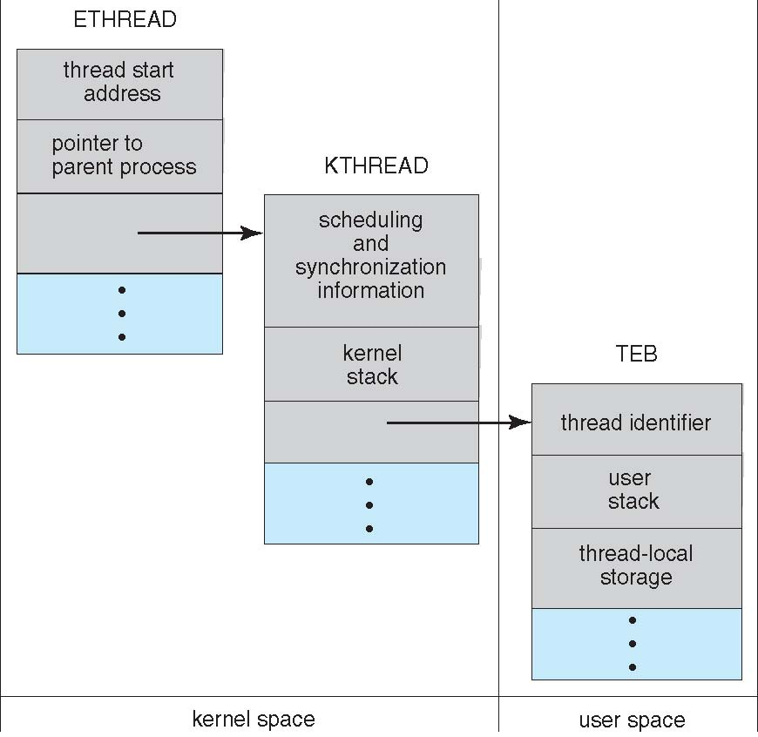
Windows XP Threads

Slide 101
Linux Threads
*
Linux uses the term task (rather than process or thread) when referring to a flow of control
Linux provides clone() system call to create threads
  A set of flags, passed as arguments to the clone() system call determine how much sharing is involved (e.g. open files, memory space, etc.)
Linux: 1-to-1 thread mapping
  NPTL (Native POSIX Thread Library)

Slide 102
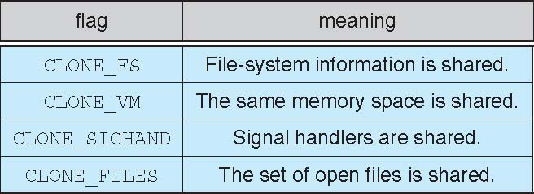
Linux Threads

