Slide 1
CS 3733 Operating Systems
Topics: Process (Thread) Synchronization
(SGG, Ch 5 in 9th Ed Ch 6 in Old Ed)
(USP, Chapter 13-14)
Get processes (threads) to work together in a coordinated manner.
Instructor: Dr. Turgay Korkmaz
Department Computer Science
The University of Texas at San Antonio
Office: NPB 3.330
Phone: (210) 458-7346
Fax: (210) 458-4437
e-mail: korkmaz@cs.utsa.edu
web: www.cs.utsa.edu/~korkmaz
These slides are prepared based on the materials provided by the textbook [SGG] .

Slide 2
Process Synchronization
Background **
  Problems with concurrent access to
  shared data (Race condition)
The Critical-Section Problem *****
Peterson’s Solution *****
Synchronization mechanisms
  Hardware support: e.g., GetAndSet TestAndSet ***
  Software solution: e.g., Semaphore *****
Classic Problems of Synchronization ****
Monitors ***
Java Synchronization ***
Pthread Synchronization ***
Atomic Transactions (more later in Dist. Sys)

Slide 3
Objectives
To introduce the critical-section problem, whose solutions can be used to ensure the consistency of shared data
To present both software and hardware solutions of the critical-section problem
To introduce the concept of an atomic operation and describe mechanisms to ensure atomicity

Slide 4
BACKGROUND
Shared data
at the same logical address space √
at different address space through messages (later in Dist Sys)

Slide 5
Shared Data
> java BalanceMain
Both threads are done ...
Final BALANCE is 0.0
Computed BALANCE is 0.0
> java BalanceMain
Both threads are done ...
Final BALANCE is -3256.0
Computed BALANCE is 0.0
> java BalanceMain
Both threads are done ...
Final BALANCE is -5230.5
Computed BALANCE is 0.0
> java BalanceMain
Both threads are done ...
Final BALANCE is -10890.0
Computed BALANCE is 0.0
Concurrent access to shared data may result in data inconsistency (how/why)
Recall the Quiz 13 (deposit and withdraw threads)
  What was happening?
  Thread 1: B = B + a
  Thread 2: B = B - d
Maintaining data consistency requires synchronization mechanisms to ensure the orderly execution of cooperating processes/threads

Slide 6
Quiz 13 - solution ?
// how about if we have
paramT *dep, *with;
#include <stdio.h>
#include <stdlib.h>
#include <pthread.h>
double BALANCE = 0.0;
typedef struct param {
int x;
double y;
} paramT;
void *deposit(void *args){
int i;
paramT *ptr=(paramT*)args;
for(i=0; i<ptr->x; i++)
BALANCE += ptr->y; // b
}
void *withdraw(void *args){
int i;
paramT *ptr=(paramT*)args;
for(i=0; i<ptr->x; i++)
BALANCE -= ptr->y; // d
}
int main(int argc, char *argv[]){
paramT dep, with;
pthread_t t1, t2;
dep.x=atoi(argv[1]); // a
dep.y=atof(argv[2]); // b
//… similarly get c d
pthread_create(&t1,NULL,
deposit, &dep);
pthread_create(&t2,NULL,
withdraw, &with);
pthread_join(t1,NULL);
pthread_join(t2,NULL);
total = (dep.x * dep.y) –
(with.x * with.y);
printf(“B=%lf vs T=%lf\n”,
BALANCE,total);
return 0;
}

Slide 7
public class Balance {
double BALANCE=0.0;
public Balance(double value){ BALANCE = value; }
public void add(double b) { BALANCE += b; }
public void sub(double d) { BALANCE -= d; }
public double get() { return BALANCE; }
}
public class DepositRunnable implements Runnable {
Balance BALANCE; int a; double b;
public void run() {
for (int i = 0; i < a; i++)
BALANCE.add(b);
}
public DepositRunnable(Balance
BALANCE, int a, double b) {
this.BALANCE = BALANCE;
this.a = a;
this.b = b;
}
}
synchronized
public class BalanceMain {
public static void main(String[] args) {
Balance BALANCE = new Balance(0.0);
int a=10000, c=10000;
double b=5.5, d=5.5;
Thread deposit = new Thread(
new DepositRunnable(BALANCE, a, b) );
Thread withdraw = new Thread(
new WithdrawRunnable(BALANCE, c, d) );
deposit.start( );
withdraw.start( );
try {
deposit.join( );
withdraw.join( );
} catch (InterruptedException e) { }
System.out.println("Both threads are done ...\n");
System.out.println("Final BALANCE is " + BALANCE.get() );
System.out.println("Computed BALANCE is " + (a*b-c*d) );
}
}
public class WithdrawRunnable implements Runnable {
Balance BALANCE; int c; double d;
public void run() {
for (int i = 0; i < c; i++)
BALANCE.sub(d);
}
public WithdrawRunnable(Balance
BALANCE, int c, double d) {
this.BALANCE = BALANCE;
this.c = c;
this.d = d;
}
}

Slide 8
Quiz 13 - solution - corrected
#include <stdio.h>
#include <stdlib.h>
#include <pthread.h>
double BALANCE = 0.0;
pthread_mutex_t lock;
struct param {
int x;
double y;
};
void *deposit(void *args){
int i;
struct param *ptr=
(struct param *) args;
for(i=0; i<ptr->x; i++) {
pthread_mutex_lock(&lock);
BALANCE += ptr->y; // b
pthread_mutex_unlock(&lock);
}
}
void *withdraw(void *args){
int i;
struct param *ptr =
(struct param *) args;
for(i=0; i<ptr->x; i++) {
pthread_mutex_lock(&lock);
BALANCE -= ptr->y; // d
pthread_mutex_unlock(&lock);
}
}
int main(int argc, char *argv[]){
struct param dep, with;
pthread_t t1, t2;
pthread_mutex_init(&lock,NULL);
dep.x=atoi(argv[1]); // a
dep.y=atof(argv[2]); // b
//… similarly get c d
pthread_create(&t1,NULL,
deposit, &dep);
pthread_create(&t2,NULL,
withdraw, &with);
pthread_join(t1,NULL);
pthread_join(t2,NULL);
total = (dep.x * dep.y) –
(with.x * with.y);
printf(“B=%lf vs T=%lf\n”,
BALANCE,total);
return 0;
}

Slide 9
Example1:
Concurrent Access to Shared Data
.
Two processes/threads A and B have access to a shared global variable “Balance”
Thread deposit: Thread withdraw:
BALANCE = BALANCE + 100 BALANCE = BALANCE - 200
How will they be implemented using machine code?
  A1. LOAD R1, BALANCE
  A2. ADD R1, 100
  A3. STORE BALANCE, R1
  B1. LOAD R2, BALANCE
  B2. SUB R2, 200
  B3. STORE BALANCE, R2
Notes:
. Shared account: husband/wife;
. multiple thread/processes, different code sections
. Multiple Machine instructions

Slide 10
What is the problem then?
.
Observe: In a time-shared system the exact instruction execution order cannot be predicted
Scenario 1:
A1. LOAD R1, BALANCE
A2. ADD R1, 100
A3. STORE BALANCE, R1
Context Switch!
B1. LOAD R2, BALANCE
B2. SUB R2, 200
B3. STORE BALANCE, R2
Sequential correct execution
Balance is effectively decreased by 100!
Scenario 2:
B1. LOAD R2, BALANCE
B2. SUB R2, 200
Context Switch!
A1. LOAD R1, BALANCE
A2. ADD R1, 100
A3. STORE BALANCE, R1
Context Switch!
B3. STORE BALANCE, R2
Mixed wrong execution
Balance is effectively decreased by 200!
Notes:
. Sequential execution is always correct, which is what we want to achieve;
. Mixed execution have different versions; not always wrong

Slide 11
Example 2: Producer/Consumer Problem
The producer/consumer problem
  A producer process/thread produces/generates data
  A consumer process/thread consumes/uses data
  Buffer is normally used to exchange data between them
Bounded buffer: shared by producer/consumer
  The buffer has a finite amount of buffer space
  Producer must wait if no buffer space is available
  Consumer must wait if all buffers are empty (no data is available)

Slide 12
Bounded Buffer: A Simple Implementation
Shared circular buffer of size BSIZE
item_t buffer[BSIZE];
int in, out, count;
  in points to the next free buffer
  out points to the first full buffer
  count contains the number of full buffers
  Initially set all to 0.
if count == 0
  No data available in the buffer. Who should wait?
if count == BSIZE
  No available space to store data. Who should wait?
Otherwise, …

Slide 13
Bounded Buffer: A Simple Implementation
// Producer
while (count == BSIZE) ; // do nothing, wait
// add an item to the buffer
buffer[in] = item;
in = (in + 1) % BSIZE;
++count;
// Consumer
while (count == 0) ; // do nothing, wait
// remove an item from buffer
item = buffer[out];
out = (out + 1) % BSIZE;
--count;
Notes:
Provide a consumer thread and a producer thread that use the shared buffers.
Have an integer count that keeps track of the number of full buffers. Initially, count is set to 0.
It is incremented by the producer after it produces a new buffer and
It is decremented by the consumer after it consumes a buffer.

Slide 14
What is the problem here?
count++ could be implemented as
register1 = count
register1 = register1 + 1
count = register1
count-- could be implemented as
register2 = count
register2 = register2 - 1
count = register2
Consider this execution interleaving with “count = 5” initially:
  T0: producer execute register1 = count {register1 = 5}
  T1: producer execute register1 = register1 + 1 {register1 = 6}
  T2: consumer execute register2 = count {register2 = 5}
  T3: consumer execute register2 = register2 – 1 {register2 = 4}
  T4: producer execute count = register1 {count = 6 }
  T5: consumer execute count = register2 {count = 4}
How many different interleaving can we have?
Race Condition (RC)
Notes:
abc klm

Slide 15
Race Conditions
Race Condition (RC): the outcome of an execution depends on the particular order in which the accesses to shared data takes place
RC is a serious problem for concurrent systems using shared variables!
To solve it, we need to make sure that
only one process executes some shared high-level code sections (e.g., count++) known as critical sections (CS)
  In other words, CS must be executed atomically
  Atomic operation means that it completes in its entirety without worrying about interruption by any other potentially conflict-causing process
Notes:
. Need some sort of synchronization to ensure the atomicity;

Slide 16

Mutual Exclusion - atomic execution
register1 = count
register1 = register1 + 1
count = register1
count++
Thread
Thread
count--
register2 = count
register2 = register2 – 1
count = register2
Making these two concurrent and cooperating processes/threads work together in a coordinated manner is known as synchronization
Notes:
. Critical section for same shared data;

Slide 17
What was Synchronization?
orderly execution of concurrent and cooperating processes/threads
Concurrent executions
  Single processor → achieved by time slicing
  Parallel/distributed systems → truly simultaneous
Independent processes/threads | Cooperating processes/threads
do not share data and thus no effect on each other | share data and thus have effects on each other
Executions of are reproducible | executions are NOT reproducible with non-deterministic execution speed
No need for synchronization | We need synchronization
Synchronization → making concurrent and cooperating processes/threads to work together in a coordinated manner so the race conditions will be avoided!

Slide 18
Exercise
Implement a program to solve Bounded Buffer Problem.
> prog BSIZE n
Assume that
  Producer will generate n integer numbers as 1, 2, 3 , …, n, and put each into a buffer.
  Consumer will get the numbers from the buffer and compare each with the expected number. If the received number is different than the expected number, give an error message, stop the thread and return -1; if all n numbers are received in the expected order, the tread returns 1
First, do not use any synchronization and observe what is happing with different parameters?
Second, fix the program using synchronization…

Slide 19
Recall The Simple Implementation
for(item=1; item <= n; item++) {
  // Producer
  while (count == BSIZE) ; // do nothing, wait
  // add an item to the buffer
  buffer[in] = item;
  in = (in + 1) % BSIZE;
  ++count;
}
for(expected=1; expected <= n; expected++) {
  // Consumer
  while (count == 0) ; // do nothing, wait
  // remove an item from buffer
  item = buffer[out]; out = (out + 1) % BSIZE;
  --count;
  if(item != expected ) return -1;
}
return 1;

Slide 20
#include <stdio.h>
#include <stdlib.h>
#include <pthread.h>
int in=0, out=0, count=0, count2=0, BSIZE=0;
int *buffer;
pthread_mutex_t lock;
void *producer(void *args){
int item;
int n = *(int *)args;
for(item=1; item <= n; item++) {
while (count == BSIZE) ; // do nothing
buffer[in] = item; // add an item to buffer
in = (in + 1) % BSIZE;
++count2;
}
}
pthread_mutex_lock( &lock ) ;
++count;
pthread_mutex_unlock( &lock );

Slide 21
void *consumer(void *args){
int item, expected;
int n = *(int *)args;
int *res = (int *) malloc(sizeof(int));
// if null ?
*res=-1;
for(expected=1; expected <= n; expected++) {
while (count == 0) ; // do nothing
item = buffer[out]; // remove an item from buffer
if(item != expected ) return res;
out = (out + 1) % BSIZE;
--count2;
}
*res=1;
return res;
}
pthread_mutex_lock( &lock ) ;
--count;
pthread_mutex_unlock( &lock );

Slide 22
int main(int argc, char *argv[]){
pthread_t t1, t2;
int n, *res;
pthread_mutex_init( &lock, NULL );
BSIZE = atoi(argv[1]);
n = atoi(argv[2]);
buffer = (int *) malloc(sizeof(int)*BSIZE);
// if NULL
pthread_create(&t1, NULL, producer, &n);
pthread_create(&t2, NULL, consumer, &n);
pthread_join(t1,NULL);
pthread_join(t2,(void **)&res);
printf(" consumer returned %d \n", *res);
return 0;
}
printf("count=%d vs. count2=%d\n", count, count2);
Notes:
Declare int count2=0;
Then add count2++; and count2--; after count++ and count--; respectively in each thread
Finally protect count with a lock while leaving count2 unprotected…
Then you will see the difference when you print both!

Slide 23
CRITICAL-SECTION (CS) PROBLEM
Multiple processes/threads compete to use some shared data
Solutions
  SW based (e.g., Peterson’s solution, Semaphores, Monitors) and
  HW based (e.g., Locks, disable interrupts, atomic get-and-set instruction )

Slide 24
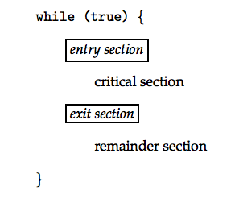
Critical-Section (CS) Problem
Cooperating processes or threads compete to use some shared data in a code segment, called critical section (CS)
If the instructions in CS are executed in an interleaved manner, race condition (RC) will happen!
CS Problem is to ensure that only one process is allowed to execute in its CS (for the same shared data) at any time (mutual exclusion)
Each process must request permission to enter its CS
(allow or wait)
CS is followed by exit and remainder sections.
//Th1
// count++
reg1 = count
reg1 = reg1 + 1
count = reg1
// Th2
// count- -;
reg2 = count
reg2 = reg2 – 1
count = reg2

Slide 25
Requirements for the Solutions to Critical-Section Problem
  Mutual Exclusion – If process P_{i} is executing in its critical section, then no other processes can be executing in their critical sections. (At most one process is in its critical section at any time.)
Progress - If no process is executing in its critical section and there exist some processes that wish to enter their critical section, then only the ones that are not busy in their reminder sections must compete and one should be able to enter its CS (the selection cannot be postponed indefinitely to wait a process executing in its remainder section).
Bounded Waiting - A bound must exist on the number of times that other processes are allowed to enter their critical sections after a process has made a request to enter its critical section and before that request is granted.
  Assume that each process executes at a nonzero speed
  No assumption concerning relative speed of the N processes
Notes:
. Requirements for the solutions
. Arbitrary speed: context switch can happen anywhere anytime?!

Slide 26
Mutual Exclusion
  If process P_{i} is executing in its critical section, then no other processes can be executing in their critical sections.
  At most one process is in its critical section at any time.
Notes:
. Recall the atomicity requirement;
. What is the “permission”? → lock, for modify shared data → CS is as small as possible
. Principle of CS: as small/fast as possible! Example: signature from chair/president/boss; get fully prepared before you go!!!

Slide 27
Progress
If no process is executing in its critical section and there exist some processes that wish to enter their critical section,
then only the ones that are not busy in their reminder sections must compete and one should be able to enter its CS
the selection cannot be postponed indefinitely to wait a process executing in its remainder section.

Slide 28
Bounded Waiting
A bound must exist on the number of times that other processes are allowed to enter their critical sections after a process has made a request to enter its critical section and before that request is granted.
  Assume that each process executes at a nonzero speed
  No assumption concerning relative speed of the N processes
Notes:
. Recall the atomicity requirement;
. What is the “permission”? → lock, for modify shared data → CS is as small as possible
. Principle of CS: as small/fast as possible! Example: signature from chair/president/boss; get fully prepared before you go!!!

Slide 29
RC and CS in OS kernel code
Suppose two processes try to open files at the same time, to allocate memory etc.
Two general approach
  Non-preemptive kernel (free from RC, easy to design)
  Preemptive kernel (suffer from RC, hard to design)
Why, then, would we want non-preemptive kernel
  Real-time systems
  Avoid arbitrarily long kernel processes
  Increase responsiveness
Later, you will study how various OSes manage preemption in the kernel

Slide 30
PETERSON'S SOLUTION
Suppose load and store are atomic!

Slide 31
Here is a software solution to CS
Suppose we have two processes/threads and a shared
variable turn, which is initially set to 0 or 1;
say turn is 0
Process 0: Process 1:
--------- ---------
while(TRUE) { while(TRUE) {
while (turn == 1) ; while (turn == 0) ;
critical section critical section
turn = 1; turn = 0;
remainder section remainder section
} }
Is this correct or incorrect? Why?
Think about mutual exclusion, progress, bounded waiting
Strict alternation
Notes:
Turn is 0, but proc 0 is in rem section working on something….

Slide 32
Here is a corrected solution to CS
Known as Peterson's solution
Process 0: Process 1:
--------- ---------
while(TRUE) { while(TRUE) {
flag[0] = 1; // I am ready flag[1] = 1;
turn = 1; turn = 0;
while (flag[1]==1 && while (flag[0]==1 &&
turn == 1) ; turn == 0) ;
critical section critical section
flag[0] = 0; // I am not ready flag[1] = 0;
remainder section remainder section
} }
The variable turn indicates whose turn it is to enter the critical section.
The flag array is used to indicate if a process is ready to enter the critical section. flag[i] = true implies that process P_{i} is ready!
If I am not ready, the other process can enter CS even if it is not its turn..
So we avoid strict alternation…. How about bounded waiting?

Slide 33
Does Peterson’s Solution
Satisfy the Requirements
Mutual Exclusion
  P0 enters CS only if either flag[1] is false or turn=0
  P1 enters CS only if either flag[0] is false or turn=1
  If both are in CS then both flag should be true, but then turn can be either 0 or 1 but cannot be both
Progress
Bounded-waiting
Process 0: Process 1:
--------- ---------
while(TRUE) { while(TRUE) {
flag[0] = 1; flag[1] = 1;
turn = 1; turn = 0;
while (flag[1]==1 && * while (flag[0]==1 &&
turn == 1) ; turn == 0) ;
critical section * critical section
flag[0] = 0; flag[1] = 0;
remainder section remainder section
} }
Notes:
Bounded waiting: requesting process will wait at most one entry by the other because it will be waiting in the while loop and after the current process (say 0) is done, it will say it is not ready and the other process will go ahead an enter the CS

Slide 34
Peterson’s Solution +/-
Software solution for two processes/threads (T0 and T1): alternate between CS and remainder codes
Assume that the LOAD and STORE instructions are atomic (cannot be interrupted).
Otherwise, and actually it cannot be guaranteed that this solution will work on modern architectures
But still it is a good algorithmic solution to understand the synchronization requirements: mutual exclusion, progress, bounded waiting
// process i, j=1-i
do {
flag[i] = true;
turn = j;
while (flag[j] &&
turn == j) ;
critical section
flag[i] = false;
remainder section
} while(1);

Slide 35
SYNC HARDWARE
Many systems provide hardware support for critical section code

Slide 36
Solution to Critical-Section Problem
Using Locks
SW-based solutions are not guaranteed to work on modern architectures, why?
In general we need a LOCK mechanism which could be based on HW (easy and efficient) or SW (quite sophisticated) ….
So we will now study HW based supports first.
while (true) {
acquire lock
critical section
release lock
remainder section
}

Slide 37
Synchronization Hardware
Uniprocessors – could disable interrupts
  Currently running code would execute without preemption
  Generally too inefficient on multiprocessor systems
    Operating systems using this are not broadly scalable
    Clock updates!
Modern machines provide special atomic (non-interruptible) hardware instructions
  Test memory word and set value
  Swap contents of two memory words
  Lock the bus not the interrupt, not easy to implement on multiprocessor systems
do {
……
DISABLE INTERRUPT
critical section
ENABLE INTERRUPT
Remainder statements
} while (1);
do {
……
acquire lock
critical section
release lock
Remainder statements
} while (1);
Notes:
. Disable interrupt → ensure there is no context switch
. Problems:
.. miss important interrupts events
.. Not work for multiprocessor systems
.. Machine dependent

Slide 38
Hardware Support for Synchronization
Synchronization
  Need to test and set a value atomically
IA32 hardware provides a special instruction: xchg
  When the instruction accesses memory, the bus is locked during its execution and no other process/thread can access memory until it completes!!!
  Other variations: xchgb, xchgw, xchgl
In general, we have hardware instructions
  GetAndSet (a) or TestAndSet(a)
  Swap (a,b)

Slide 39
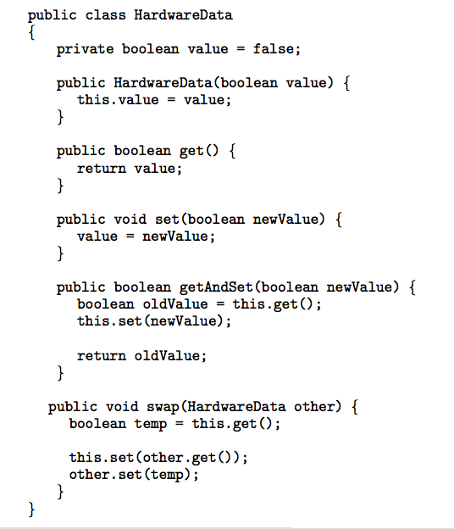
Data Structure for Hardware Solutions
Suppose these methods and
functions are atomic
//int TestAndSet(int *target)
int GetAndSet(int *target)
{
int m = *target;
*target = TRUE;
return m;
}
void Swap(int *a, int *b)
{
int temp = *a;
*a = *b;
*b = temp:
}

Slide 40
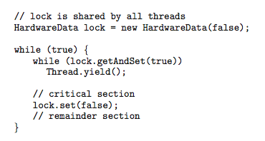
Solution using GetAndSet Instruction
lock = FALSE;
while(1) {
……
while (GetAndSet(&lock)) ;
critical section
lock = FALSE; //free the lock
remainder section
}
spin-locks → busy waiting;
Waiting processes loop continuously at the entry point; waste cpu cycles
User space threads might not give control to others !
Hardware dependent; and NO Bounded waiting!!

Slide 41
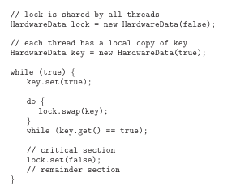
Solution using Swap Instruction
lock = FALSE
while(1){
… …
key = TRUE;
while (key == TRUE)
Swap(&lock, &key );
Critical Section;
lock = FALSE //release the lock
remainder section
}
Notes:
. Shared Boolean variable
. Lock = FASLE
. Each process has a local Boolean variable key
key = TRUE;
while ( key == TRUE) Swap (&lock, &key );
// critical section
lock = FALSE

Slide 42
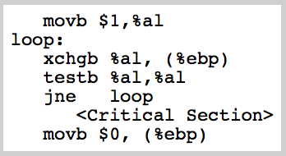
An Example Using xchgb
OPT
The solution only works because the xchgb – swap is atomic!
Suppose %ebp contains the address of a byte (lock)
  it is used to lock a critical section
  1 → in use; 0 → available
  testb %al, %al →
  set ZF (zero flag) if %al contains 0
lock = FALSE
while(1){
… …
key = TRUE;
while( (key == TRUE)
Swap(&lock, &key );
Critical Section;
lock = FALSE
remainder section
}
Notes:
Problems with previously discussed methods:
not easily generalized
not easy to apply to other types of problems

Slide 43
What is the problem with solutions so far!
Mutual exclusion √
Progress √
Bounded waiting ?

Slide 44
Exercise
Self-study
Write a general solution to synchronize n processes
// shared data structures
int waiting[n]={0}; // to enter CS
int lock=0;
// code for P_i
do {
Entry section
// CS
Exit Section
// Remainder
// Section
} while(1);
waiting[i] = 1;
key = 1;
while(waiting[i] && key)
key = GetAndSet(&lock);
waiting[i] = 0;
j = (i+1) % n;
while((j!=i) && !waiting[j])
j = (j+1) % n;
if (j == i)
lock=0;
else
waiting[j] = 0

Slide 45
SEMAPHORES
*****
Initial SW-based solutions may not work in modern systems
Hardware instructions may be complicated for programmers
Both solutions use spin-locks, wasting CPU time…
We need synchronization support to deal with these problems
A software-based solution….

Slide 46
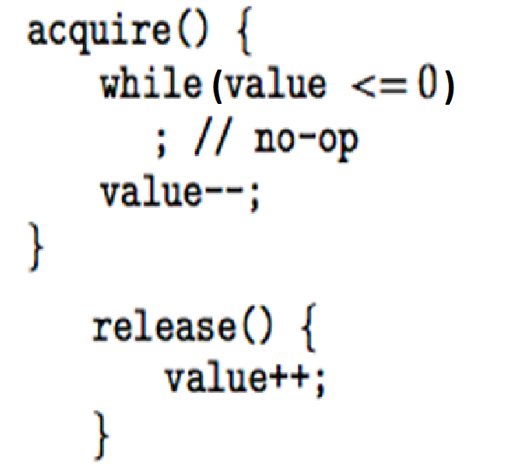
Semaphore
Semaphore S – integer variable
Can only be accessed via two
indivisible (atomic) operations
  acquire() and release()
  Originally called P() and V(),
  Also called: wait() and signal(); or
  down() and up()
How can we make acquire() and release() atomic? (More later)
  Busy waiting (spinlock) can be avoided by blocking a process execution until some condition is satisfied
First let us focus on their usage
  Easy to generalize, and less complicated for application programmers
// sem_wait()
block
queue
// sem_post()

Slide 47
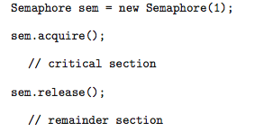
Semaphore Usage
Counting semaphore – integer value can range over an unrestricted domain
  Can be used to control access to a given resources consisting of finite number of instances
Binary semaphore – integer value can range only between 0 and 1; Also known as mutex locks
S = number of resources
while(1){
……
sem_wait(S);
use one of S resource
sem_post(S);
remainder section
}
mutex = 1
while(1){
……
sem_wait(mutex);
Critical Section
sem_post(S);
remainder section
}

Slide 48
Semaphore Usage (cont’d)
Also used for synchronization between different processes
Suppose we require S2 to be executed after S1 is completed
How can we synchronize these two processes?
Declare a sync semaphore and initially set it to 0
// Thread1
…
S1();
…
// Thread2
…
S2();
…
// Proc1
…
S1();
sem_post(sync); // sync.release;
…
// Proc2
…
sem_wait(sync);// sync.acquire
S2();
…

Slide 49
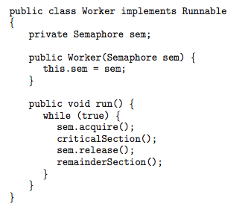
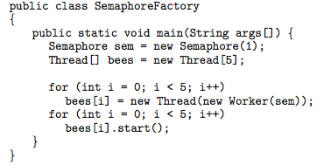
Java Example Using Semaphores
criticalSection() {
Balance = Balance – 100;
}
We did not use join in main!
What will happen to other threads when main() exits?
Notes:
Main thread exits but the other threads will continue executing

Slide 50
Pthread Example Using Semaphores
#include <pthread.h>
#include <semaphore.h>
#include <stdio.h>
#include <stdlib.h>
#define NUM_THREADS 5
sem_t sem;
……
T0 Critical Section
T0 Remainder Section
T0 Critical Section
T0 Remainder Section
T0 Critical Section
T0 Remainder Section
T0 Critical Section
T0 Remainder Section
T1 Critical Section
T1 Remainder Section
T3 Critical Section
T3 Remainder Section
T3 Critical Section
T3 Remainder Section
T4 Critical Section
T4 Remainder Section
T4 Critical Section
T4 Remainder Section
T4 Critical Section
T0 Critical Section
T4 Remainder Section
T4 Critical Section
T0 Remainder Section
T3 Critical Section
T3 Remainder Section
T2 Critical Section
T4 Remainder Section
T4 Critical Section
T2 Remainder Section
T2 Critical Section
T0 Critical Section
T4 Remainder Section
T2 Remainder Section
T0 Remainder Section
T3 Critical Section
T3 Remainder Section
void *Worker(void *args) {
long id = (long)args;
int i=100;
while(i--){
sem_wait(&sem);
printf(" T%ld Critical Section\n", id);
sem_post(&sem);
printf(" T%ld Remainder Section\n", id);
}
}
int main(int argc, char *argv[]){
long t; pthread_t threads[NUM_THREADS];
sem_init(&sem, 0, 1);
for(t=0;t<NUM_THREADS;t++)
pthread_create(&threads[t], NULL, Worker, (void *)t);
for(t=0;t<NUM_THREADS;t++)
pthread_join(threads[t], (void **)NULL);
printf(" All threads are done t\n" );
pthread_exit(NULL);
}
// int id = (int)args; ???????
// int id = *(int *)args; // &t
We used join in main!
What would happen to other threads if we did not?
Notes:
// int id = (int)args;
// int id = *(int *)args;
pthread_create(&threads[t], NULL, Worker, (void *)&t);
------------------
phtread_exit makes main thread quit but the other threads continue to execute.
If we remove pthread_exit too then the process will terminate…

Slide 51
POSIX: SEM: Unnamed Semaphores
#include <semaphore.h>
Type sem_t
  sem_t s; //declares a semaphore variable s
A semaphore has to be initialized!
  int sem_init(sem_t *s, int pshared, unsigned value);
  pshared: 0 →can be used by any process; note that child process with fork get a COPY of the semaphore!
Operation functions
  sem_post(sem_t *s); // release signal, P
  sem_wait(sem_t *s); // acquire wait, V
  sem_trywait(sem_t *s); sem_timedwait(…); // see the notes
  Semaphore functions return 0 on success; or -1 on failure with errno for error type
Notes:
sem_trywait() is the same as sem_wait(), except that if the decrement cannot be immediately performed, then call returns an error (errno set to EAGAIN) instead of blocking.
sem_timedwait() is the same as sem_wait(), except that abs_timeout specifies a limit on the amount of time that the call should block if the decrement cannot be immediately performed. The abs_timeout argument points to a structure that specifies an absolute timeout in seconds and nanoseconds since the Epoch, 1970-01-01 00:00:00 +0000 (UTC). This structure is defined as follows:
struct timespec { time_t tv_sec; /* Seconds */ long tv_nsec; /* Nanoseconds [0 .. 999999999] */ };If the timeout has already expired by the time of the call, and the semaphore could not be locked immediately, then sem_timedwait() fails with a timeout error (errno set to ETIMEDOUT). If the operation can be performed immediately, then sem_timedwait() never fails with a timeout error, regardless of the value of abs_timeout. Furthermore, the validity of abs_timeout is not checked in this case.

Slide 52
Semaphore vs. Mutex lock
Entering and Exiting CS
volatile int cnt = 0;
pthread_mutex_t mutex;
// Initialize to Unlocked
pthread_mutex_init(&mutex, NULL);
volatile int cnt = 0;
sem_t smutex;
sem_init(&smutex, 0, 1);
for(i = 0; i<niters; i++){
sem_wait(&smutex);
cnt++;
sem_post(&smutex);
}
for (i = 0; i<niters; i++) {
pthread_mutex_lock(&mutex);
cnt++;
pthread_mutex_unlock(&mutex);
}
Coordinate actions of threads
sem_t sem;
sem_init(&sem, 0, 0);
Only the owner of the mutex should unlock the mutex.
s1();
sem_post(&sem);
sem_wait(&sem);
s2();

Slide 53
SEM vs. Pthread MUTEX
If the mutex is locked, a distinguished thread holds or owns the mutex.
If the mutex is unlocked, we say that the mutex is free or available.
The mutex also has a queue of threads that are waiting to hold the mutex.
  POSIX does not require that this queue be accessed FIFO.
A mutex is meant to be held for only a short period of time.
It is usually used to protect access to a shared variable.
lock the mutex
critical section
unlock the mutex
Unlike a semaphore, a mutex does not have a value.
Only the owner of the mutex can unlock the mutex.
  Priority inversion safety: potentially promote a task
  Deletion safety: a task owning a lock can’t be deleted.
SEM
Has a value!
No ownership
So ?
Notes:
Do not lock a mutex that is already locked: behavior is unspecified.
Do not unlock a mutex that is not already locked.

Slide 54
Exercise: Quiz 14
Suppose there are three threads P, Q and R, each of them has some sequential code sections and then updates a shared variable count, as shown in the below table. Define and initialize semaphores to solve the synchronization and the critical section problems. Assume that
  QS2 needs to be executed after PS1 and RS1, and
  PS2 and RS2 needs to be executed after QS2
P Q R
PS1() ; QS1(); RS1();
  QS2();
PS2(); RS2 ();
count = count + 1 count = count + 2 count = count - 5

Slide 55
Implementation without any Semaphore
#include <pthread.h>
#include <semaphore.h>
#include <stdio.h>
#include <stdlib.h>
#define NUM_THREADS 3
int main(int argc, char *argv[]){
int t; pthread_t threads[NUM_THREADS];
pthread_create(&threads[0], NULL, P, (void *)10);
pthread_create(&threads[1], NULL, R, (void *)20);
pthread_create(&threads[2], NULL, Q, (void *)30);
for(t=0;t<NUM_THREADS;t++){ pthread_join(threads[t], (void **)NULL); }
printf(" All threads are done the count is %d \n", count);
pthread_exit(NULL);
}
void *P(void *threadid){ printf("P is created\n"); printf("PS1 start\n"); printf("PS1 end\n"); printf("PS2 start\n"); printf("PS2 end\n"); count = count + 1; pthread_exit(NULL); } | void *Q(void *threadid){ printf("\t\t Q is created\n"); printf("\t\t QS1 start\n"); printf("\t\t QS1 end\n"); printf("\t\t QS2 start\n"); printf("\t\t QS2 end\n"); count = count + 2; pthread_exit(NULL); } | void *R(void *threadid){ printf("\t\t\t\t R is created\n"); printf("\t\t\t\t RS1 start\n"); printf("\t\t\t\t RS1 end\n"); printf("\t\t\t\t RS2 start\n"); printf("\t\t\t\t RS2 end\n"); count = count - 5; pthread_exit(NULL); }

Slide 56
Outputs without any Semaphore
  QS2 needs to be executed after PS1 and RS1, and
  PS2 and RS2 needs to be executed after QS2
P is created
PS1 start
PS1 end
PS2 start
PS2 end
R is created
RS1 start
RS1 end
RS2 start
RS2 end
Q is created
QS1 start
QS1 end
QS2 start
QS2 end
All threads are done the count is -2
P is created
PS1 start
R is created
Q is created
PS1 end
PS2 start
QS1 start
PS2 end
RS1 start
RS1 end
RS2 start
RS2 end
QS1 end
QS2 start
QS2 end
All threads are done the count is -2

Slide 57
Implementation with Semaphores
  QS2 needs to be executed after PS1 and RS1, and
  PS2 and RS2 needs to be executed after QS2

Slide 58
Implementation with Semaphores
#include <pthread.h>
#include <semaphore.h>
#include <stdio.h>
#include <stdlib.h>
#define NUM_THREADS 3
sem_t s1, s2, s3;
int main(int argc, char *argv[]){
int t; pthread_t threads[NUM_THREADS];
sem_init(&s1, 0, 0);
sem_init(&s2, 0, 0);
sem_init(&s3, 0, 1);
pthread_create(&threads[0], NULL, P, (void *)10);
pthread_create(&threads[1], NULL, R, (void *)20);
pthread_create(&threads[2], NULL, Q, (void *)30);
for(t=0;t<NUM_THREADS;t++){ pthread_join(threads[t], (void **)NULL); }
printf(" All threads are done the count is %d \n", count);
pthread_exit(NULL);
}
sem_wait(&s3);
count = count ………
sem_post(&s3);
void *P(void *threadid){ printf("P is created\n"); printf("PS1 start\n"); printf("PS1 end\n"); sem_post(&s1); sem_wait(&s2); printf("PS2 start\n"); printf("PS2 end\n"); count = count + 1; pthread_exit(NULL); } | void *Q(void *threadid){ printf("\t\t Q is created\n"); printf("\t\t QS1 start\n"); printf("\t\t QS1 end\n"); sem_wait(&s1); sem_wait(&s1); printf("\t\t QS2 start\n"); printf("\t\t QS2 end\n"); sem_post(&s2); sem_post(&s2); count = count + 2; pthread_exit(NULL); } | void *R(void *threadid){ printf("\t\t\t\t R is created\n"); printf("\t\t\t\t RS1 start\n"); printf("\t\t\t\t RS1 end\n"); sem_post(&s1); sem_wait(&s2); printf("\t\t\t\t RS2 start\n"); printf("\t\t\t\t RS2 end\n"); count = count - 5; pthread_exit(NULL); }

Slide 59
Outputs with Semaphores
  QS2 needs to be executed after PS1 and RS1, and
  PS2 and RS2 needs to be executed after QS2
P is created
Q is created
R is created
PS1 start
PS1 end
RS1 start
RS1 end QS1 start
QS1 end
QS2 start
QS2 end
RS2 start
RS2 end
PS2 start
PS2 end
All threads are done the count is -2

Slide 60
Exercise: Modify Quiz 14
Suppose there are three threads P, Q and R, each of them has some sequential code sections and then updates a shared variable count, as shown in the below table. Define and initialize semaphores to solve the synchronization and the critical section problems. Assume that
  QS1 needs to be executed after RS1, and
  QS2 needs to be executed after PS1. and
  PS2 needs to be executed after QS1, and
  RS2 needs to be executed after QS2, and
P Q R
PS1(); RS1();
QS1();
QS2();
PS2(); RS2();
count = count + 1 count = count + 2 count = count - 5

Slide 61
SEMAPHORE IMPLEMENTATION

Slide 62
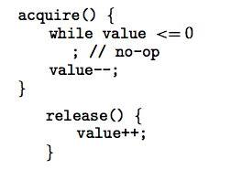
Semaphore Implementation
Main disadvantage of this implementation is that
  it requires busy waiting because of spin lock
    Waste CPU time
    Processes kernel-level threads might do context SW but user-level threads would be in loop forever
// sem_wait
block
queue
//sem_post
To overcome busy waiting, we can
replace spinlock with block process,
  sem_wait/acquire blocks the process (e.g., places the process in a queue) if the semaphore value is not positive. Then give CPU to another process
  sem_post/release will remove a process from queue and wake it up
  If CS is short, spinlock might be better than this option as it avoids context SW

Slide 63
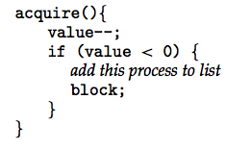
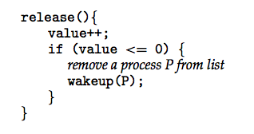
Semaphore Implementation with no Busy waiting
With each semaphore there is an associated waiting queue. Each entry in a waiting queue has two data items:
  value (of type integer)
  pointer to next record in the list
Two operations:
  block – place the process invoking the operation on the appropriate waiting queue.
  wakeup – remove one of processes in the waiting queue and place it in the ready queue.
Negative semaphore values.
(what does that mean?)

Slide 64
Semaphore Implementation
vs.
The second major issue is
how to implement acquire() and release() in an atomic manner
Must guarantee that no two processes can execute acquire() and release() on the same semaphore at the same time
In other words, their implementation becomes the critical section (CS) problem where the acquire/sem_wait and release/sem_post codes are placed in the critical section.
  Could now have busy waiting in critical section implementation because these implementation codes are short
  We moved busy waiting from application to here; but, note that applications may spend lots of time in critical sections and therefore busy waiting is not a good solution there while OK here.
Notes:
Even can be coded in assembly language

Slide 65
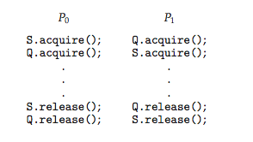
Deadlock and Starvation
Deadlock – two or more processes are waiting indefinitely for an event that can be caused by only one of the waiting processes
Let S and Q be two semaphores initialized to 1
Starvation – indefinite blocking. A process may never be removed from the semaphore queue in which it is suspended.
Application programmer must be careful!
Notes:
. Deadlock – two or more processes are waiting indefinitely for an event that can be caused by only one of the waiting processes
. Starvation – indefinite blocking. A process may never be removed from the semaphore queue in which it is suspended.

Slide 66
Priority Inversion
opt
L < M < H
L has resource x
H wants resource x, but it will wait for this resource
Now M becomes runnable and preempts L
M will have higher priority than H !!!!
(Mars path finder had that problem)
Solutions
Use only two priorities, but this not flexible
Priority-inheritance
  L will inherit Highest priority while using resource x. When it is finished, its priority will be reverted to the original one

Slide 67
CLASSICAL PROBLEMS OF SYNCHRONIZATION
Bounded-Buffer (Consumer-Producer) Problem Using
SEMAPHORES
CONDITION VARIABLES
MONITORS
Dining-Philosophers Problem
Readers and Writers Problem

Slide 68
.
Recall Bounded-Buffer Problem
for consumer-producer application
producer
consumer
Need to make sure that
  The producer and the consumer do not access the buffer area and related variables at the same time
  No item is made available to the consumer if all the buffer slots are empty.
  No slot in the buffer is made available to the producer if all the buffer slots are full
Notes:
. How to characterize the shared buffer? Variables:
(a). Buffer size; b). Next empty pointer; c). Next full pointer;
Circular array: when empty+1== full, no more add in; when full=empty, no item in buffer;
. Single mutex to protect ALL codes in producer/consumer?!

Slide 69
The Simple Implementation was…
// Producer
while (count == BSIZE)
; // do nothing, busy wait
// add an item to the buffer buffer[in] = item;
in = (in + 1) % BSIZE;
++count;
// Consumer
while (count == 0)
; // do nothing, busy wait
// remove an item from buffer
item = buffer[out];
out = (out + 1) % BSIZE;
--count;
What is the problem with this simple solution?
pthread_mutex_lock( &lock ) ;
++count;
pthread_mutex_unlock( &lock );
pthread_mutex_lock( &lock ) ;
--count;
pthread_mutex_unlock( &lock );
Is there still any other problem?
Busy waiting problem:
How to make these threads wait for a condition without busy waiting (spin lock)?
Notes:
Provide a solution to the consumer-producer problem that fills all the buffers.
Have an integer count that keeps track of the number of full buffers. Initially, count is set to 0.
It is incremented by the producer after it produces a new buffer and is decremented by the consumer after it consumes a buffer.

Slide 70
A Solution with Semaphores
.
If the condition is simple, such as waiting for an integer to be 0 or any other positive value (as in previous slide), we can do this with semaphores.
semaphore mutex, full, empty;
What are the initial values?
Initially:
mutex = 1 // controlling mutual access to the buffer
full = 0 // The number of full buffer slots
empty = BSIZE // The number of empty buffer slots

Slide 71
Bounded buffer Codes
.
// Producer
while (count == BSIZE)
; // do nothing, busy wait
// add an item
buffer[in] = item;
in = (in + 1) % BSIZE;
++count;
// Consumer
while (count == 0) )
; // do nothing, busy wait
// remove an item
item = buffer[out];
out = (out + 1) % BSIZE;
--count;
sem_wait( empty); // init BSIZE
sem_wait( full); // init 0
sem_post(full);
sem_post(empty);
sem_wait(empty); // BSIZE
sem_wait(mutex);
add item to buffer
++count;
sem_post(mutex);
sem_post(full);
sem_wait(full); // init 0
sem_wait(mutex);
remove an item from buffer
--count;
sem_post(mutex);
sem_post(empty);
return the item
What will
happen if
we change
the order?
Be careful of the sequence of semaphore operations; → deadlock could happen as before;
The general rule: get the easy resource first, and then difficult; release in reverse order;

Slide 72
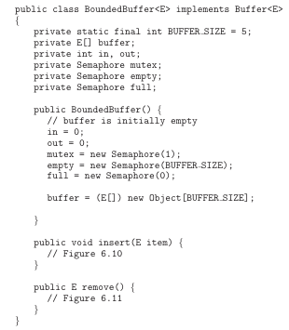
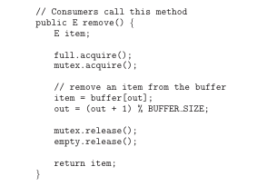
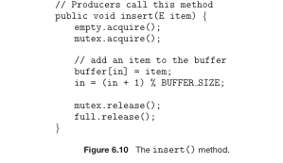
Bounded-Buffer Problem with Java
Ref

Slide 73
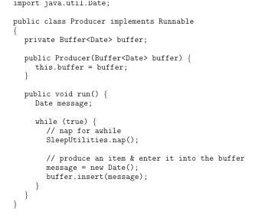
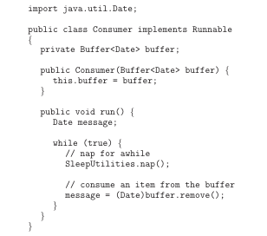
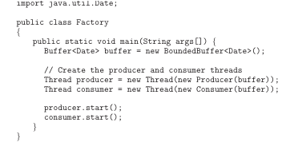
Producer and consumer application
Ref

Slide 74
CONDITION VARIABLES
What if we have more general condition,
such as waiting for x == y to be true so then we can do something!
while(x != y) ; // busy wait
We cannot solve this problem with semaphores/mutex alone.
Notes:
We can still do it with semaphore, but not in a simple way.

Slide 75
Will this work?
Case1: int x=3, y=5;
// T3
while(x!=y) ;
…_lock(&m);
x=x+y;
y--;
…_unlock(&m);
Case2: int x=3, y=4;
// T1
…_lock(&m);
x++;
y--;
…_unlock(&m);
// T2
…_lock(&m);
x--;
y++;
…_unlock(&m);
In Case2, suppose T1 executes x++. But then before T1 executes y--, T3 will see that condition is false and finish waiting in while loop! Which is wrong!
Put while(…) ; in CS

Slide 76
Will this work?
Case1: int x=3, y=5;
// T3
while(x!=y) ;
…_lock(&m);
x=x+y;
y--;
…_unlock(&m);
Case2: int x=3, y=4;
// T3
…_lock(&m);
while(x!=y) ;
x=x+y;
y--;
…_unlock(&m);
// T1
…_lock(&m);
x++;
y--;
…_unlock(&m);
// T2
…_lock(&m);
x--;
y++;
…_unlock(&m);
In Case2, suppose T1 executes x++. But then before T1 executes y--, T3 will see that condition is false and finish waiting in while loop! Which is wrong!
Put while(…) ; in CS
What if T3 gets the lock first?

Slide 77
To wait for a general condition,
We would have to:
  lock the shared variables (with a mutex)
  check the condition
  If the condition is not satisfied, block the thread (but still has the lock)
  So we must first unlock the shared variables; so that other thread can access/change them {unlock(); block();}
  If the change occurs between the unlocking of the shared variables and the blocking of the thread, we might miss the change.
So, we need to atomically unlock the mutex and block the current thread T3 {unlock(); block();}
This way another thread T1 or T2 can get into CS and make changes to shared variables.
Also T1 and T2 should wake up T3. So, T3 can get the lock and check the condition again! Why?
This is what condition variables do.
Notes:
Because waking up does not mean that the condition is met, it might be still not what we want. So that is why it needs to be checked again!

Slide 78
Waiting for a general condition using Condition Variable
*****
Case1: int x=3, y=5;
Case2: int x=3, y=4;
CON
m
// T3 with CON
…_lock(&m);
while(x!=y)
…_wait(&CON,&m);
x=x+y;
y--;
…_unlock(&m);
// T3
…_lock(&m);
while(x!=y)
;
x=x+y;
y--;
…_unlock(&m);
// T1
…_lock(&m);
x++;
y--;
…_signal(&CON);
…_unlock(&m);

Slide 79
Condition Variables
*
In a critical section, a thread can suspend itself on a condition variable if the state of the computation (i.e., the condition that we have) is not right for it to proceed.
  It will suspend by waiting on a condition variable.
  It will, however, release the critical section lock so other threads can access the critical section and change shared variables.
  When that condition variable is signaled, it will become ready again (waked up); it will try to reacquire that critical section lock and only then it will be able to proceed if the condition that we have is satisfied.
With POSIX threads, a condition variable is associated with a mutex, not with a condition.
  They get their name from the way they are used (or the problem they are used to solve), not from what they are.
Now, using a condition variable, we can atomically unlock the mutex and block the process on a condition variable.

Slide 80
condition variable
  A condition variable is an object that has a mutex and a list of threads waiting for something to happen.
There are 2 basic operations you can do with condition variables: wait and signal
wait:
  associate the condition variable with a mutex
  atomically unlock the mutex and block the thread
  blocking the thread means: remove it from the running state and put in a queue of threads waiting for a signal operation on the condition variable.
signal:
  wake up a thread, if any, that is waiting for the condition variable, and have it attempt to acquire (lock) the mutex (put it into mutex queue).
  You perform this signal operation with the mutex already locked,
  Immediately after you do the signal on the condition variable, you should unlock the mutex (so the process woke up can eventually enter the run state).
Notes:
A classical condition variable is associated with a particular condition. In contrast, POSIX
condition variables provide an atomic waiting mechanism but are not associated with particular
conditions.
Compare signal on cond var to a mutex or a semaphore.
Compare signal on cond var to a monitor condition variable.

Slide 81
POSIX condition variable syntax
pthread_cond_t cond = PTHREAD_COND_INITIALIZER;
int pthread_cond_wait(pthread_cond_t *restrict cond,
pthread_mutex_t *restrict mutex);
int pthread_cond_signal(pthread_cond_t *cond);
Rules
  pthread_cond_wait may only be called by a thread that owns the mutex.
  When it returns, it will own the mutex again.
  The waiting thread should check the condition again (in a loop) to see if it is satisfied (if cond will not work).
    Typically a thread calls signal when it changes a variable, not necessarily when the condition is satisfied.
    In fact, even if the condition was satisfied at the time of wake up, it might not be satisfied when the awakened thread executes.
  pthread_cond_signal should be called while the thread owns the mutex. But this is not required and if that is not the case signal has no effect.
  Threads that modify or test the shared variables involved in the condition should own the mutex.

Slide 82
Examples: (no error checking)
TH1 waits for the condition x==y to happen. If not, wait until it is true (i.e., wait while(not the condition we are looking for)!
  pthread_mutex_lock(&m);
      while (x != y) // not (x==y)
        pthread_cond_wait(&cond, &m);
      /* modify x or y if necessary */
  pthread_mutex_unlock(&m);
TH2 modifies shared variables and wake up TH1 to check the condition again:
  pthread_mutex_lock(&m);
      x++; y--;
      pthread_cond_signal(&cond);
  pthread_mutex_unlock(&m);

Slide 83
Ex: Modify The Simple Implementation of BB
How to make a thread wait for a condition without busy waiting?
  Semaphore √
  Use Condition variable
// Producer
while (count == BSIZE)
; // do nothing
// add an item to the buffer buffer[in] = item;
in = (in + 1) % BSIZE;
pthread_mutex_lock( &lock ) ;
++count;
pthread_mutex_unlock( &lock );
// Consumer
while (count == 0)
; // do nothing
// remove an item from buffer
item = buffer[out];
out = (out + 1) % BSIZE;
pthread_mutex_lock( &lock ) ;
--count;
pthread_mutex_unlock( &lock );
Notes:
Provide a solution to the consumer-producer problem that fills all the buffers.
Have an integer count that keeps track of the number of full buffers. Initially, count is set to 0.
It is incremented by the producer after it produces a new buffer and is decremented by the consumer after it consumes a buffer.

Slide 84
Implementation with condition variable
#include <pthread.h>
#include "buffer.h"
static buffer_t buffer[BSIZE];
static pthread_mutex_t lock = PTHREAD_MUTEX_INITIALIZER;
static int in = 0;
static int out = 0;
static pthread_cond_t pcond= PTHREAD_COND_INITIALIZER;
static pthread_cond_t ccond = PTHREAD_COND_INITIALIZER;
static int count = 0;
// Producer
int putitem(buffer_t item) {
pthread_mutex_lock(&lock);
while (count == BSIZE)
pthread_cond_wait (&pcond, &lock);
buffer[in] = item;
in = (in + 1) % BSIZE;
count++;
pthread_cond_signal(&ccond);
pthread_mutex_unlock(&lock);
}
// Consumer
int getitem(buffer_t *item) {
pthread_mutex_lock(&lock))
while (count == 0)
pthread_cond_wait (&ccond, &lock);
*item = buffer[out];
out = (out + 1) % BSIZE;
count--;
pthread_cond_signal(&pcond);
pthread_mutex_unlock(&lock);
}
Notes:
Provide a solution to the consumer-producer problem that fills all the buffers.
Have an integer count that keeps track of the number of full buffers. Initially, count is set to 0.
It is incremented by the producer after it produces a new buffer and is decremented by the consumer after it consumes a buffer.

Slide 85
Exercise
wait for test_condition() to be true:
static pthread_mutex_t m = PTHREAD_MUTEX_INITIALIZER;
static pthread_cond_t cond = PTHREAD_COND_INITIALIZER;
TH1:
pthread_mutex_lock(&m);
while (!test_condition()) /* get resource */
pthread_cond_wait(&cond, &m);
/* do critical section, possibly changing test_condition() */
pthread_mutex_unlock(&m);
TH2:
pthread_mutex_lock(&m);
/* do critical section, possibly changing test_condition() */
/* inform another thread */ pthread_cond_signal(&cond);
pthread_mutex_unlock(&m);

Slide 86
Example: a barrier
A barrier is a synchronization construct that prevents all threads from continuing until they all have reached a certain place in their execution.
When it does happen, all threads can proceed
static pthread_cond_t bcond = PTHREAD_COND_INITIALIZER;
static pthread_mutex_t bmutex = PTHREAD_MUTEX_INITIALIZER;
static int count = 0;
static int limit = 0;
void initbarrier(int n) { /* initialize the barrier to be size n */
pthread_mutex_lock(&bmutex);
limit = n;
pthread_mutex_unlock(&bmutex);
}
void waitbarrier(void) { /* wait at the barrier until all n threads arrive */
pthread_mutex_lock(&bmutex);
count++;
while (count < limit)
pthread_cond_wait(&bcond, &bmutex);
pthread_cond_broadcast(&bcond); /* wake up everyone */
pthread_mutex_unlock(&bmutex);
}
Notes:
It uses pthread_cond_broadcast that wakes up all threads waiting for the condition variable. This is similar to notifyAll in Java monitors.

Slide 87
Synchronization in Pthread Library
*
REF
Mutex variables
  pthread_mutex_t
Conditional variables
  pthread_cond_t
All POSIX thread functions have the form:
pthread[ _object ] _operation
Most of the POSIX thread library functions return 0 in case of success and some non-zero error-number in case of a failure

Slide 88
Synchronization in Pthread Library cont’d
*
REF
A mutex variable can be either locked or unlocked
  pthread_mutex_t lock; // lock is a mutex variable
Initialization of a mutex variable by default attributes
  pthread_mutex_init( &lock, NULL );
Lock operation
  pthread_mutex_lock( &lock ) ;
Unlock operation
  pthread_mutex_unlock( &lock );

Slide 89
Synchronization in Pthread Library cont’d
*
REF
pthread_cond_t a_cond;
pthread_cond_init (&a_cond, NULL );
pthread_cond_wait(&a_cond, &lock);
pthread_cond_signal(&a_cond);
  unblock one waiting thread on that condition variable
pthread_cond_broadcast(&a_cond);
  unblock all waiting threads on that condition variable

Slide 90

Quiz 15

Slide 91
MONITORS
One of the problem with semaphores is that programmers might make mistake in the order of acquire (sem_wait) and release (sem_post) and cause deadlock!
A monitor is a high-level abstraction that provides a convenient and effective mechanism for process synchronization
  We can use semaphore to implement a monitor.

Slide 92
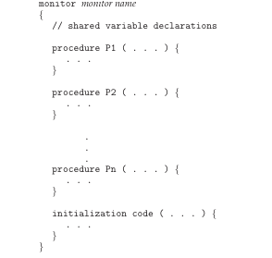
What are the problems with Sem?
sem_wait()/sem_post() should be executed in the correct order; but, programmers may make mistake
To deal with such mistakes, researchers developed monitors to provide a convenient and effective mechanism for process synchronization
A monitor is a collection of procedures, variables, and data structures grouped together such that
Only one process may be active within the monitor at a time
A monitor is a language construct (e.g., synchronized methods in Java)
  The compiler enforces mutual exclusion.
  Semaphores are usually an OS construct
public class SynchronizedCounter {
private int c = 0;
public synchronized void inc(){
c++;
}
public synchronized void dec(){
c--;
}
public synchronized int value()
{
return c;
}
}

Slide 93

Schematic View of a Monitor
*
Monitor construct ensures at most one process/thread can be active within the monitor at a given time.
Shared data (local variables) of the monitor can be accessed only by local procedures.
So programmer does not need to code this synchronization constraints explicitly
However, this is not sufficiently powerful,
so for tailor-made synchronization, condition variable construct is provided

Slide 94

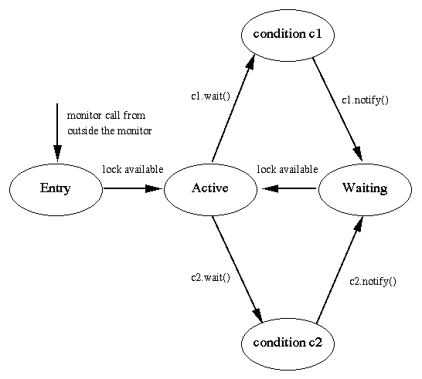
Condition Variables
Condition x, y;
// a queue of blocked processes
Two operations
  x.wait () means that the process invoking this operation is suspended until another process invokes x.signal(); Also unlock the monitor lock, so another process can get into monitor
  x.notify() (like x.signal ()) resumes exactly one suspended process (if any) that invoked x.wait (); otherwise, no effect.
  Monitor is not a counter
Signal and wait
Signal and continue
Many languages have some support,
We will see Java version
Notes:
.If a condition variable is signaled with nobody waiting, the signal is lost.
Compare this with semaphores, in which a signal will allow a process that executes a wait in the future to not block.
.You should not think of a condition variable as a variable in the traditional sense.
. It does not have a value.
.Think of it as an object in the OOP sense.
It has two methods, wait and signal that manipulate the calling process.

Slide 95
Exercise
Producer-Consumer (PC) Monitor
.
Monitor PC {
condition pcond, ccond;
int count;
void init() {
count = 0;
}
void insert(int item){
while(count==N) pcond.wait();
insert_item(item);
count++;
if (count==1) ccond.signal();
}
int remove(){
int item;
while(count==0) ccond.wait();
iten = remove_item();
count--;
if (count==N–1) pcond.signal();
return item;
}
void producer() { //Producer process
while (1) {
item=Produce_Item();
PC.insert(item);
}
}
void consumer(){ //Consumer process
while (1) {
item = PC.remove();
consume_item(item);
}
}
Notes:
. Circular queue, waste one element

Slide 96
Bounded Buffer Using Java Monitor
Busy waiting loops when buffer is full or empty
Shared variable count may develop race condition
We will see how to solve these problems using Java sync
Busy waiting can be removed by blocking a process
  while(full/empty); vs.
  while(full/empty) Thread.yield();
  Problem: livelock
    (e.g., what will happen if a process with high priority waits for another low priority process to update full/empty, it may never get that chance!)
    We will see there is a better alternative than busy waiting or yielding
Race condition
  Can be solved using synchronized methods (see next page)

Slide 97
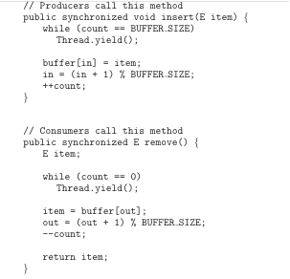
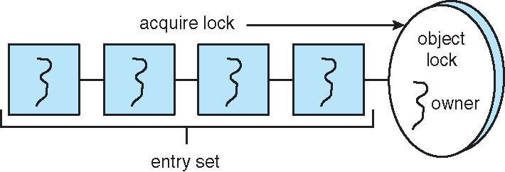
Java Synchronization
Java provides synchronization at the language-level.
Each Java object has an associated lock.
This lock is acquired by invoking a synchronized method.
This lock is released when exiting the synchronized method.
Threads waiting to acquire the object lock are placed in the entry set for the object lock.
Incorrect! Why?
Notes:
Like the case where while loop is moved into critical section….

Slide 98
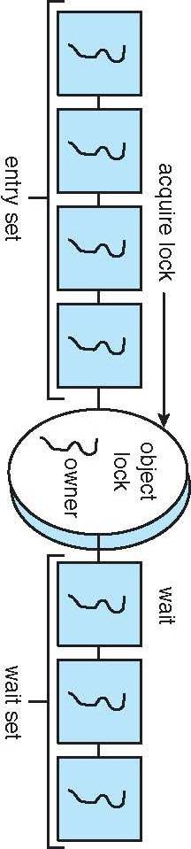
Java Synchronization
Why the previous solution is incorrect?
  Suppose buffer is full and consumer is sleeping.
  Producer call insert(), gets the lock and then yields. But it still has the lock,
  So when consumer calls remove(), it will block because the lock is owned by producer …
  Deadlock
We can solve this problem using two new Java methods
  When a thread invokes wait():
  1. The thread releases the object lock;
  2. The state of the thread is set to Blocked;
  3. The thread is placed in the wait set for the object.
  When a thread invokes notify():
  1. An arbitrary thread T from the wait set is selected;
  2. T is moved from the wait to the entry set;
  3. The state of T is set to Runnable.
Condition variable?

Slide 99
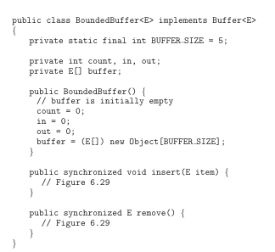
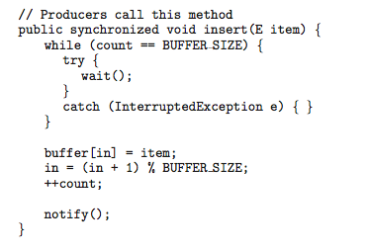
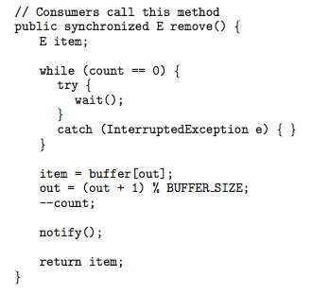
Java Synchronization - Bounded Buffer
Can be used instead of the one used semaphores before (see next for sem imp)
Correct! Why?

Slide 100
Bounded-Buffer Problem with Java
Covered before

Slide 101
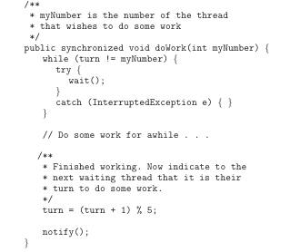
Java Synchronization
The call to notify() selects an arbitrary thread from the wait set.
  It is possible that the selected thread is in fact not waiting upon the condition for which it was notified.
  Consider doWork():
    turn is 3, T1, T2, T4 are in wait set, and T3 is in doWork()
    What happens when T3 is done?
The call notifyAll() selects all threads in the wait set and moves them to the entry set.
In general, notifyAll() is a more conservative strategy than notify().
notify() may not notify the correct thread!
So use notifyAll();

Slide 102
Monitor Implementation
compiler
will do this
Monitors are implemented by using queues to keep track of the processes attempting to become active in the monitor.
To be active, a monitor must obtain a lock to allow it to execute.
Processes that are blocked are put in a queue of processes waiting for an unblocking event to occur.
  The entry queue contains processes attempting to call a monitor procedure from outside the monitor. Each monitor has one entry queue.
  The signaller queue contains processes that have executed a notify operation. Each monitor has at most one signaller queue. In some implementations, a notify leaves the process active and no signaller queue is needed.
  The waiting queue contains processes that have been awakened by a notify operation. Each monitor has one waiting queue.
  Condition variable queues contain processes that have executed a condition variable wait operation. There is one such queue for each condition variable.
The relative priorities of these queues determines the operation of the monitor implementation.
Notes:
From http://vip.cs.utsa.edu/classes/cs3733f2012/notes/Monitors.html

Slide 103
IF TIME PERMITS
Classical Problems of Synchronization
Dining-Philosophers Problem
Readers and Writers Problem
Java Synchronization
Other Synchronization Examples

Slide 104
CLASSICAL PROBLEMS OF SYNCHRONIZATION
Bounded-Buffer (Consumer-Producer) Problem
Dining-Philosophers Problem
Readers and Writers Problem

Slide 105
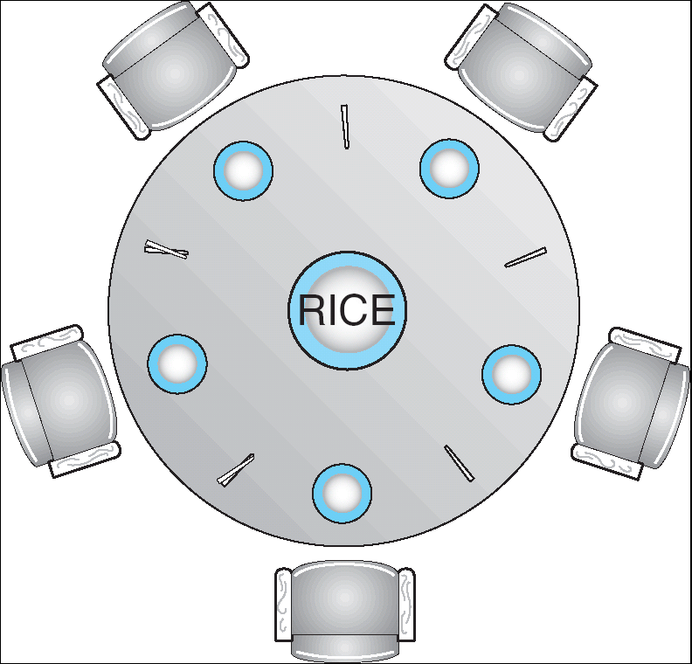
Dining-Philosophers Problem
Five philosophers share a common circular table. There are five chopsticks and a bowl of rice (in the middle).
When a philosopher gets hungry, he tries to pick up the closest chopsticks.
A philosopher may pick up only one chopstick at a time, and cannot pick up a chopstick already in use.
When done, he puts down both of his chopsticks, one after the other.
How to design a deadlock-free and starvation-free protocol….
4
0
0
4
1
3
1
3
2
2
Shared data
  Bowl of rice (data set)
  semaphore chopStick[5]; // Initially all set to 1
Notes:
. CS people hate philosophers !!! ☺
. Suppose the chopsticks are number clockwise, with top one as 0; label philosophers accordingly;

Slide 106
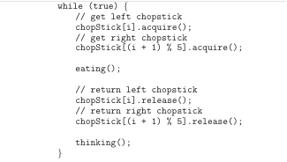
Dining-Philosophers Problem (cont.)
*
Solution for the i’th philosopher:
Agreement:
  First, pick right chopstick
  Then, pick left chopstick
while(1) {
think; //and become hungry
wait(chopstick[i]);
wait(chopstick[(i+1) % 5]);
eat
signal(chopstick[i]);
signal(chopstick[(i+1) % 5]);
…
}
What is the problem?!
Deadlock: Each one has one chopstick
Here are some options: allow at most 4 to sit, allow to pick up chopsticks if both are available, odd ones take left-then-right while even ones take right-then-left
Deadlock-free does not mean starvation-free (how about progress, and bounded waiting)
Notes:
. Agreement between philosophers (their solutions):
. Everyone pick the right side chopstick first, then left shop stick
. Problem: deadlock!!!! → temp solution, 4 token;

Slide 107
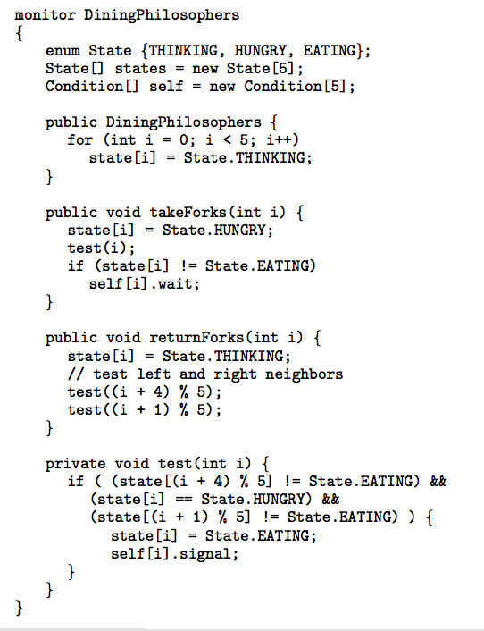
Solution to Dining Philosophers
Each philosopher picks up chopsticks if both are available
P_i can set state[i] to eating if her two neighbors are not eating
We need condition self[i] so P_i can delay herself when she is hungry but cannot get chopsticks
Each P_i invokes the operations takeForks(i) and returnForks(i) in the following sequence:
dp.takeForks (i)
EAT
dp.returnForks (i)
No deadlocks
How about Starvation?
http://vip.cs.utsa.edu/nsf/pubs/starving/starving.html
Notes:
One could starve to death why? must take turns?
Starvation → solution, check the conditional variable in order
http://vip.cs.utsa.edu/nsf/pubs/starving/starving.html

Slide 108
CLASSICAL PROBLEMS OF SYNCHRONIZATION
Bounded-Buffer (Consumer-Producer) Problem
Dining-Philosophers Problem
Readers and Writers Problem

Slide 109
Readers-Writers Problem
Readers only read the data set; they do not perform any updates, so multiple readers may access the shared data simultaneously
Writers can both read and write, so they must have exclusive access
A data set is shared among a number of concurrent processes
Problem – allow multiple readers to read at the same time; but only one single writer can access the shared data at the same time
Shared Data
  Data set
  Integer readerCount initialized to 0
  Semaphore mutex initialized to 1 //for readers to access readerCount
  Semaphore db initialized to 1 //for writer/reader mutual exclusive

Slide 110

Reader Writer
.
wait(mutex);
readerCount++;
if(readerCount == 1)
wait(db);
signal(mutex);
…
reading is performed
…
wait(mutex);
readerCount--;
if(readcount == 0)
signal(db);
signal(mutex);
wait(db);
…
writing is performed
…
signal(db);
Any problem with
this solution?!
What happens if one reader gets in first?
This solution is generalized as readers-writers lock…
multiple processes acquire r lock but only one can acquire w lock
Notes:
. Problem: starvation for writer. How to solve it?!

Slide 111
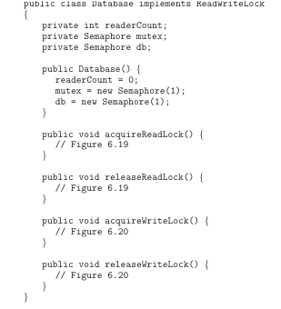
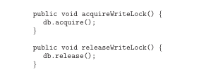
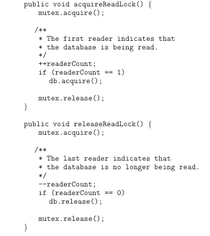
Readers-Writers Problem with Java
wait(db);
…
writing isperformed
…
signal(db);
wait(mutex);
readerCount++;
if(readerCount == 1)
wait(db);
signal(mutex);
…
reading is performed
…
wait(mutex);
readerCount--;
if(readcount == 0)
signal(db);
signal(mutex);

Slide 112
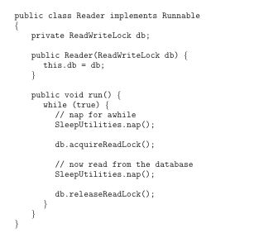
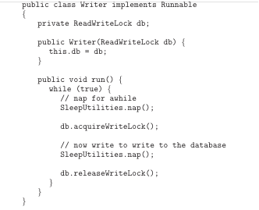
Readers-Writers Problem with Java (Cont.)

Slide 113
Advanced Reader/Writer Problems
*
OPT
Preferred Reader: original solution favors readers
Preferred Writer Problem
  If there is a writer in or waiting, no additional reader in
Alternative Reader/Writer Problem
  Reader/writer take turn to read/write

Slide 114
Preferred Writer: Variables & Semaphores
*
OPT
Variables
  readcount: number of readers current reading, init 0
  writecount: number of writers current writing or waiting, init 0
Semaphores
  rmtx: reader mutex for updating readcount, init 1;
  wmtx: writer mutex for updating writecount, init 1;
  wsem: semaphore for exclusive writers, init 1;
  rsem: semaphore for readers to wait for writers, init 1;
  renter: semaphore for controlling readers getting in;
Notes:
. Need to count number of writer waiting;

Slide 115
Preferred Writer: Solutions
*
OPT
Reader
Writer
//wait(renter);
wait(rsem);
wait(rmtx);
readcount++;
if (readcount = = 1)
wait(wsem);
signal(rmtx);
signal(rsem);
//signal(renter);
READING
wait(rmtx);
readcount--;
if (readcount == 0)
signal(wsem);
signal(rmtx);
wait(wmtx);
writecount++;
if (writecount = = 1)
wait(rsem);
signal(wmtx);
wait(wsem);
WRITING
signal(wsem);
wait(wmtx);
writecount--;
if (writecount == 0)
signal(rsem);
signal(wmtx);
Notes:
. Reader may be starvation;. Also, if renter, no other reader can proceeds .. … ;
. Scenario: readers in; one writer comes, get rsem, but waiting on wsem; when more readers come, first wait on rsem, and other waiting on renter;
when last reader leaves, signal the writer to get in; if more writers come, waiting on wsem; note that, only last writer signal rsem; when last writer leaves, the reader waiting on rsem gets in (after get wsem), which in turn wakeup other readers on renter;
. without ‘renter’, all readers wait on rsem; when last writer leaves; before all readers get in, new writer comes and will wait on rsem; Here, both readers and writers wait on rsem, writers do not have preference anymore, violate requirements;
. Only one reader should wait on ‘rsem’; others wait on ‘renter’;

Slide 116
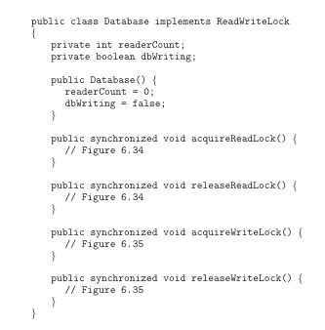
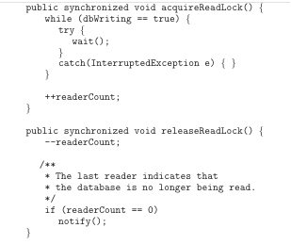
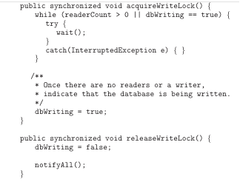
Java Synchronization - Readers-Writers using both notify() and notifyAll()

Slide 117
JAVA SYNCHRONIZATION
http://www.caveofprogramming.com/tag/multithreading/

Slide 118
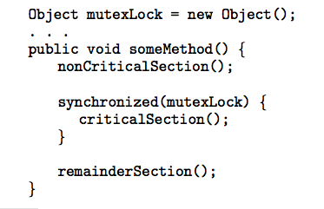
Java Synchronization
Block synchronization
Rather than synchronizing an entire method, Block synchronization allows blocks of code to be declared as synchronized
This will be also necessary if you need more than one locks to share different resources

Slide 119
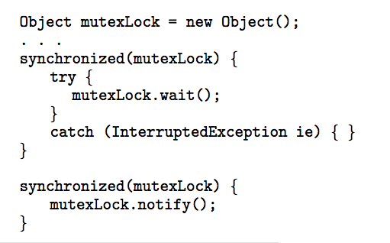
Java Synchronization
Block synchronization using wait()/notify()

Slide 120
Concurrency Features in Java 5
Prior to Java 5, the only concurrency features in Java were Using synchronized/wait/notify.
Beginning with Java 5, new features were added to the API:
Reentrant Locks
Semaphores
Condition Variables

Slide 121
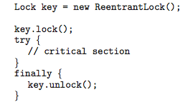
Concurrency Features in Java 5
Reentrant Locks

Slide 122
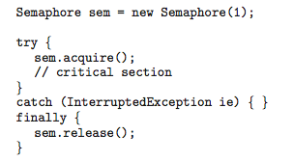
Concurrency Features in Java 5
Semaphores

Slide 123

Concurrency Features in Java 5
A condition variable is created by first creating a
ReentrantLock and invoking its newCondition() method:
Once this is done, it is possible to invoke the
await() and signal() methods

Slide 124
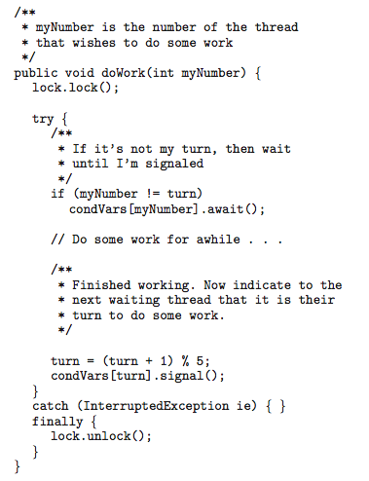
Concurrency Features in Java 5
doWork() method with condition variables

Slide 125
EXTRAS

Slide 126
SYNCHRONIZATION EXAMPLES
Pthread Library see USP 13-14
for reference and self-study
Pthreads
Solaris
Windows XP
Linux

Slide 127
Pthreads Synchronization
Pthreads API is OS-independent
It provides:
  mutex locks
  condition variables
Non-portable extensions include:
  read-write locks
  spin locks

Slide 128
Condition Variables
Special pthread data structure
Make it possible/easy to go to sleep
  Atomically:
    release lock
    put thread on wait queue
    go to sleep
Each CV has a queue of waiting threads
Do we worry about threads that have been put on the wait queue but have NOT gone to sleep yet?
  no, because those two actions are atomic
Each condition variable associated with one lock

Slide 129
Condition Variables
Wait for 1 event, atomically release lock
  wait(Lock& l, CV& c)
    If queue is empty, wait
      Atomically releases lock, goes to sleep
      You must be holding lock!
      May reacquire lock when awakened (pthreads do)
  signal(CV& c)
    Insert item in queue
      Wakes up one waiting thread, if any
  broadcast(CV& c)
    Wakes up all waiting threads

Slide 130
Condition Variable Exercise
Implement “Producer Consumer”
  One thread enqueues, another dequeues
  void * consumer (void *){
  while (true) {
  pthread_mutex_lock(&l);
  while (q.empty()){
  pthread_cond_wait(&nempty, &l);
  }
  cout << q.pop_back() << endl;
  pthread_mutex_unlock(&l);
  }
  }
  void * producer(void *){
  while (true) {
  pthread_mutex_lock(&l);
  q.push_front (1);
  pthread_cond_signal(&nempty);
  pthread_mutex_unlock(&l);
  }
  }
Questions?
  Can I use if instead of while?
DK: need to add CV declaration?!

Slide 131
Barrier
A barrier is used to order different threads (or a synchronization).
  A barrier for a group of threads: any thread/process must stop at this point and cannot proceed until all other threads/processes reach this barrier.
Where it can be used?
  Watching movie.

Slide 132
Barrier
Epoch0
Epoch1
Epoch2
“Thread” 1
“Thread” 2
“Thread” 3
Time

Slide 133
Barrier Interfaces
It is used when some parallel computations need to "meet up" at certain points before continuing.
Pthreads extension includes barriers as synchronization objects
(available in Single UNIX Specification)
  Enable by #define _XOPEN_SOURCE 600 at start of file
Initialize a barrier for count threads
int pthread_barrier_init(pthread_barrier_t *barrier, const pthread_barrier attr_t *attr, int count);
Each thread waits on a barrier by calling
int pthread_barrier_wait(pthread_barrier_t *barrier);
Destroy a barrier
int pthread_barrier_destroy(pthread_barrier_t *barrier);

Slide 134
Synchronization – Barrier (2)
void * thread1 (void *not_used) {
time (&now);
printf (”T1 starting %s",
ctime (&now));
sleep (20);
pthread_barrier_wait (&barrier);
time (&now);
printf (”T1: after barrier at %s",
ctime (&now));
}
void * thread2 (void *not_used) {
time (&now);
printf (”T2 starting %s", ctime (&now));
sleep (20);
pthread_barrier_wait (&barrier);
time (&now);
printf (”T2: after barrier at %s", ctime (&now));
}
int main () // ignore arguments {
time_t now;
// create a barrier object with a count of 3
pthread_barrier_init (&barrier, NULL, 3);
// start up two threads, thread1 and thread2
pthread_create (NULL, NULL, thread1, NULL);
pthread_create (NULL, NULL, thread2, NULL);
time (&now);
printf ("main() before barrier at %s", ctime (&now));
pthread_barrier_wait (&barrier);
// Now all three threads have completed.
time (&now);
printf (“main() after barrier at %s", ctime (&now));
pthread_exit( NULL );
return (EXIT_SUCCESS);
}

Slide 135
Solaris Synchronization
Implements a variety of locks to support multitasking, multithreading (including real-time threads), and multiprocessing
Uses adaptive mutexes for efficiency when protecting data from short code segments
Uses condition variables and readers-writers locks when longer sections of code need access to data
Uses turnstiles to order the list of threads waiting to acquire either an adaptive mutex or reader-writer lock

Slide 136
Windows XP Synchronization
Uses interrupt masks to protect access to global resources on uniprocessor systems
Uses spinlocks on multiprocessor systems
Also provides dispatcher objects which may act as either mutexes and semaphores
Dispatcher objects may also provide events
  An event acts much like a condition variable

Slide 137
Linux Synchronization
Linux:
  Prior to kernel Version 2.6, disables interrupts to implement short critical sections
  Version 2.6 and later, fully preemptive
Linux provides:
  semaphores
  spin locks

Slide 138
ATOMIC TRANSACTIONS
More later in Distributed Systems
System Model
Log-based Recovery
Checkpoints
Concurrent Atomic Transactions

Slide 139
End of Chapter 6

