Slide 1
SEEP2D
CE 544 – BRIGHAM YOUNG UNIVERSITY

Slide 2
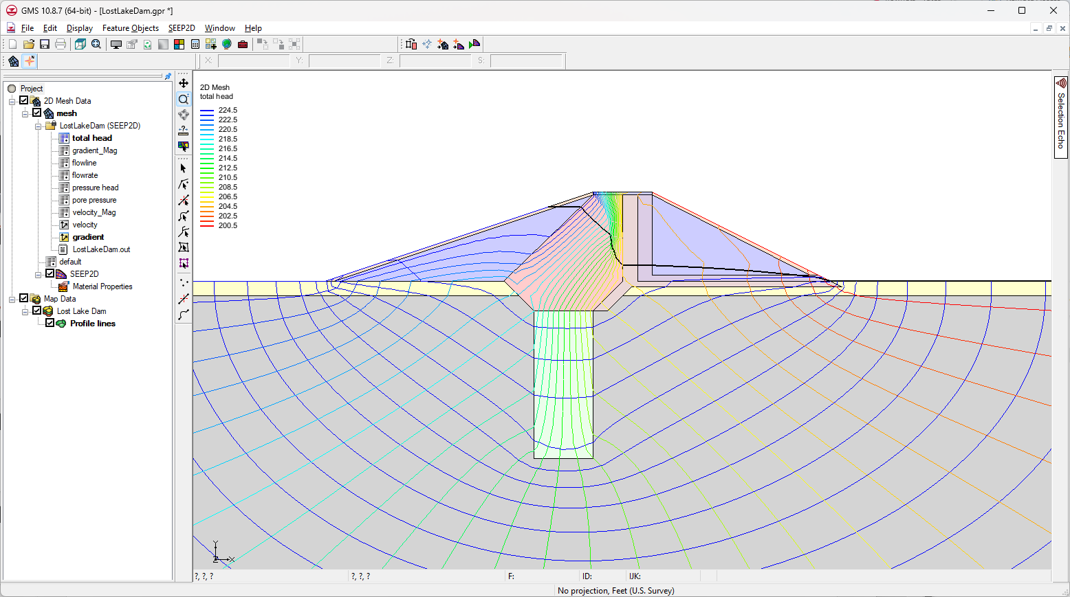
Background
2D finite element flow model
Written by Fred Tracy
US Army Engineer Waterways Experiment Station

Slide 3
Applications
Suited for
Not suited for
Heterogeneous , anistropic soil properties
Confined/unconfined flow for profile models
Saturated/unsaturated flow for unconfined profile models
Confined flow for plan (areal) models
Axisymmetric models
Transient (time varying) problems
Unconfined plan models
Transport

Slide 4
Governing Equation
Where:
H = total head
K = hydraulic conductivity

Slide 5
Modeling Process
Model conceptualization/boundary conditions
Mesh generation
Analysis options
Material properties

Slide 6
1. Model Conceptualization
Determine model type
Plan vs. Profile
Confined vs. Unconfined
Determine appropriate boundary conditions

Slide 7
Confined Flow, Ex. 1

Slide 8
Confined Flow, Ex. 2

Slide 9
Unconfined, Dupuit Problem

Slide 10
Unconfined, Embankment

Slide 11
Impermeable Barriers

Slide 12
Impermeable Barriers, cont.

Slide 13
2. Mesh Construction
3 node triangles
4 node quadrilaterals

Slide 14
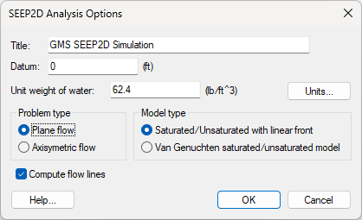
3. Analysis Options

Slide 15
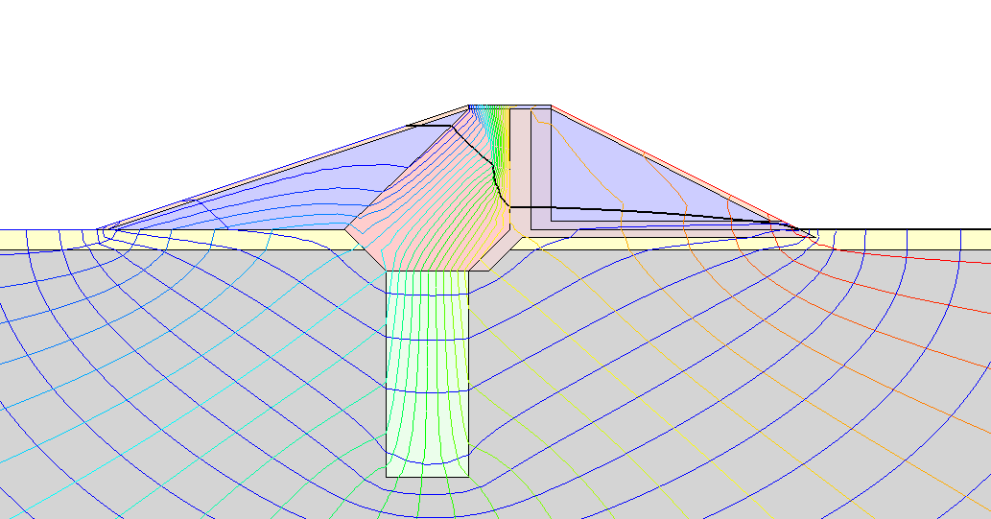
Unconfined Problems
Flow is modeled in both saturated and unsaturated zones
Phreatic surface is where pressure head = zero
Phreatic Surface
Unsaturated Zone
Saturated Zone

Slide 16
Unsaturated Zone
where
H = total head
h_{p} = pressure head
h_{el} = elevation head
h_{p} < zero in unsaturated zone

Slide 17
Relative Conductivity
In unsaturated zone
where:
k = k used in unsaturated zone
k_{r} = relative conductivity
k_{s} = saturated conductivity

Slide 18
Methods for Determining Kr
Linear front method
Van Genuchten method
where α and m are empirical parameters based on soil type
Required parameters: k_{ro}, h_{min}
** Default method **

Slide 19
4. Material Properties

