Slide 1
Course Introduction
CE 544 – BRIGHAM YOUNG UNIVERSITY

Slide 2
Topics – Seepage Analysis
Review (Darcy’s Law, heads, etc.)
Governing equations
Graphical solutions
Analytical solutions
Well equations
Construction dewatering
Finite difference method
Finite element method, XSLOPE

Slide 3
Flow Nets

Slide 4
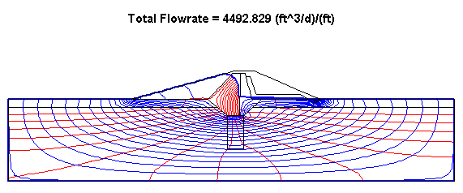
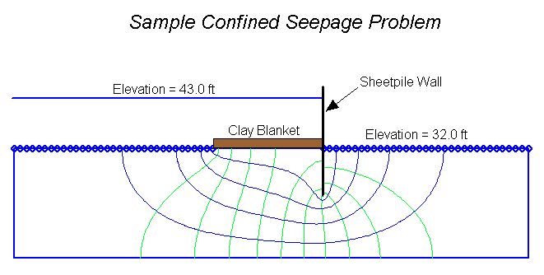

Slide 5
Analytical Solutions
y
H
o
h
H
D
x
D

Slide 6
Well Equations

Slide 7
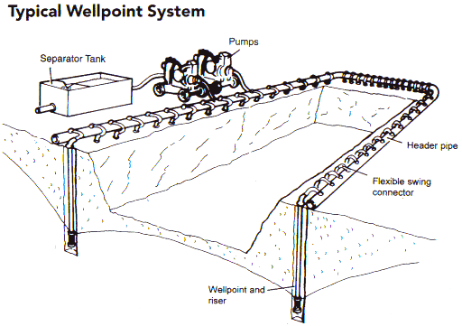
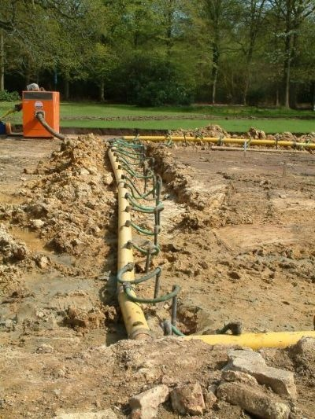
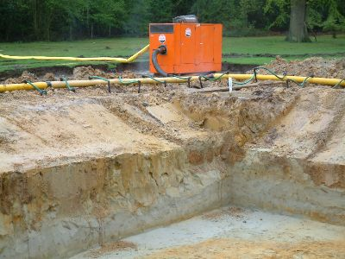
Construction Dewatering

Slide 8
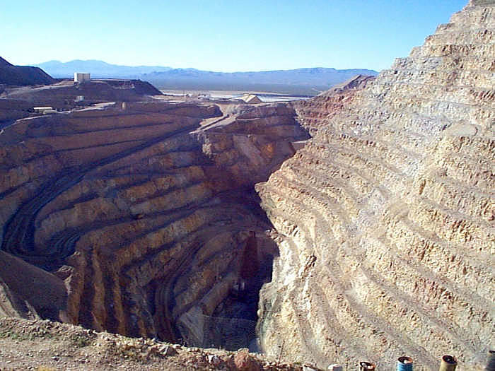
Mine Dewatering

Slide 9
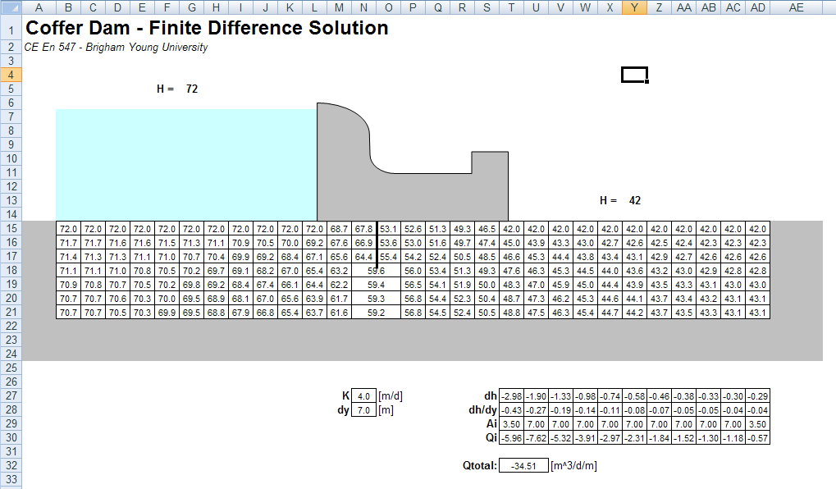
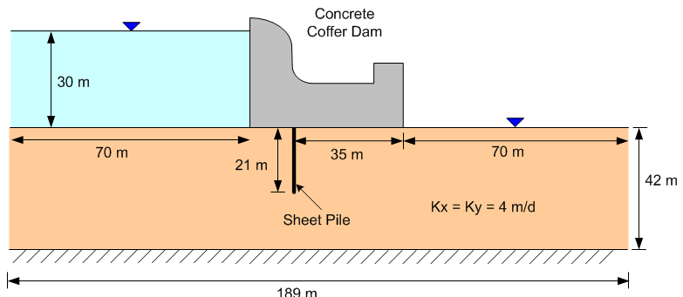
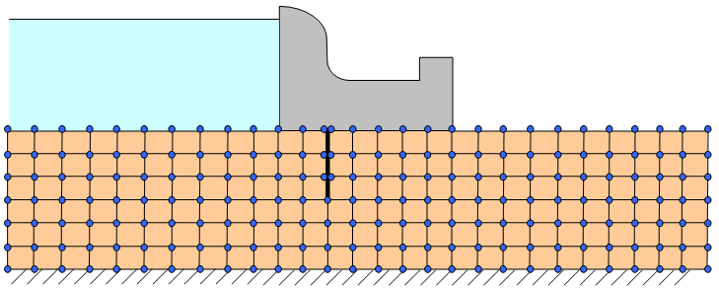
Finite Difference Method

Slide 10
Finite Element Method

Slide 11
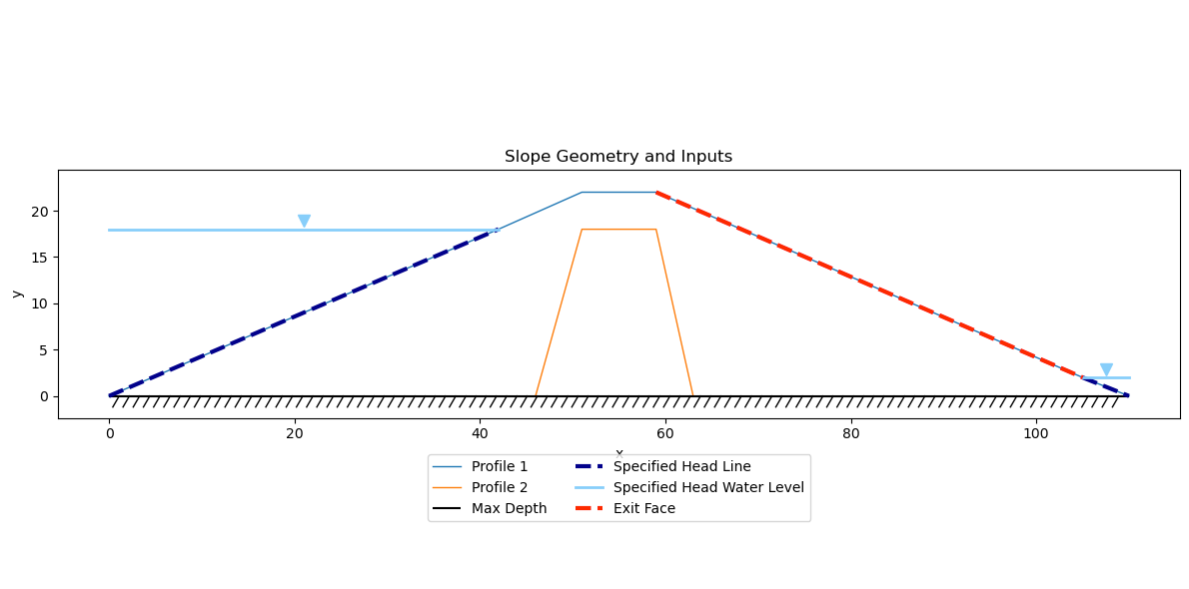
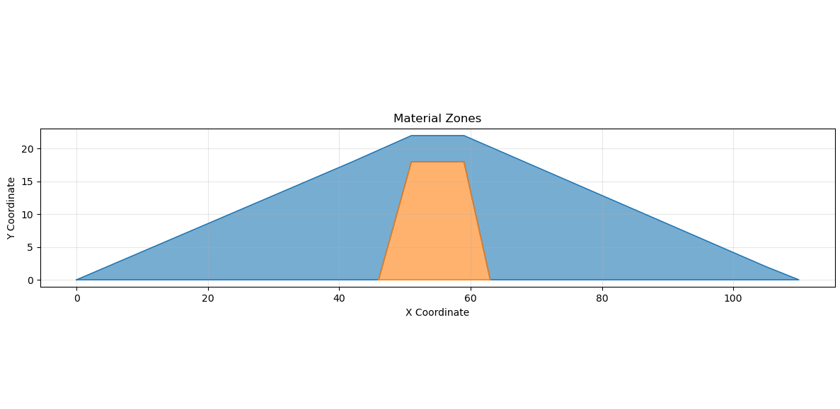
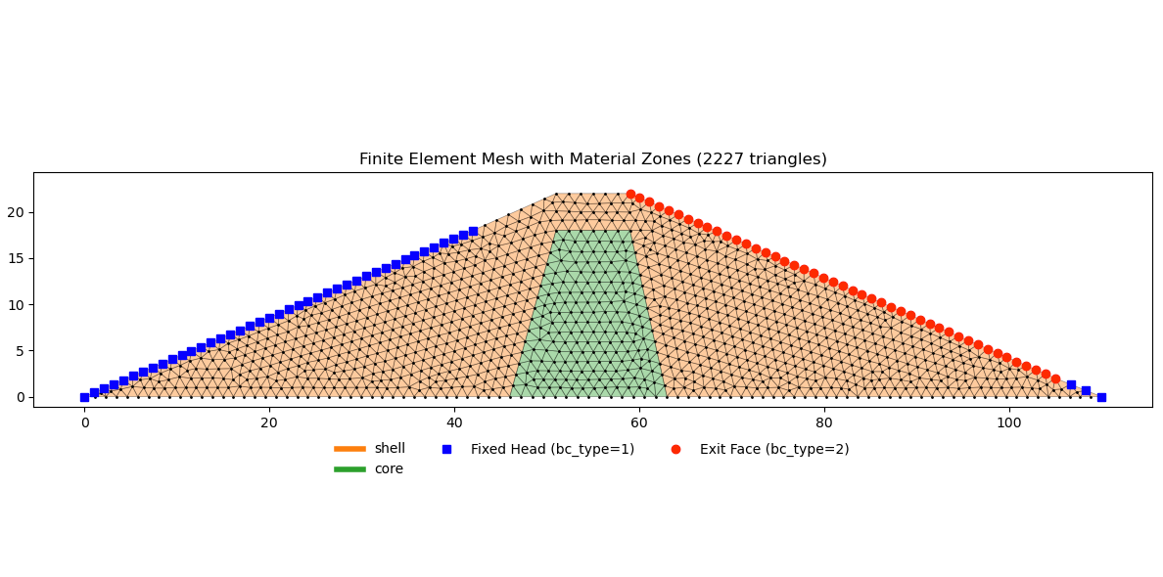
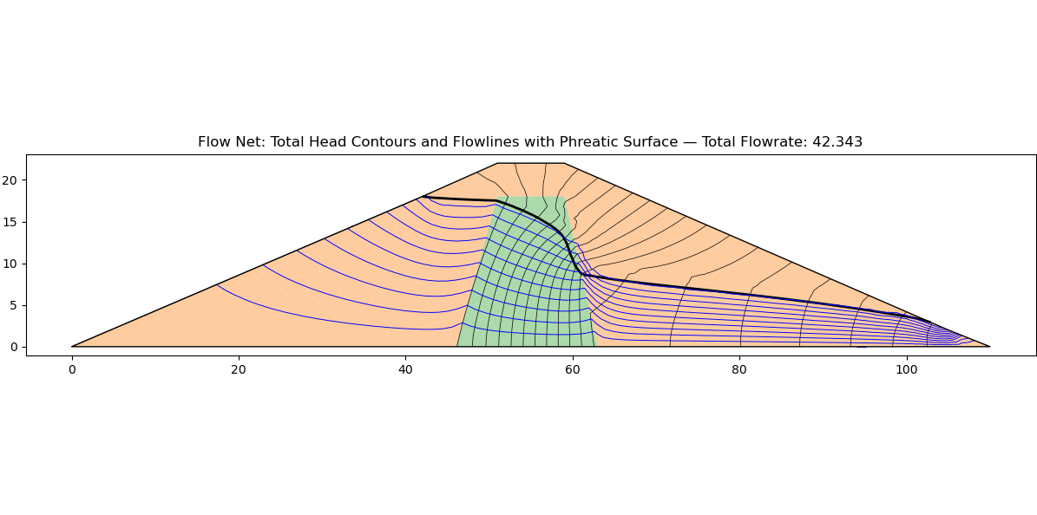
FE – Seepage Analysis

Slide 12
Topics – Slope Stability
Types of failures
Method of slices
Infinite slope analysis
UTEXAS slope stability program
Seismic analysis
Sudden drawdown, multi-stage analysis

Slide 13
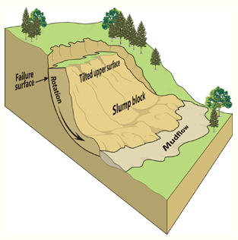

Slide 14
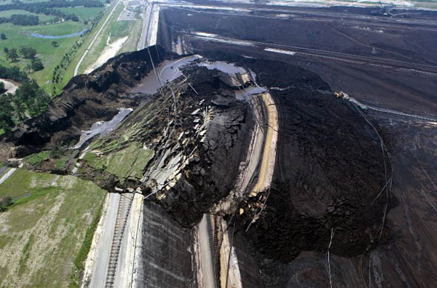

Slide 15
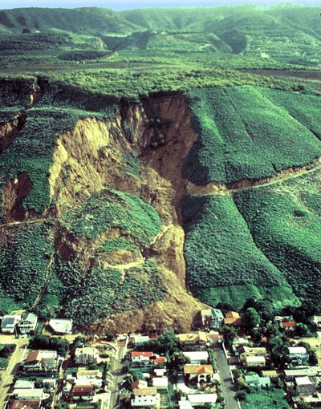

Slide 16
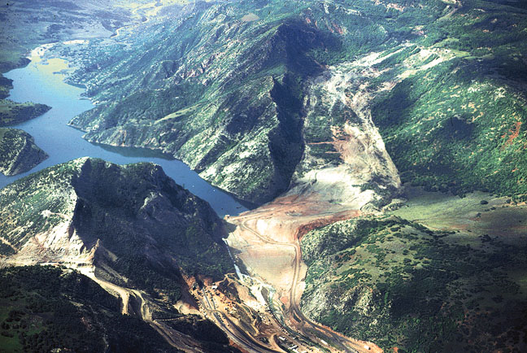

Slide 17
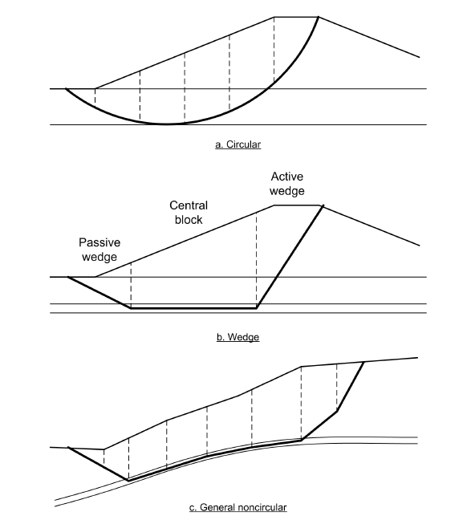
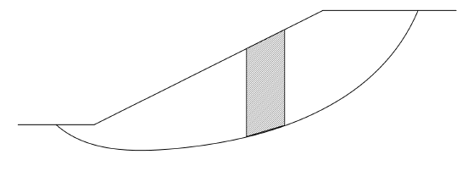
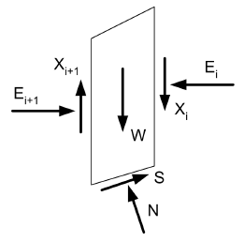
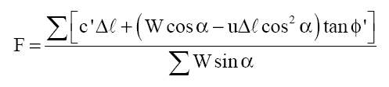
Method of Slices

Slide 18
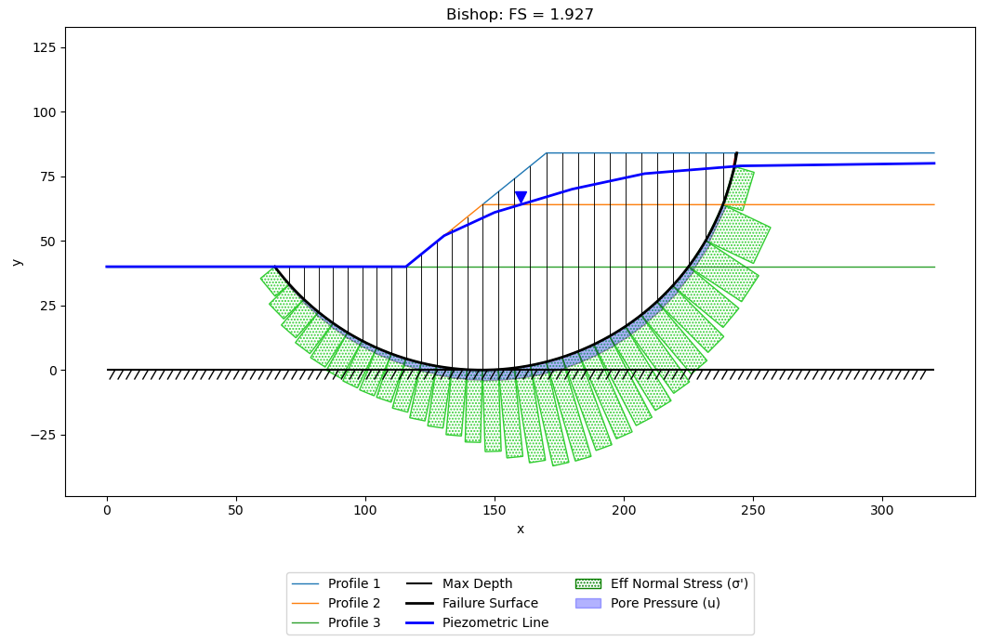
Limit Equilibrium Analysis

Slide 19
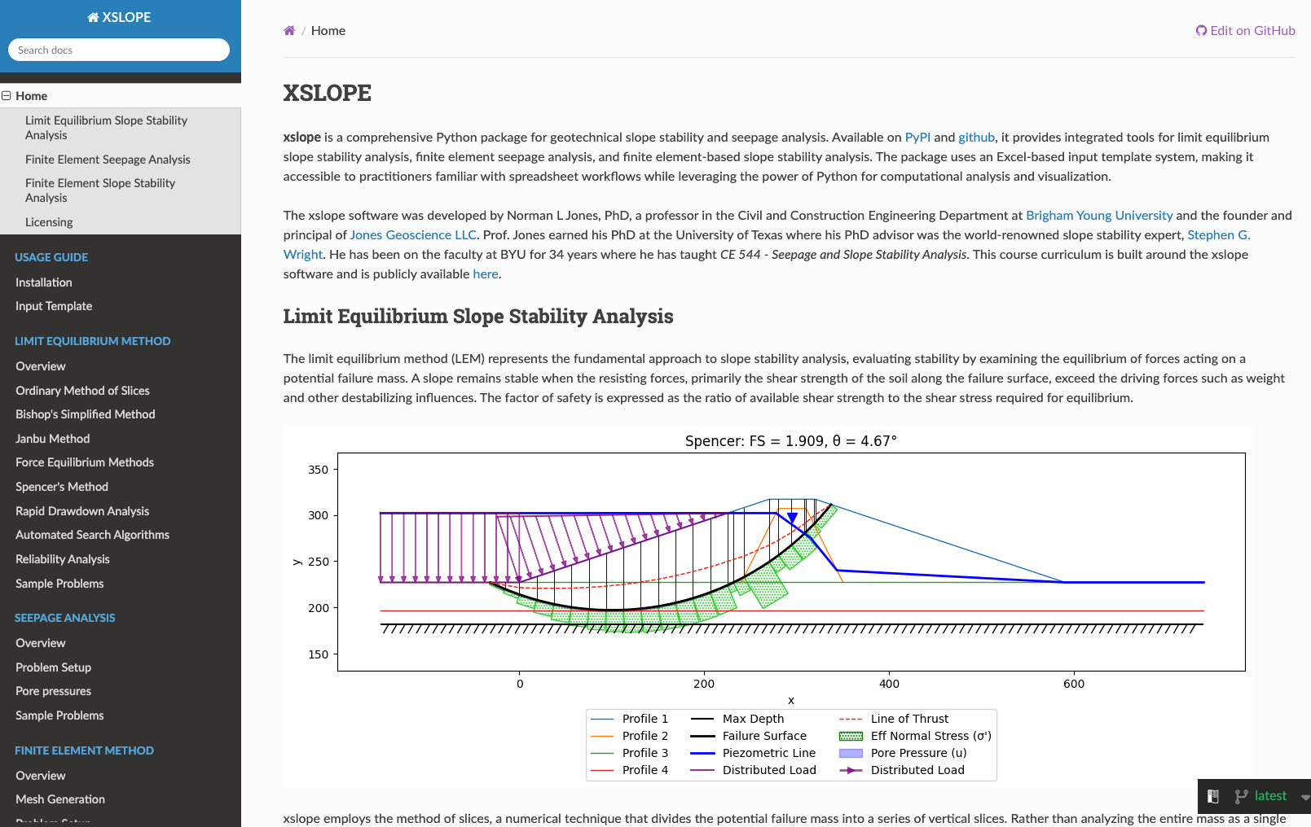
https://xslope.readthedocs.io/en/latest/

