Slide 1
UTEXAS Slope Stability Program
CE 544 – BRIGHAM YOUNG UNIVERSITY

Slide 2
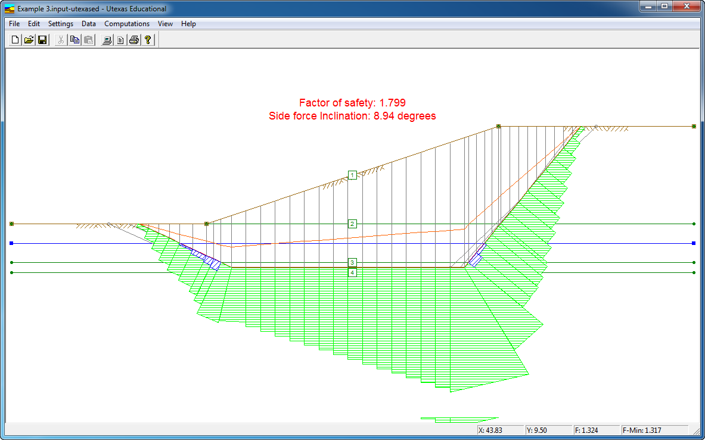
UTEXAS
Developed by: Stephen G. Wright – University of Texas at Austin

Slide 3
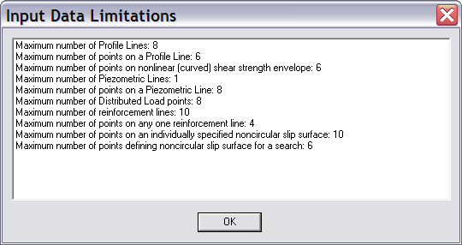
Educational Version (UTEXASED4)
The following notes are based on free educational version

Slide 4
Profile Lines

Slide 5
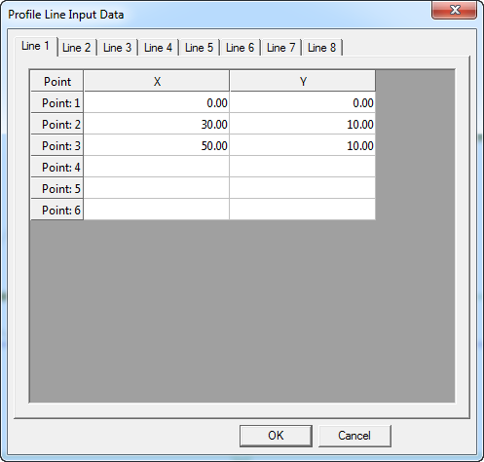
Profile Lines

Slide 6
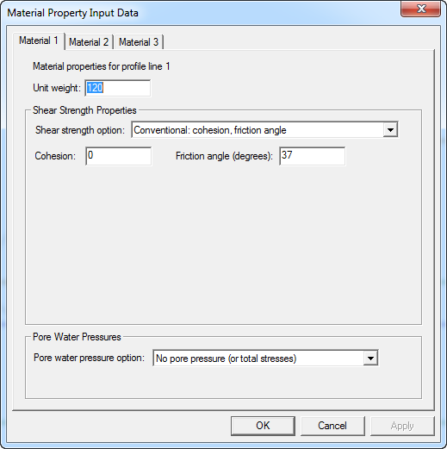
Material Properties

Slide 7
Material Properties
Unit weights
Generally recommended to use total unit wts and specify external water pressures as distributed loads rather than using bouyant unit wts.
Shear strength properties
Conventional c and φ
Linear increase of Su with depth (“c/p ratio”)
Non-linear Mohr-Coulomb envel0pe

Slide 8
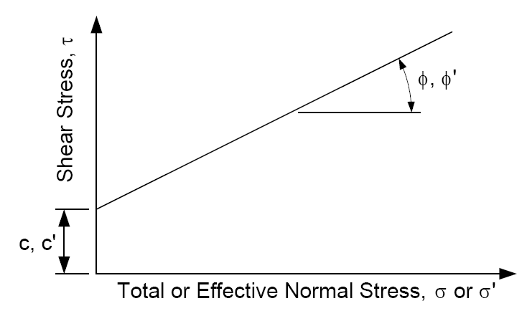
Conventional Mohr-Coulomb

Slide 9
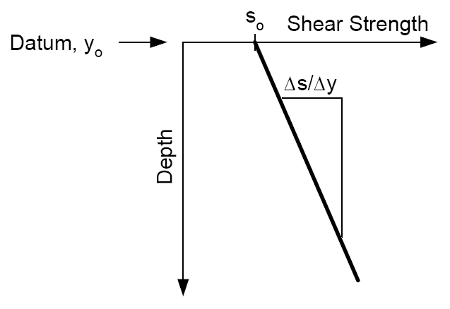
Linear Increase in Su with Depth
φ is assumed to be zero
No pore pressures should be specified

Slide 10
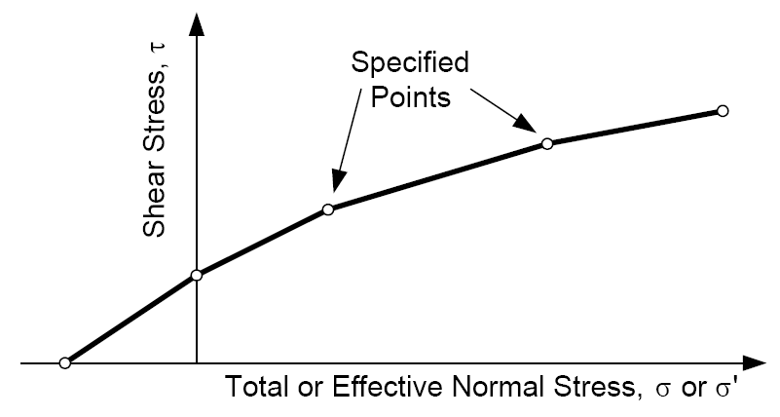
Nonlinear (Curved) Mohr-Coulomb Envelope

Slide 11
Pore Pressure Options
No pore pressure (default)
Dry
Total stress analysis
Constant r_{u} coefficient
Piezometric line
Full version includes an option to interpolate pore pressures from a SEEP2D solution

Slide 12
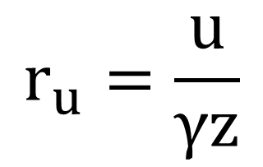
Constant r_{u} Coefficient
r_{u} = ratio of pore water pressure to total vertical overburden pressure at any point
$$r_{u}=\frac{u}{γz}$$

Slide 13
Piezometric Line

Slide 14
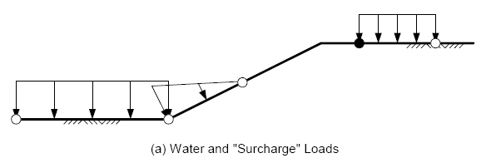
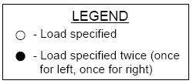
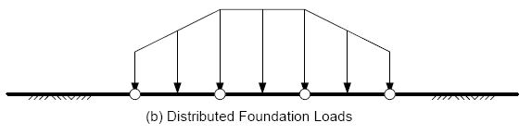
Distributed Loads
If the distributed load changes abruptly, i. e. a “step” load exists, the point where the load changes is entered twice - once with the value of the pressure to the left of the point and, the second time, with the value of the pressure to the right of the point

Slide 15
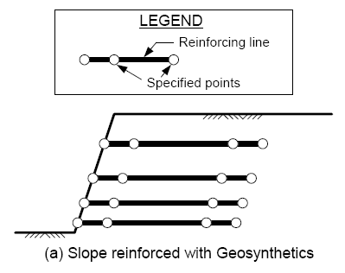
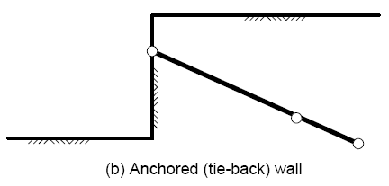
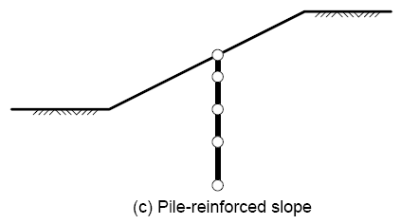
Reinforcement Lines
User inputs longitudinal (axial) and transverse (shear) force at each point.
Tensile forces are positive.

Slide 16
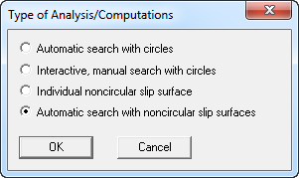
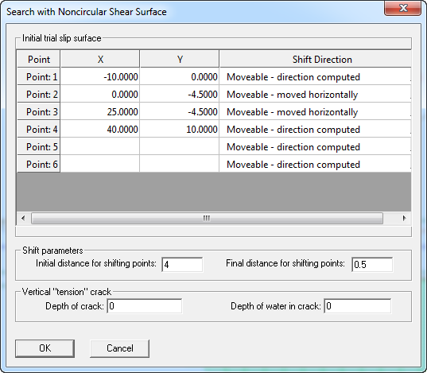
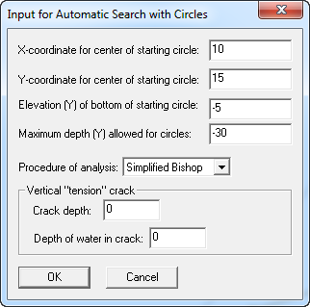
Analysis Options

