Slide 1
Analytical Solutions - 2D Profile Modeling
CE 544 – BRIGHAM YOUNG UNIVERSITY

Slide 2
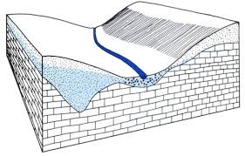
2D Profile Models
Flow is primarily in a vertical plane. Little flow in the orthogonal direction
For cases with simple geometry, we can sometimes derive simple analytical solutions to the governing equations

Slide 3
Analytical Solutions
We will review two examples:
Flow through a rectangular section
Seepage through an earth dam

Slide 4
Dupuit Assumptions
Most of the analytical solutions are based on the Dupuit assumptions:
The exit point coincides with the tailwater
The hydraulic gradient is constant along a vertical line
The hydraulic gradient is equal to the slope of the free surface

Slide 5
1. The exit point coincides with the tail water

Slide 6
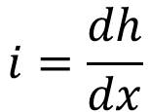
2. The hydraulic gradient is constant along a vertical line
The hydraulic gradient i (dh/dx) is independent of y
This is a good assumption if the flow is primarily horizontal
$$i=\frac{dh}{dx}$$

Slide 7
3. The hydraulic gradient is equal to the slope of the free surface

Slide 8
Comparison
α | Sin(α) | Tan(α)
0 | 0 | 0
5 | 0.087 | 0.087
10 | 0.174 | 0.176
20 | 0.342 | 0.346
30 | 0.500 | 0.577
40 | 0.643 | 0.839
50 | 0.766 | 1.192

Slide 9
Governing Equation
The Dupuit assumptions alter the governing equation. Since the hydraulic gradient is constant along a vertical line:
dh/dy = 0
q_{y} = 0

Slide 10
Governing Equation, cont.

Slide 11
Governing Equation, cont.
Assume:
h = saturated thickness

Slide 12
Governing Equation, cont.

Slide 13
Governing Equation, cont.
Note:
Substituting
"Dupuit - Forchheimer Equation"

Slide 14
Flow Through a Rectangular Section of Soil
Analytical Solution

Slide 15
Flow Through a Rectangular Section

Slide 16
Rectangular Section, cont.
Assumptions:
Darcy's law is valid
Dupuit assumptions
From above:
After double integration:

Slide 17
Rectangular Section, cont.
Apply boundary conditions:
(1) @ x = 0, h = H_{o}
(2) @ x = D, h = H_{D}

Slide 18
Rectangular Section, cont.
Substituting for C₁ and C₂:

Slide 19
Rectangular Section, cont.
Now we need an equation for q:
from
Take first derivative

Slide 20
Rectangular Section, cont.

Slide 21
Infiltration/Evaporation

Slide 22
Infiltration/Evaporation, cont.
Governing equation:
inflow - outflow + infiltration = 0

Slide 23
Infiltration/Evaporation, cont.
After double integration:
After applying boundary equations, finding
and inserting into
as shown above:

Slide 24
Confined Flow

Slide 25
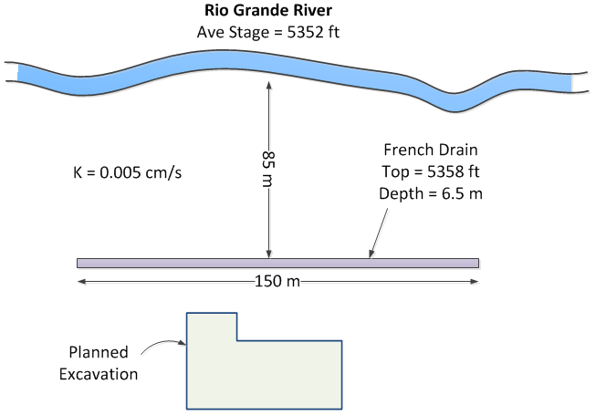
Applications
Analytical solutions for rectangular sections are often used to estimate flow from a line source (river, stream, pond, etc) to a line sink (drainage trench, excavation, etc).
River
Trench
5232 ft
5217 ft

Slide 26
Seepage Through an Earth Dam
Analytical Solution

Slide 27
Seepage Through an Earth Dam

Slide 28
Assumptions
Dupuit Assumptions
i = constant along vertical line
i = slope of free surface
Darcy's law is valid
Curve a'bc is a parabola

Slide 29
Earth Dam, cont.
Flow through section ce:
q = k i A
A = c e (1) = L sin(α)
q = k L tan(α) sin(α)
← (equation 1)

Slide 30
Earth Dam, cont.
Flow through section bf:
Flow through both sections must be equal
q_{(ce)} = q_{(bf)}

Slide 31
Earth Dam, cont.
After integrating and solving for L:
← (equation 2)

Slide 32
Earth Dam, cont.
Steps
Compute α, Δ, 0.3Δ, d
Compute L from equation (2)
Compute q from equation (1)

Slide 33
Example
compute q in m³/day/m of length
(see in-class exercise)

