Slide 1
The Finite Difference Method Part 1
CE 544 – BRIGHAM YOUNG UNIVERSITY

Slide 2
Introduction
Flow nets and analytical solutions can only be used for simple problems. For problems with complex geometry or soil conditions we typically use a numerical method to find a solution to our governing equation.

Slide 3
Discretization
Cell-Centered

Slide 4
Discretization
Mesh-Centered

Slide 5
Boundary Conditions
H=23 ft
H=23 ft
Or
No-Flow
H=26.5 ft
All other boundaries are no-flow by default

Slide 6
Formulation of FD Equations
Approximation of derivatives

Slide 7
Formulation of FD Equations
First, we will focus on the following governing equation:
a
Δy
l
i
r
Δx
b

Slide 8
Approximate First Derivatives
From l to i:
a
From i to r:
Δy
l
i
r
Δx
From b to i:
b
From i to a:

Slide 9
Approximate Second Derivates
a
l
i
r
Δx
b

Slide 10
Second Derivatives, cont.
Likewise:

Slide 11
Formulation, cont.
Substitute into governing equation:
Solve for h_{i}:
Or if Δx = Δy:

Slide 12
Alternative Formulation
Darcy’s Law and conservation of mass

Slide 13
Alternative Derivation
We can derive the same equation using Darcy's law and conservation of mass:
a
l
r
q_{x}
i
Δy
Δx
b
q_{y}

Slide 14
Alt. Derivation, cont.
Flow in:
Flow out:

Slide 15
Conservation of Mass
q_{in} - q_{out} = 0 or q_{in} = q_{out}

Slide 16
Alt. Derivation, cont.
Multiply by ΔxΔy:
If k_{x} = k_{y}

Slide 17
Boundary Conditions

Slide 18
Boundary Conditions
(1) Known head at boundary
Simply use known head for h at node rather than solving for h using the equation we derived above.

Slide 19
Boundary Conditions, cont.
(2) No flow boundaries
At node i:
i
r
q_{y} = 0
l
b

Slide 20
No-Flow Boundaries, cont.
Consider an imaginary node:
if h_{a} = h_{b}
a
Δy
l
i
r
Δy
b

Slide 21
No-Flow, Cont.
Original equation (assume Δx = Δy):
Substitute h_{b} for h_{a}:

Slide 22
Flow at a Corner
a
Δy
Δx
Δx
l
i
l
i
r
Δy
b
b
At node i:

Slide 23
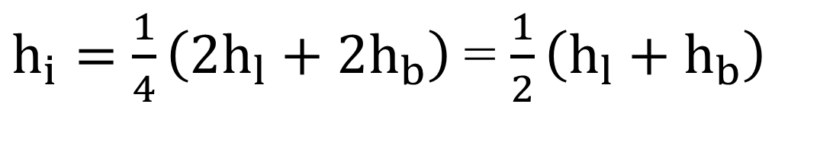
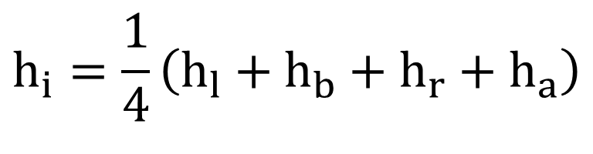
Flow at a Corner, cont.
Original equation:
$$h_{i}=\frac{1}{4}\left(h_{l}+h_{b}+h_{r}+h_{a}\right)$$
Substitute h_{b} for h_{a} and h_{l} for h_{r} (assume Δx = Δy):
$h_{i}=$ $\frac{1}{4}\left(2h_{l}+2h_{b}\right)$= $\frac{1}{2}\left(h_{l}+h_{b}\right)$

Slide 24
Flow at a Corner, Case 2
a
Consider derivation:
l
i
r
a
q_{y}
b
l
i
r
For this type of corner we use a different approach.
q_{x}
b

Slide 25
Flow at a Corner, Case 2 (cont.)
Flow in:
q_{in} = q_{left} + q_{bottom}
Flow out:
q_{out} = q_{right} + q_{top}

Slide 26
Flow at a Corner, Case 2 (cont.)
For conservation of mass:
q_{in} - q_{out} = 0 or q_{in} = q_{out}

Slide 27
Flow at a Corner, Case 2 (cont.)
If k_{x} = k_{y} and Δx = Δy, the equation simplifies to:

Slide 28
No-Flow BC, General Case
Set up equation for h_{i} using quadrants and coefficients. Multiply head of all nodes by 1/2 times the number of pervious quadrants adjacent to node and divide by the total number of pervious quadrants
a
1/2
1/2
l
1/2
i
1/2
r
1/2
1/2
1/2
1/2
b
Assume Δx = Δy

Slide 29
Example
a
h_{l} (1) + h_{b} (1/2) + h_{r} (1/2) + h_{a} (1) - 3 h_{i} = 0
Solving for h_{i}:
l
i
r
b

Slide 30
Sheetpiles
Apply general equation:

Slide 31
Exercise

Slide 32
Exercise
Each red dot become a cell in the spreadsheet

Slide 33
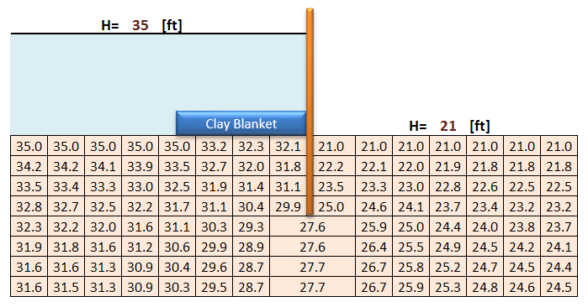
Exercise

