Slide 1
MODFLOW Solvers
CE 547 – BRIGHAM YOUNG UNIVERSITY

Slide 2
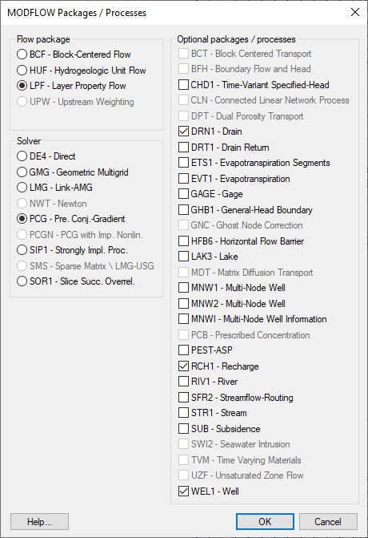
Solver Packages
User must select a solver to use with each simulation
Most solvers use an iterative solution algorithm

Slide 3
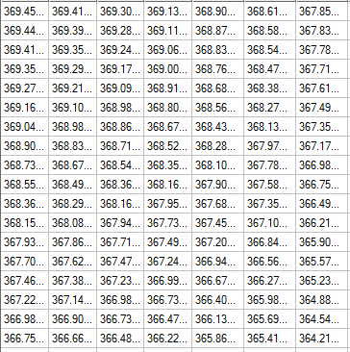
Iterative Solvers
User provides initial guess of head values
Starting head values are iteratively “tweaked” until head differences satisfy governing equation
Each solver uses a different algorithm to modify heads
Sometimes we need to switch solvers or tweak solver parameters to get a model to converge

Slide 4
Solver Packages
Code | Name | Notes
SIP1 | Strongly Implicit Procedure | One of the original solvers. Simple but can have speed and stability issues.
SOR1 | Slice-Successive Over-Relaxation | One of the original solvers. Can result in incorrect solutions. Not recommended.
PCG2 | Pre-Conditioned Conjugate Gradient | Good all-around solver. Default solver in GMS.
PCGN | PCG with Improved Non-Linear Control | Newer version of PCG2 package. More stable under some conditions.
NWT | Newton Solver | Used with MODFLOW-NWT. Best for wetting/drying problems.
GMG | Geometric Multi-Grid | Multi-grid solver requires more memory but results in faster solution. USGS version.
DE4 | Direct Solver | Direct matrix solution (non-iterative).
LMG | Link - Algebraic Multi-Grid | Commercial multi-grid solvers. Outstanding performance but extra cost.
SMS | Sparse Matrix Solver/LMG-USG | For use with MODFLOW-USG only.

Slide 5
Basic Solver Options
Max number of iterations
Iteration stops at this point regardless of convergence
Convergence tolerance
Iteration stops if max head change is less than this amount
Acceleration/damping* parameter
Controls the amount of adjustment made to heads at each iteration
Options
=1.0 Default value. Head changes standard amount determined by solver
<1.0 Head change is reduced. Improves convergence but results in slower solution
>1.0 Converges faster but may be unstable
*In the PCG2 package, this is called the “damping” parameter

Slide 6


Slide 7
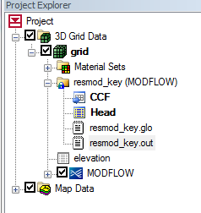
Troubleshooting Steps
Review command line output from MODFLOW (Run MODFLOW Window)
Run Model Checker
Look in MODFLOW output file (*.OUT)

Slide 8
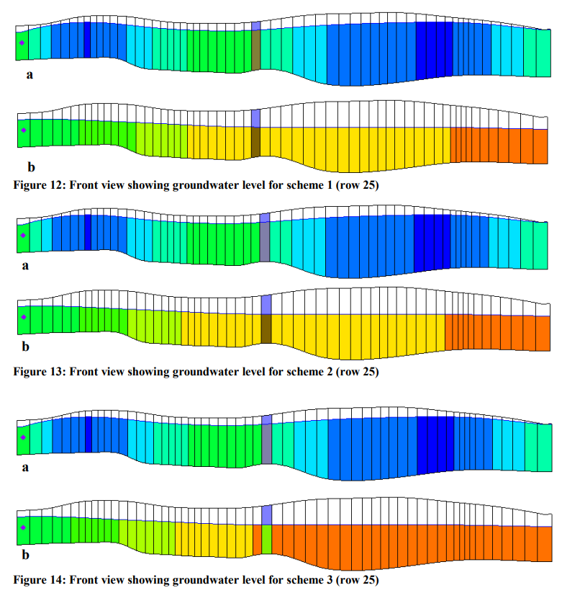
Improper Aquifer Properties
K = 0
K is too small
Heads can become very high
K is too high
flat water table
areas go dry

Slide 9
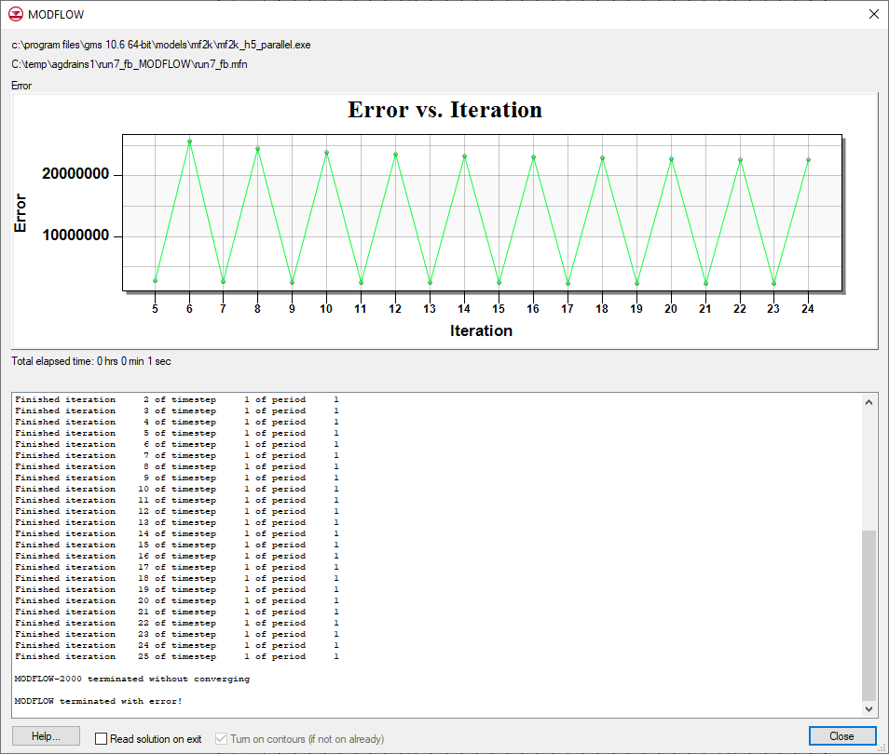
Unbalanced Flow Budget
If you do not provide sufficient head-dependent boundaries (acts as a flexible source/sink) you may end up with a water imbalance that prevents convergence.
This is similar to putting water in a tub faster than it can drain. It will eventually overflow – i.e., it cannot reach an equilibrium.

Slide 10
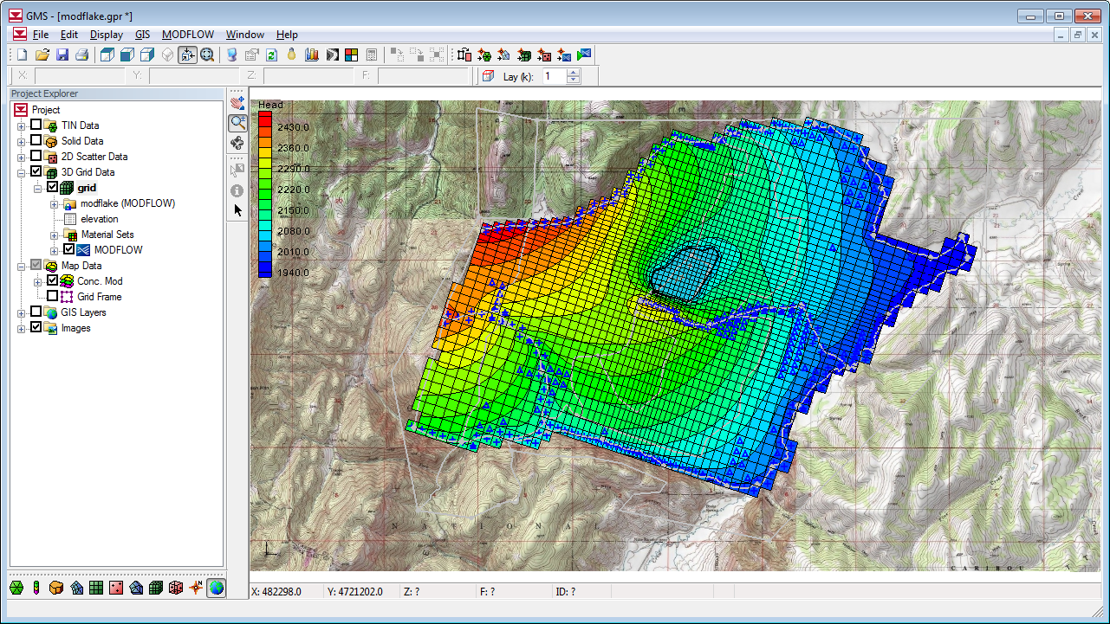
Initial Conditions (Starting Heads)
In most cases, letting starting heads = ground surface (top of layer 1) results in a stable model
In some cases, you need to have the starting heads closer to the final solution in order for the model to converge

Slide 11
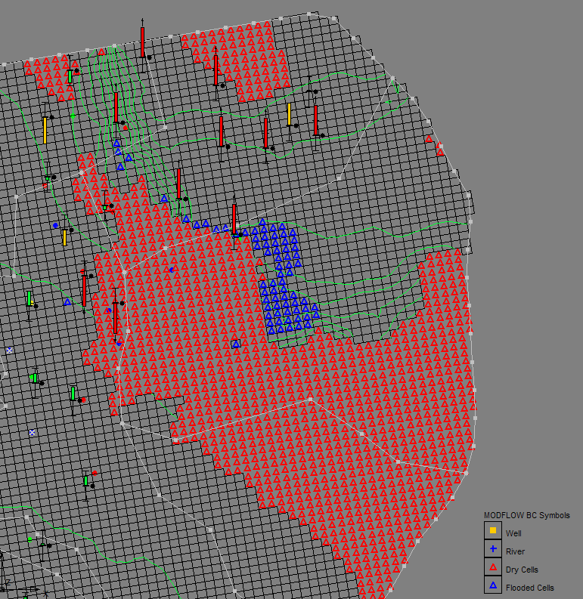
Wetting and Drying
With most solvers, if head drops below bottom of cell, the cell becomes dry and is “turned off”
Can occur during any portion (iteration) of solution process, not just at end of time step
Causes
Head overshoot
Model parameters
Transient conditions

Slide 12
Head overshoot
Starting head
Solver guesses how much to adjust head downward
Cell goes “dry”, and is turned off during remainder of simulation
“Final” head
“Final” head
Bottom elevation
Bottom elevation
Computed head
Initial Condition
After One Iteration

Slide 13
Eliminating Head Overshoot
Starting head
Starting head is closer to final head
Iteration #1
Iteration #2
Starting head
Iteration #3
“Final” head
“Final” head
Bottom elevation
Bottom elevation
Reduce Acceleration/Damping Parameter
Improve Starting Head Estimates

Slide 14
Model Parameters
Cells can go dry if:
K is too high – flat water table
Recharge is too low
Pumping rates are too large
Solution
Adjust model parameters

Slide 15
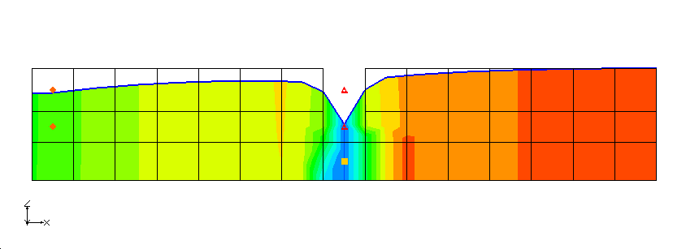
Transient Water Table
Transient conditions will cause heads to fluctuate and cells to go dry
Particularly an issue for multi-layer models

Slide 16
Rewetting Option
Option available in all flow packages (BCF, LPF, HUF)
Off by default
Rewetting increases solution time
May case solution to be less stable

Slide 17
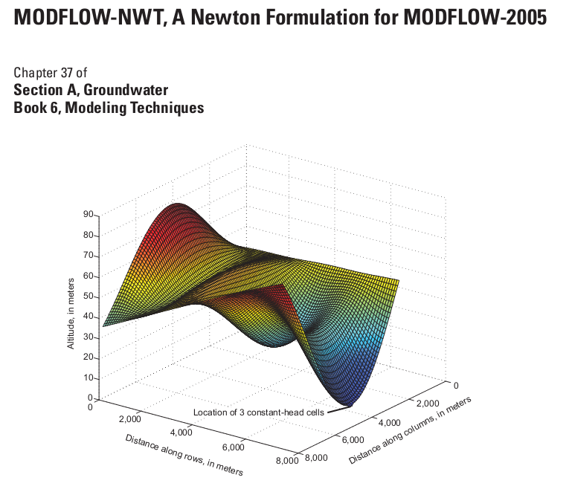
MODFLOW-NWT
New version of MODFLOW released in 2011
Designed to solve nonlinear problems due to unconfined conditions or nonlinear boundary conditions
Best solution for wetting and drying

