Slide 1
Model Calibration
CE 547 – BRIGHAM YOUNG UNIVERSITY

Slide 2
Calibration
Solution is computed by model
Simulated heads and flows are compared to field observed values
Input parameters (K, recharge, etc.) are adjusted until model outputs match field observations

Slide 3
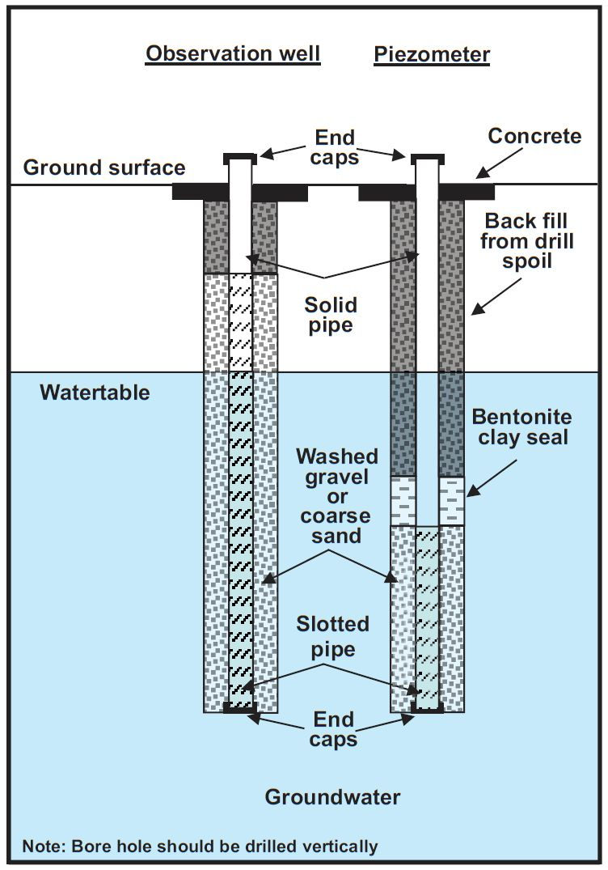
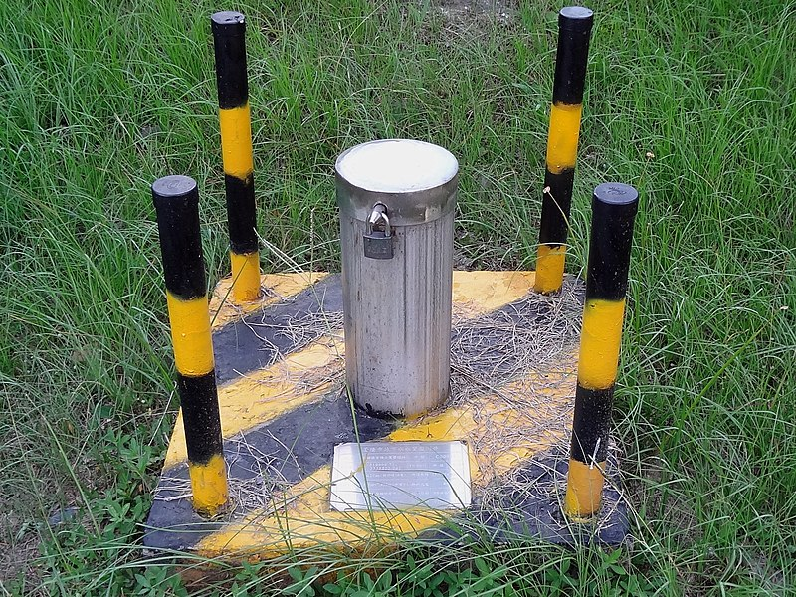
Head Observations

Slide 4
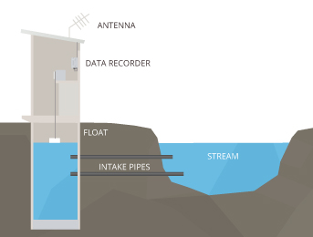
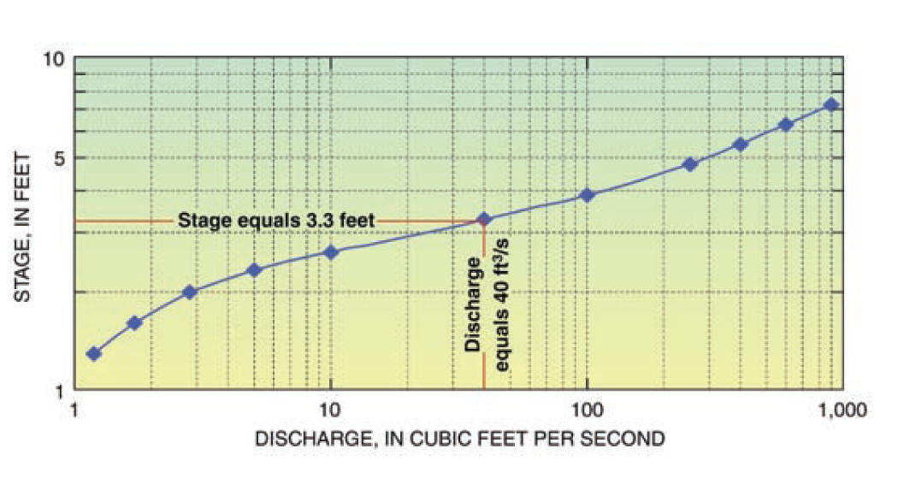
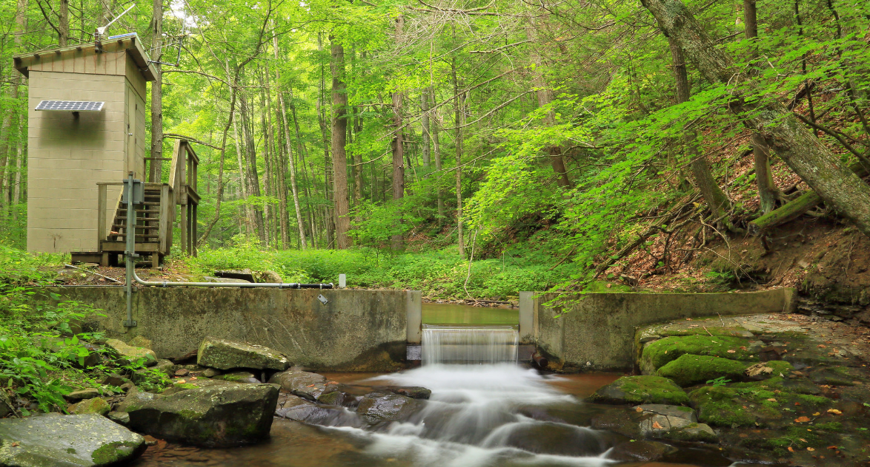
Flow Observations
Used to analyze gains/losses to baseflow

Slide 5
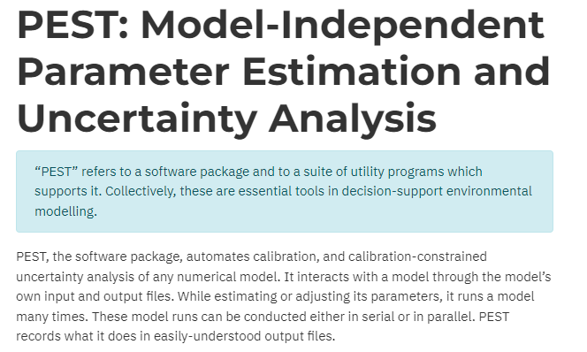
Types of Calibration
Trial and error
Manually tweak inputs and re-run model
Automated parameter estimation
Optimization utility is used to adjust input parameters in a systematic fashion

Slide 6
When is a model “calibrated”?
We should not expect a perfect fit between simulated and observed values due to:
Measurement error
Simplifying assumptions
Uncertainty in inputs (river stages, estimated pumping rates, etc.)
We generally try to get the simulated values within a certain “window” of the field observations:
Eventually you reach a point of diminishing returns

Slide 7
Calibration Error Norms
Mean Error
Mean Absolute Error
Root Mean Squared Error
Each error norm provides a numerical measure of how well the model is calibrated overall

Slide 8
Error Norms, cont.
Weighted errors:
where:
Standard deviation can be derived from interval and confidence

Slide 9
Error Norms, cont.
Sum of Squared Weighted Residuals:
where:

Slide 10
Flow Observations
Represents
Gain/loss in streams
Gain/loss in reservoirs and lakes
If flow observations are not included, the solution may be non-unique
+Q
-Q

Slide 11
Model Uniqueness
Consider a model of a basin where the only input is recharge. Water leaves system through stream and spec. head boundary. Main parameters are recharge and K.
Let’s look at cross section through main axis of site (next slide)

Slide 12
Model Uniqueness
Calibration is achieved by adjusting parameters so that the water table raises or lowers until it fits the head observations
In order to lower water table:
Increase K (water leaves system more rapidly)
Reduce Recharge (less water entering system)
In order to raise water table:
Decrease K (causes water to mound, raising water table)
Increase Recharge (causes water to mound)

Slide 13
Model Uniqueness
Looking at head observations only, calibration can be achieved via:
Low K, low recharge
High K, high recharge
Theoretically, there are an infinite number of combinations of recharge/K that will “calibrate” the model

Slide 14
Model Uniqueness
If we include a flow observation for the stream, we eliminate one unknown/degree of freedom from the system since the recharge then becomes fixed.
The only remaining unknown is then the hydraulic conductivity (K) and the number of combinations of parameters resulting in “calibration” is drastically reduced → A unique model/solution

Slide 15
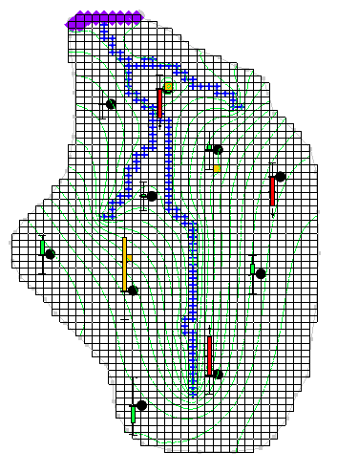
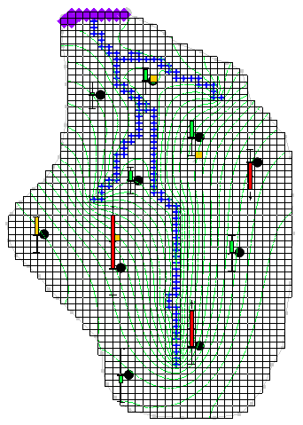
Example
In both cases, R is fixed and K is allowed to vary.
K=0.8
R=0.0012
Error (SSWR) = 142
K=0.2
R=0.0003
Error (SSWR) = 157

Slide 16
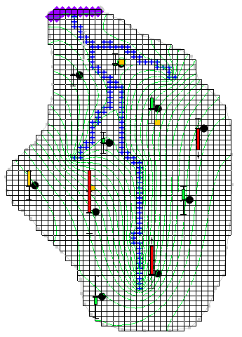
Example, cont.
In this case, we add a flow observation to the river network and solve again for K and R
K=0.42
R=0.00067
Error (SSWR) = 125 (including flow error)

