Slide 1
Calibration Tools in GMS
CE 547 – BRIGHAM YOUNG UNIVERSITY

Slide 2
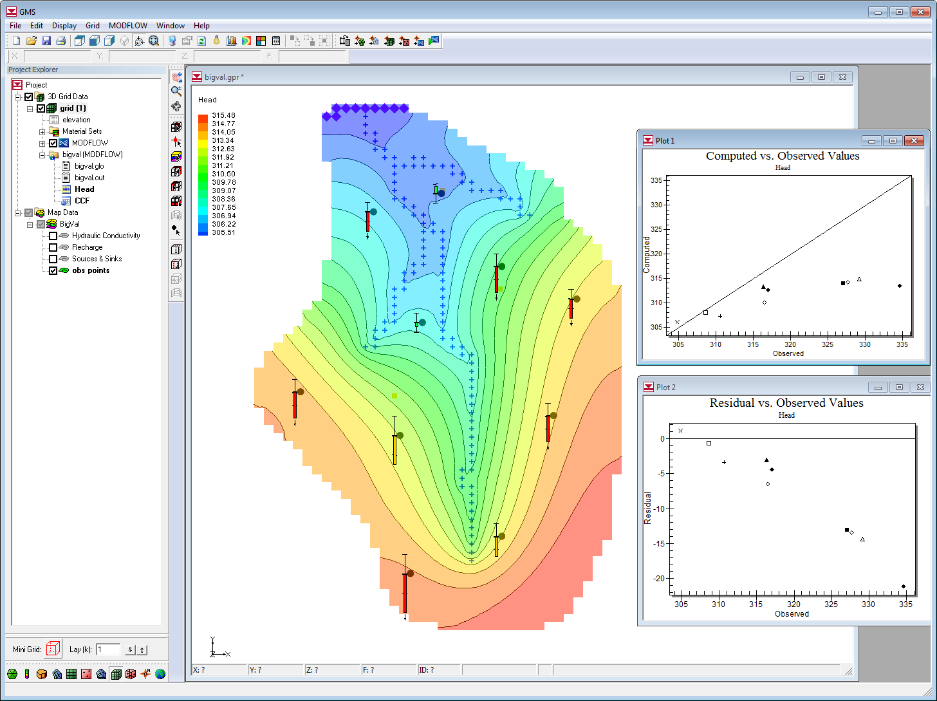
Calibration in GMS
Observation points
Flow observations
Calibration statistics
Automated parameter estimation with PEST

Slide 3
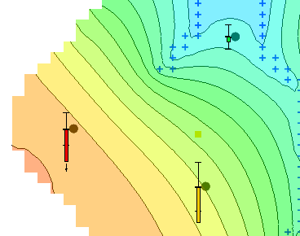
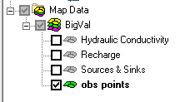
Observation Points
Primarily used for head values observed in monitoring wells
Points are contained in an “Observation Coverage” in the Map module

Slide 4
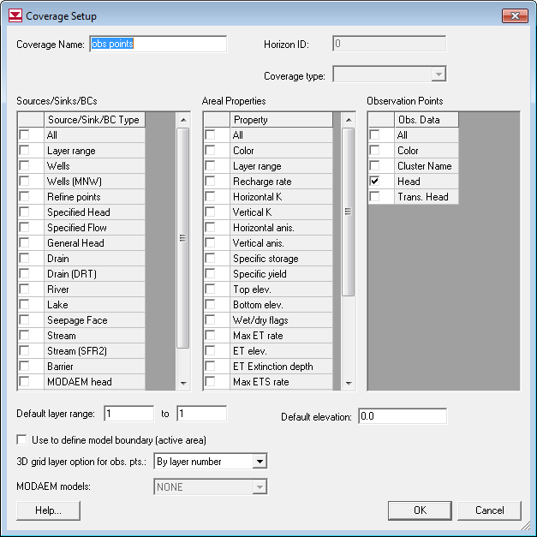
Observation Coverage Setup

Slide 5
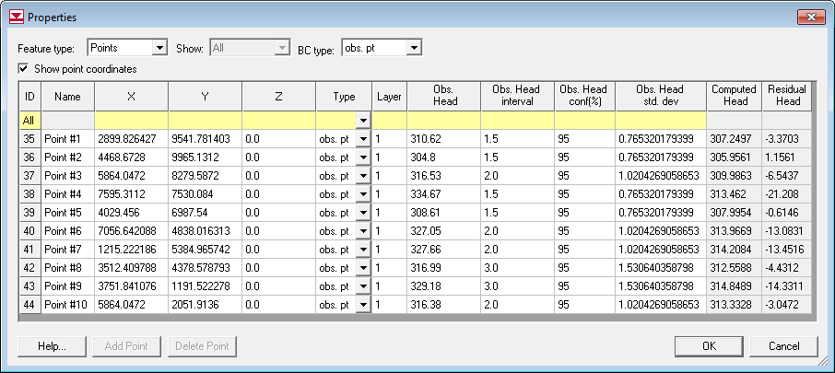
Observation Point Properties

Slide 6
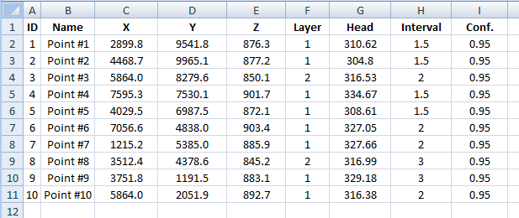
Importing Calibration Points
Can be entered/organized in spreadsheet
Import options
Save to *.txt file and open using Text Import Wizard
Cut and paste directly to Properties dialog
Required. All other columns are optional.

Slide 7
Calibration Targets

Slide 8
Magnitude of Error

Slide 9
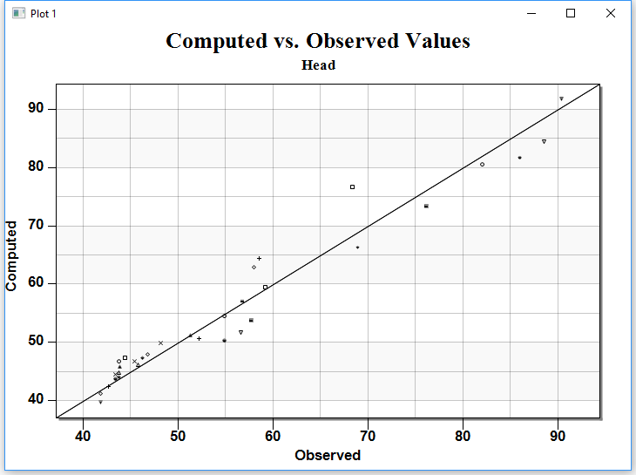
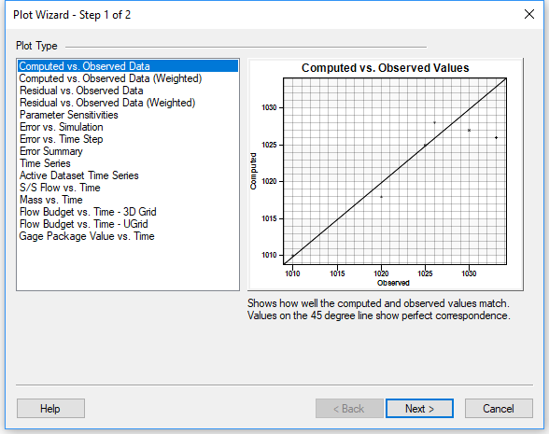
Calibration Statistics Plots
Click on Create Plot macro
Select plot type

Slide 10
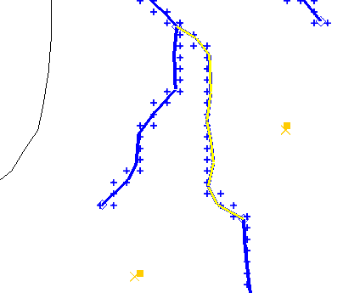
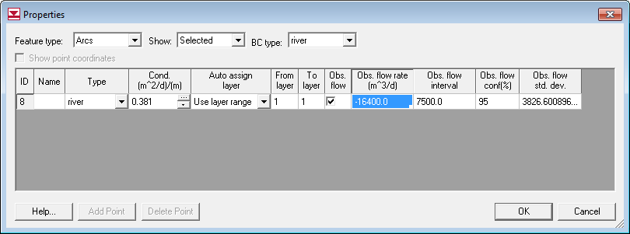
Observed Flows
Assigned to arcs and polygons in source/sink coverage

Slide 11
Arc Groups
Observed flows may span multiple arcs
Arc group must be defined so that computed flow is summed correctly
Create Group
Select arcs
Select Create Arc Group
Assign Flow
Select with Select Arc Group tool

Slide 12
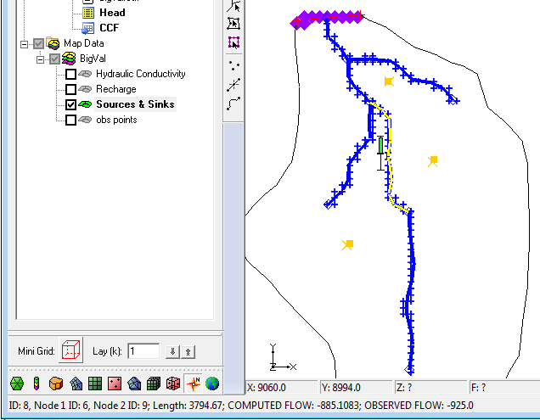
Displaying Computed Flows
Selecting object displays flow
Multi-select for total flow

Slide 13
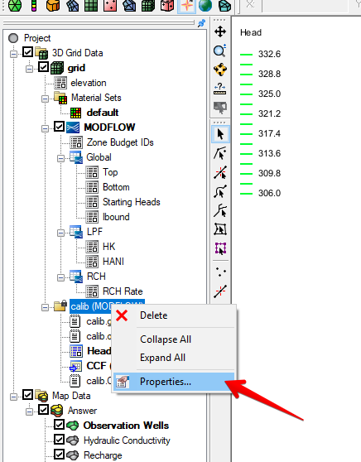
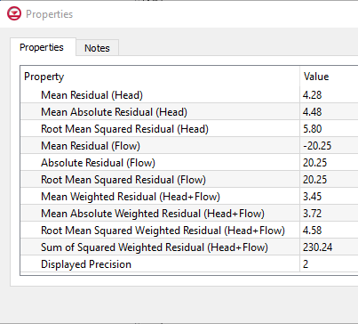
Comprehensive Error Summary
Right-click on solution folder in Project Explorer window
Select Properties

