Slide 1
Automated Parameter Estimation
CE 547 – BRIGHAM YOUNG UNIVERSITY

Slide 2
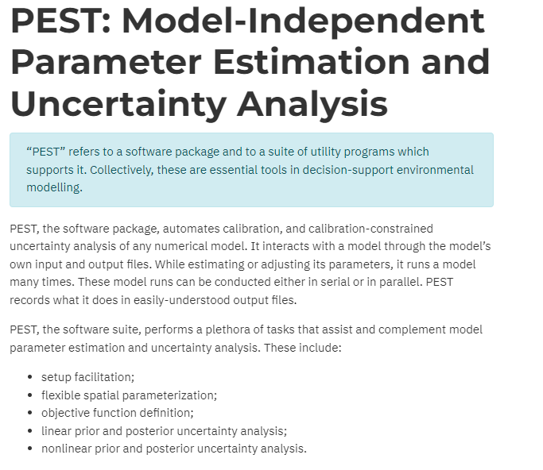
Parameter Estimation Software
Optimization algorithm that minimizes residual error by iteratively perturbing selected input parameters
Developed by John Doherty (Brisbane, Australia)
Fully integrated in GMS

Slide 3
Automated Parameter Estimation
Steps
Build a working MODFLOW model
Enter field-observed data
Parameterize the model
Build parameter list
Edit PEST options
Edit group weight multipliers
Save and run model
View output/results
Import optimal parameter values

Slide 4
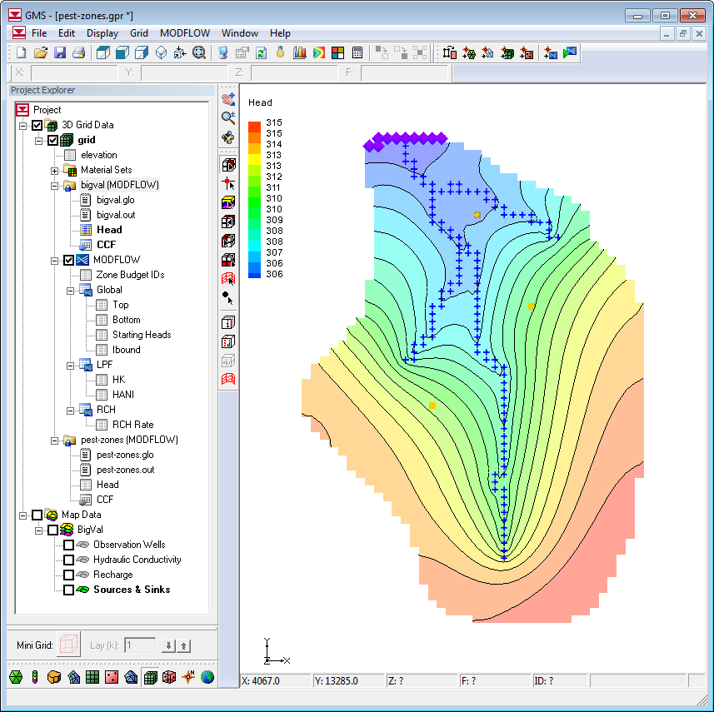
Step 1. Build a Working MODFLOW Model
You must have a stable, working MODFLOW model
Find good set of starting values for parameters
Copy computed heads to starting heads array for faster convergence

Slide 5
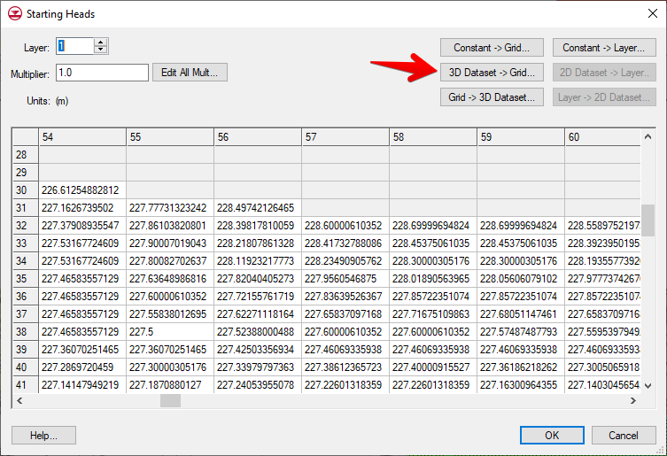
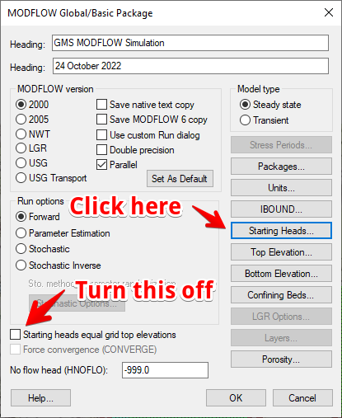
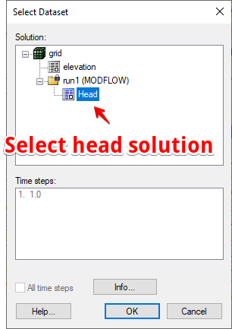
Copying Starting Heads
2
1
3

Slide 6
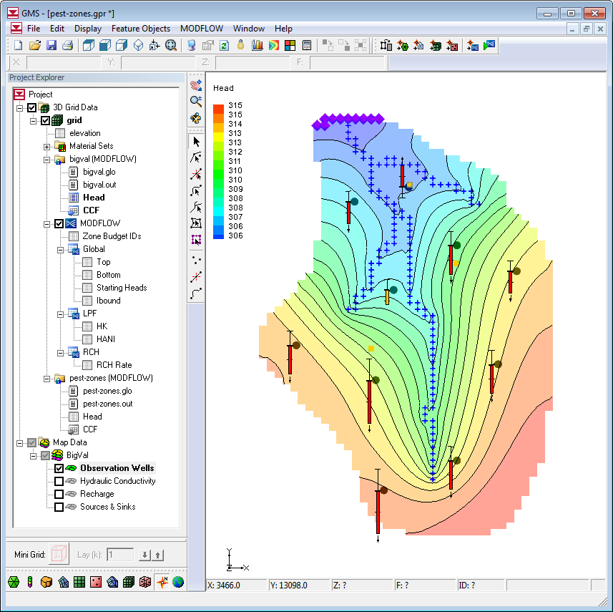
Step 2. Enter Field-Observed Data
Enter observed head and flows
Remember that calibration interval is used to assign weights to observations
Large int. = small wt.
Small int. = large wt.

Slide 7
Step 3. Parameterize the Model
Identify set of input values you want the inverse model to optimize
Number of parameters must be less than the number of observations (except for pilot point option)
Primary methods:
Zonation
Multiplier arrays
Pilot points

Slide 8
Legal Parameters
Flow package
Source/sink packages
HK – Horizontal hydraulic conductivity*
HANI – Horizontal anisotropy
VK – Vertical hydraulic conductivity
VANI – Vertical anisotropy (stored in the VK array)
SS – Specific storage
SY – Specific yield
VKCB – Vertical hydraulic conductivity of quasi-3D confining layers
RCH – Recharge flux*
RIV – Riverbed conductance
DRN, DRT – Drain conductance
GHB – General head conductance
STR, SFR – Stream conductance
WEL – Well pumping rate
CHD – Time variant specified head
EVT, ETS – Evapotranspiration rate
HFB – Hydraulic characteristic
*most sensitive

Slide 9
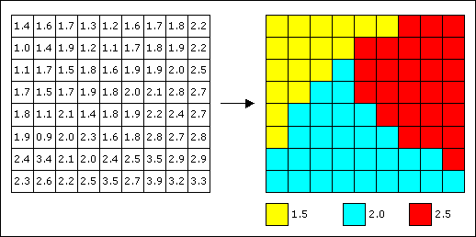
Zonation
Arrays are split into zones
Zones best defined in conceptual model using polygons

Slide 10
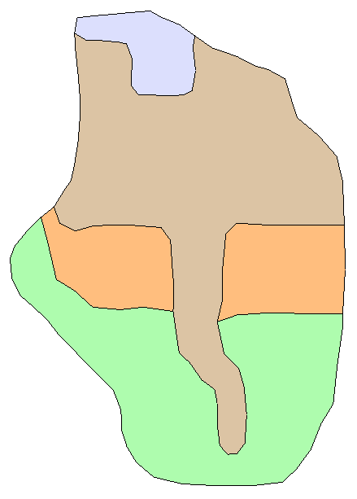
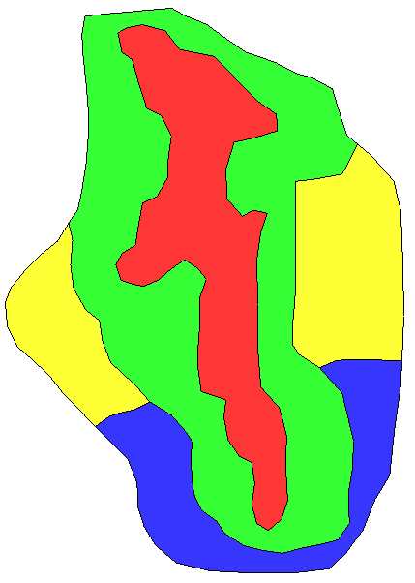
Zonation
Recharge Zones
K
Zones

Slide 11
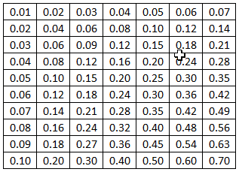
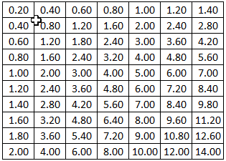
Multiplier Arrays
x 20 =
Multiplier Array
Parameter
MODFLOW Array
One parameter controls the entire array, but the array is a warped function that is scaled up or down as opposed to a single zone.

Slide 12
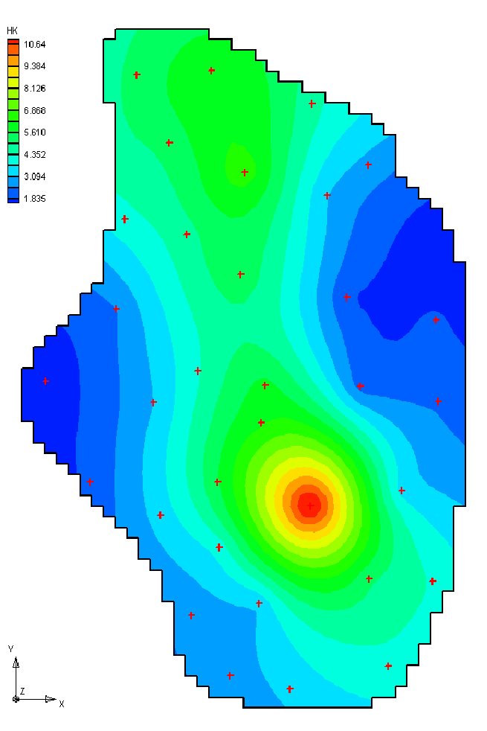
Pilot Point Method
Used for K and recharge only
Arrays are interpolated from values at scatter points
We will cover this in more detail in our next lecture.

Slide 13
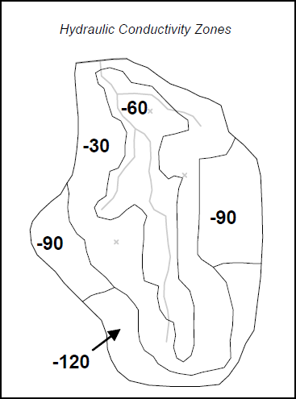
Key Values
Parameter zones are defined by entering "key values"
Use a value that would not be expected in the input file (-900, -800, -700, etc.)
These are not input values – they simply mark the locations of parameters

Slide 14
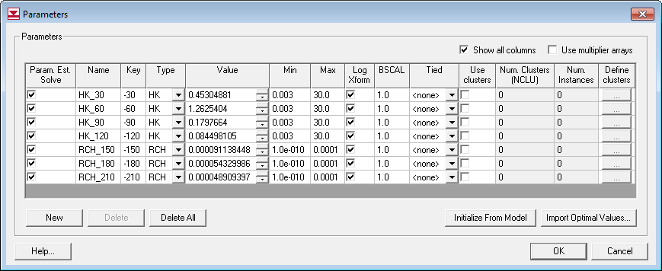
Step 4. Build Parameter List

Slide 15
Parameters
A parameterized model can be used many ways:
Forward run
Normal run where heads and flows are computed based on parameter values
Great for manual calibration
Inverse run
PEST is used to compute optimal parameter values that minimize residuals
May involve hundreds or thousands of model runs
Stochastic simulation
We will cover this layer

Slide 16
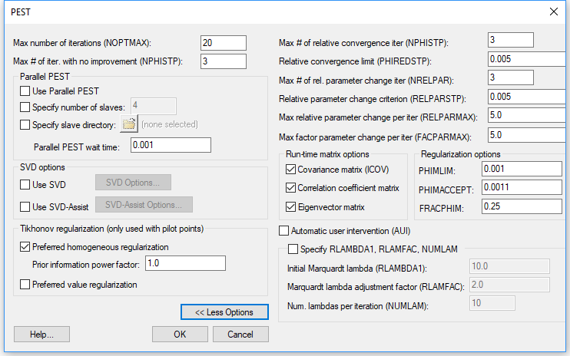
Step 5. Edit PEST options
Parallel PEST can be used with multi-core machines to reduce processing time.
SVD can make inversion process more efficient, especially with large numbers of parameters.
(see pilot point slides)
Notes:
From JD:
Ok, settings. There is no optimum setting for PHIMLIM when you do a PEST run for the first time. Set it lower than you think the fit can be, and thereby find out how good a fit you can get. Your default of 0.001 is fine On the next PEST run, set it on a value that you think is reasonable, and at a level of fit that you don't want PEST to exceed. This is case-specific. If necessary, set the REGCONTINUE variable to "continue" to ensure that the smoothest parameter field possible achieves this fit.
When setting PHIMLIM very low on the initial "probing" PEST run, it is good to set FRACPHIM to 0.1 so as to allow Tikhonov regularisation to have some effect before it is completely abandoned in pursuit of the perfect fit.

Slide 17
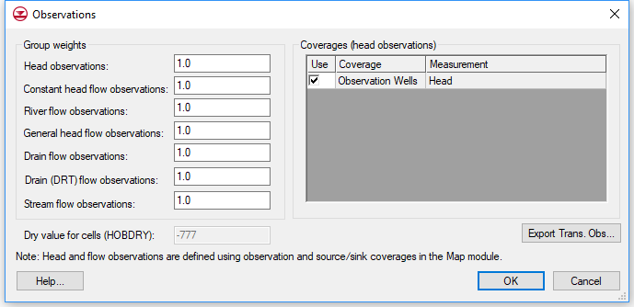
Step 6. Edit Group Weight Multipliers
This is to ensure that head observations don’t overwhelm flow observations (or vice versa).
This is typically done after first running PEST and checking the solution to see if the fit is balanced.
Defaults values are usually OK.

Slide 18
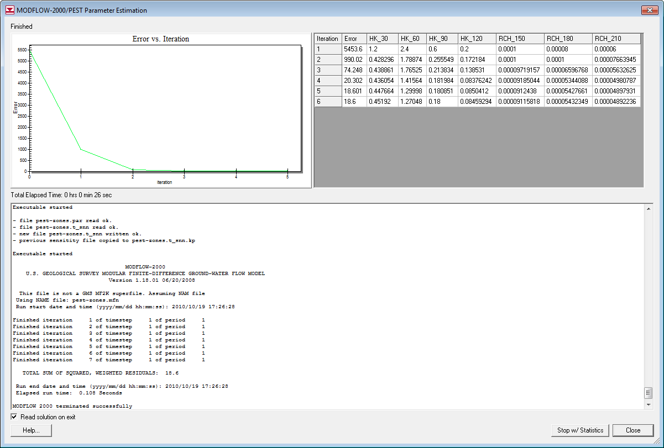
Step 7. Save and Run Model

Slide 19
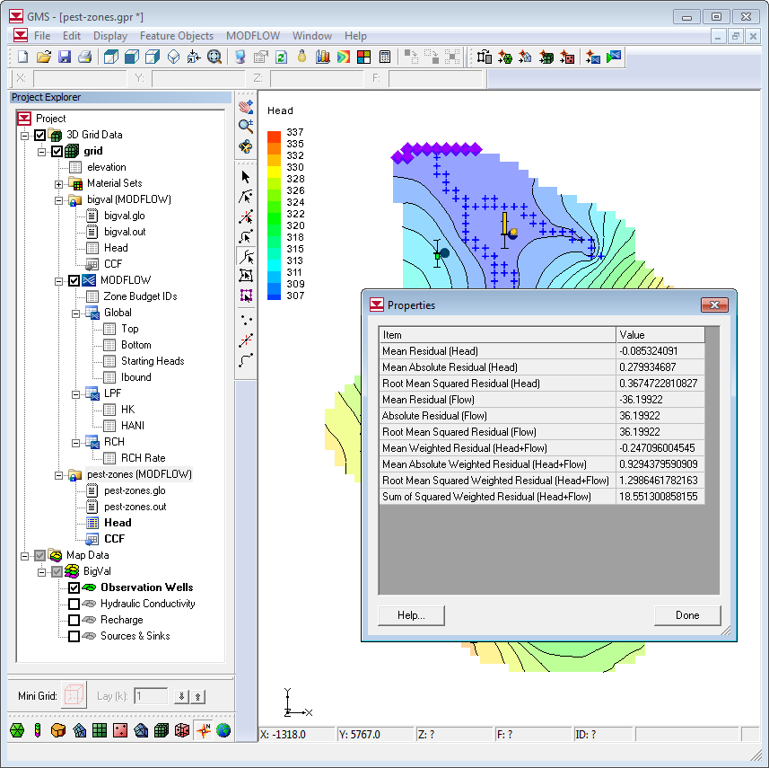
Step 8. View Output/Results
MODFLOW solution corresponds to optimal parameter values
Calibration targets/plots are updated
Right click on solution folder in data tree to see global error norms

Slide 20
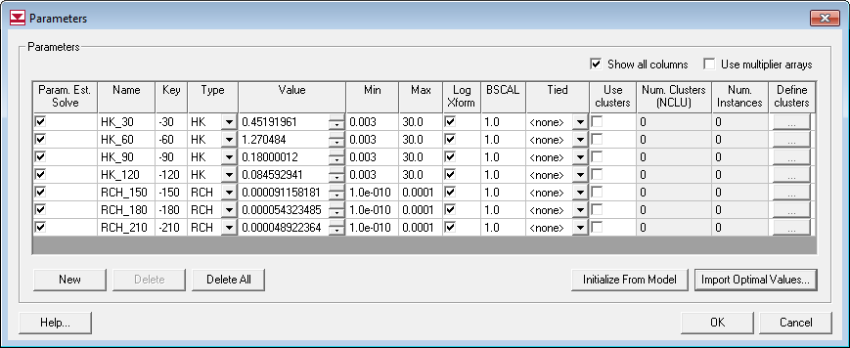
Step 9. Import Optimal Parameters
Output from PEST is a list of optimal parameter values
Optimal values are not automatically imported to model
Can be loaded into starting value field in parameter list using the "Import Optimal Values" button

Slide 21
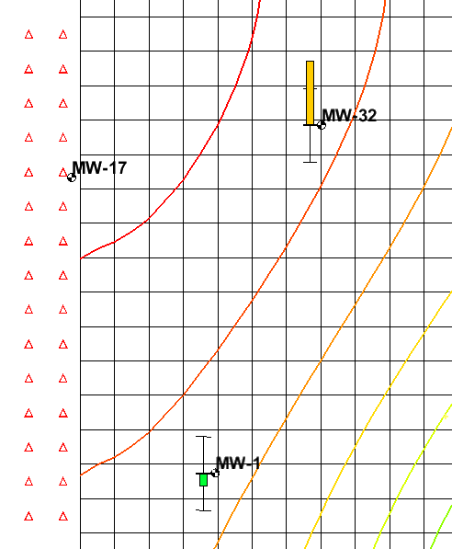
Inverse Model Stability
MODFLOW solver must converge in order for PEST to run successfully
Increase max iterations
Decrease acceleration parameter
Cells going dry cause irregularities in objective function, resulting in instability in optimization algorithm

Slide 22
Model Uniqueness
When using PEST, look in the *.MTT file and compare the max to min Eigen value
If max/min > ~10⁸, then model is non-unique
max/min = 8.0549e-03/4.755e-09 = ~10⁶ (unique)
Notes:
What you say is true Norm. But when the eigenvalue ratio is very high, then there is an awful lot of wiggle room in that uniqueness.
Or at least there appears to be from the point of view of the parameter estimator.
So, for example, compared with other parameters, a certain parameter may appear to be sensitive if its value is expressed in certain units. Now if the same parameter is expressed in other units (for example grams instead of kilograms), it will appear to be relatively INsensitive compared to other parameters, strictly on account of the units it is expressed in. Its uncertainty will therefore be 1000 times higher compared to that of other parameters.
In the end, all of this should all come out in the wash. But the trouble is, we now have a numerical situation where one parameter is very insensitive, just because it is expressed in grams. Meanwhile PEST must invert the XtQX matrix to estimate all parameters. The noise that attends this inversion process is amplified by the condition number of the matrix. In PEST noise comes from finite difference derivatives calculation - which is seriously compromised if a parameter is very insensitive - at the same time as that noise gets amplified more because of the high condition number. So in the end, the pragmatics of having to do the inversion numerically starts to erode the process.
Let me know if you want me to discuss this more (or I could call if that would help).
Best wishes
John
At 09:13 AM 12/11/2010, you wrote:
>Yes, it does have recharge and both are log-scaled.
>
>But this doesn't answer my original question. To me, whether or not a
>model is unique should be a function of the final optimal parameter
>values (and field observations), not the mechanism one uses to perturb
>those values on the way to achieving a solution.
>What am I missing?
>
>Norm
>
>-----Original Message-----
>From: John Doherty [mailto:johndoherty@ozemail.com.au]
>Sent: Monday, November 08, 2010 3:50 PM
>To: Norm Jones
>Subject: RE: Eigenvalue question
>
>Actually I'm not surprised by that Norm. I'll bet that recharge is on
>of the parameters. It is a small number and hence is super-sensitive.
>This super sensitivity can distort the numerical solution procedure of
>the inverse problem - kind of artificially. So, one again - if in doubt
>- log transform. Or scale parameters like recharge (using the SCALE
>thing in the "parameter data" section) so that its sensitivity is about
>the same as that of the other parameters. This can preserve what is
>normally a pretty linear relationship between model outputs and
>recharge.
>
>Keep asking questions by all means. Send me the files if you would like
>a more context-specific explanation.
>
>Good luck
>
>John
>
>
>At 08:45 AM 9/11/2010, you wrote:
> >I am teaching a groundwater modeling class and I am grading my second
> >midterm. I have a simple model that I asked them to convert from
> >forward to inverse mode and then comment on the model uniqueness by
> >looking at the eigenvalues. I did not tell them to log-transform but
> >about half of the class did. If you log-transform, the ratio is about
> >1e5. If you don't log-transform, the ratio is about 1e11. Nothing
> >else changes. I can send you a copy of the model if you are
> >interested.
> >
> >Norm
> >
> >-----Original Message-----
> >From: John Doherty [mailto:johndoherty@ozemail.com.au]
> >Sent: Monday, November 08, 2010 3:20 PM
> >To: Norm Jones
> >Subject: Re: Eigenvalue question
> >
> >Hello Norm
> >
> >Actually I don't think it really depends on whether the parameters
> >are log-transformed or not. If the parameters are log transformed,
> >then that is how PEST sees them when it calculates the eigenvalues,
> >and that is what matters in the end. At that stage, PEST does not
> >care whether they are log-transformed or not.
> >
> >Actually, here is what I do now. This pretty much works all the time.
> >Therefore it does not matter whether a problem is well-posed or ill-posed.
> >
> >1. I set up a PEST input dataset.
> >2. Use the ADDREG1 utility to add Tikhonov regularisation.
> >3. Maybe use the PWTADJ1 utility to get inter-group weighting right.
> >4. Use truncated svd to solve. I set EIGTHRESH at 5e-7 5. Set RLAMFAC
> >to -3 for fast-ranging Marquardt lambda and initial lambda to 10.
> >
> >If using SVD assist I use as many super parameters as I have
> >resources for, and solve for super parameters using svd to keep
> >things numerically stable.
> >
> >This pretty much works all the time.
> >
> >If in doubt I log-transform parameters, for this helps to equalize
> >sensitivities and normalizes parameters wrt their innate variability
> >(which helps the svd process).
> >
> >Best wishes
> >
> >John
> >
> >
> >
> >
> >At 06:57 AM 9/11/2010, you wrote:
> > >Hey John,
> > >
> > >Long time, no see. I hope all is well with you.
> > >
> > >I have a question for you. You once told me that one can look at
> > >the ratio between the max and min eigenvalue in the *.mtt file to
> > >check on model non-uniqueness. If the ratio is less than about 1e8,
> > >the model should be unique. However, the ratio will depend on
> > >whether or not one is doing a log transform of the parameters. I
> > >assume your rule of thumb is for non-log-transformed parameters.
> > >What should one do with log-transformed parameters?
> > >
> > >Norm
> >
> >
> >Watermark Numerical Computing
> >336 Cliveden Avenue
> >Corinda 4075
> >Australia
> >
> >Phone: +61 7 3379 1664

Slide 23
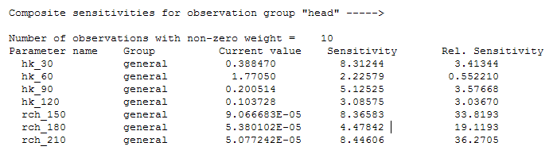
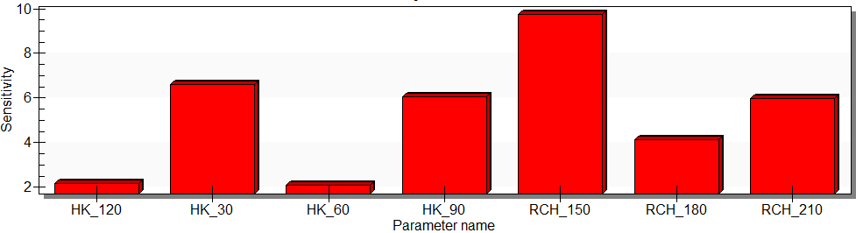
Sensitivities
How much does a parameter affect the model error?
Look in the *.SEN file for a summary of parameter sensitivities relative to each observation group
Or generate parameter sensitivity plot

Slide 24
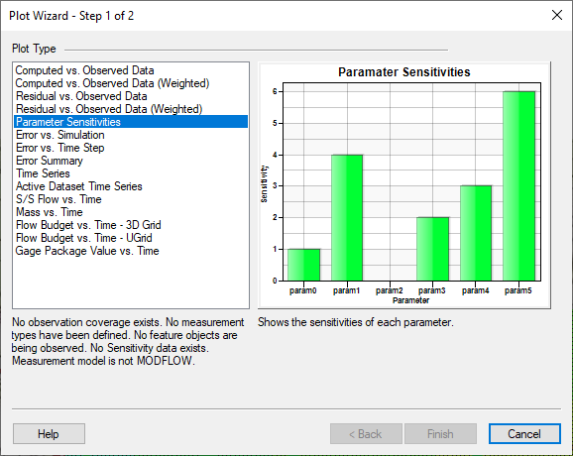
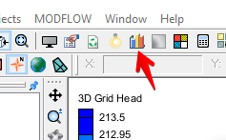
Sensitivity Plot

