Slide 1
Parameter Estimation The Pilot Point Method
CE 547 – BRIGHAM YOUNG UNIVERSITY

Slide 2
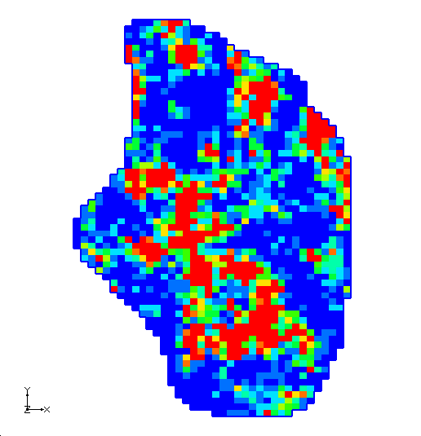
Aquifer Heterogeneity
Aquifer properties vary spatially
Sometimes it is difficult to select discreet zones with constant properties
We need a method that simulates heterogeneity with a small number of parameters

Slide 3
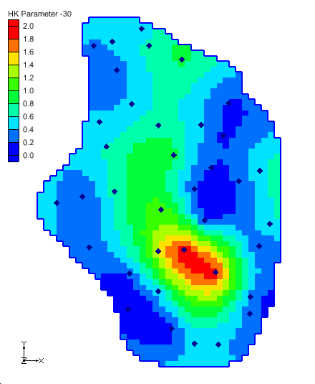
The Pilot Point Method
The user creates a set of “pilot points” and assigns a parameter value to each (K, Recharge)
The properties of the aquifer are spatially interpolated from point data.

Slide 4
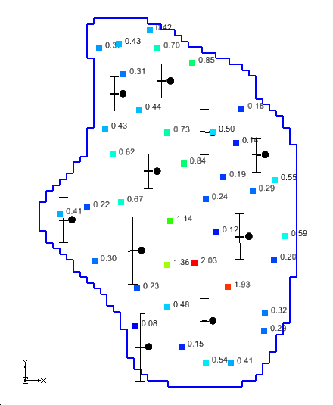
Pilot Points
PEST warps the interpolated surface by adjusting the values at the pilot points based on feedback from observations during the parameter estimation process.

Slide 5
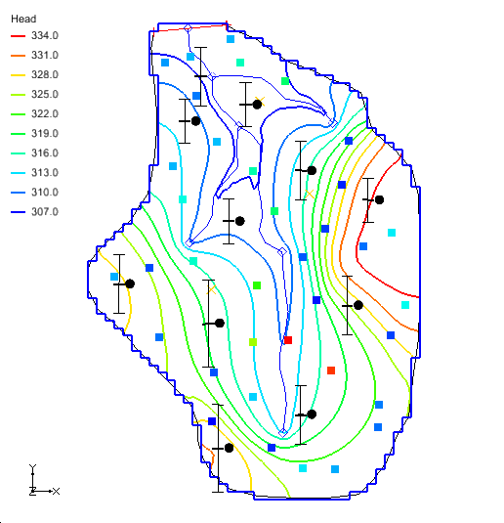

Pilot Point Advantages
Can produces calibrated models with low error
Does not require arbitrary zonation

Slide 6
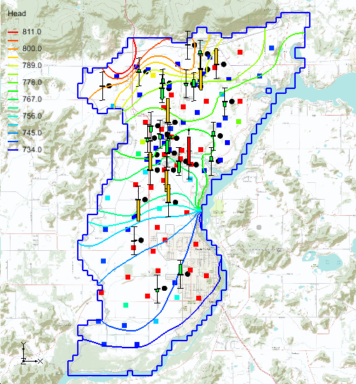
Pilot Point Disadvantages
Longer run times
1 parameter created for each point
More parameters require more model runs
Decrease time by using:
SVD-Assist
Parallel PEST

Slide 7
Tikhonov Regularization
Normally #parameters must be < #observations
PEST uses regularization to:
add stiffness to the objective function
allow for more parameters than observations
# Observations: 25
# Parameters: 85

Slide 8
Regularization Options
Preferred homogenous regularization*
In the absence of any strong influence from the PEST objective function, pilot points that are near to one another should have about the same value.
Preferred value regularization
In the absence of any strong influence from the PEST objective function, the pilot point values should be equal to their starting value.
Both methods provide stiffness and stability to the solution
*default method

Slide 9
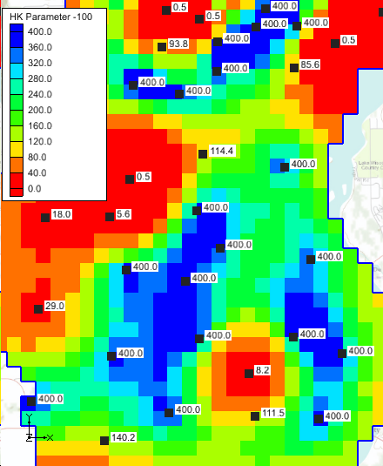
Creating Pilot Points
Pilot points are 2D Scatter Points
User selects a 2D Scatter Point Set and dataset
Values at points are interpolated to the MODFLOW array

Slide 10
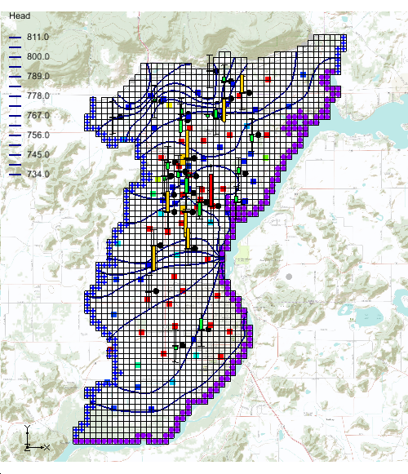
Creating Pilot Points
Adaptive Placement
Manually create points in a non-uniform fashion
Points are strategically located based on obs well and boundary locations
Uniform Placement
Grid-based distribution
Simpler and works well in many cases

Slide 11
Adaptive Placement Strategy
Points placed at rear and sides of model domain
Piezometric contour
Pilot point
Observation well
Pump-tested well: pilot point and well coincident
Points placed between observation wells
Points placed along zone of high hydraulic gradient
Greater point density reflects greater observation well density
Points placed between fixed head boundary and nearest downhill observation wells
Fixed head boundary

Slide 12
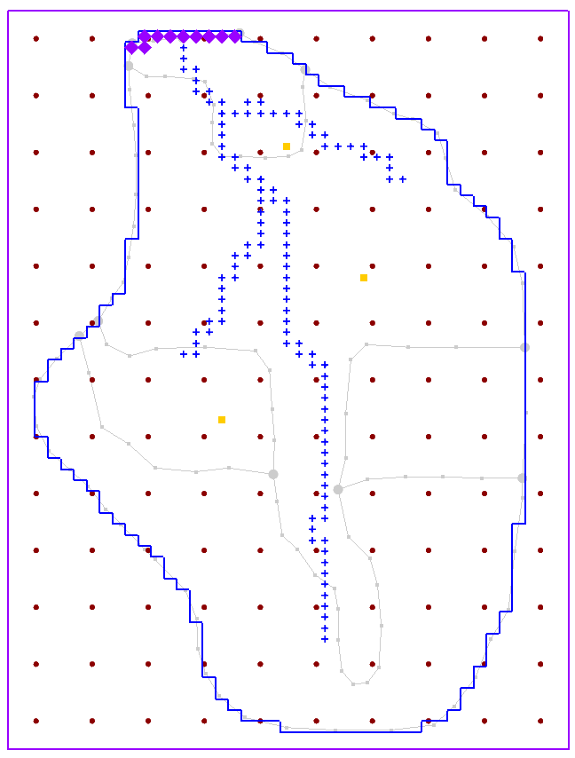
Uniform Placement
Or use the Grid Frame to uniformly distribute a set of points.
Steps
Create a Grid Frame
Select Map -> 2D Grid and enter desired number of rows and columns.
Convert 2D grid to scatter point set.

Slide 13
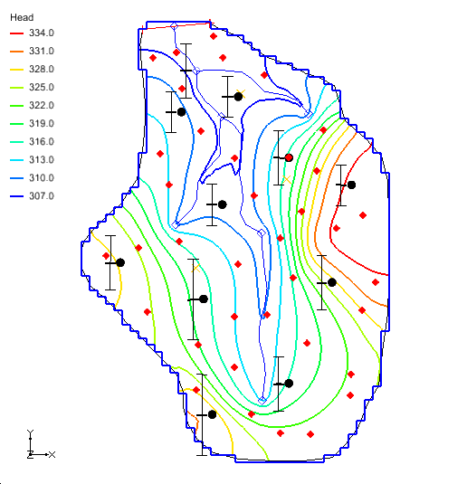
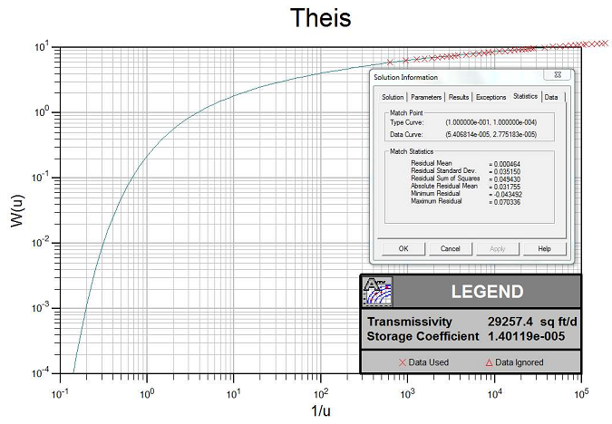
Field Data
Pilot points can use field data for measured HK

Slide 14
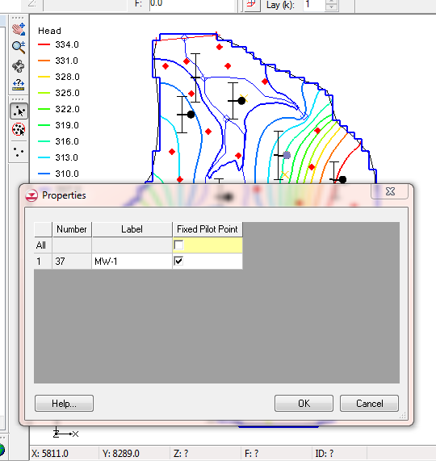
Field Data
Select point and use Properties dialog
Turn on the “Fixed Pilot Point” option

Slide 15
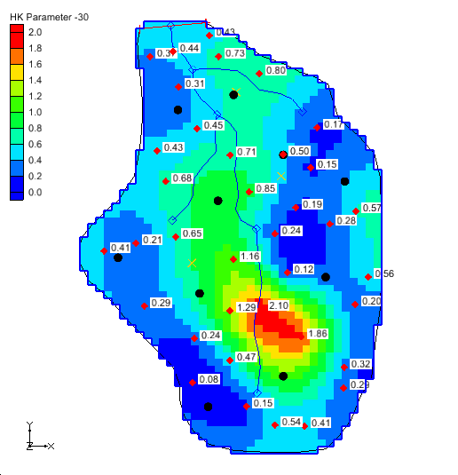
Field Data
The HK array estimated by PEST will not change the measured value

