Slide 1
Particle Tracking with MODPATH
CE 547 – BRIGHAM YOUNG UNIVERSITY

Slide 2
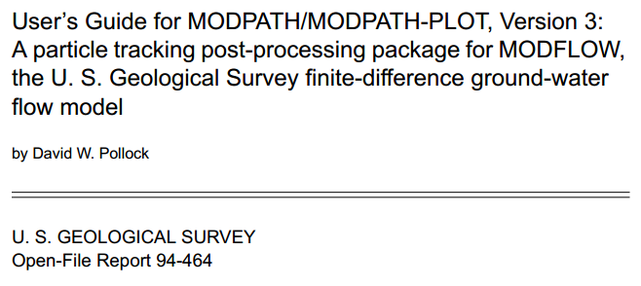
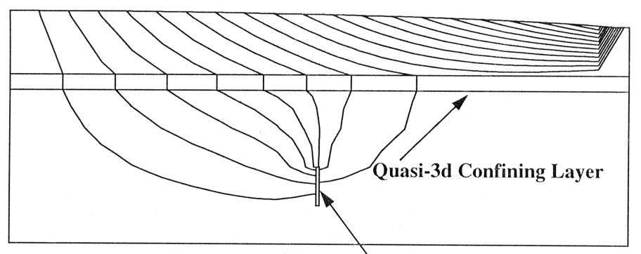
Background
Companion program to MODFLOW
Applications
Particle tracking
Travel time analysis
Capture zones

Slide 3
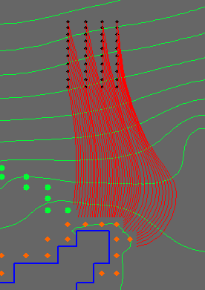
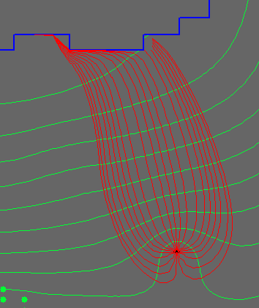
Pathlines

Slide 4
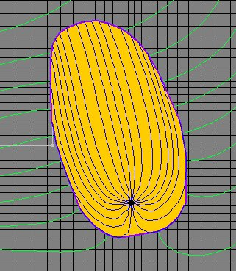
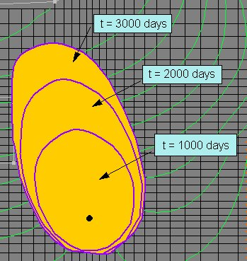
Capture Zones

Slide 5
Using MODPATH in GMS
Steps
Run MODFLOW
Define porosity (if travel time is important)
Generate particles
Pathlines/capture zones are automatically computed and updated

Slide 6
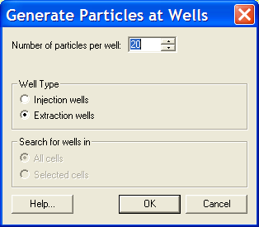
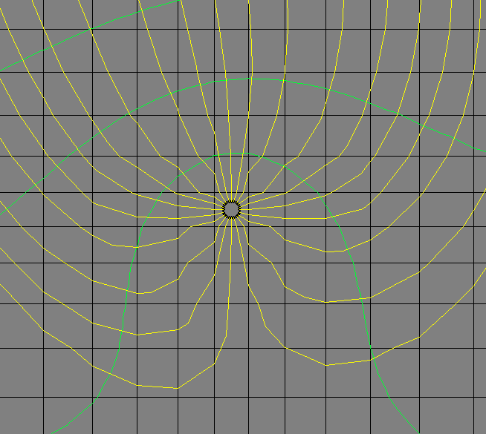
Generating Particles at Wells

Slide 7
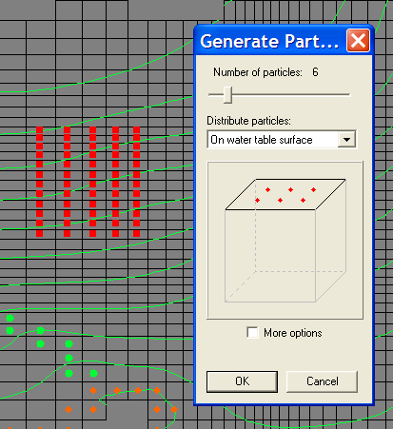
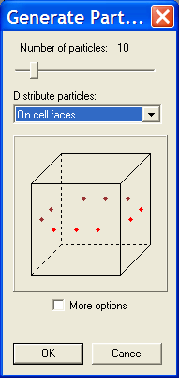
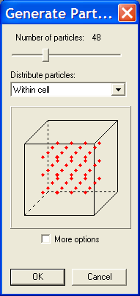
Generating Particles at Selected Cells

Slide 8
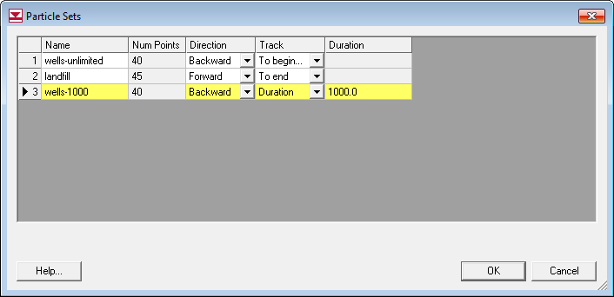
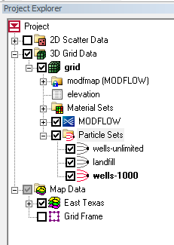
Particle Sets
Particle starting locations are organized into particle sets

Slide 9
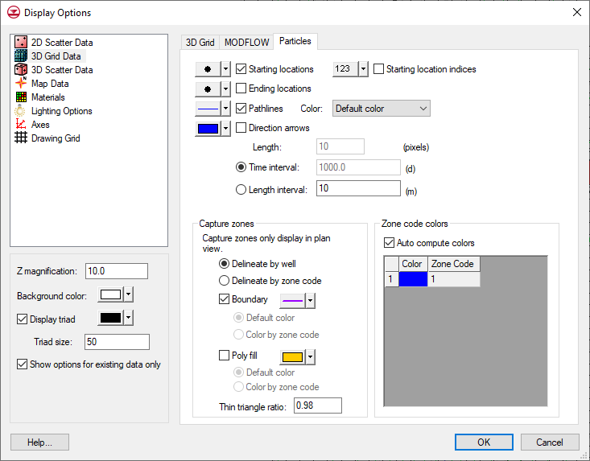
Display Options

Slide 10
Time Concepts

Slide 11
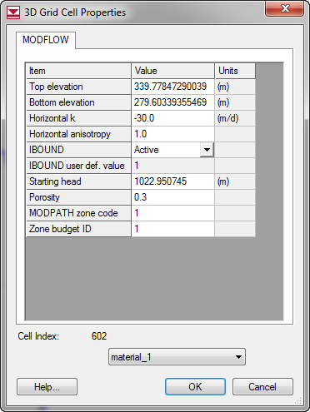

Porosity
Use effective porosity to get correct travel time
Entered via
Zones in map module
Spreadsheet dialog
Selected cells
$$v_{s}=\frac{x}{t}=\frac{ki}{n}$$

Slide 12
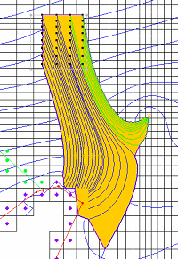
Zone Codes
Each cell in the grid can be assigned a zone code.
The zone code of beginning and ending locations can be stored in the end point file.
Useful for post-processing

Slide 13
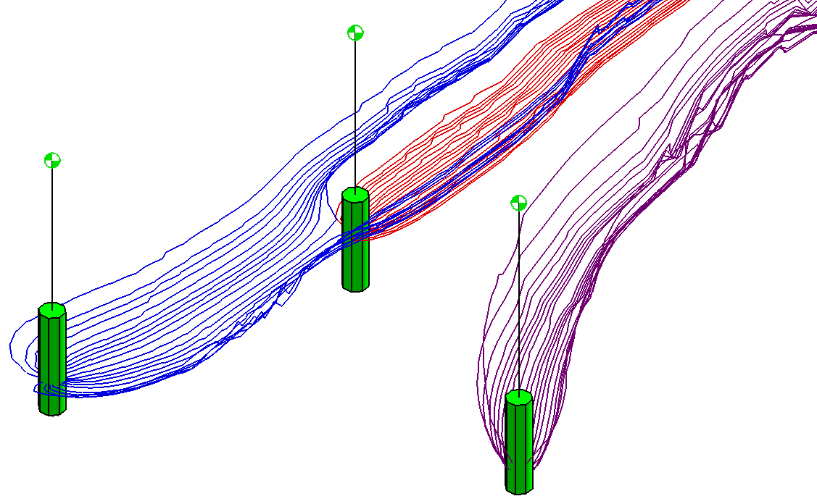
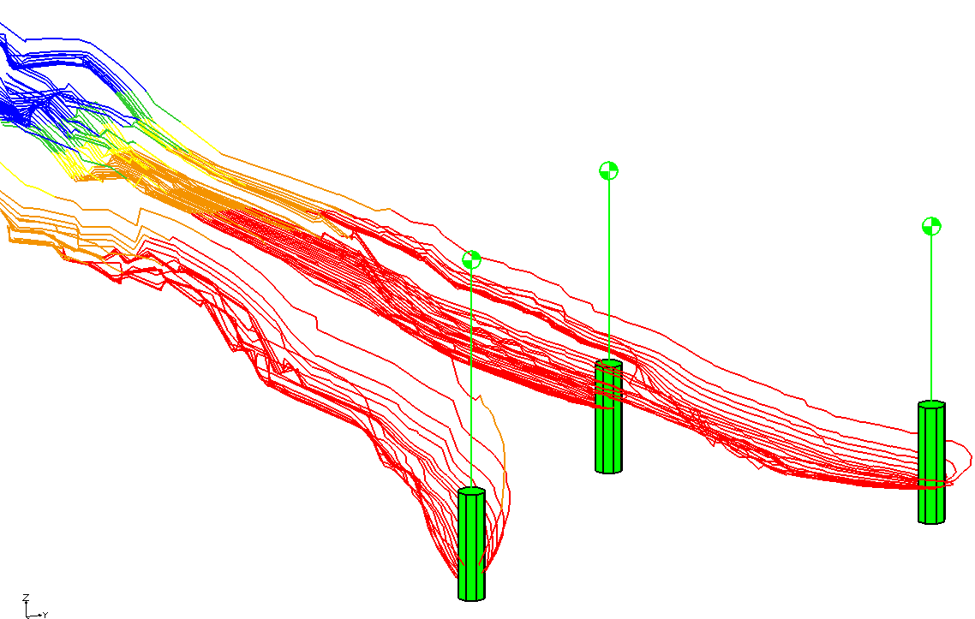
Zone Codes, Examples

Slide 14
Capture Zone Algorithm
A vertex is created for each point on all pathlines
Vertices are triangulated
Long thin triangles on perimeter of triangulation are deleted
Resulting boundary → capture zone

Slide 15
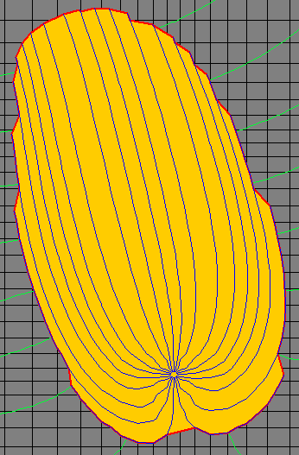
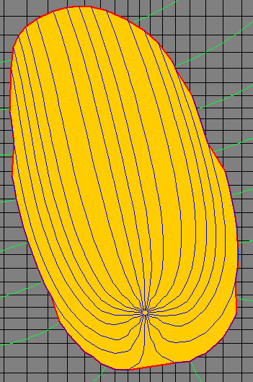
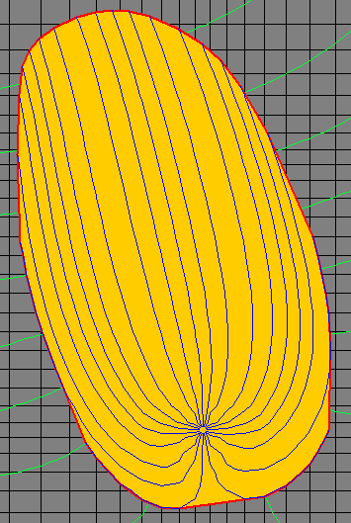
Capture Zone Ratio
Ratio = 0.90
Ratio = 0.98
Ratio = 1.00

Slide 16
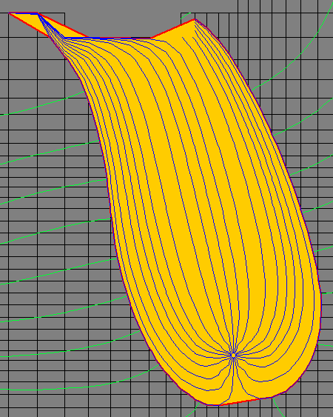
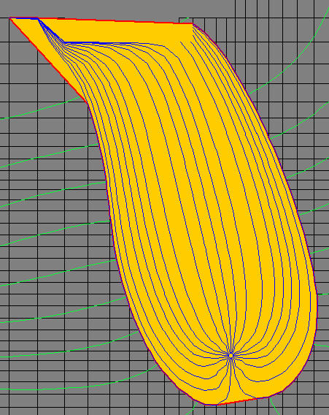
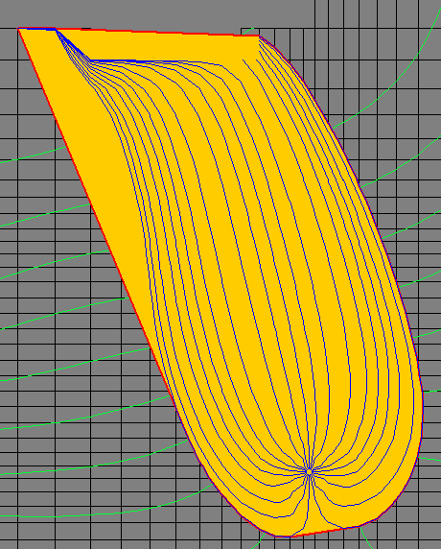
Capture Zone Ratio, cont.
Ratio = 0.96
Ratio = 0.98
Ratio = 1.00

