Slide 1
Stochastic Simulations Basic Theory
CE 547 – BRIGHAM YOUNG UNIVERSITY

Slide 2
Stochastic Modeling
Generate N equally likely model “instances” or “realizations”
Run all N models
Evaluate target outcome on solution from all N models
Determine probability of target outcome
Sometimes called a “Monte Carlo analysis”

Slide 3
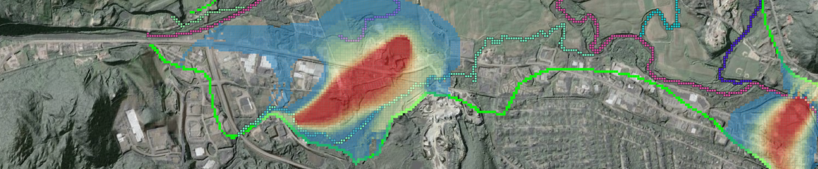
Why Stochastic Modeling?
Deterministic approaches can give a misleading impression of accuracy
Provides systematic way of dealing with uncertainty in:
Parameters
Conceptual Model
Observations
Etc

Slide 4
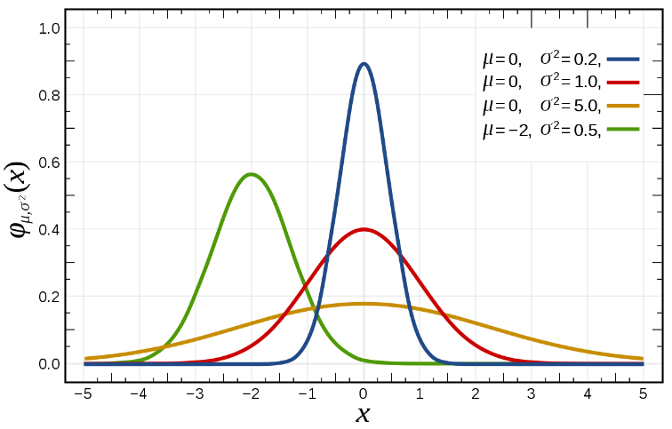
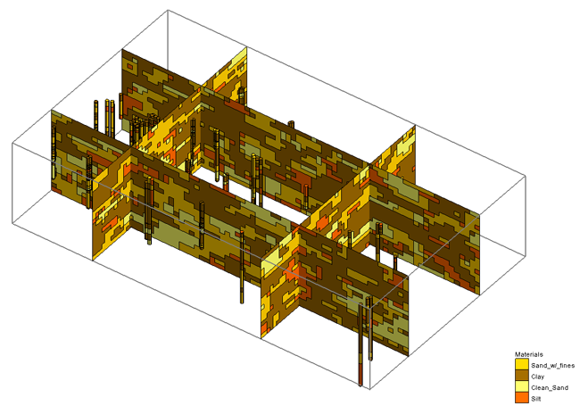
Stochastic Methods
Parameter randomization
Random sampling
Latin Hypercube
Gaussian Fields
Indicator Simulation
Indicator kriging
Transition probability geostatistics

Slide 5
Parameter Randomization
K₁
K₁
K₃
K₂
K₂
K₃
Notes:
One disadvantage is that this method requires the modeler to come up with the parameter zones. This can be difficult for sites with complex stratigraphy.

Slide 6
Distribution Options
Freq.
Uniform
K
Freq.
Normal
K
Freq.
Log-Normal
Y = log(K)

Slide 7
Normal Distribution - PDF
Mean
Probability distribution function is defined by mean and standard deviation.
Std. Deviation
K₂
min
max
Min/max can be specified to prevent extreme outliers that would cause numerical instabilities.

Slide 8
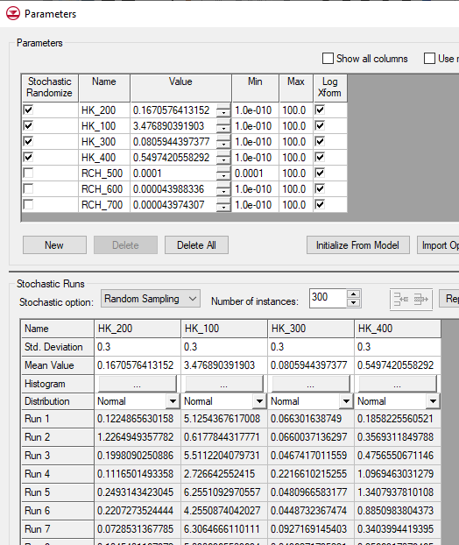
Parameter Randomization
User defines the following for each parameter:
Distribution type (uniform/linear, normal, log-normal)
Mean
Standard deviation
min value
max value
User also selects number of model runs (instances)

Slide 9
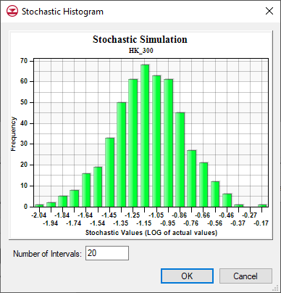
Random Sampling, cont.
For each model instance:
a random value is generated for each parameter
Each value honors user defined distribution
random values are generated independently
Model run is saved and executed for each model instance

Slide 10
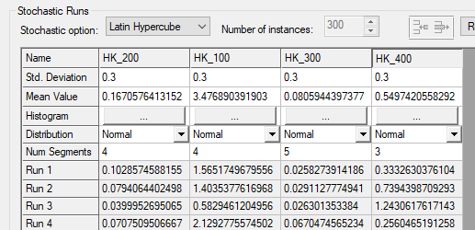
Latin Hypercube
Each parameter is assigned a number of segments
A structured approach is used to ensure that a random value is selected from every possible combinations of segments
Objective is to ensure that parameter space is explored as thoroughly as possible
Result = greater certainty with fewer model runs

Slide 11
Segments (quantiles)
Freq.
3
4
2
5
1
6
Parameter Value

Slide 12
Combining Segments
Run | P₁ | P₂ | P₃
1 | S1 | S1 | S1
2 | S1 | S1 | S2
3 | S1 | S1 | S3
4 | S1 | S2 | S1
5 | S1 | S2 | S2
6 | S1 | S2 | S3
7 | S1 | S3 | S1
8 | S1 | S3 | S2
9 | S1 | S3 | S3
Run | P₁ | P₂ | P₃
10 | S2 | S1 | S1
11 | S2 | S1 | S2
12 | S2 | S1 | S3
13 | S2 | S2 | S1
14 | S2 | S2 | S2
15 | S2 | S2 | S3
16 | S2 | S3 | S1
17 | S2 | S3 | S2
etc. | … | … | …

Slide 13
Total Number of Instances
Where:
N | = | Number of instances
m | = | Number of parameters
S_{i} | = | Number of segments for parameter i

Slide 14
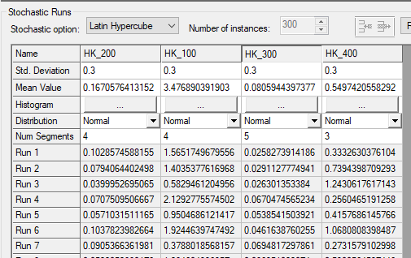
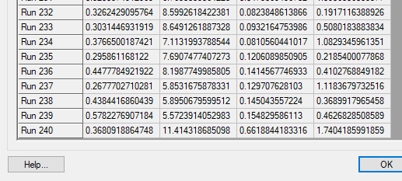
Example
Three Parameters
Parameter 1: 4 segments
Parameter 2: 4 segments
Parameter 3: 5 segments
Parameter 4: 3 segments
Total number of runs
4 x 4 x 5 x 3 = 240

Slide 15
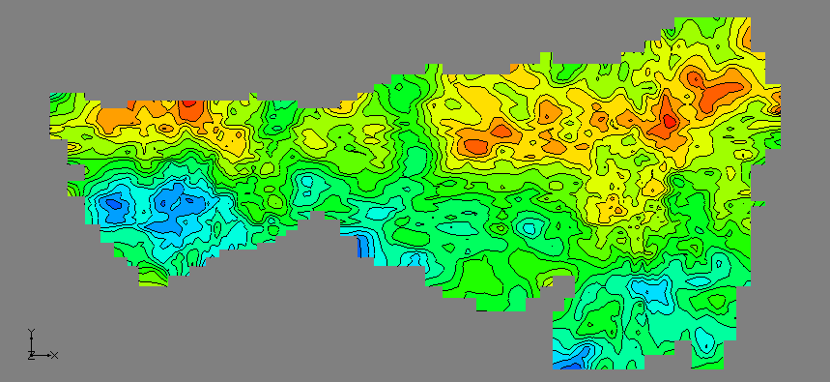
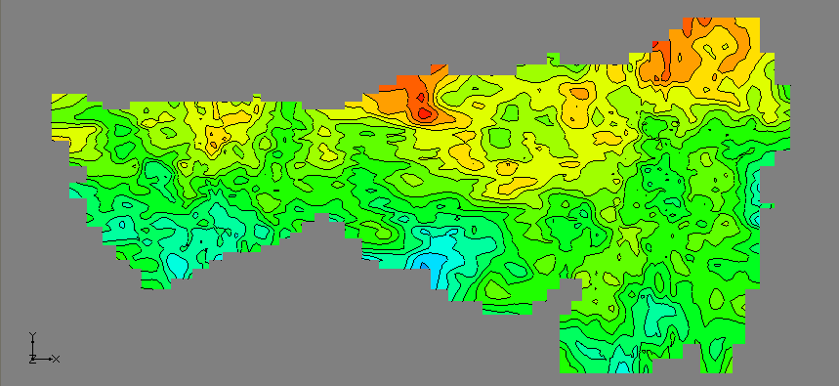
Gaussian Fields
Selected arrays (K, recharge) are randomized spatially
An "ensemble" of arrays is generated, each array defining a model instance

