Slide 1
Stochastic Simulations GMS Tools
CE 547 – BRIGHAM YOUNG UNIVERSITY

Slide 2
Setting up a Stochastic Simulation
Select stochastic run option
Parameterize your model inputs
Select parameter values
Select randomization options
Save and Run MODFLOW
Read solution
Analyze results

Slide 3
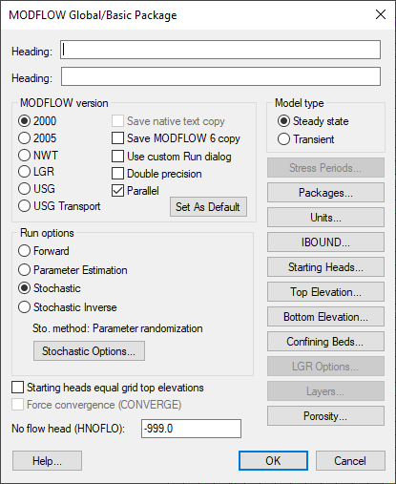
1. Select stochastic run option

Slide 4
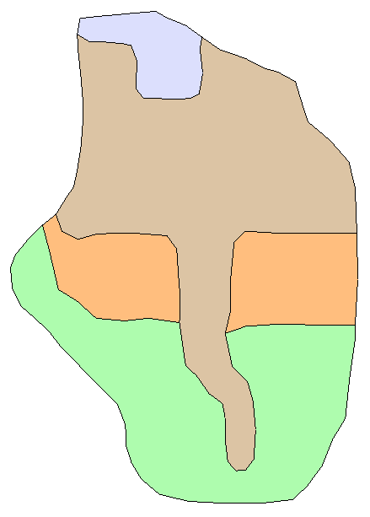
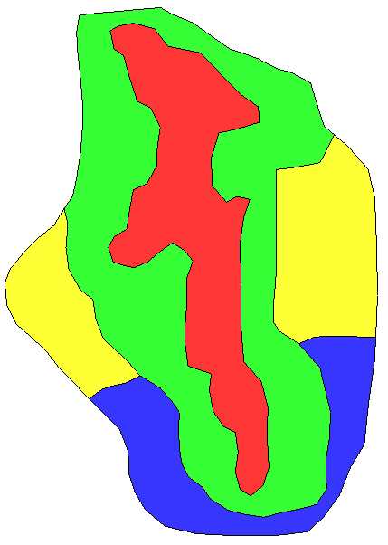
2. Parameterize your model inputs
Recharge Zones
K
Zones

Slide 5
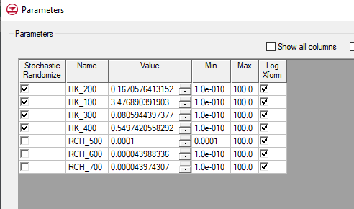
3. Select parameter values

Slide 6
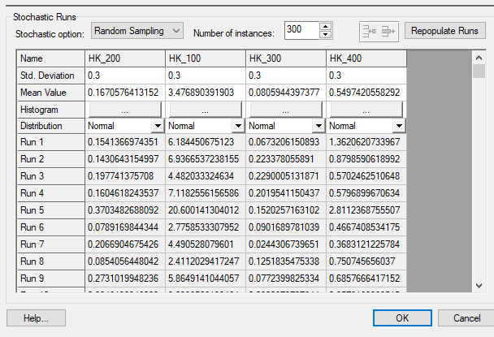
4. Select randomization options

Slide 7
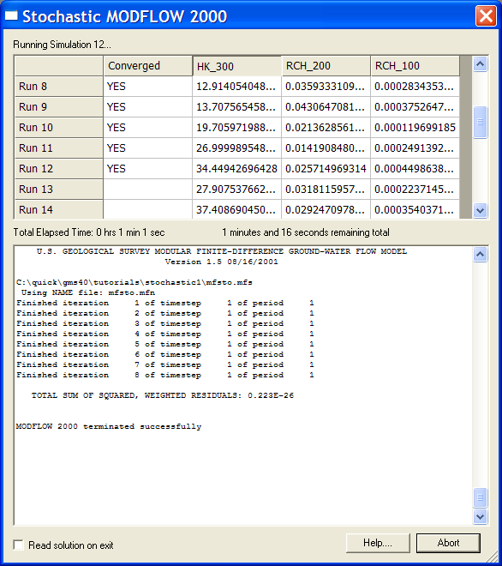
5. Save and Run MODFLOW

Slide 8
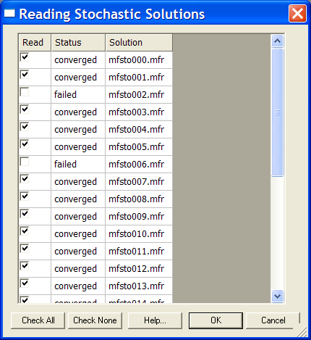
6. Read the solution

Slide 9
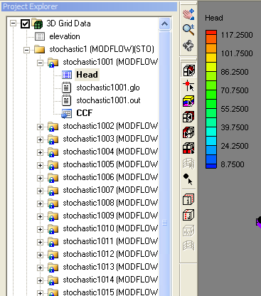
7. Analyze results
Solutions organized in Project Explorer Window
Select a solution folder to display solution results for that instance
Right click on individual solution folder for summary of residuals
Right click on top level folder to run capture zone analysis (optional)

Slide 10
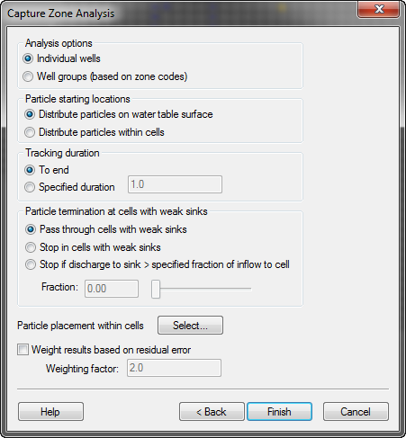
Probabilistic Capture Zone Analysis

Slide 11
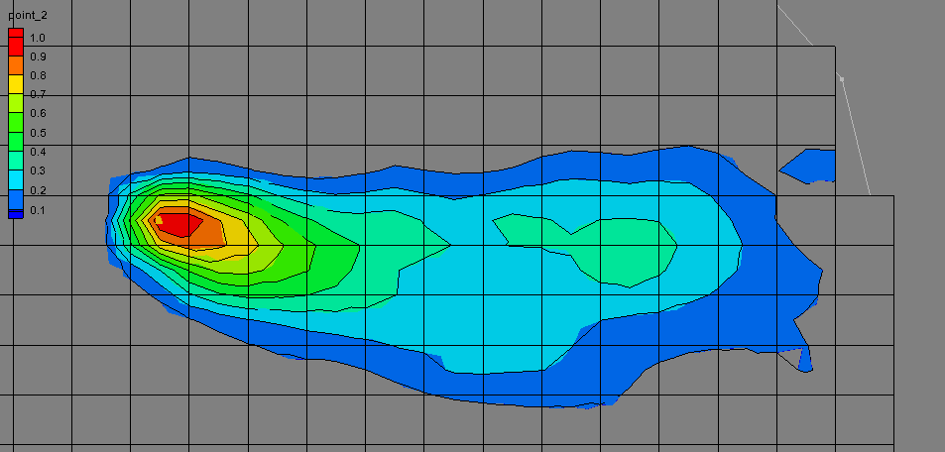
Probabilistic Capture Zone
Probability of capture

Slide 12
Algorithm
For each instance, particles are tracked forward in time
Number of particles from each cell captured by the well is counted
Probability = number particles captured/total number of particles
Results saved as data sets (one per well)

Slide 13
Other Applications
Stochastic modeling can be applied to any problem outcome.
Examples
Travel time from spill to receptor
Springs going dry
Drawdown greater than some threshold amount
Sustainable conditions in an aquifer
Etc.

