Slide 1
Groundwater Sustainability Pt. 2 - Equilibrium Dynamics
CE 547 – BRIGHAM YOUNG UNIVERSITY

Slide 2
Lecture Objectives
Understand how equilibrium and capture relate to groundwater sustainability
Be able to define:
Transitional storage
Groundwater mining
Be able to define the “water budget myth” and the impacts it has on groundwater management policy

Slide 3
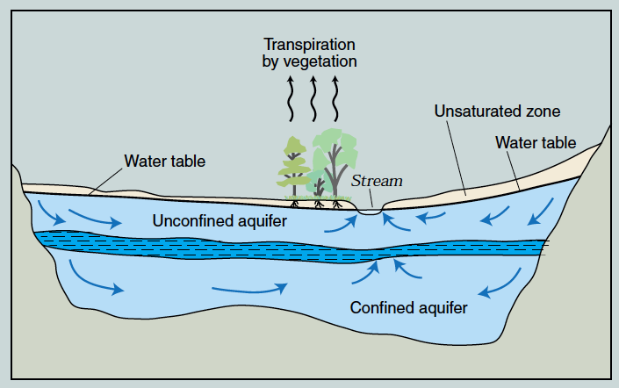

Natural Groundwater Systems
Precip/
Recharge

Slide 4
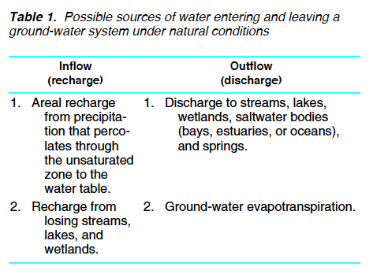
Groundwater Flow Budget

Slide 5
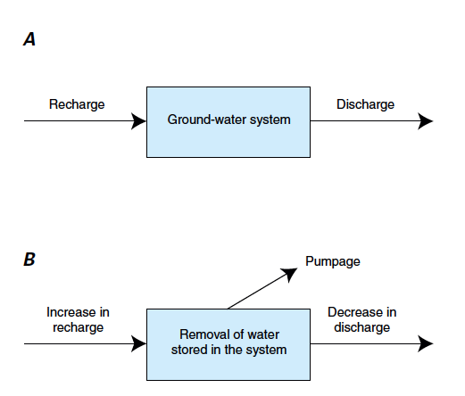
“Under natural conditions ... previous to development by wells, aquifers are in a state of approximate dynamic equilibrium. Discharge by wells is thus a new discharge superimposed upon a previously stable system, and it must be balanced by an increase in the recharge of the aquifer, or by a decrease in the old natural discharge, or by loss of storage in the aquifer, or by a combination of these.” -- Theis (USGS) 1940
Pumpage = Increased recharge + Water removed from storage + Decreased discharge.
Notes:
- Now let's skip ahead a few years. Charles Theis is another pioneer in groundwater hydrology and he published several landmark papers that are widely cited.
- In 1940, Theis published a paper that provided a classic statement on equilibrium in a GW basin.
(READ STATEMENT)
- This definition has been widely adopted and one can see its influence in the statements on PY made by the NSE.

Slide 6
Sustainability & Equilibrium
As pumping begins:
Pumpage = Increased recharge + Water removed from storage + Decreased discharge.
After equilibrium is achieved
Pumpage = Increased recharge + Decreased discharge.
Transitional storage = water lost from storage as a system evolves from one equilibrium state to another

Slide 7
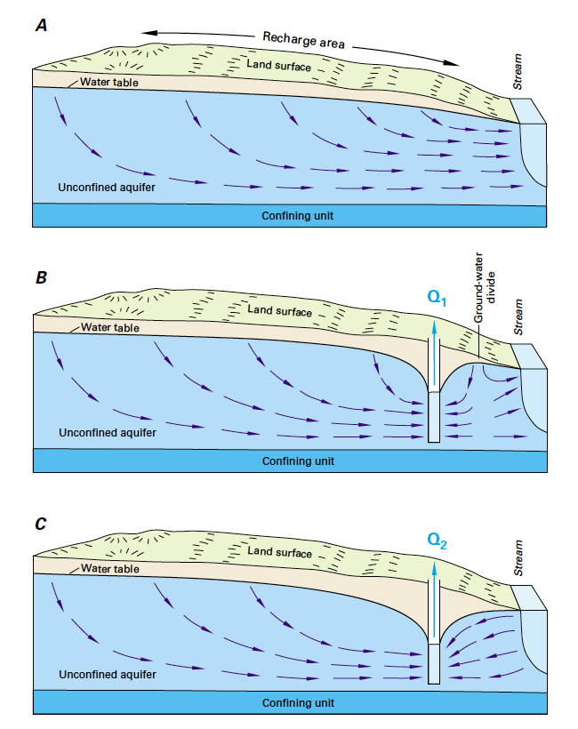
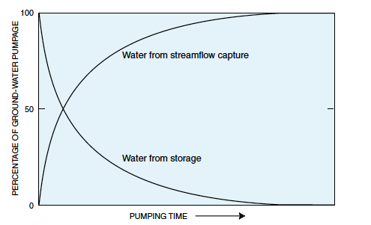
Equilibrium
Transition
If equilibrium is never achieved, an aquifer is said to be in a state of “groundwater mining”
New Equilibrium

Slide 8
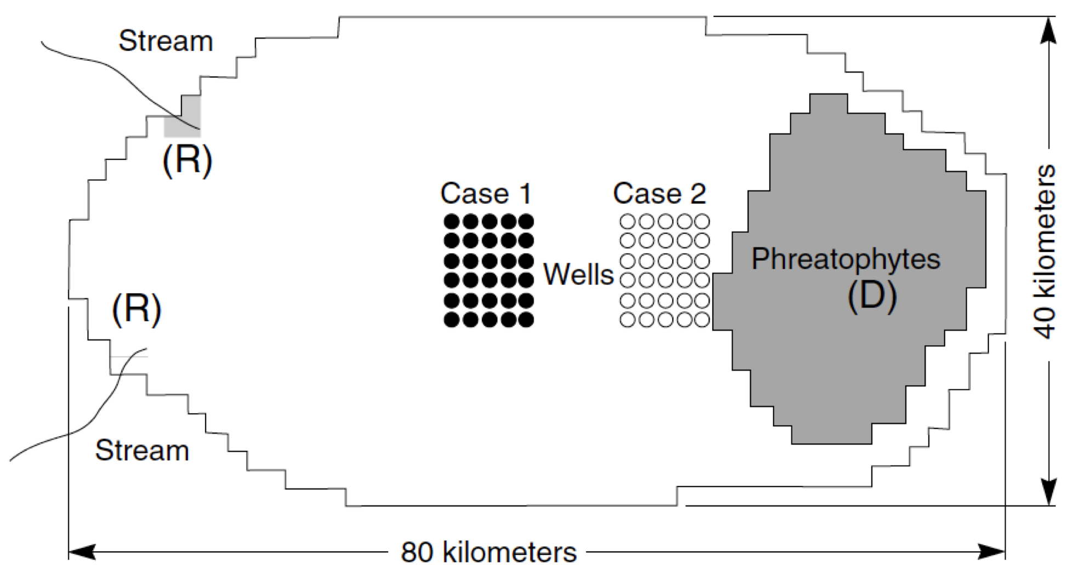
Before pumping: R (recharge from streams) = D (discharge to phreatophytes)
Shortly after pumping: Pumping = Decreased D + Water from storage
Eventually: Pumping = Decreased (eliminated) D
Capture is assumed to happen water table is greater than 5 ft below phreatophytes. 1000-yr simulation. Pumping = R = D.

Slide 9
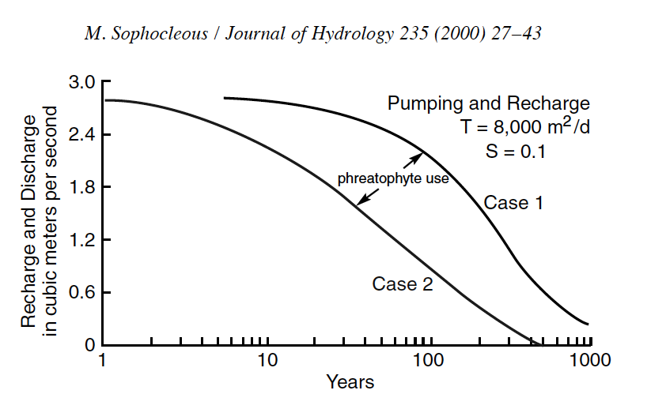
Discharge to Phreatophytes
Discharge to phreatophytes vs. time after pumping begins.
Case 1: >1000 yrs to full capture
Case 2: ~500 yrs to full capture
Notes:
Not sure why this plot says “recharge, discharge” on the vertical axis and then includes “pumping” in caption in the journal article. It is a plot of discharge to phreatophytes vs time. Recharge is constant. Pumping is constant. The only thing that changes is discharge.

Slide 10
“The pumps should be placed as close as economically possible to areas of rejected recharge or natural discharge where ground water is being lost by evaporation or transpiration by non-productive vegetation.. ”
“In localities developing water from non-artesian aquifers and remote from areas of rejected recharge or natural discharge, the condition of equilibrium connoted by the concept of perennial safe yield may never be reached in the predictable future and the water used may all be taken from storage.”
Theis, Charles V. "The source of water derived from wells." Civil Engineering 10.5 (1940): 277-280.
Notes:
- In the same 1940, Theis made the same point regarding the proper location of wells that was made in the 1915 article by Lee.
(READ STATEMENT)
- So in order to capture recharge, wells need to be close to the discharge zones.

Slide 11
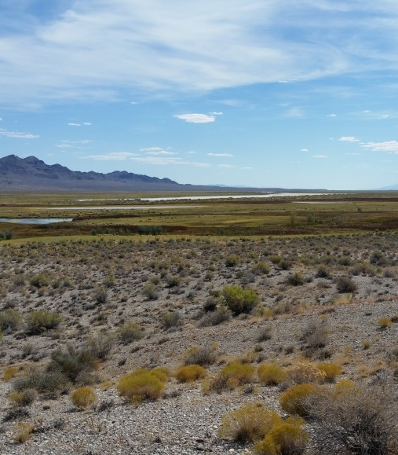
The Water Budget Myth
“Perhaps the most common misconception in groundwater hydrology is that a water budget of an area determines the magnitude of possible groundwater development.”
“The ultimate production of groundwater depends on how much the rate of recharge and (or) discharge can be changed—how much water can be captured. Although knowledge of the virgin rates of recharge and discharge is interesting, such knowledge is almost irrelevant in determining the sustained yield of a particular groundwater reservoir. … Somehow, we have lost or misplaced the ideas Theis stated in 1940 and before.”
Bredehoeft, J. D., Papadopulos, S. S., & Cooper, H. H. (1982). Groundwater: The water budget myth. Scientific basis of water resource management, 51, 57.
Notes:
- In 1982, this disconnect between basic groundwater science and aquifer management was noted in a frequently cited paper by Bredehoeft, Papadopulos, and Cooper.
- In this paper, the authors coined a phrase called “The Water Budget Myth”.
(READ STATEMENT)
(CONTINUE TO NEXT SLIDE)

