Slide 1
Boundary Condition Analysis Pt 1 – Types of Boundary Conditions
CE 547 – BRIGHAM YOUNG UNIVERSITY

Slide 2
Objectives
Understand different types of boundary conditions (pt 1)
Be able to identify poorly-posed or improper boundary conditions (pt 2)
Understand how regional-to-local model conversion can be used to address boundary condition issues (pt 2)
Review some case studies (pt 3)

Slide 3
Types of Boundary Conditions
Head
Constant head (strong source/sink)
Head dependent (river, drain, lake)
Specified Flow
Lateral influx
No-Flow
Physical barrier (e.g. bedrock outcropping)
Groundwater divide
Parallel flow boundary

Slide 4

Constant Head
Large river or lake with a strong connection to aquifer (minimal head loss between aquifer and lake/river)

Slide 5
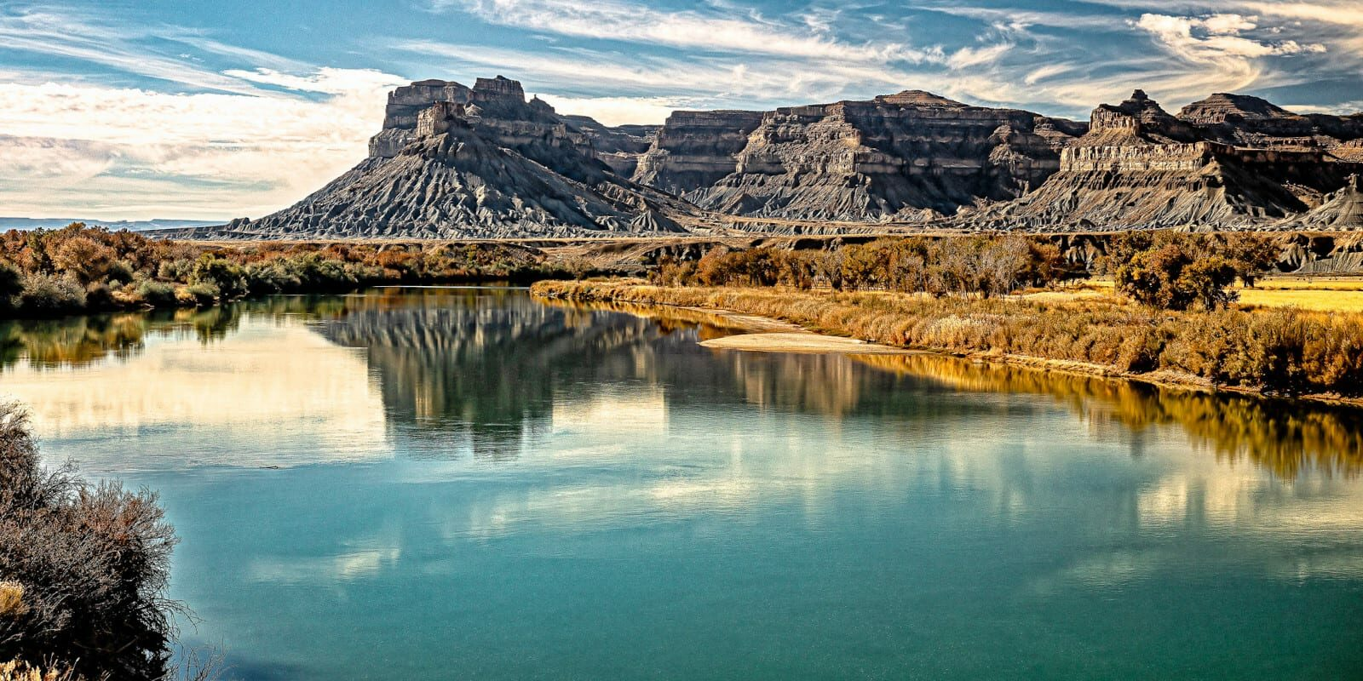
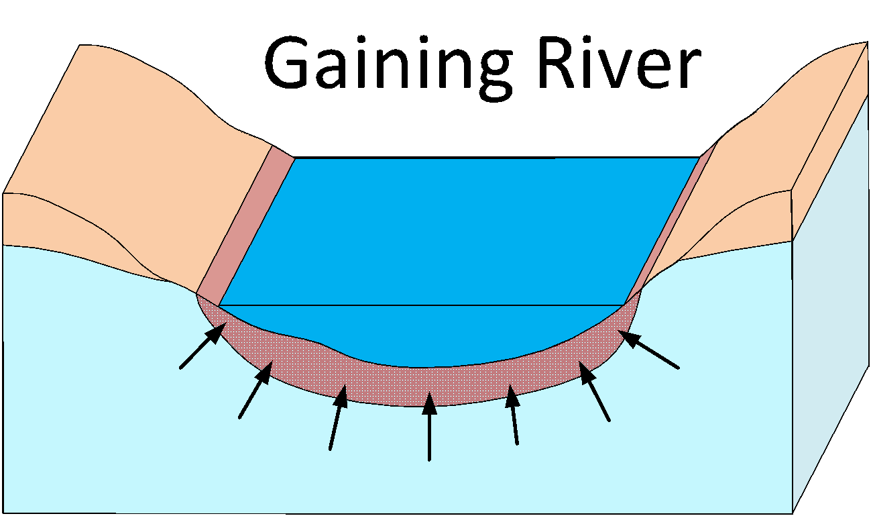
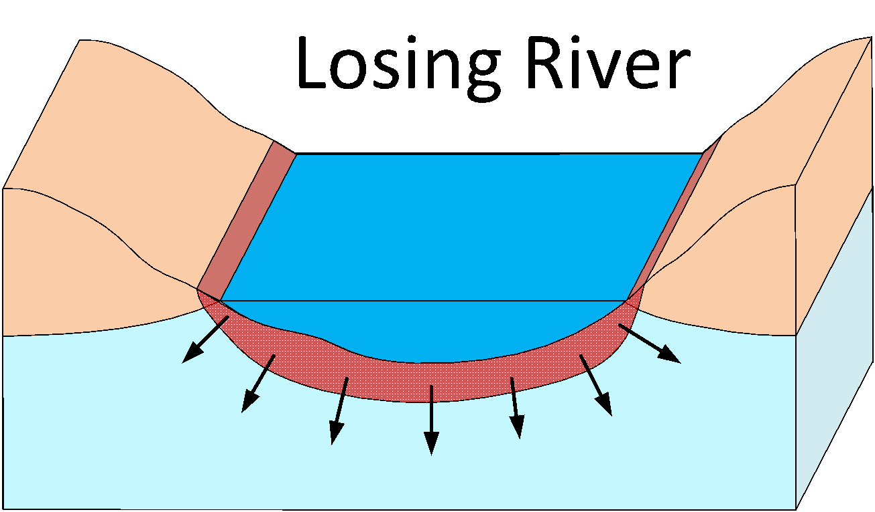
Head Dependent Boundary
River, lake, reservoir, drain, etc with an intermediate low K layer that results in head loss as water flows from aquifer to object or vice versa.

Slide 6
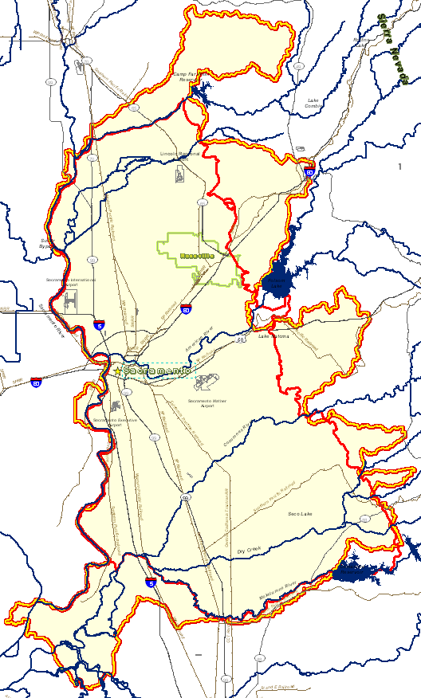
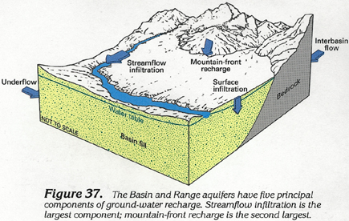
Lateral Flow Boundary
1
2
3
4
Common for alluvial aquifers with significant runoff from adjacent mountains. Sometimes called “mountain front recharge”
5
6
7
Can be simulated with a series of wells along edge of model or with focused recharge on edge.

Slide 7
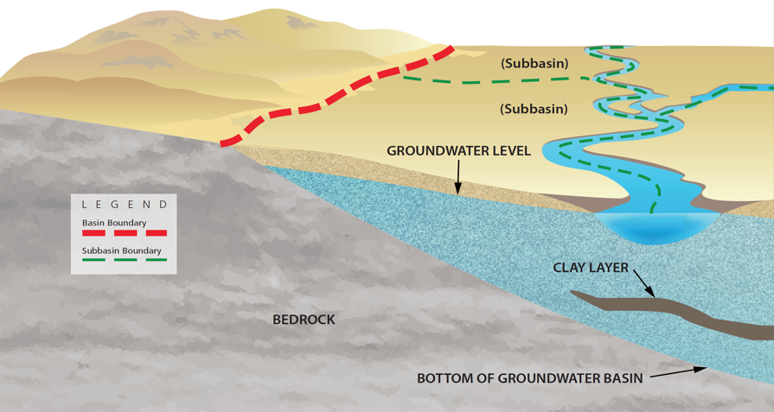
No Flow – Physical Barrier

Slide 8
No Flow - Groundwater Divide
G.W. Divide

Slide 9
No Flow - Parallel Flow Boundary
Head Contours
No-Flow Boundary

Slide 10
Example 1
Parallel Flow
GW Divide
Industrial Plant
Specified Head or River
River

