Slide 1
Boundary Condition Analysis Pt 2 – Selecting Proper Boundary Conditions
CE 547 – BRIGHAM YOUNG UNIVERSITY

Slide 2
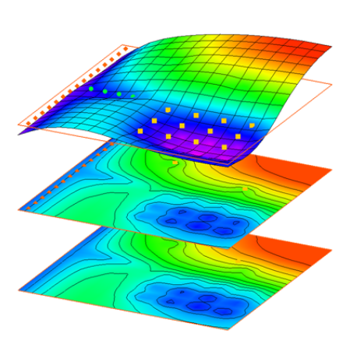
Boundary Condition Analysis
It is critical to select boundary conditions
That are appropriate for site being studied
That do not lead to artificial calibration
Common source of model error!

Slide 3

Example 2
River
Mountain Range
Industrial Plant
What boundary conditions should be used?

Slide 4
Local Scale
Head Contours
Plume
Obs. Wells

Slide 5
Simple Approach
Fixed Head BC
No Flow

Slide 6
Cross-Section View
Computed Head
Left Head BC
Right Head BC
Head Observations
Bottom Elevation

Slide 7
Darcy’s Law
where:
Q = ΔVol/Δt = flow rate [L³/T]
K = hydraulic conductivity [L/T]
i = hydraulic gradient [L/L]
A = gross cross-sectional area of flow [L²]
Δh = head loss [L]
L = length of flow path [L]

Slide 8
Darcy’s Law
H₁
H₂
K
T
Q
L
Assumptions:
K = constant T = ave thickness W = width Minimal recharge

Slide 9
Variables
L, T, W → Geometric constants
H₁ – H₂ → Specified by user
Q, K → Independent variables

Slide 10
Variables, Cont.
Method 1
Specify K, model solves for Q
Method 2
Specify Q, model solves for K

Slide 11
Model Non-Uniqueness
Computed Head
Left Head BC
Right Head BC
Head Observations
Distribution of heads is not a variable!
Model will produce the same head distribution regardless of what value of K is specified

Slide 12
Avoiding Non-Unique Models
Specified flow boundary conditions
Flow observations
Regional to local model conversion

Slide 13
Specified Flow Conditions
Extend upper boundary back to no flow boundary (outcropping or g.w. divide)
Recharge
No Flow BC
Q
Right Head BC
Q is now tied to recharge and heads will rise and fall based on K. For a given recharge value, unique K can be found.

Slide 14
Flow Observations
Stream gages
Measured gain or loss between two gages in a stream
Tracer tests
Can be used to estimate V_{s}, V_{d}, and Q
Lateral inflow
Can sometimes be estimated

Slide 15
Flow Observations, Cont.
Left Head BC
Observed Flow Q’
Right Head BC
Computed flow through right BC is compared to observed flow, Q’
Heads are still fixed by BC, but flow is fixed, and unique K can be found

Slide 16
Best Case
Flow-based upstream BC and a flow observation
Recharge
No Flow BC
Q
Observed Flow Q’
Right Head BC
Observed flow results in unique value of recharge
Fixed Q and observed heads result in unique value of K

Slide 17
Regional to Local Conversion
In many cases, flow observations are not available and there are no head or flow boundaries close by
Strategy
Build regional model corresponding to well-defined boundary conditions
Use heads/flows from regional model to develop boundary conditions for local model
K, recharge and other model parameters derived from the regional model

Slide 18
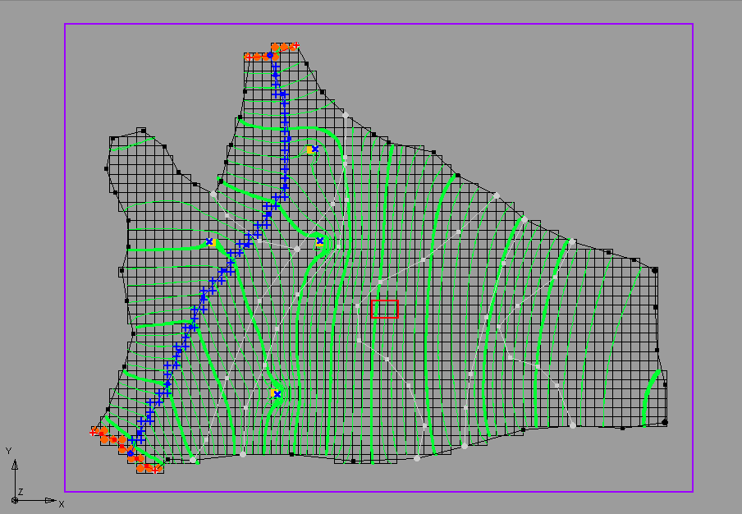
Regional Model

Slide 19
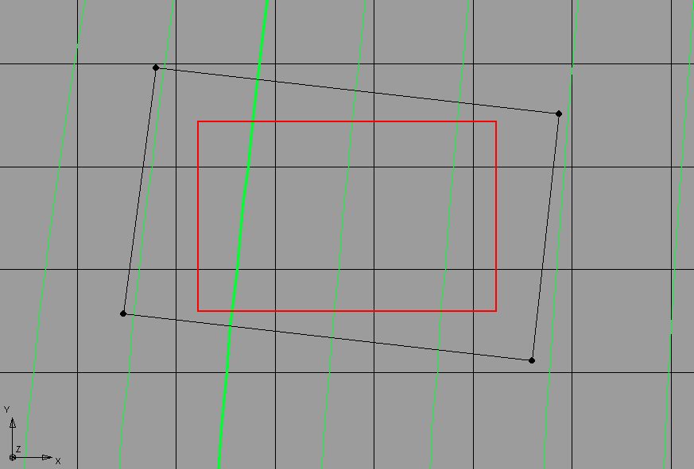
Local Grid Boundaries
No-flow
Head
Head
No-flow

Slide 20
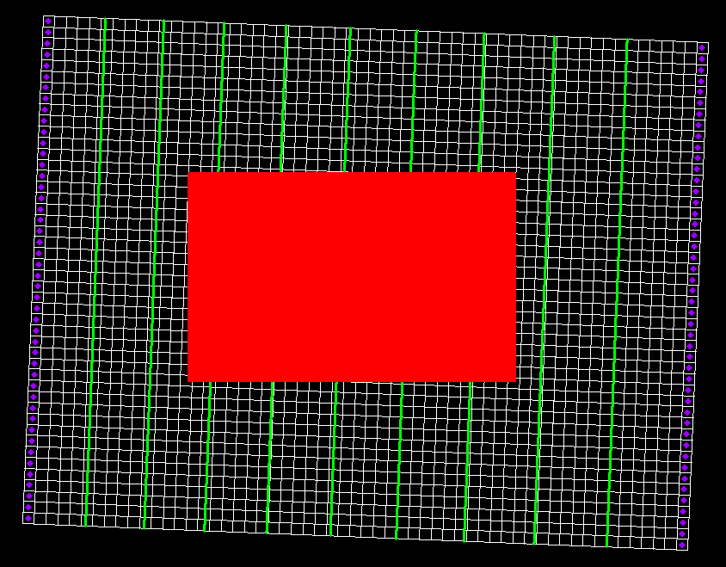
Local Model

