Slide 1
Governing Differential Equations - Transient
CE 547 – BRIGHAM YOUNG UNIVERSITY

Slide 2
Lecture Objectives
Understand the derivation of the transient term of the governing equation
Understand the physical mechanisms behind specific storage
Understand the difference between specific storage, storativity, and specific yield

Slide 3
Steady State Equation
inflow - outflow = 0
mass flow rate = ρ v

Slide 4
Transient Saturated Flow
Assume that we have no sources and sinks. The term:
represents the change in mass stored in the system.

Slide 5
The mass per unit volume can be expressed as the density times the volume of the voids:
m = ρ V_{v}
= ρ (n V_{total})
= ρ n dx dy dz
The change in storage with respect to time can then be represented as:

Slide 6
In the steady state case:
inflow - outflow = 0
or:

Slide 7
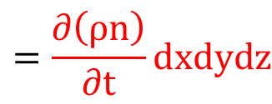
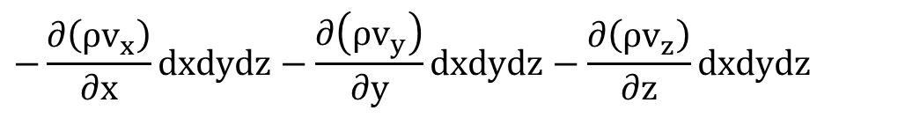
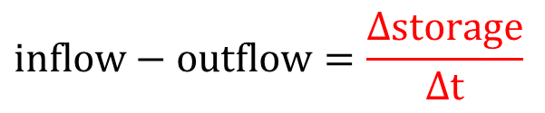
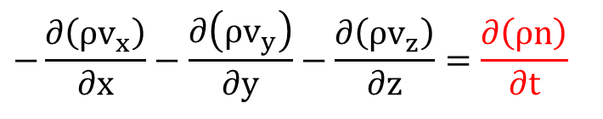
Now we have:
$$inflow−outflow=\frac{Δstorage}{Δt}$$
or:
$$−\frac{∂\left(ρv_{x}\right)}{∂x}dxdydz−\frac{∂\left(ρv_{y}\right)}{∂y}dxdydz−\frac{∂\left(ρv_{z}\right)}{∂z}dxdydz$$
$$=\frac{∂\left(ρn\right)}{∂t}dxdydz$$
which reduces to:
$$−\frac{∂\left(ρv_{x}\right)}{∂x}−\frac{∂\left(ρv_{y}\right)}{∂y}−\frac{∂\left(ρv_{z}\right)}{∂z}=\frac{∂\left(ρn\right)}{∂t}$$

Slide 8
Once again, if ρ is constant:
Assuming k_{xy}= k_{xz}= k_{yz}= 0 and inserting Darcy's law:

Slide 9
Now we need to simplify ∂n/∂t and write it in terms of head since the left hand side of the equation is expressed in terms of head. The term ∂n/∂t represents the change in volume due to a change in the head (n changes due to a change in head). The term can be related to head as follows:
where
or the change in water volume stored in a unit volume of the aquifer per unit change in head.

Slide 10

1
Change in water volume stored in a unit volume of the aquifer per unit change in head.
Specific Storage
1
1
1

Slide 11
Substituting:
This is sometimes called the "diffusion equation". Note that now we have an expression relating head (h) to position (x, y, z) and time (t).

Slide 12
Sources and Sinks
If we have sources or sinks we can simply add one more term, R, which is intrinsically positive and represents inflow to the system.
or

Slide 13
Specific Storage
An expression for specific storage can be derived as follows: A decrease in the head infers a decrease in the fluid pore pressure u and an increase in the effective stress in the soil (σ‘). The water that is released from the aquifer due to a decrease in h is due to:
(1) Compression of the aquifer due to an increase in σ'. This is controlled by the aquifer compressibility, α.
dV_{w} = - dV_{T} = α V_{T} dσ'

Slide 14
for a unit volume of the aquifer, V_{T} = 1, and
dV_{w} = α dσ'
dσ' = - du = - γ_{w}dh
substituting:
dV_{w} = - α γ_{w} dh
for a unit change in head, dh = -1:
dVw = α γ_{w}

Slide 15
(2) Expansion of the pore water due to a decrease in u. This is controlled by the fluid compressibility, β:
dV_{w} = - β V_{w} du
since V_{w} = nV_{T}, = n (for unit volume of aquifer)
dV_{w} = - β n du
Also, for a unit drop in head (dh = -1):
du = γ_{w} dh = - γ_{w}
thus:
dV_{w} = β n γ_{w}

Slide 16
Combining both terms gives us an expression for specific storage:
S_{s} = γ_{w}(α + nβ)
Note:
where:
ε = strain
E = Modulus of elasticity

Slide 17
α decreases with increasing stiffness and typical values are given below (Freeze and Cherry):
Media | α (m² / N)
Clay | 10⁻⁶ - 10⁻⁸
Sand | 10⁻⁷ - 10⁻⁹
Gravel | 10⁻⁸ - 10⁻¹⁰
Jointed Rock | 10⁻⁸ - 10⁻¹⁰
Sound Rock | 10⁻⁹ - 10⁻¹¹
β is a constant for water equal to 4.4 X 10⁻¹⁰ m²/N

