Slide 1
Transient Simulations
CE 547 – BRIGHAM YOUNG UNIVERSITY

Slide 2
Lecture Objectives
Know what storage coefficients are required by MODFLOW
Understand the importance of proper initial conditions for transient simulations
Understand stress periods and time steps in MODFLOW
Learn about the Changing Head Boundary (CHD) package

Slide 3
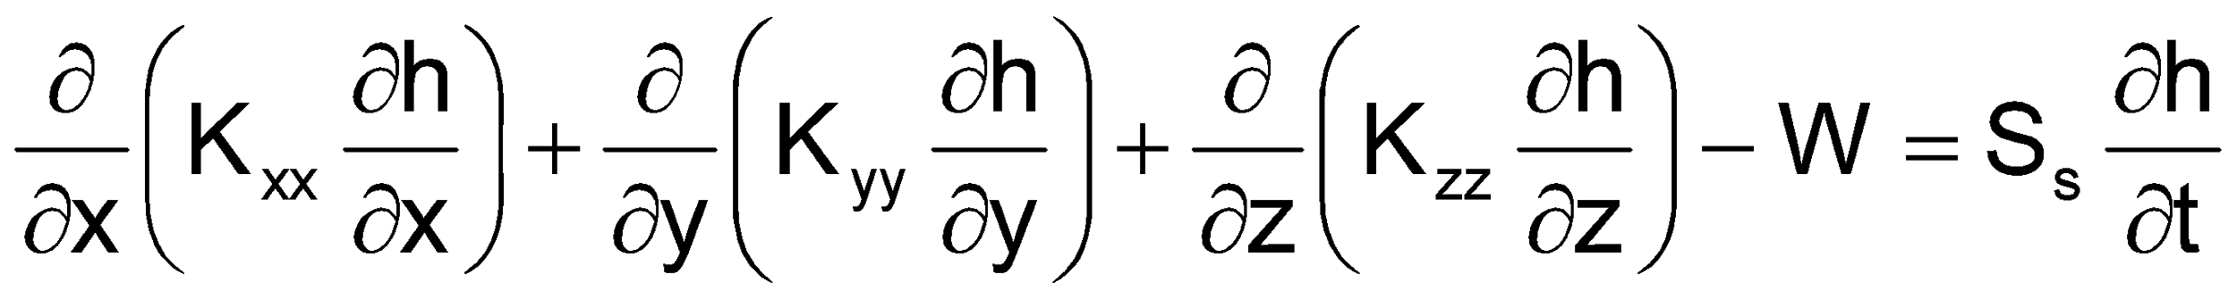
Storage Parameters
MODFLOW requires either a primary storage coefficient or both a primary and secondary storage coefficient
Depends on:
Layer type
Flow package used

Slide 4
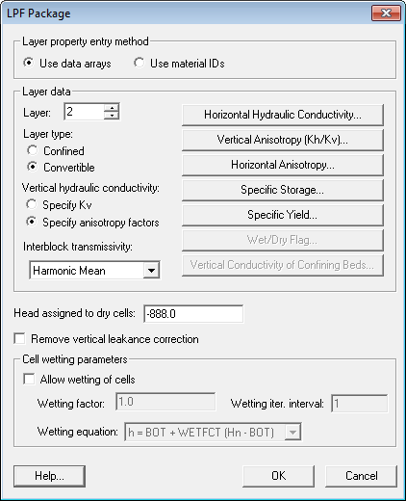
LPF Package
Confined
Specific Storage
Convertible
Specific Storage
Specific Yield
Note: Similar set of options for BCF and HUF packages

Slide 5
Defining Initial Conditions
For steady state models:
The initial conditions represent a “guess” at the starting heads and don’t generally have a big impact on the solution.
For transient model:
The initial conditions represent the state of the aquifer at the beginning of the simulation
Starting head values should be carefully selected
Arbitrary head values or heads interpolated from observation wells should NOT be used

Slide 6
Model-Generated Heads
"Use of model-generated head values ensures that the initial head data and the model hydrologic inputs and parameters are consistent. If the field-measured head values were used as initial conditions, the model response in the early time steps would reflect not only the model stresses under study but also the adjustment of model head values to offset the lack of correspondence between model hydrologic inputs and parameters and the initial head values."
Anderson & Woessner, Applied Ground Water Modeling

Slide 7
Steady State Initial Condition
Arbitrary starting head
Head at a point in the model domain
Steady-state solution compatible with BC for transient simulation
Time

Slide 8
Example
Water table lowers with time

Slide 9
Flat Water Table Initial Condition

Slide 10
Steady State Initial Condition

Slide 11
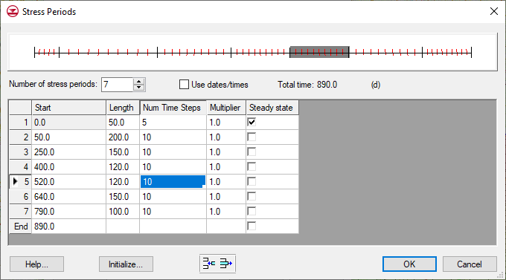
Initial Conditions
Recent versions of MODFLOW include an option to automatically run first time step as a steady state solution. This takes care of the problem automatically.

Slide 12
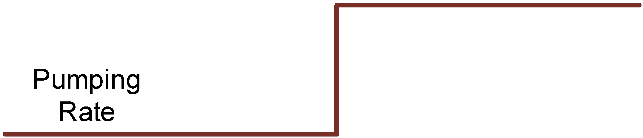
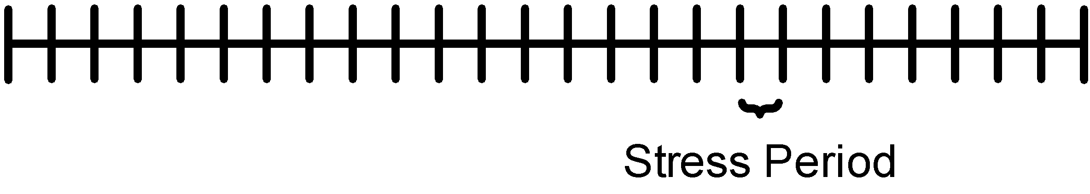
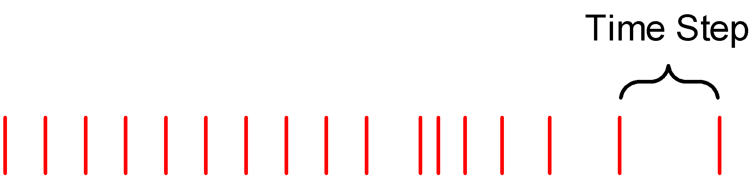
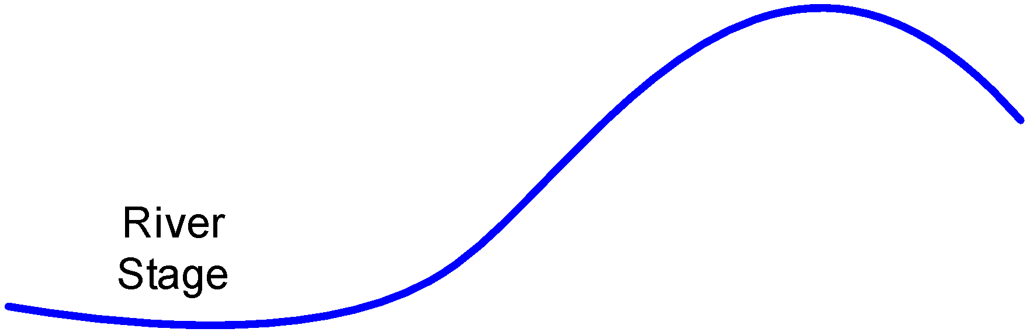
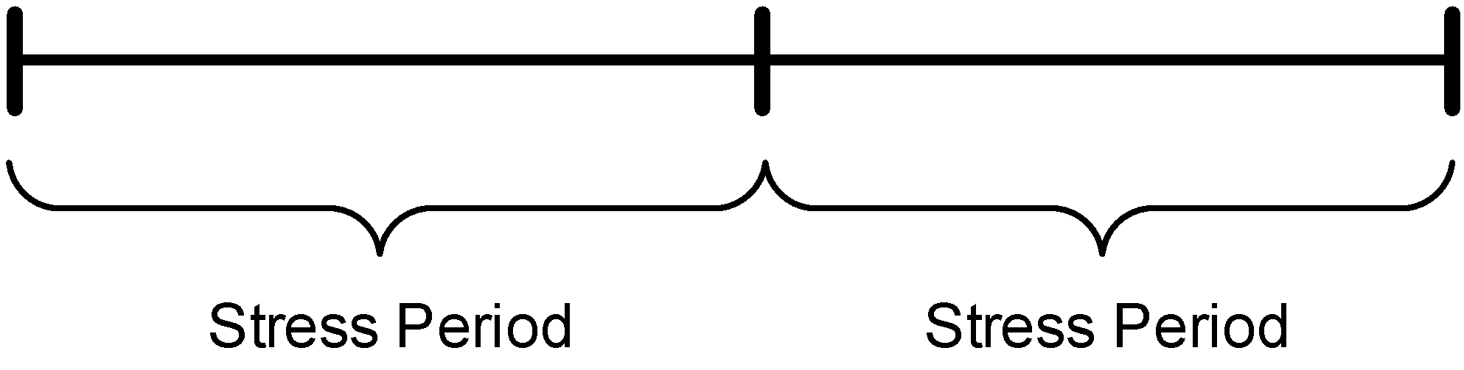
Stress Periods & Time Steps
Few stress periods,
many time steps
Few time steps,
many stress periods

Slide 13

Time Steps
Must choose appropriate distribution of time step sizes:
Too short -> long simulation times, large solutions
Too long -> model error

Slide 14
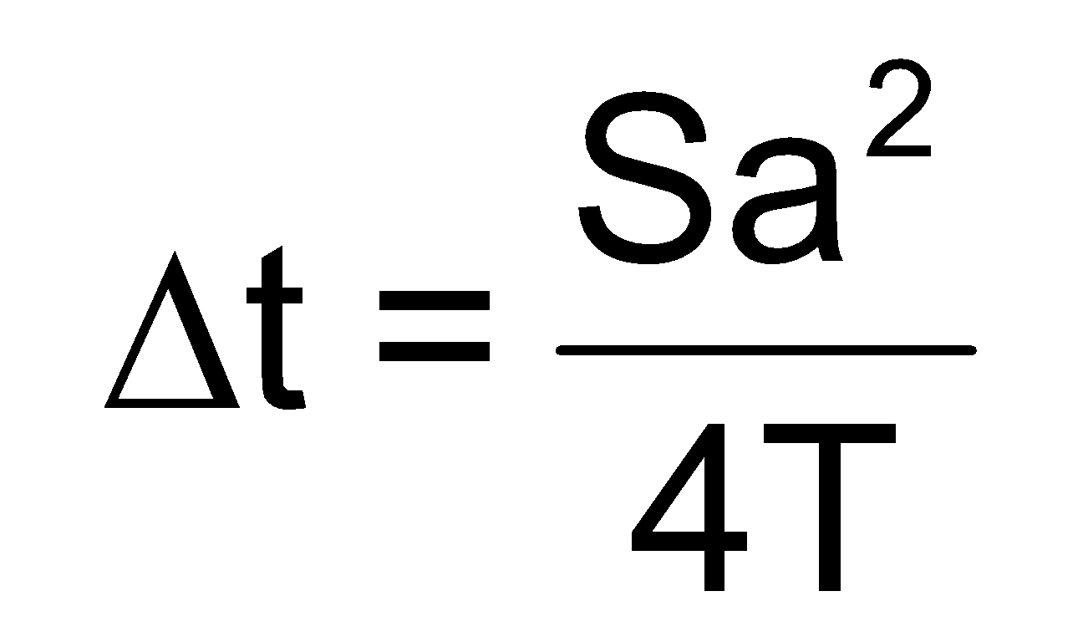
Time Step Rule of Thumb
Where:
Δt = the time step increment
S = storage coefficient
a = representative cell dimension in x and y.
T = transmissivity

Slide 15
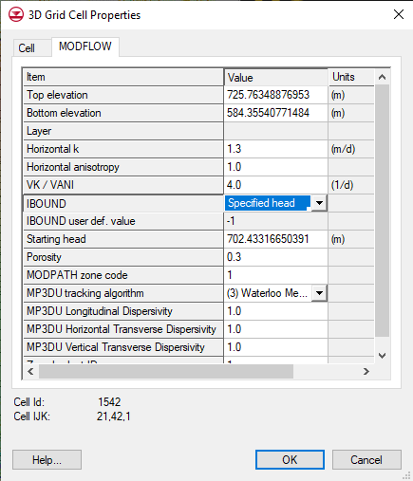
Changing Head (CHD) Package
Original method for defining specified heads works for static (steady state) heads only
- IBOUND Array
- Starting Heads Array
CHD later added to allow for transient specified head boundary conditions

Slide 16
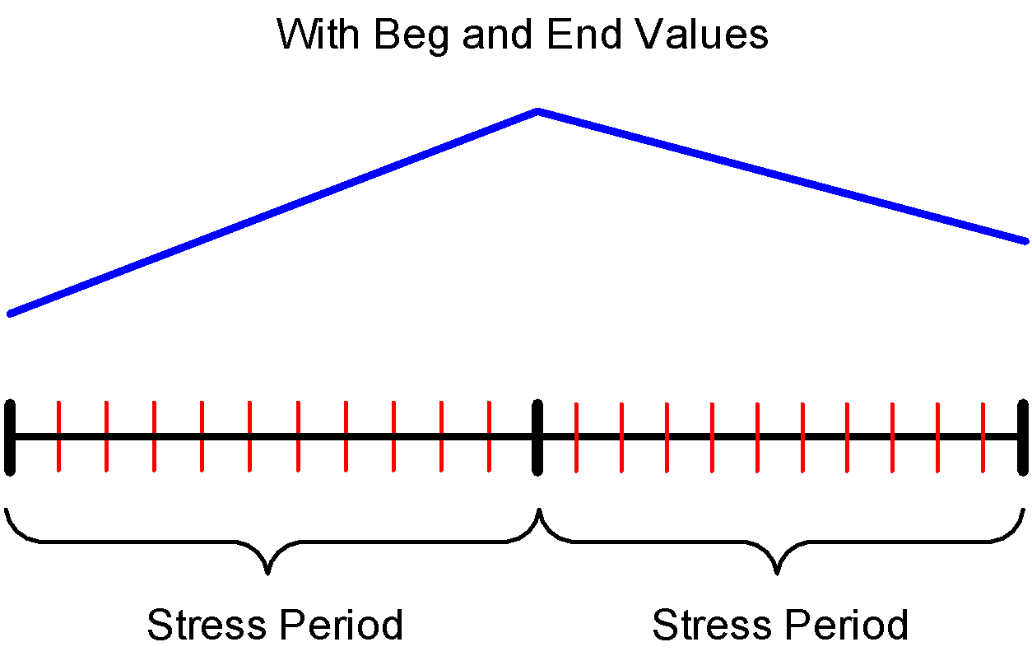
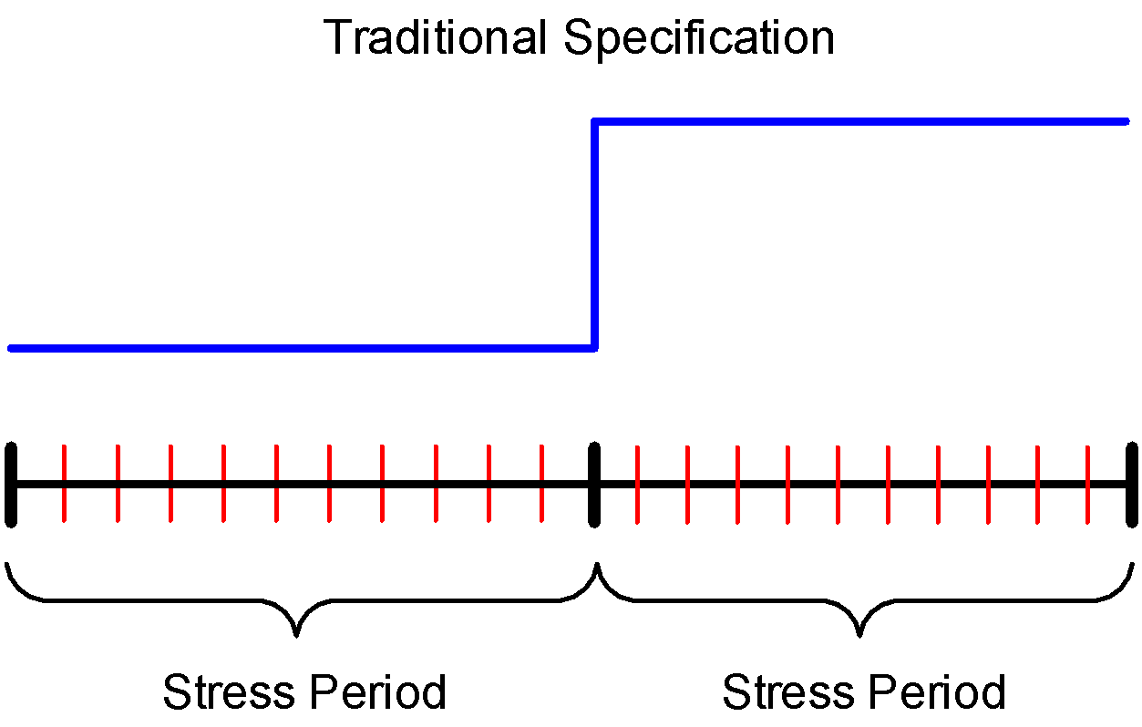
CHD Package
For each stress period, beginning and ending head is assigned

