Slide 1
Solvers Dry Wells
In-Class Task Script
CE En 547
Brigham Young University

Slide 2
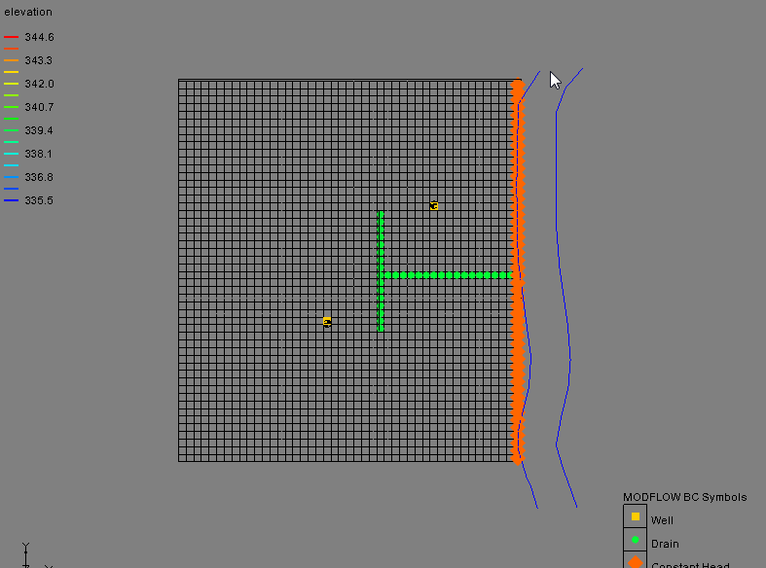
1. Download, unzip, and open file
May want to save as a different name.

Slide 3
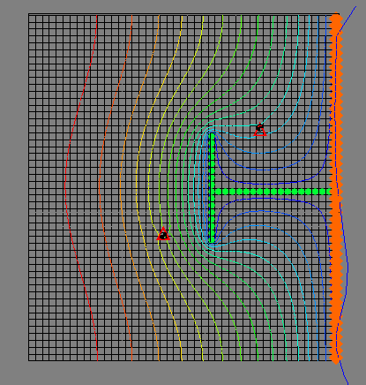
2. Save and run model
Cells containing wells are dry.
Head overshoot problem.

Slide 4
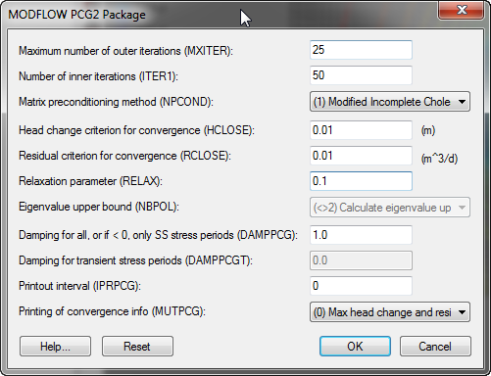
3. Reduce acceleration parameter
Save and run.
Does not fix problem.

Slide 5
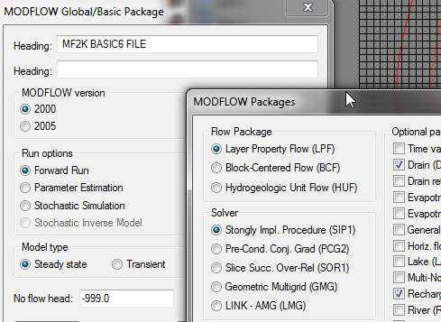
4. Try another solver
Still goes dry.
Change acc. Param to 0.1 and max iterations to 500.
Still goes dry.

Slide 6
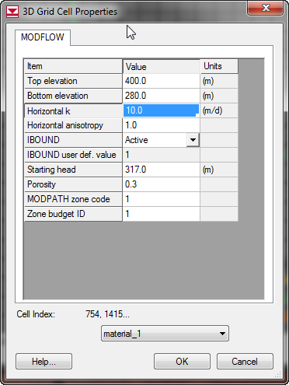
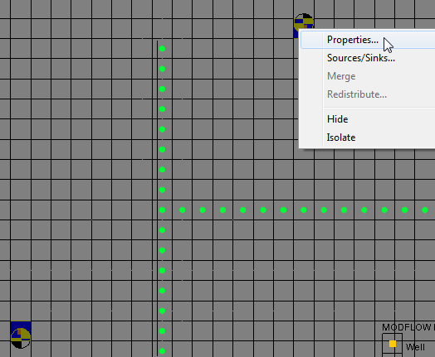
5. Change K in Cells
Select another array (other than head) so that the cells become active so that you can select them.
Ctrl-Select, right-click

Slide 7
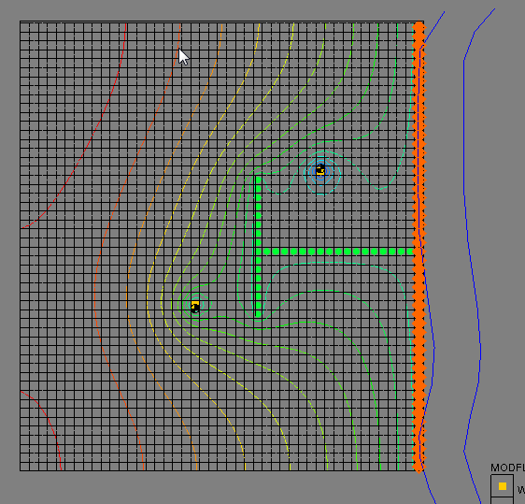
5a. Save and run
Change solver back to PCG2. Doesn’t work with SIP.

Slide 8
5b. Legitimate?
Depends on size of cell. There is some flushing of fines that occurs near wells that will increase the K. So if you have a grid where the cell containing the well is quite small, you could argue that a higher K is warranted due to the flushing that occurs during the well development process and over the lifetime of the well. However, in most cases, it means that you need to increase the overall K values used in your model as part of the calibration process.

