Slide 1
Solvers Thin Aquifer
In-Class Task Script
CE En 547
Brigham Young University

Slide 2
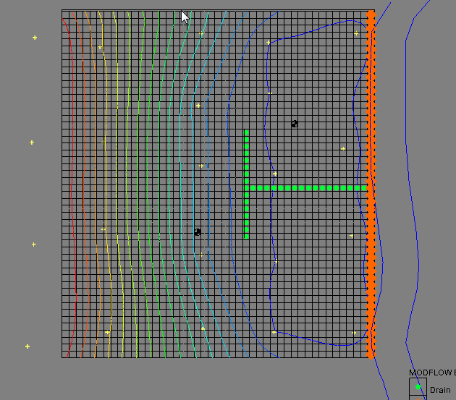
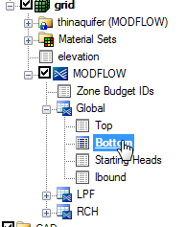
1. Download, unzip, and open file
May want to save as a different name.
You do not need to interpolate the bottom elevations. The model has already been modified with the different bottom elevations. You just need to experiment with the solver.
Activate bottom elevations array to see new elevations.

Slide 3
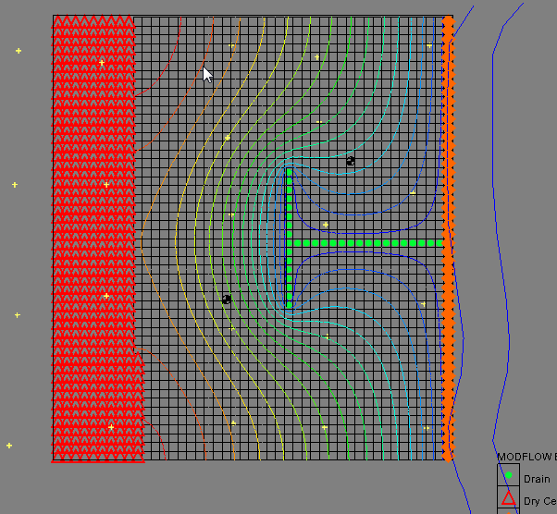
2. Save and run model
Cells go dry on left side.
Head overshoot?

Slide 4
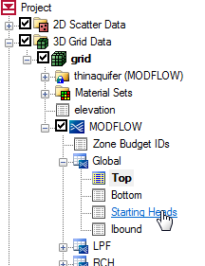
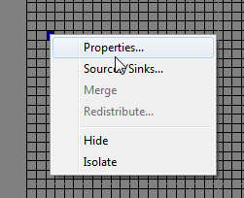
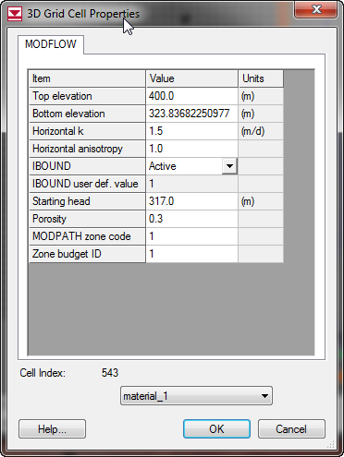
3. Change starting heads to a larger value.
First, compare starting heads to bottom elevations using the Cell Properties dialog.
a) Select one of the MODFLOW arrays so that the Head solution is not active.
b) Right-click on one of the cells that was going dry on left side of model.
c) Starting head is too low. Starts out below bottom elevation.

Slide 5
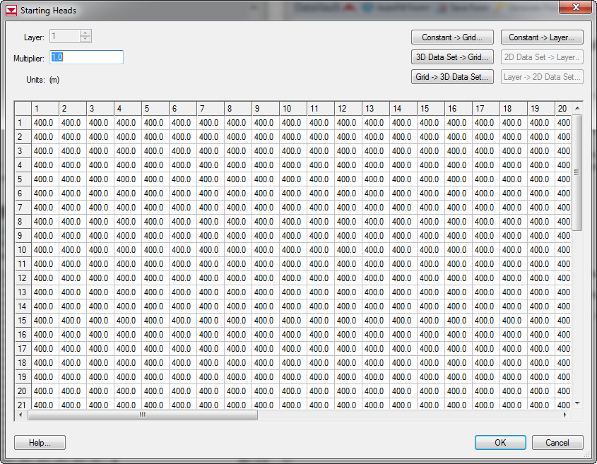
3. cont…
Change starting heads so that they are above the bottom elevation. Try 400.

Slide 6
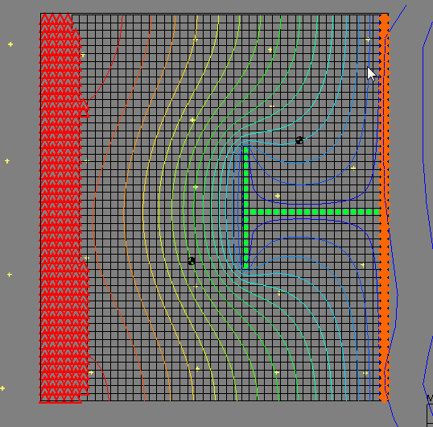
3. cont.
Not much change. Cells are still going dry.

Slide 7
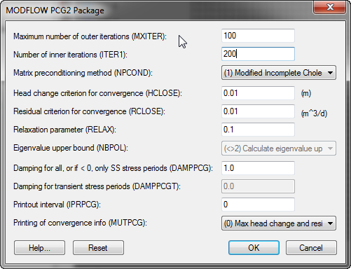
4. Change solver options
Increase number of iterations
Reduce acceleration (relax) parameter so that solver takes smaller steps. See if we have a head overshoot problem.

Slide 8
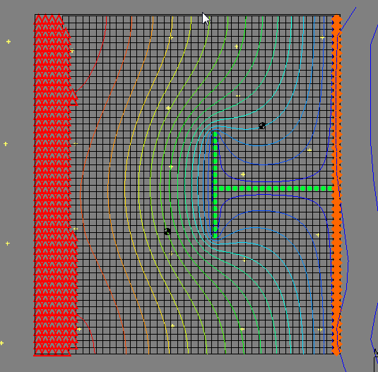
4. cont.
Still not much change.
Keep trying!

Slide 9
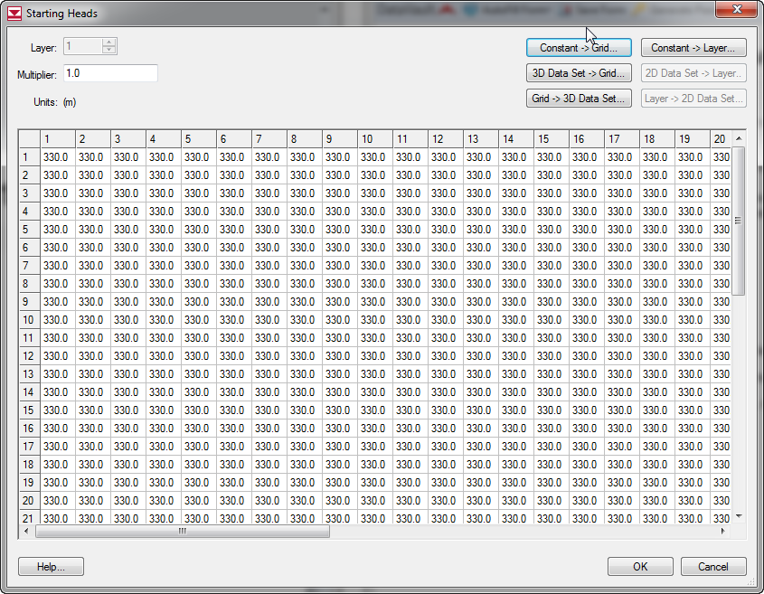
5. Try putting the starting head closer to the final head
Change to 330.
Bottom elevation =~326 on the left side.

Slide 10
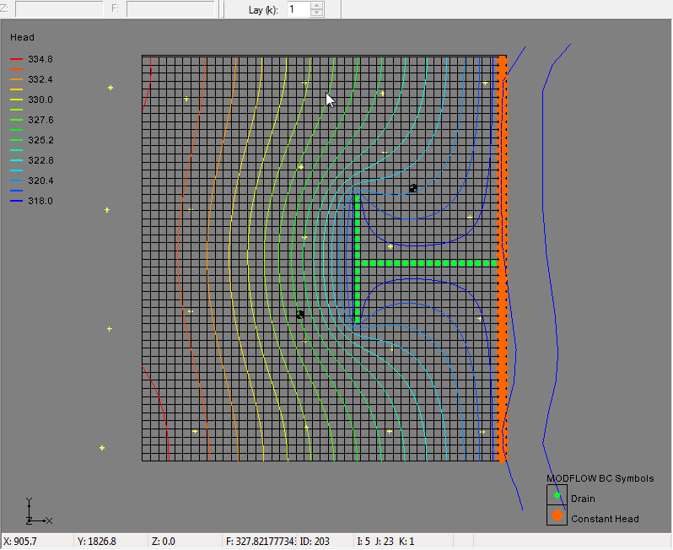
5. cont.
Bingo. Cells are no longer going dry. It was clearly a head overshoot problem.

Slide 11
5. cont.
You can also get the problem to converge with zero dry cells by switching to a different solver (SIP, GMG) and reducing the acceleration parameter.

