Slide 1
Boundary Condition Analysis
In-Class Task Script
CE En 547
Brigham Young University

Slide 2
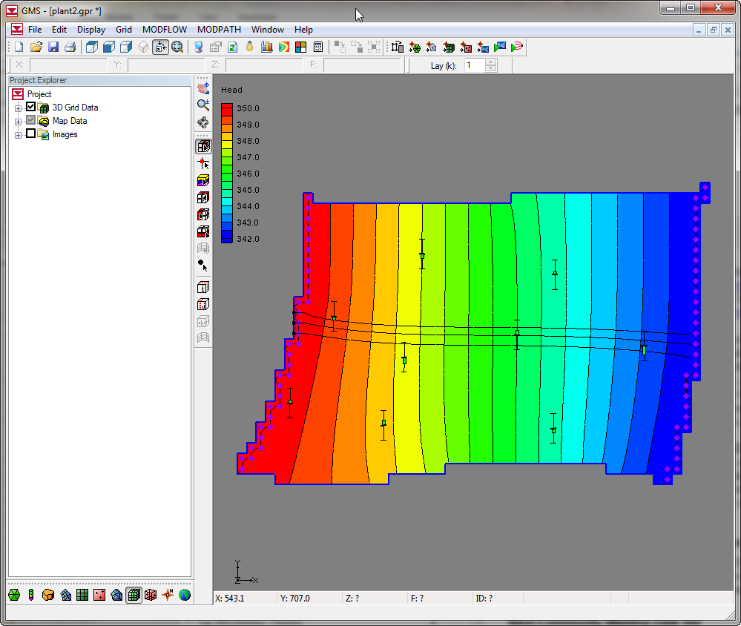
1. Download, unzip, and open file

Slide 3
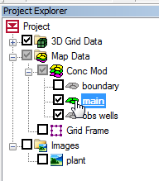
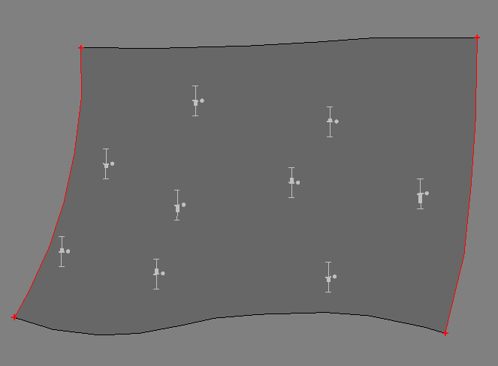
2a. Note boundary conditions
Turn on main coverage
Specified head = 350
Specified head = 342

Slide 4
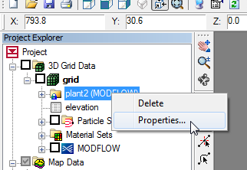
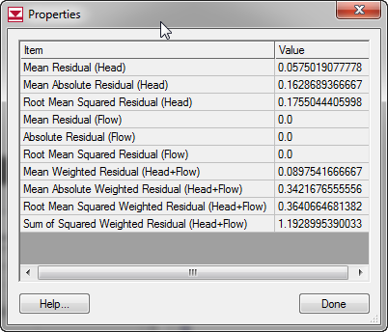
2b. Note the model error

Slide 5
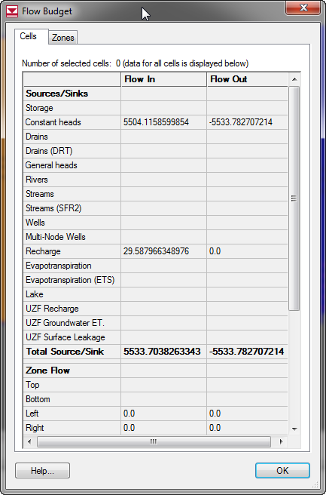
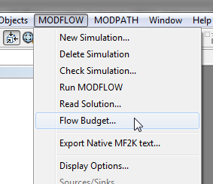
2c. Note the flow budget

Slide 6
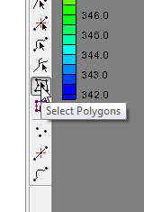
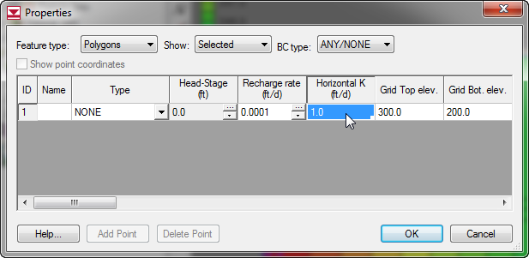

3. Reduce K and re-run model

Slide 7
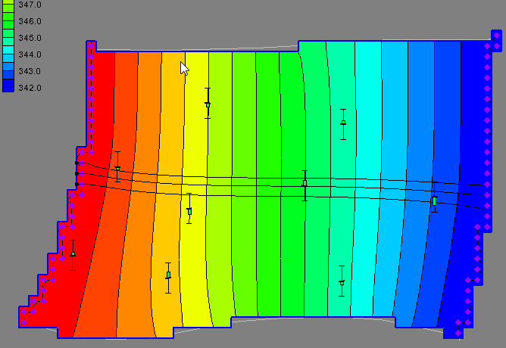
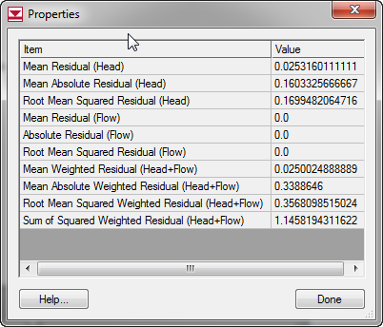
4. Examine head and error
Heads are nearly identical
Errors are nearly identical
Solution is non-unique. Same heads even though K was reduced by a factor of 10.

Slide 8

5. What is different?
Answer: Flow budget
Q reduced by a factor of 10.
Note: you can also select the pathlines and look at the change in travel times for the different solutions.

Slide 9
6. Which is most appropriate?
A: If you have some way of estimating the flow through the boundaries or the groundwater flow velocities, you can determine which solution is more appropriate. In other words, if you fix the Q, you can solve for a unique K value.

Slide 10
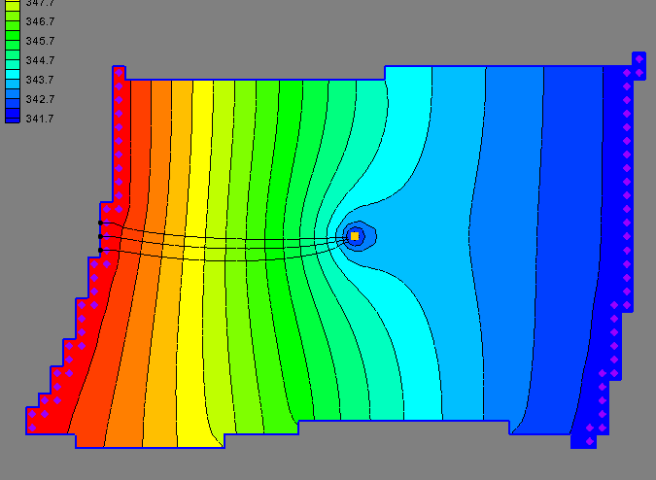
7. Well in the middle of the site
Q: Would the boundary condition assumptions still be valid?
A: Depends on the magnitude of the pumping rate in the well. If it is larger than the recharge rate (quite likely), it would change the direction in flow such that water would flow into the model from both sides.
Does that violate BC assumptions?
It depends on the pumping rate and radius of influence of the well. The cone may intersect the boundaries and violate the assumptions used in the boundaries conditions (no-flow, constant head)
If time permits, add a well in the middle of the model. Use Q=-1000.

Slide 11
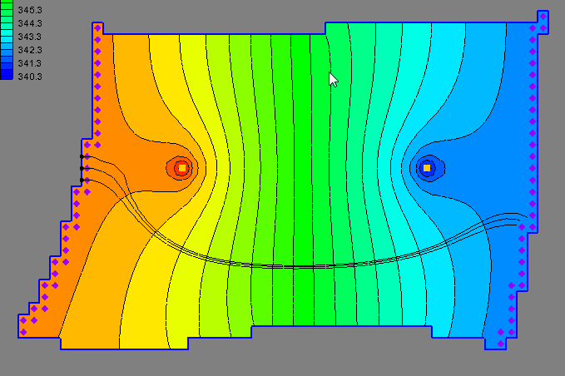
8. Dual well system.
Q: Suppose you a dual-well system (injection-extraction) in the middle of the site. Would the boundary condition assumptions still be valid?
A: Same issues as before, but at least in this case you might have zero net change to the overall flow budget if the injection rate = extraction rate.
Used Q=+500, -500
In this case, wells are probably too close to boundaries.

