Slide 1
Groundwater Modeling Concepts
CE 547 – BRIGHAM YOUNG UNIVERSITY

Slide 2
Types of Models
Predictive
Used to make predictions based on hypothetical future scenarios
Interpretive
Used to gain a better understanding of an aquifer
Generic
Based on a simple classical case, rather than on a real system. Used for academic purposes

Slide 3
Model Development Protocol
Define purpose of model
Conceptual model development
Code selection
Data collection
Model design
Calibration
Verification
Prediction
Postaudit
Adapted from Anderson & Woessner, 1992

Slide 4
1. Define Purpose of Model
Types of models
Interpretive
Predictive
How much accuracy is needed?
How much $$ is available for study?
How will answers be used?

Slide 5
2. Develop Conceptual Model
A high level description of the principal features of the system to be modeled
Includes aquifer units, boundary conditions, sources, and sinks
Parsimony - Keep the model simple enough to be manageable, yet complex enough to be useful

Slide 6
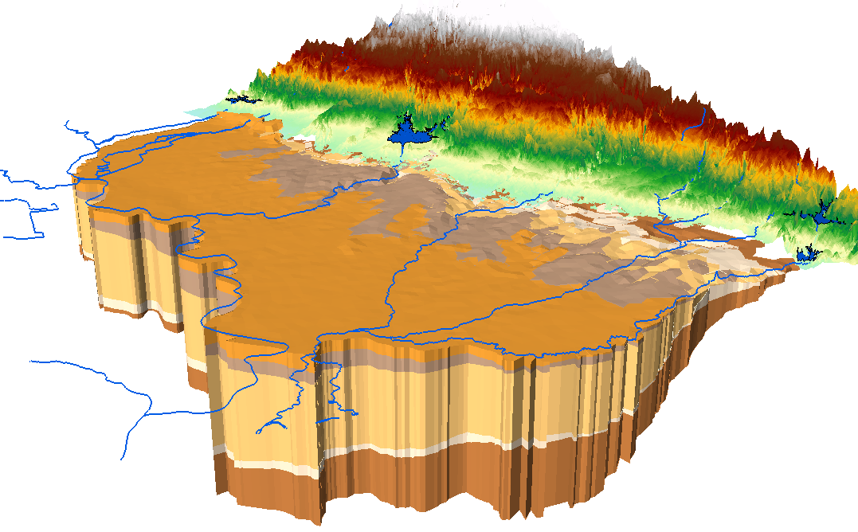
Characterize Aquifer Units
Try to determine principal hydrogeologic units
Hydrogeologic unit = zone that exhibits common hydraulic properties
May include multiple geologic units

Slide 7
3. Code Selection
Does the code model all of the processes in the conceptual model?
Use the simplest code possible in light of conceptual model and the purpose of the modeling study
Has the code been thoroughly tested and verified?

Slide 8
4. Data Collection
Well/borehole logs
River/lake stages
Pumping data
Maps, aerial photos
Elevations
Observation well data

Slide 9
5. Model Design
Construct numerical model
Find reasonable set of parameters and initial conditions

Slide 10
6. Calibration
Modify input parameters until model output matches field-observed values
Observations
Heads at wells
Flows at sources/sinks (rivers, lakes)
Can be automated in some cases with PEST utility
Should include sensitivity analysis

Slide 11
7. Verification
Calibrate to multiple sets of observation data if possible
In each case, adjust boundary conditions and model stresses to be consistent with conditions present when observations were made

Slide 12
8. Prediction
Alter model, run simulation, and make predictions
Can include stochastic analyses

Slide 13
9. Postaudit
When possible, review the model in later years to determine accuracy of predictions
Can be used to improve model

Slide 14
One of the most insidious and nefarious properties of scientific models is their tendency to take over, and sometimes supplant, reality.
— Erwin Chargaff
Quoted in J. J. Zuckerman, 'The Coming Renaissance of Descriptive Chemistry', Journal of Chemical Education, 1986, 63, 830.
…all models are approximations. Essentially, all models are wrong, but some are useful.
— George E.P. Box
In George E. P. Box and Norman R. Draper, Empirical Model-Building and Response Surfaces (2007), 414.

