Slide 1
MODFLOW – Optional Packages, Part 1
CE 547 – BRIGHAM YOUNG UNIVERSITY

Slide 2
Optional Packages
CHB – Time Variant Specified Head
DRN – Drain
DRT – Drain Return Flow
ETS – Evapotranspiration Segments
EVT – Evapotranspiration
GAGE – Gage
GHB – General Head
HFB – Horizontal Flow Barrier
LAK – Lake
MNW – Multinode Well
MNW2 – Multinode Well 2
RCH – Recharge
RIV – River
SFR – Stream Flow Routing
STR – Stream-Aquifer Interaction
SUB – Subsidence
WEL – Well
UZF – Unsaturated Zone Flow

Slide 3
Well Package
Assigned to individual cells
Q can be steady state or transient
Extraction well (neg Q)
Injection well (pos Q)

Slide 4
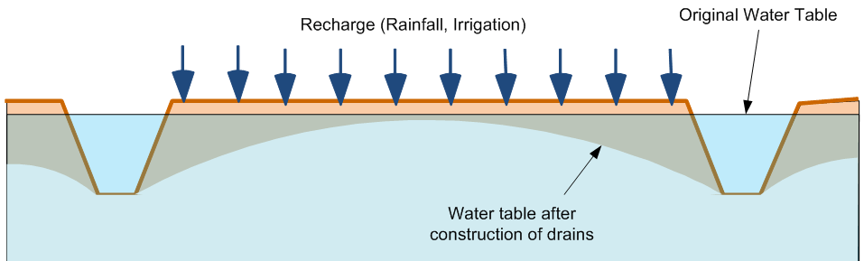
DRN - Drain Package
Assigned to individual cells
Used to simulate
Agricultural drains
Springs
Creek beds
Required parameters
Elevation
Conductance

Slide 5
Drains
H_{ijk}
CD
Delev
When the head is above the drain elevation:
Q = CD (H_{ijk} - Delev) or
Q = CD (Delev - H_{ijk}) for proper sign on Q

Slide 6
Drains
CD
Delev
H_{ijk}
When the head is below the drain elevation:
Q = 0

Slide 7
Conductance
Darcy’s Law:
Where:
q = flow rate
k = hydraulic conductivity
Dh = head difference
L = flow length
A = gross cross-sectional area

Slide 8
Conductance, Cont.
Darcy’s law can be rewritten as:
Where:
The appropriate values for k, A, and L must be determined on a case-by-case basis

Slide 9
Sample Conductance Calculation
Length of overlap of river on cell

Slide 10
Recharge Package
One value assigned to each vertical column (one per each cell in the top layer)
Represents recharge due to precipitation
Can be steady state or transient
Infiltration rate must be assigned in correct units [L/T]

Slide 11
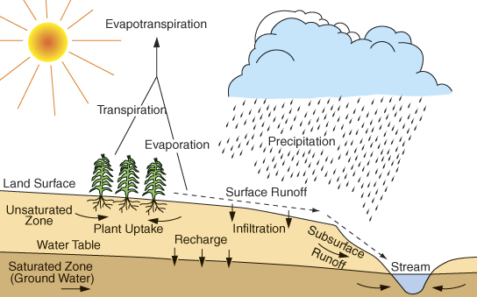
Factors Affecting Recharge Rate
Recharge is typically = ~ 10-20% of precipitation

