Slide 1
MODFLOW – Optional Packages Part 2
CE 547 – BRIGHAM YOUNG UNIVERSITY

Slide 2
Optional Packages
CHB – Time Variant Specified Head
DRN – Drain
DRT – Drain Return Flow
ETS – Evapotranspiration Segments
EVT – Evapotranspiration
GAGE – Gage
GHB – General Head
HFB – Horizontal Flow Barrier
LAK – Lake
MNW – Multinode Well
MNW2 – Multinode Well 2
RCH – Recharge
RIV – River
SFR – Stream Flow Routing
STR – Stream-Aquifer Interaction
SUB – Subsidence
WEL – Well
UZF – Unsaturated Zone Flow

Slide 3
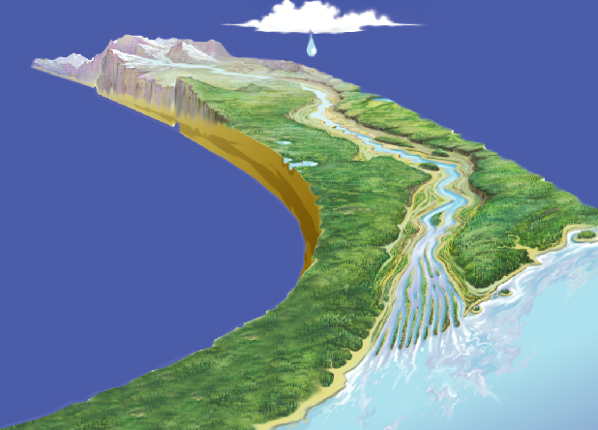
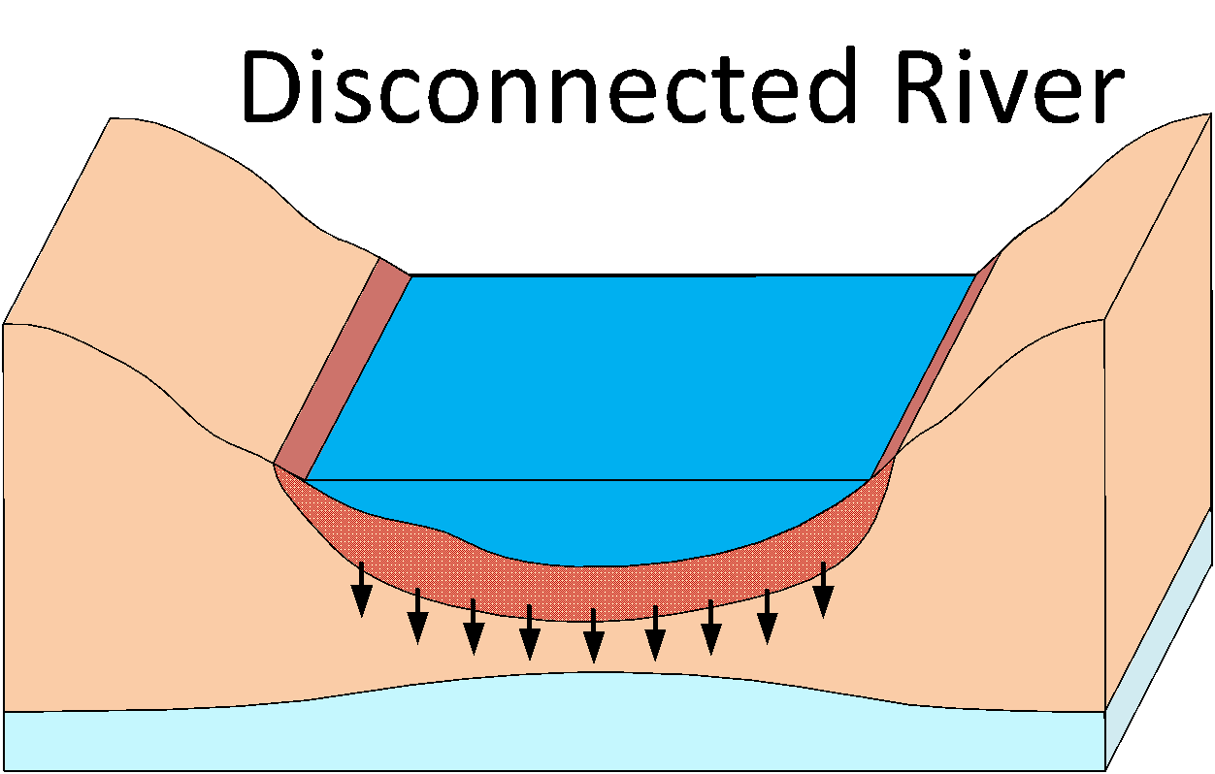
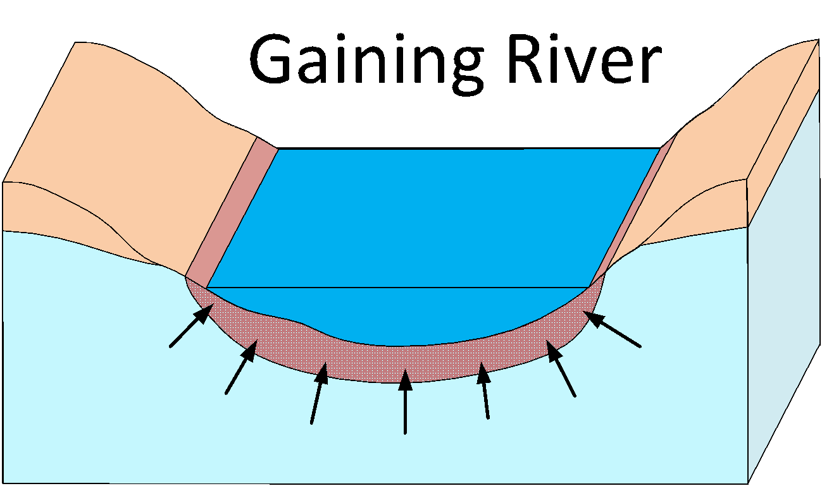
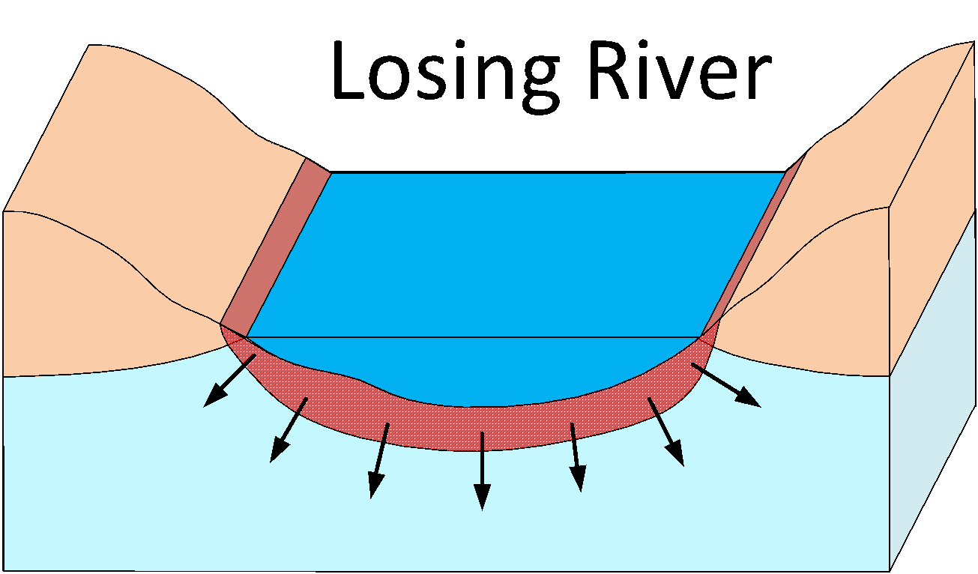
Stream-Aquifer Systems

Slide 4
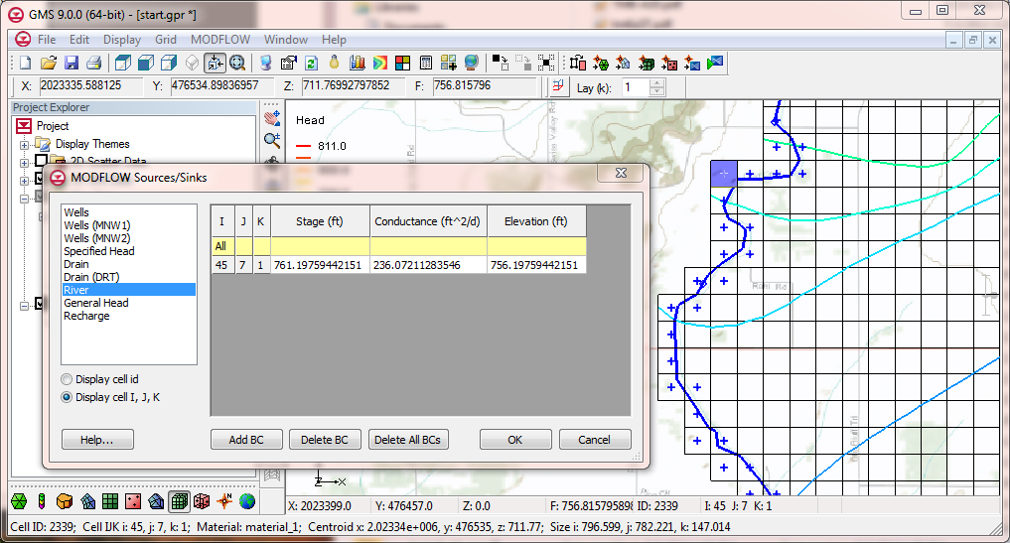
River Package
If head is above river stage, flow is from aquifer -> river
If head is below river stage, flow is from river -> aquifer

Slide 5
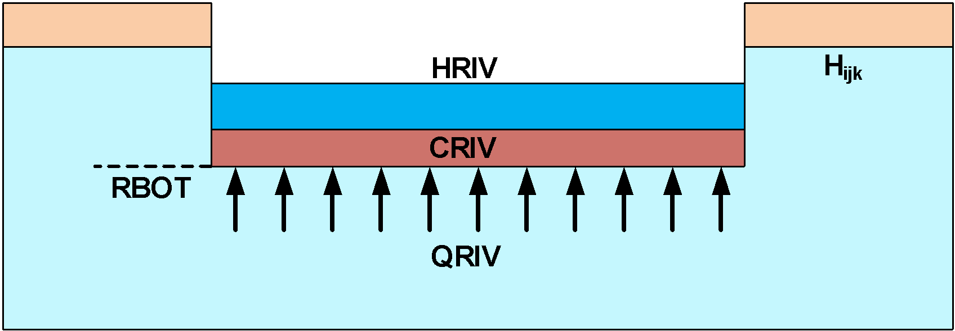
Idealized Representation
H_{ijk} = Head in cell
HRIV = Stage in river
CRIV = Conductance of river bottom sediments
RBOT = Elevation of bottom of sediments
QRIV = Flow between aquifer and river

Slide 6
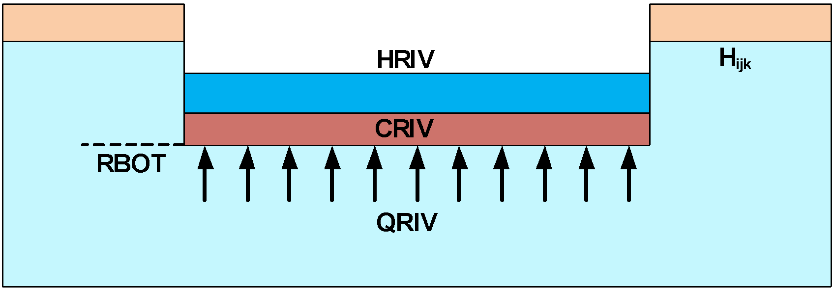
Case #1 – Head Above River Stage
QRIV = CRIV * (HRIV - H_{ijk})
(-Q signifies flow out of cell)

Slide 7
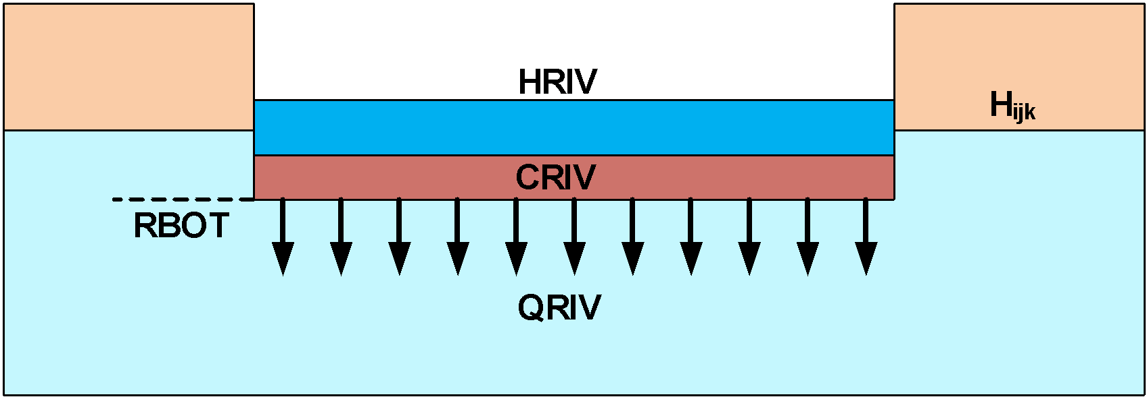
Case #2 – Head Below River Stage But Above River Bottom
QRIV = CRIV * (HRIV - H_{ijk})

Slide 8
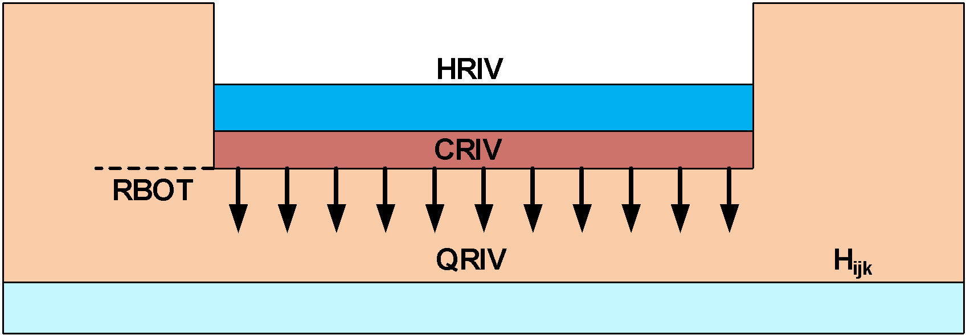
Case #3 – Head Below River Bottom
QRIV = CRIV * (HRIV - RBOT)

Slide 9
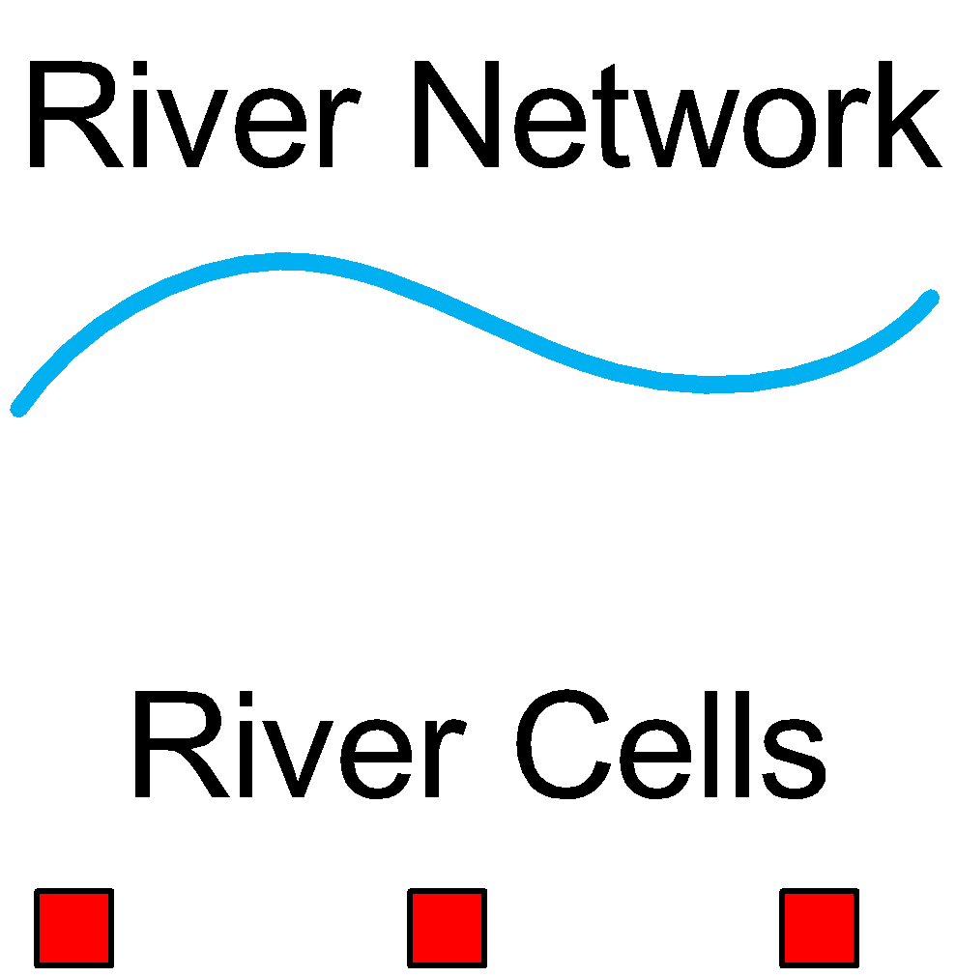
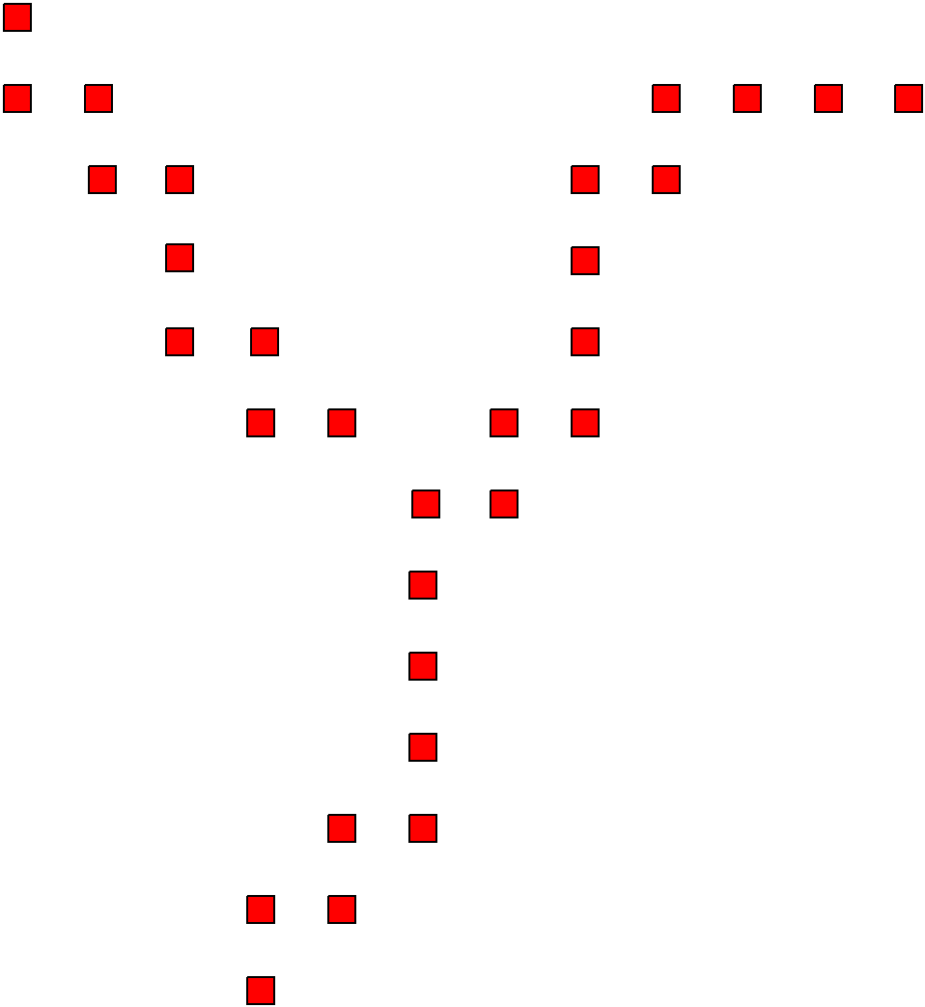
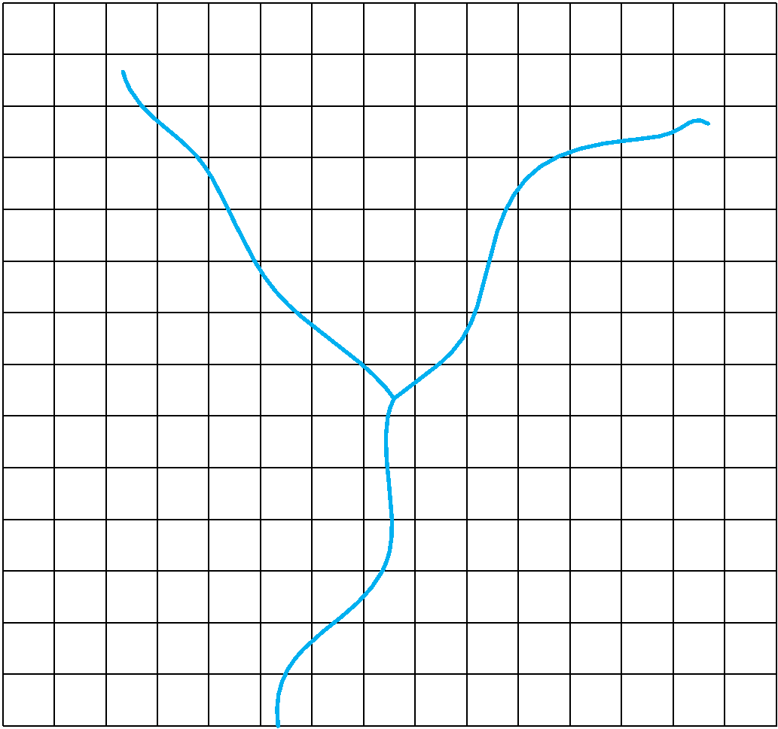
River Conductance
Length of reach in each river cell is computed

Slide 10
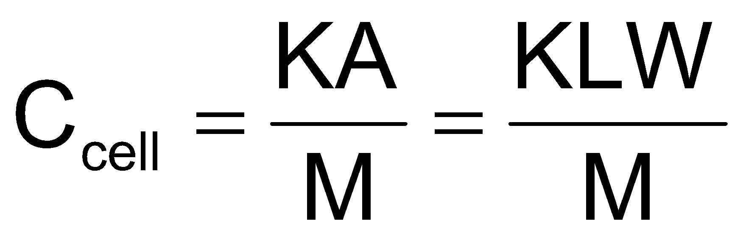
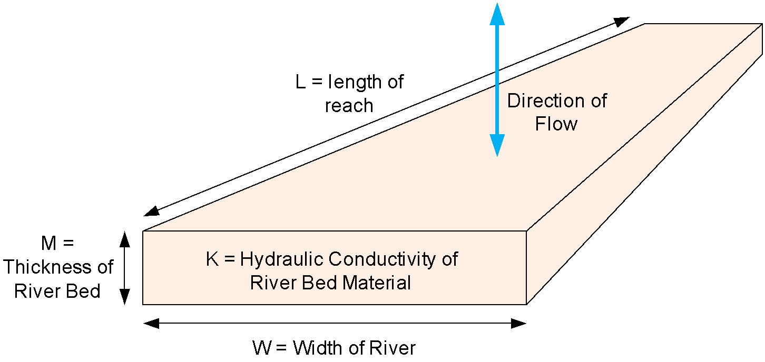
River Conductance Calculation
Length of overlap of river on cell

Slide 11
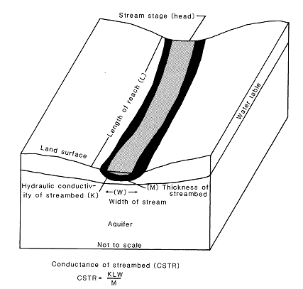
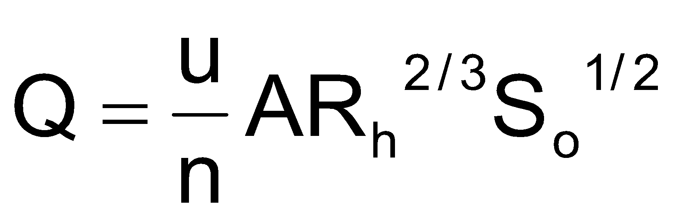
STR - Stream-Aquifer Interaction Package
Like the River Package, water can flow from aquifer to stream or vice versa.
Unlike the River Package, stage is not specified. Rather, flow is routed using simple channel hydraulics and a stage is computed using Manning’s equation.

Slide 12
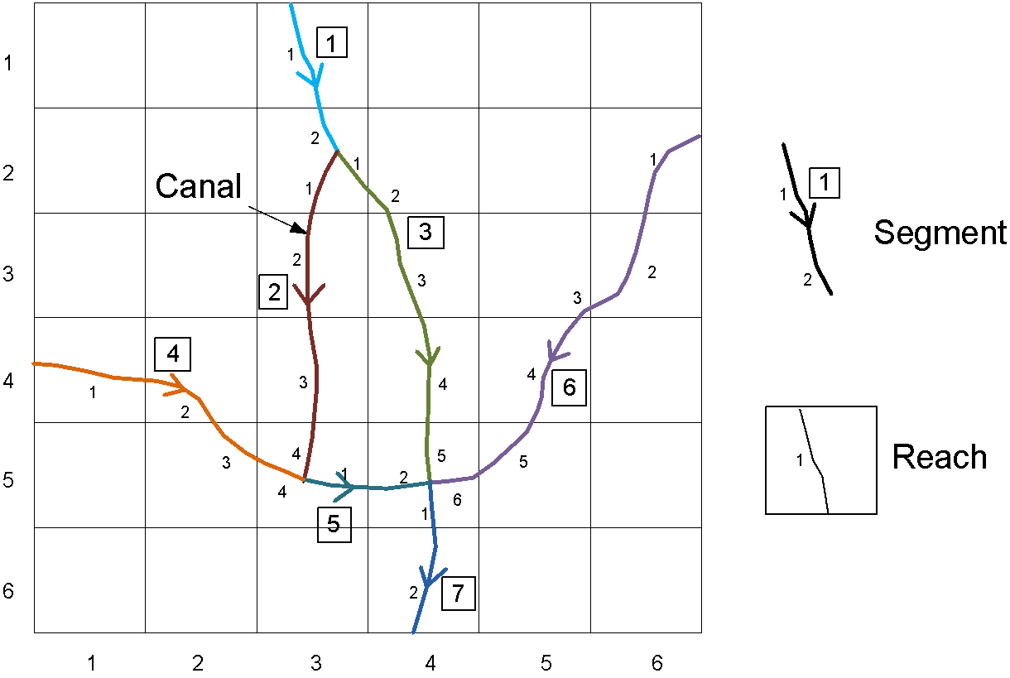
STR Package - Segments and Reaches

Slide 13
STR Package - Required Attributes
Segments
Incoming flow (for top segments and diversions)
Width
Slope
Manning’s roughness coefficient
Reaches
Conductance
Elevation of the bottom of the streambed
Elevation of the top of the streambed

Slide 14
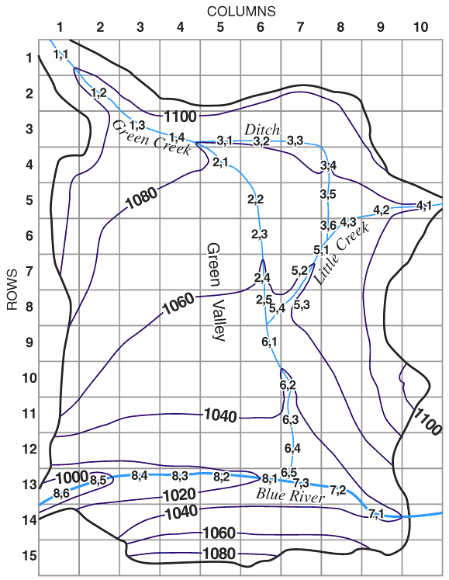
SFR - Stream Flow Routing Package
More advanced stream package
More options for inputs to streams
Interaction with the Unsaturated Zone Flow package

Slide 15
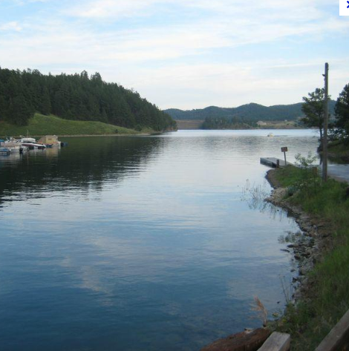
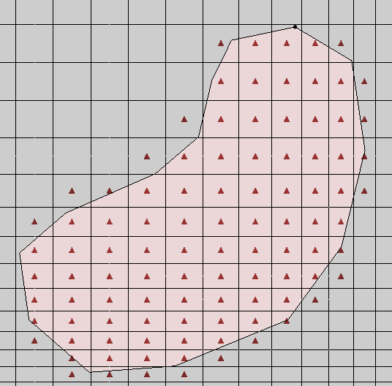
GHB - General Head Package
Often used to simulate lakes, reservoirs
Required parameters:
Head
Conductance

Slide 16
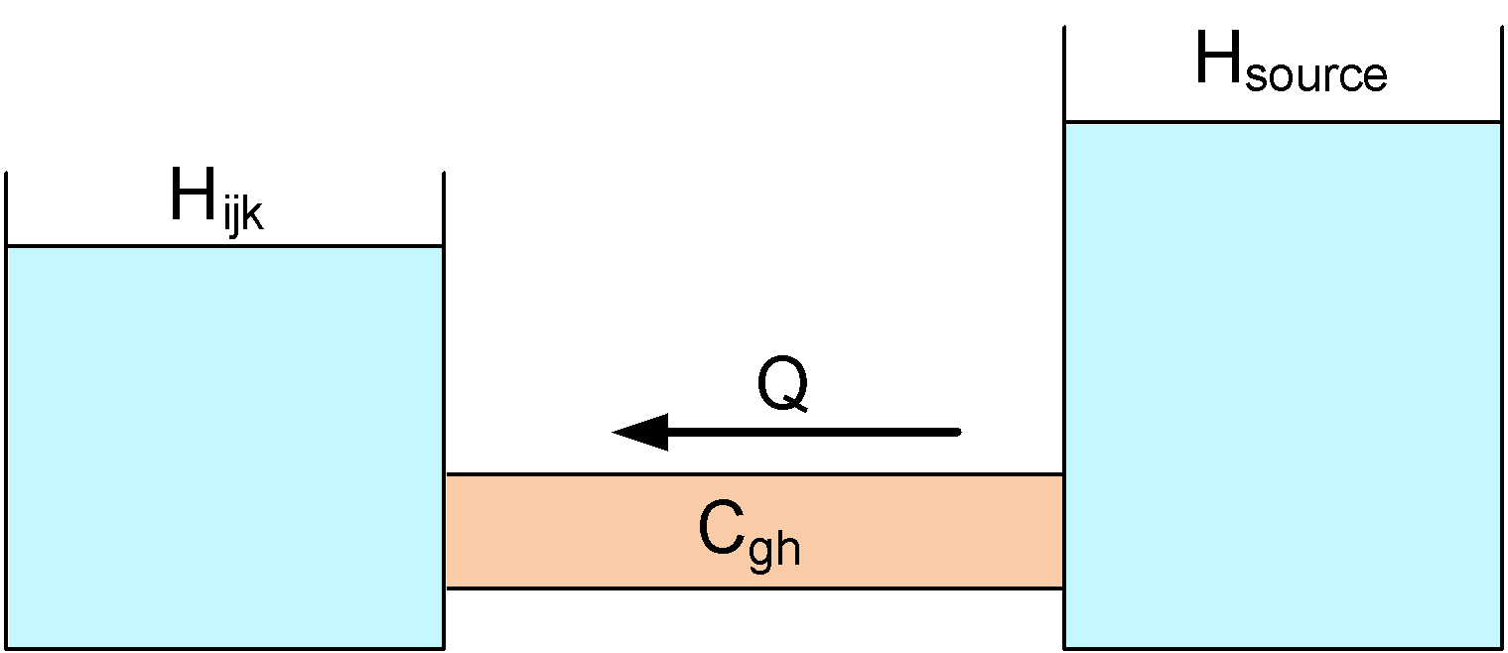
General Head
Q = Cgh * (H_{source} - H_{ijk})

Slide 17
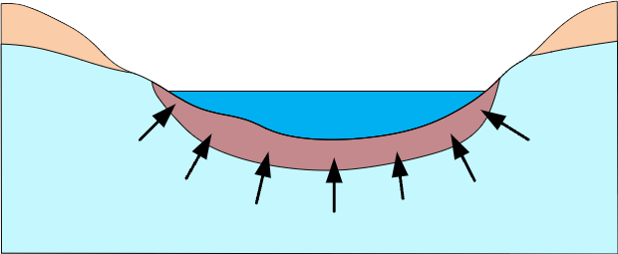
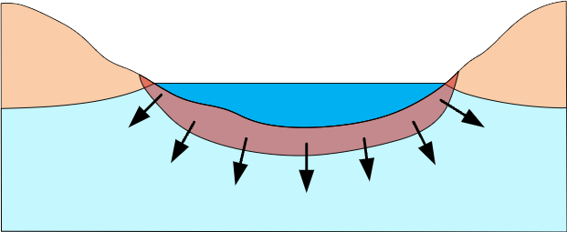
General Head Boundary
Gaining Lake/Reservoir
Losing
Lake/Reservoir

Slide 18
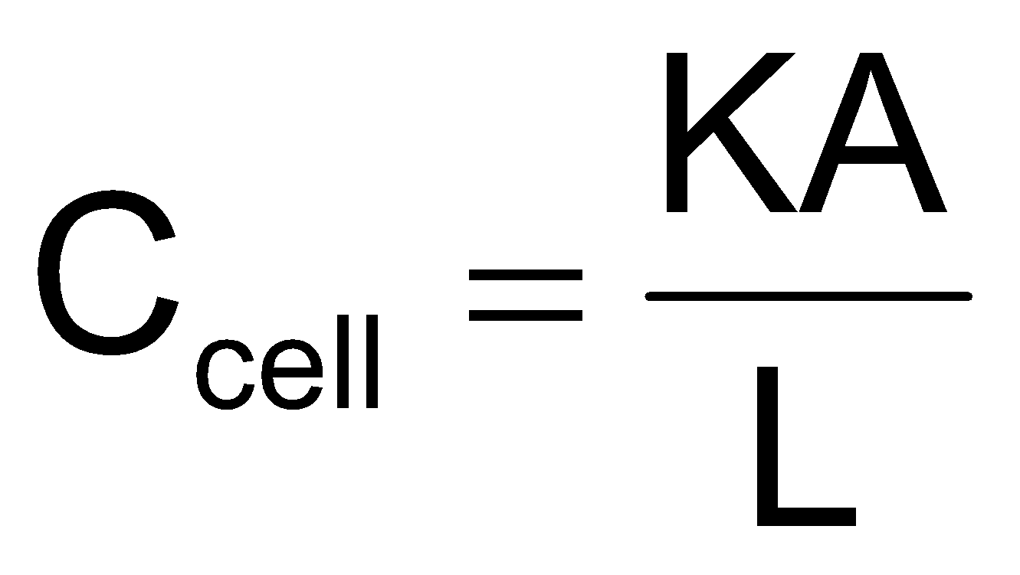
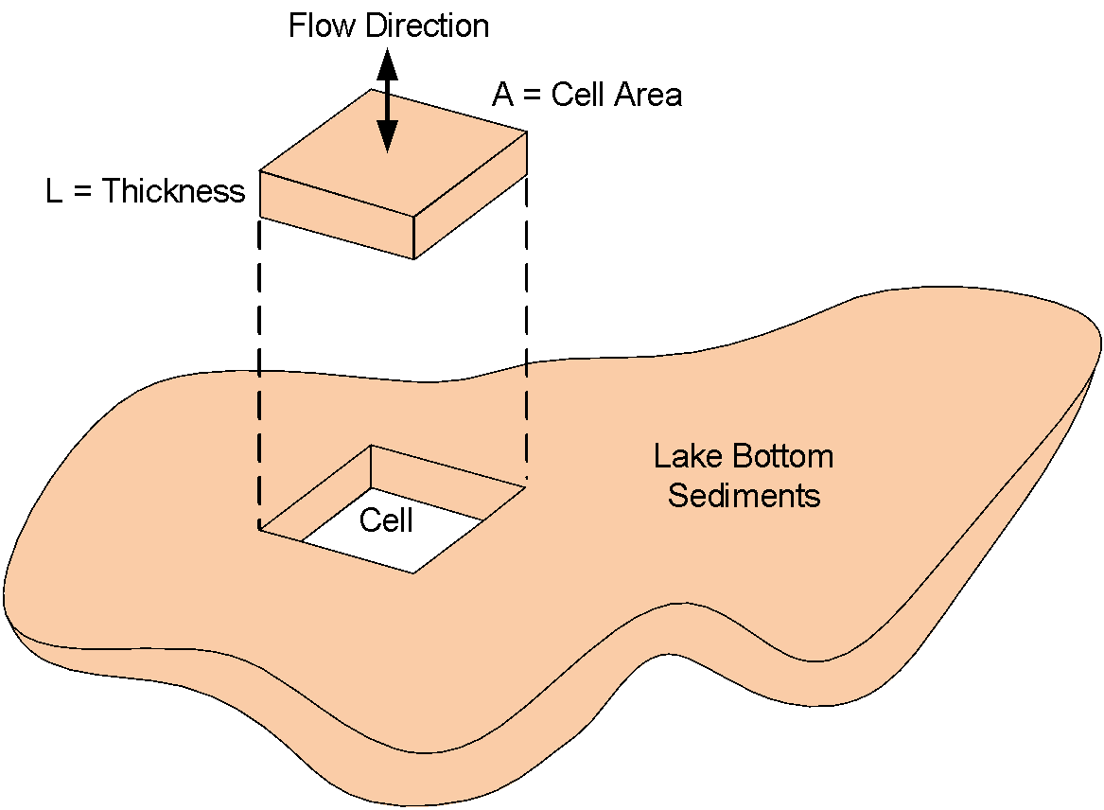
Lakes and Reservoirs

Slide 19
CHD - Time Variant Specified Head Package
CHD = Changing Head
Original method for defining specified heads, works for static (steady-state) heads only
IBOUND
Starting Heads Array
CHD later added to allow for transient specified head boundary conditions
Can be used for steady-state case also

Slide 20
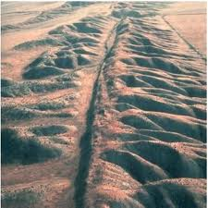
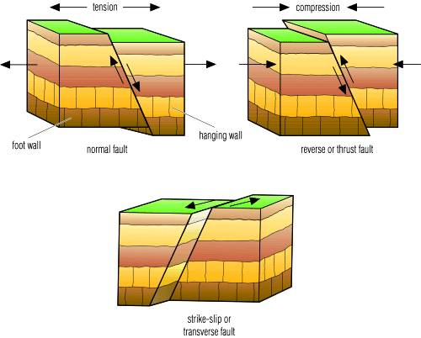
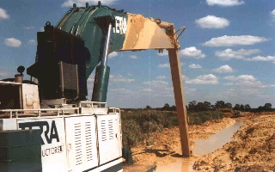
HFB – Horizontal Flow Barrier Package
Used to simulate low permeability barriers such as faults, sheet pile walls, and slurry trenches

Slide 21
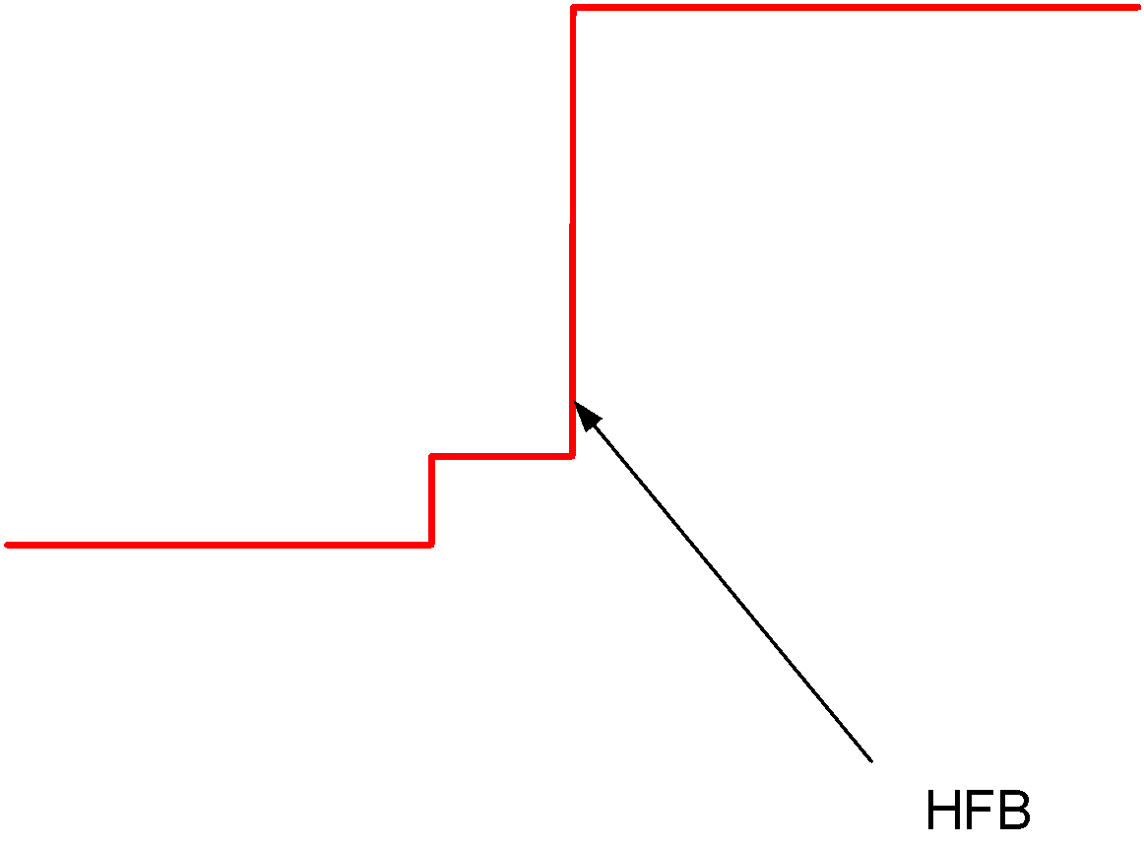
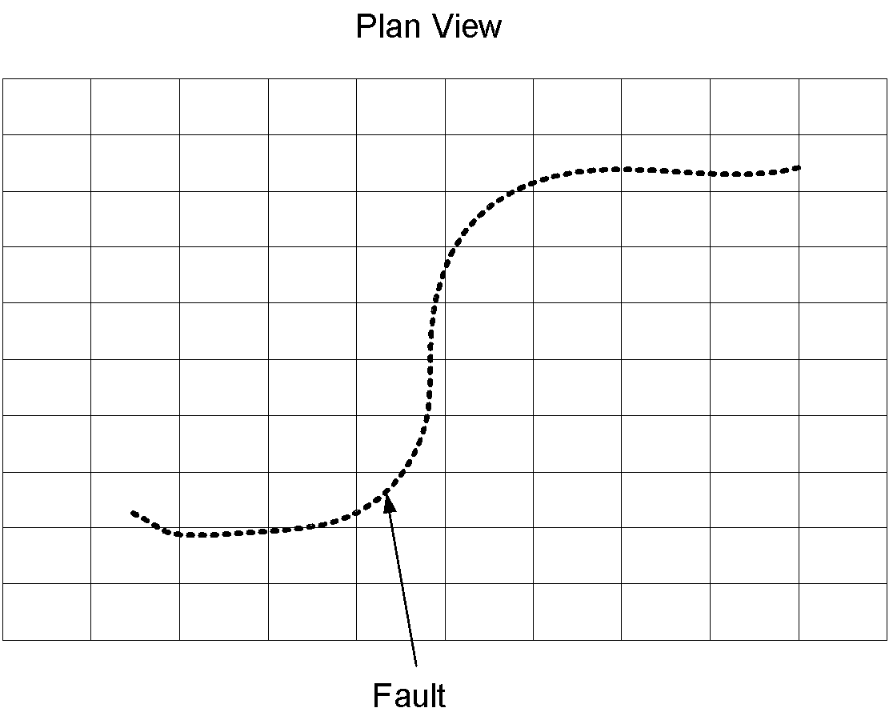
HFB Cell Boundaries

Slide 22
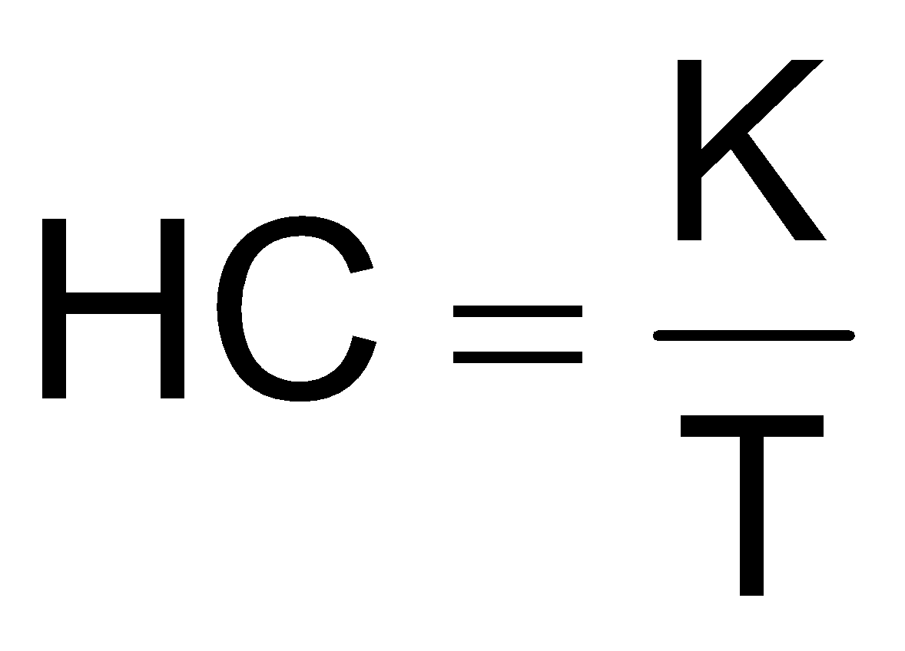

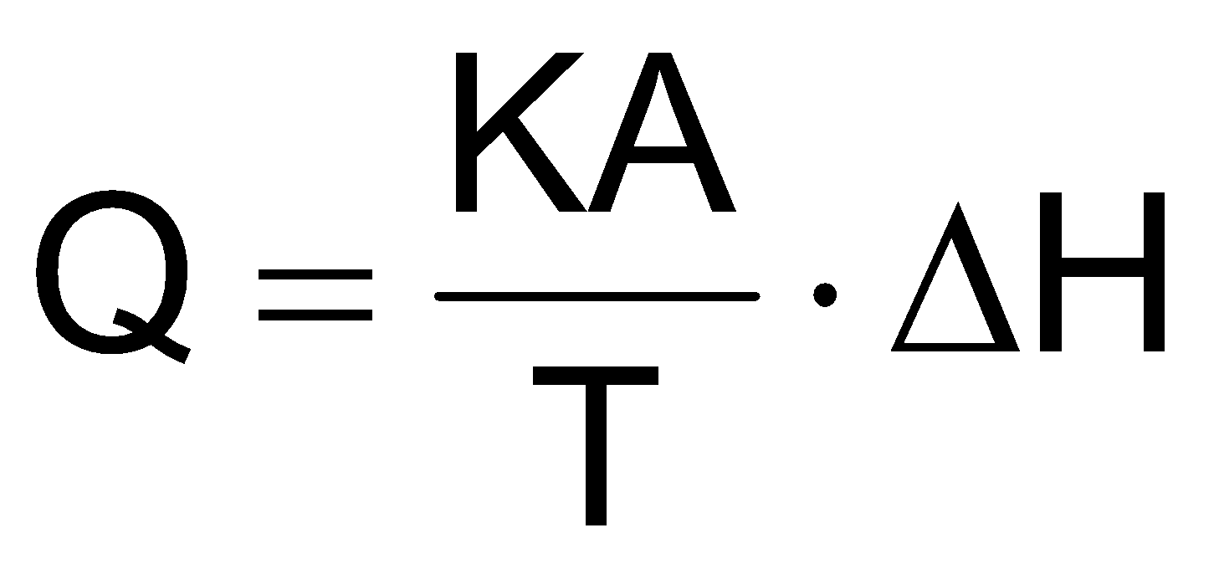
HFB – Hydraulic Characteristic
Adjacent Cells
A = Area
T = Thickness
Barrier is applied to the cell boundary
Each instance is assigned a “hydraulic characteristic”

Slide 23

EVT – Evapotransporation Package
Simulates groundwater loss from evaporation and transpiration
ET rate depends on water table elevation

Slide 24
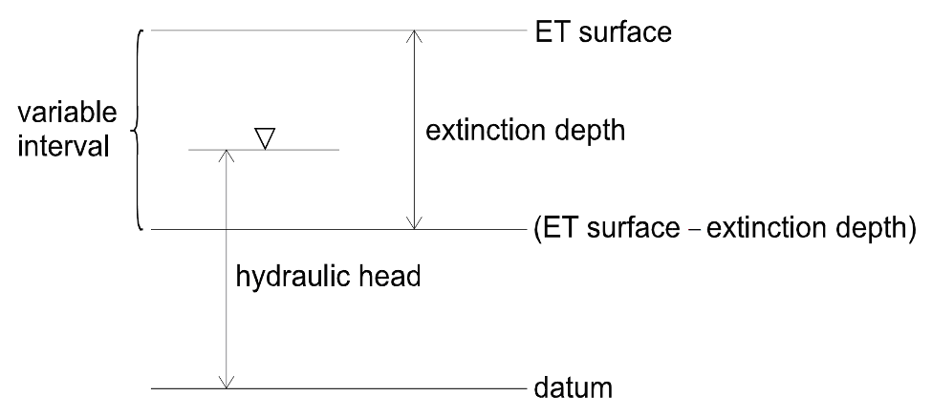
EVT – Evapotransporation Package
User specifies:
Maximum ET rate
Surface elevation (usually ground surface)
Extinction depth
ET rate = 0.0 when head below (ET surface – ext. depth)
ET rate = Max. ET rate when head above or equal to ET surface
ET rate varies when head between ET surface and ext. depth

