Slide 1
2D Geostatistics Interpolating Layer Elevations
CE 547 – BRIGHAM YOUNG UNIVERSITY

Slide 2
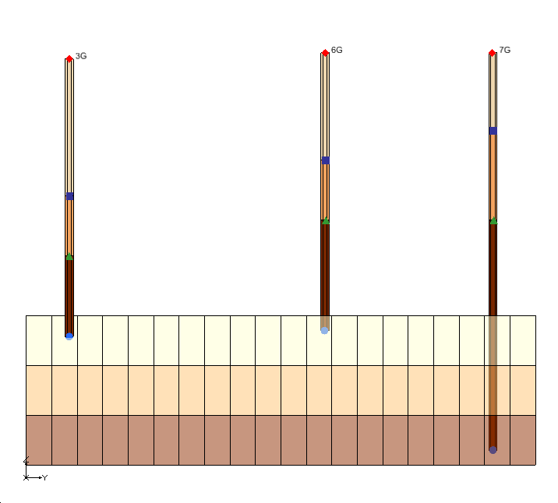
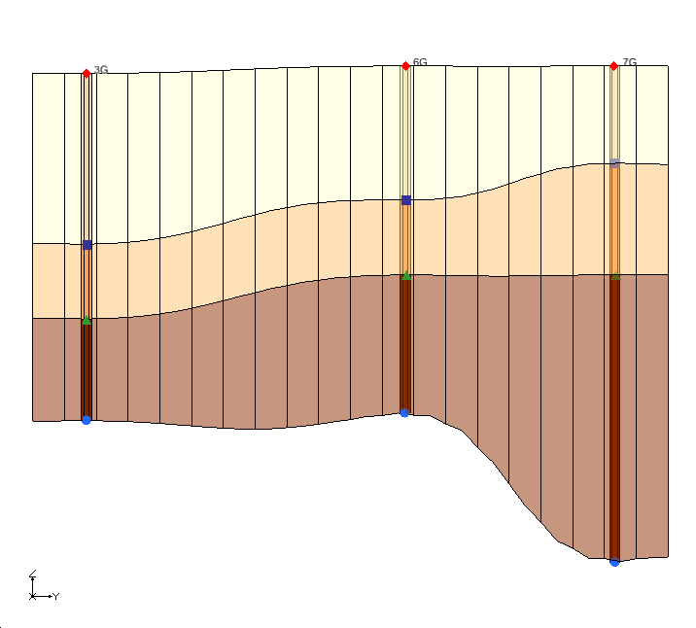
Grid Layer Elevations
Each cell has a top and bottom elevation. The elevation arrays are part of the discretization file used by Groundwater Flow Process.
They are defined/edited in the Global/Basic Package dialog in GMS.
Elevations can be interpolated using 2D geostatistics (interpolation) tools in the 2D Scatter Point Module in GMS.

Slide 3
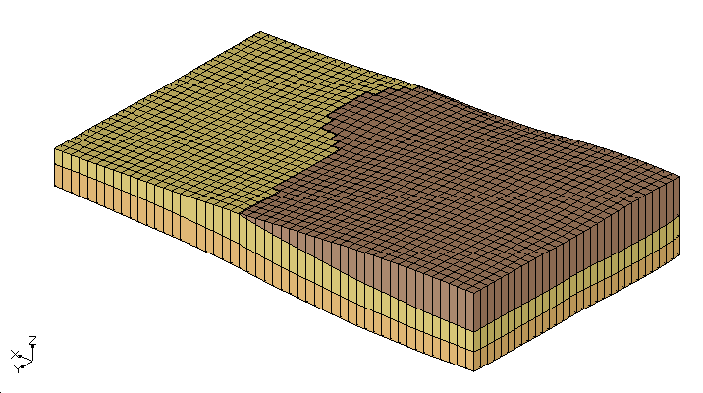
Top and Bottom Elevations
Required arrays
Top elevation for layer 1
Bottom elevation for all layers
Top1
Top2 = Bot1
Top3 = Bot2
Top4 = Bot3
Bot4
GMS assumes bot_{i} = top_{i+1}

Slide 4
Ground Surface Elevations
For the ground surface elevations (top elevation of layer 1), we can typically download and interpolate digital elevation model (DEM) data.
Steps:
Select File|Import from Web command
Locate region
Select world elevation data
Interpolate from resulting DEM to MODFLOW layer array

Slide 5
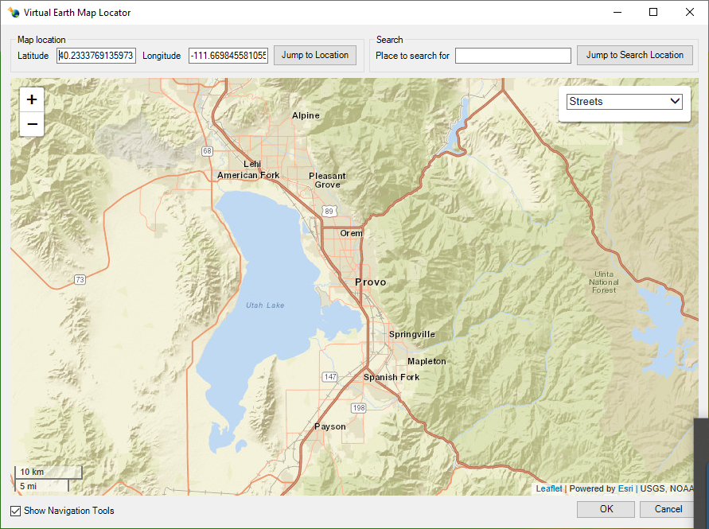
Map Locator
This appears after selecting the File|Import from Web command. Use it to zoom in on the location where you want to download DEM data.

Slide 6
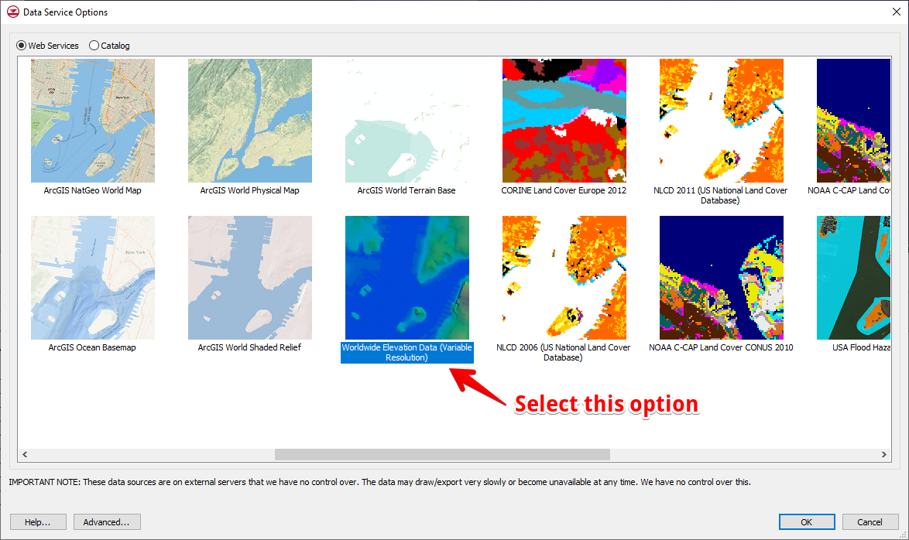
Select Data Service

Slide 7
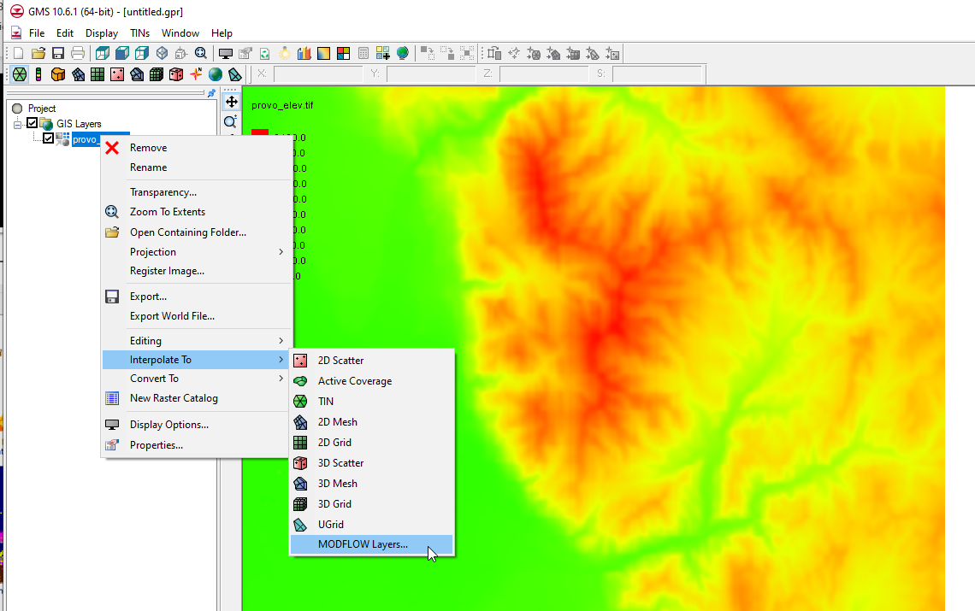
Interpolate to MODFLOW Layer Array

Slide 8
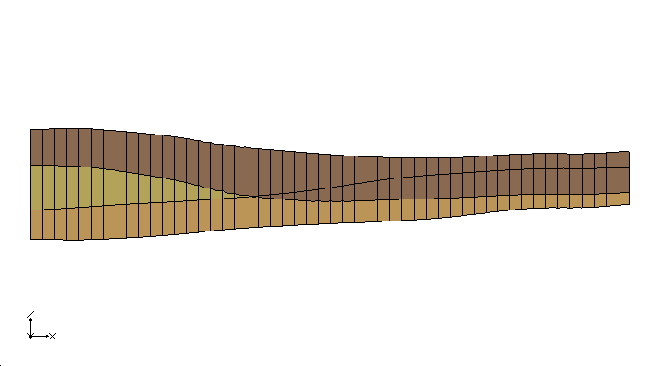
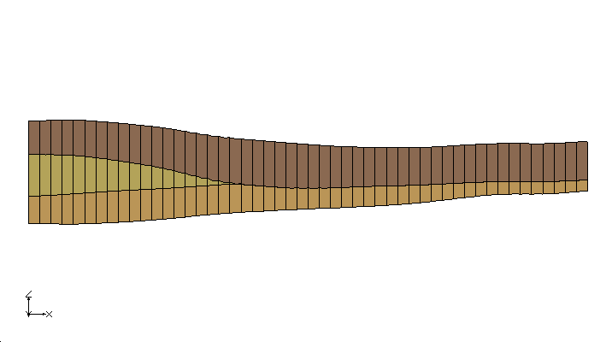
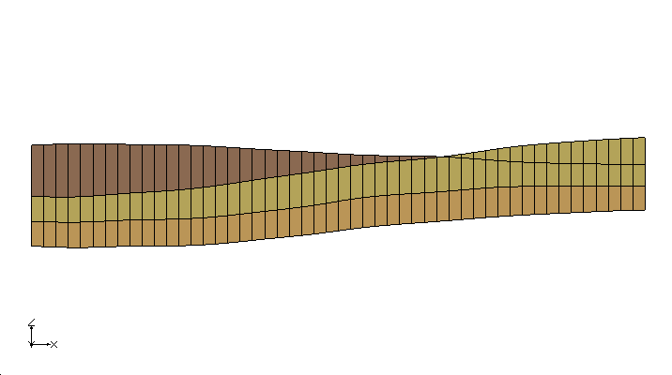
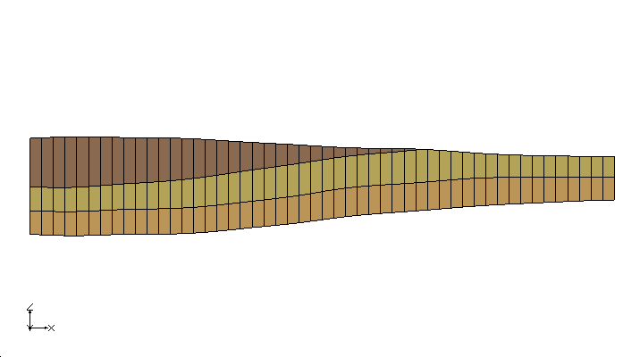
Interpolating Other Layer Elevations
Steps:
Import/Create scatter point sets using data from boreholes, cross sections, etc
Interpolate to layers
Fix errors (when necessary)

Slide 9
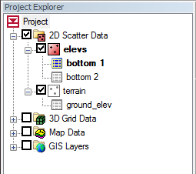
Scatter Point Sets
Each set contains
a list of points with an XY location
a list of data sets

Slide 10
Scatter Data Import Options
Prepare tabular scatter point data file
Two import options:
Save as *.txt or *.cvs and import to GMS using File|Open command
Copy table in Excel and paste to GMS using Windows Clipboard
Follow Text Import Wizard

Slide 11
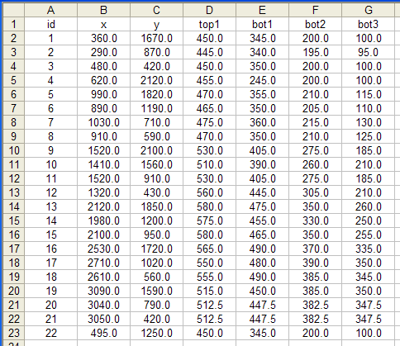
Sample Scatter Point Data

Slide 12
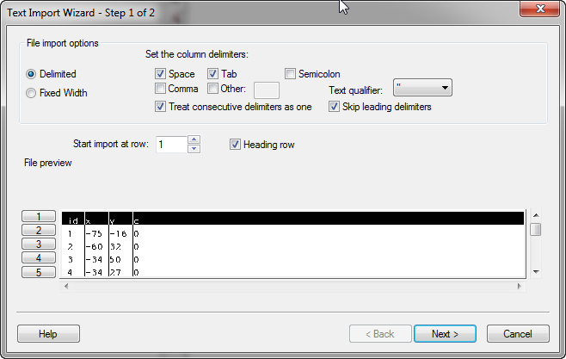
Import Wizard – Step 1
Be sure to turn this on if there is a header row

Slide 13
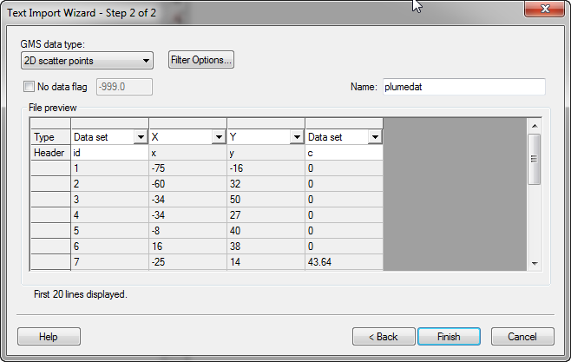
Import Wizard – Step 2
Select data type here
Select type for each column

Slide 14
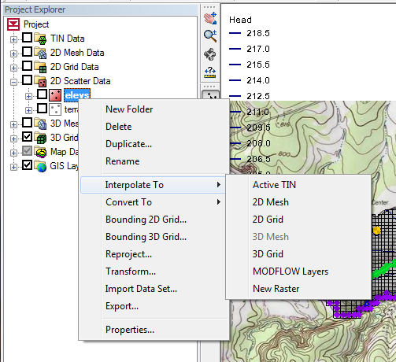
Interpolation
You can interpolate from any one of the scatter point data sets to:
TIN Elevations
Meshes (2D or 3D)
Grids (2D or 3D)
MODFLOW data array layers
A new data set is created on the target object
Notes:
14

Slide 15
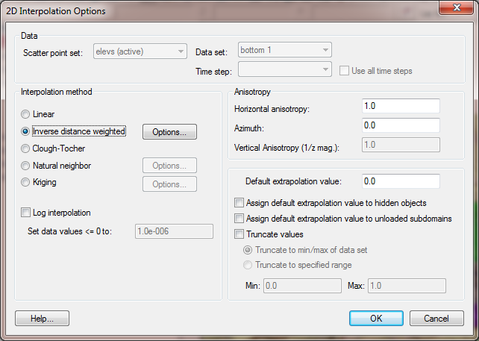
2D Interpolation Schemes

Slide 16
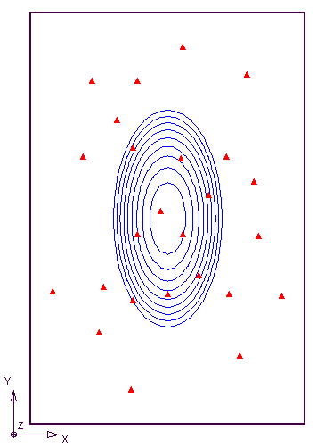
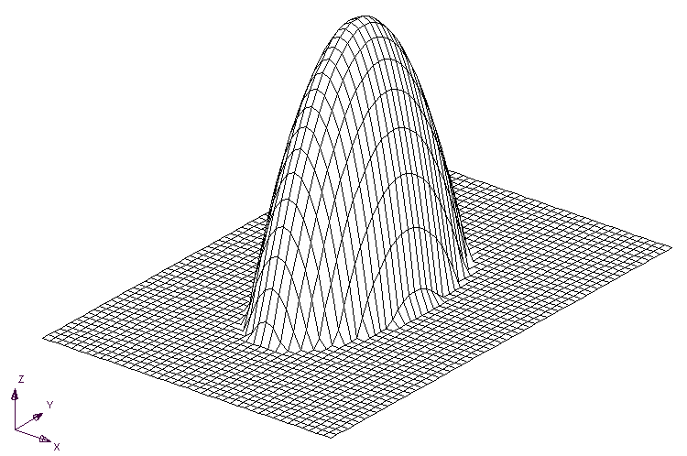
Comparing Interpolation Schemes
Elliptical Control Function

Slide 17
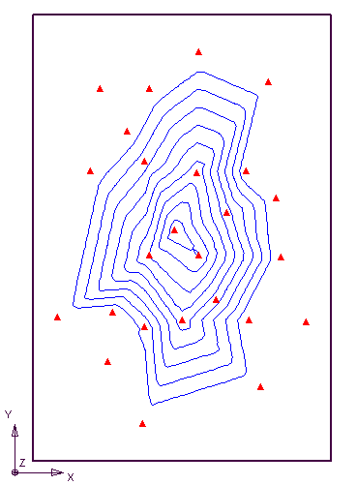
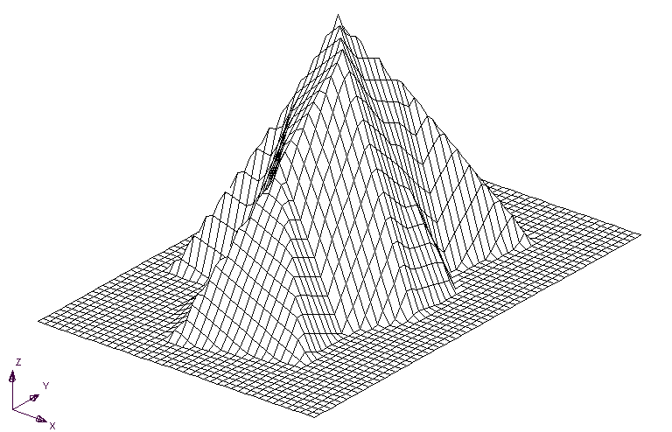
Comparing Interpolation Schemes
Linear

Slide 18
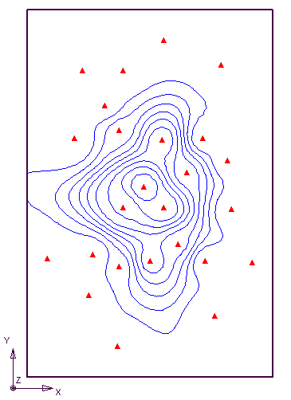
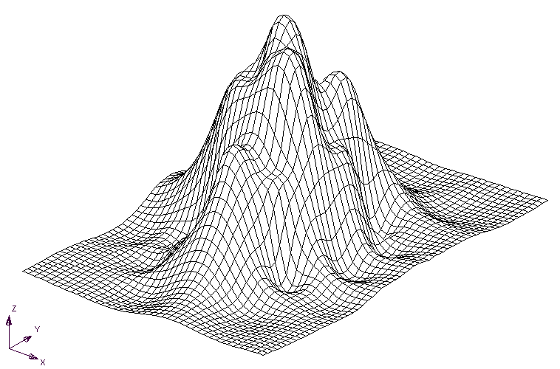
Comparing Interpolation Schemes
IDW - Constant

Slide 19
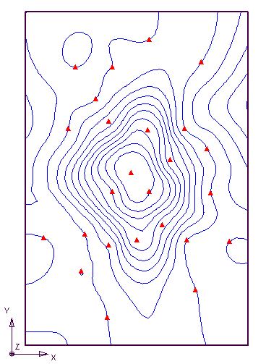
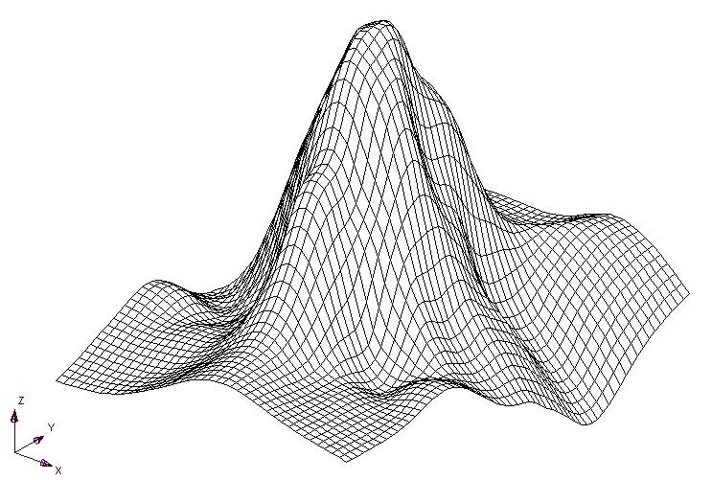
Comparing Interpolation Schemes
IDW – Gradient Planes

Slide 20
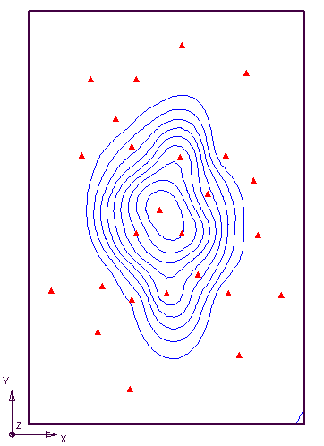
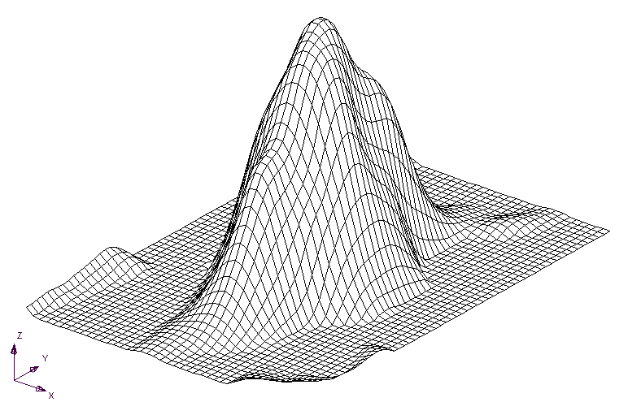
Comparing Interpolation Schemes
IDW – Quadratic, Truncated

Slide 21
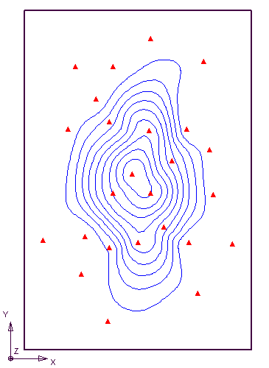
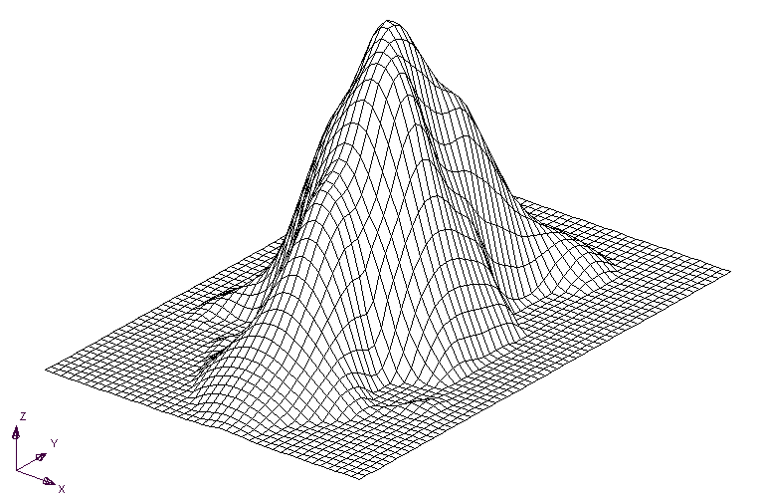
Comparing Interpolation Schemes
Natural Neighbor, Truncated

Slide 22
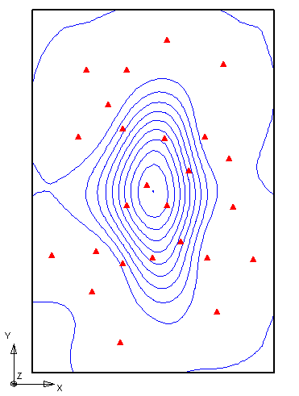
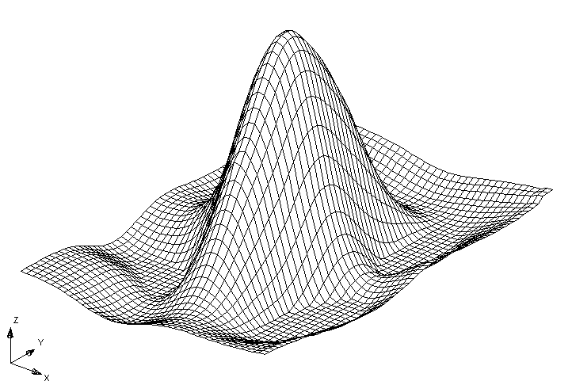
Comparing Interpolation Schemes
Kriging

Slide 23
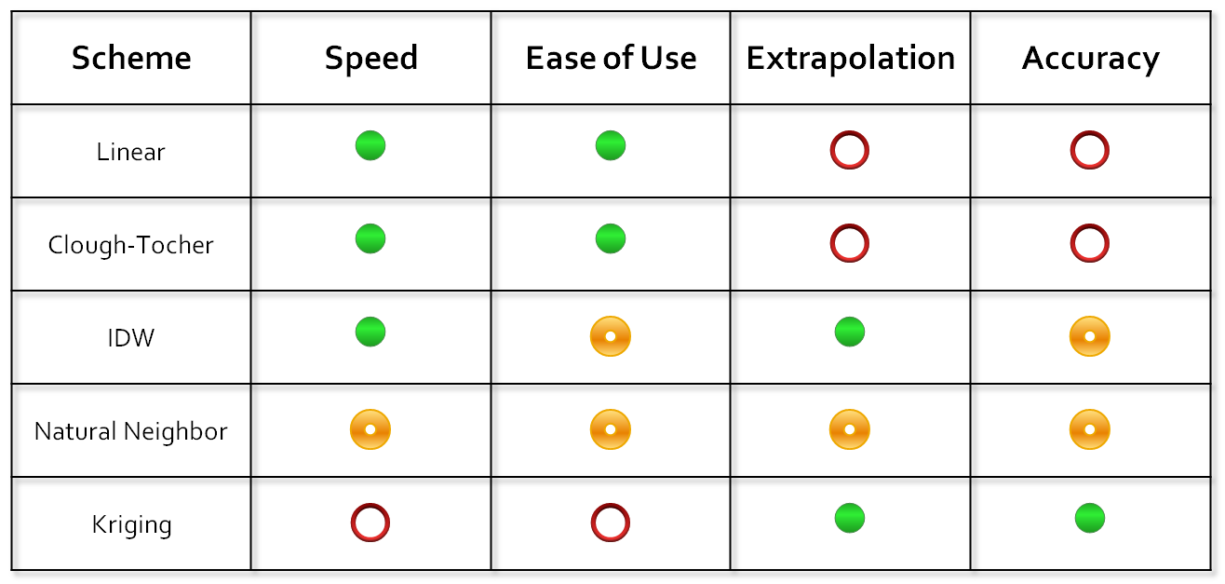

Summary
Good

Average
○
Poor

Slide 24
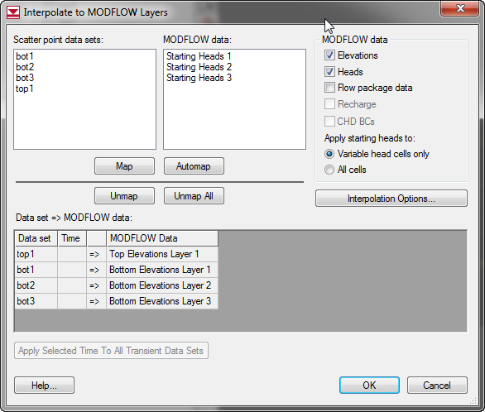
Interpolating to Layers
Use the Interpolate -> MODFLOW Layers command
Interpolates directly to appropriate layer arrays

Slide 25
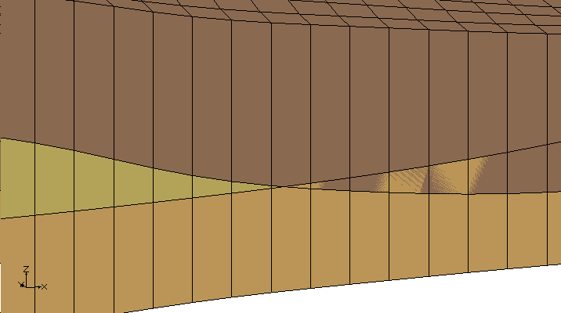
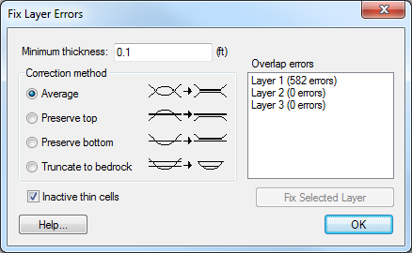
Fixing Errors
Interpolation often causes overlapping elevations
Errors can be detected and fixed using the Model Checker

Slide 26
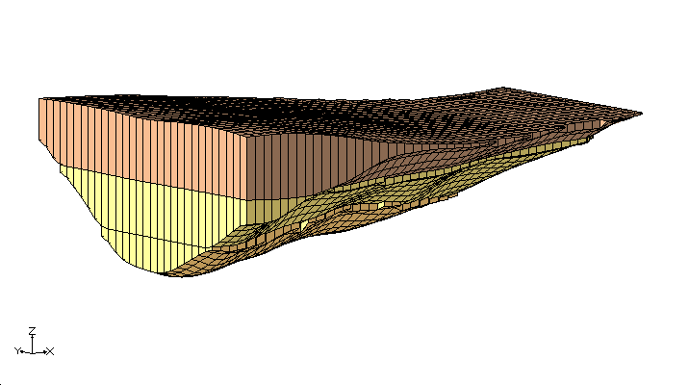
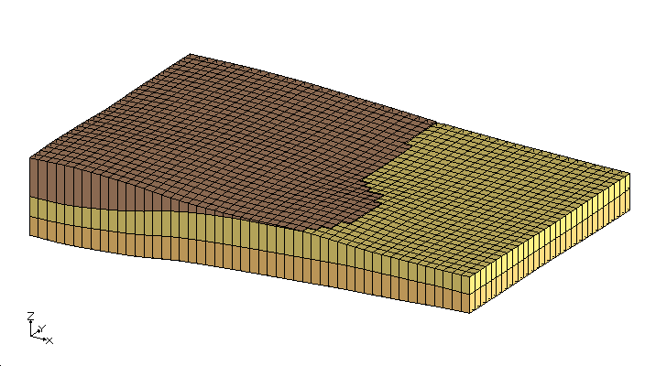
Complex Stratigraphy
Interpolation and layer fixing tools can be used to model complex stratigraphic relationships
Bedrock Truncation
Layer Outcropping

