Slide 1
Darcy’s Law - Introduction
CE 547 – BRIGHAM YOUNG UNIVERSITY

Slide 2
Darcy’s Experiments
Henry Darcy did some lab tests on flow through sand in order to design filters
*Published in “The Public Fountains of the City of Dijon” - 1856

Slide 3
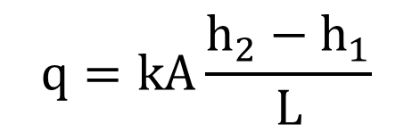
Darcy’s Law
Darcy experimented with different soils and with different values of L, h₁, and h₂. The results showed that:
$$q=kA\frac{h_{2}−h_{1}}{L}$$
where:
q = ΔVol/Δt = flow rate [L³/T]
k = coefficient of permeability
or hydraulic conductivity [L/T]
A = gross cross-sectional area of flow [L²]
h = total head [L]
L = length of flow path [L]

Slide 4
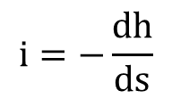
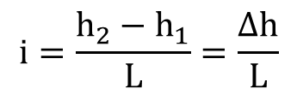
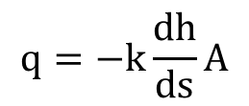
Alternate Formulation
Darcy's law is often written as:
q = kiA
where:
i = hydraulic gradient
$$i=\frac{h_{2}−h_{1}}{L}=\frac{Δh}{L}$$
$$i=−\frac{dh}{ds}$$
where s is the flow path length
$$q=−k\frac{dh}{ds}A$$

Slide 5
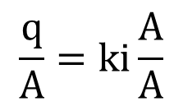
Darcian vs. Seepage Velocity
Darcy's law can be rewritten as:
$$\frac{q}{A}=ki\frac{A}{A}$$
q = kiA
v_{d} = ki
v_{d} = "discharge velocity" or "Darcian velocity"
V_{s}
V_{d}
v_{s} = "seepage velocity"

Slide 6
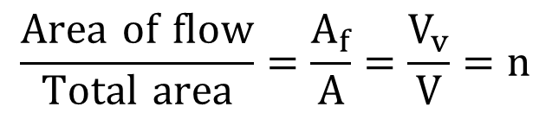
Seepage Velocity
Seepage velocity can be related to discharge velocity as follows:
$$\frac{Area of flow}{Total area}=\frac{A_{f}}{A}=\frac{V_{v}}{V}=n$$
V_{v} = Volume of soil voids
V = Total volume
n = porosity

Slide 7

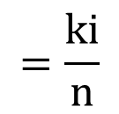
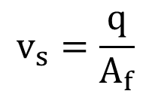
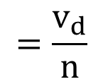
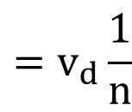
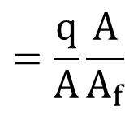
Seepage Velocity, cont.
area
n = porosity
=
total area
$$v_{s}=\frac{q}{A_{f}}$$
$$=\frac{q}{A}\frac{A}{A_{f}}$$
$$=v_{d}\frac{1}{n}$$
n | v_{s}/v_{d}
0.25 | 4
0.3 | 3.33
0.35 | 2.9
0.4 | 2.5
$$=\frac{v_{d}}{n}$$
$$=\frac{ki}{n}$$
$$v_{s}$$

Slide 8
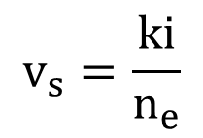
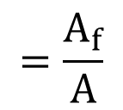
Effective Porosity
Not all voids in the soil conduct flow.
n_{e} = "effective" porosity
$$=\frac{A_{f}}{A}$$
where A_{f} = actual area of flow
$$v_{s}=\frac{ki}{n_{e}}$$

Slide 9
Effective Porosity, cont.
n_{e} = λn
λ = effective porosity factor
λ is determined experimentally
λ ≈ 1 for sands and gravels
λ = 0.01 - 0.05 for clays or fractured rock

Slide 10
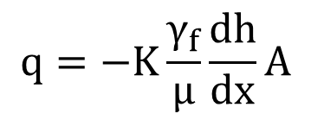
Permeability
In the equation for Darcy's law:
q = kiA
k is a constant which depends on both the fluid and the soil.
where:
K = "constant of proportionality“ [L²]
or "intrinsic permeability"
or "permeability"
K is based on soil properties only
γ_{f} = unit weight of fluid [F/L³]
μ = viscosity of fluid [ML/T]
Darcy's law can be rewritten as:
$$q=−K\frac{γ_{f}}{μ}\frac{dh}{dx}A$$

Slide 11
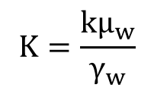
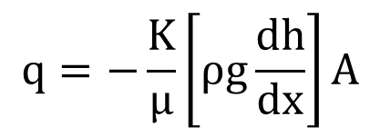
Permeability, cont.
Can also be written as:
For water at 20º C:
$$q=−\frac{K}{μ}\left[ρg\frac{dh}{dx}\right]A$$
$$K=\frac{kμ_{w}}{γ_{w}}$$
This form is used in the petroleum industry.
K is often expressed in units of Darcies
1 Darcy = the permeability for a flow of 1 cm³/sec/cm² for a viscosity of 1 centipoise and [ρg(dh/dx)] = 1 atm/cm.
1 poise = 1 dyne-sec/cm² = 1 g/cm-s
1 Darcy = 0.987X10⁻⁸ cm²
μ_{w} = 0.0100 poise
γ_{w} = ρ_{w}g
ρ_{w} = 1 g/cm³
g = 980.7 cm/sec²
for k = 1 cm/s: K = 1.02X10⁻⁵ cm²
We will use k (hydraulic conductivity) in this class.

Slide 12
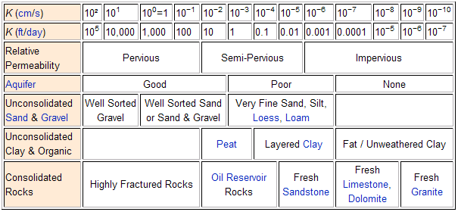
Typical Values of K
http://en.wikipedia.org/wiki/Hydraulic_conductivity

