Slide 1
Darcy’s Law in Layered Systems
CE 547 – BRIGHAM YOUNG UNIVERSITY

Slide 2
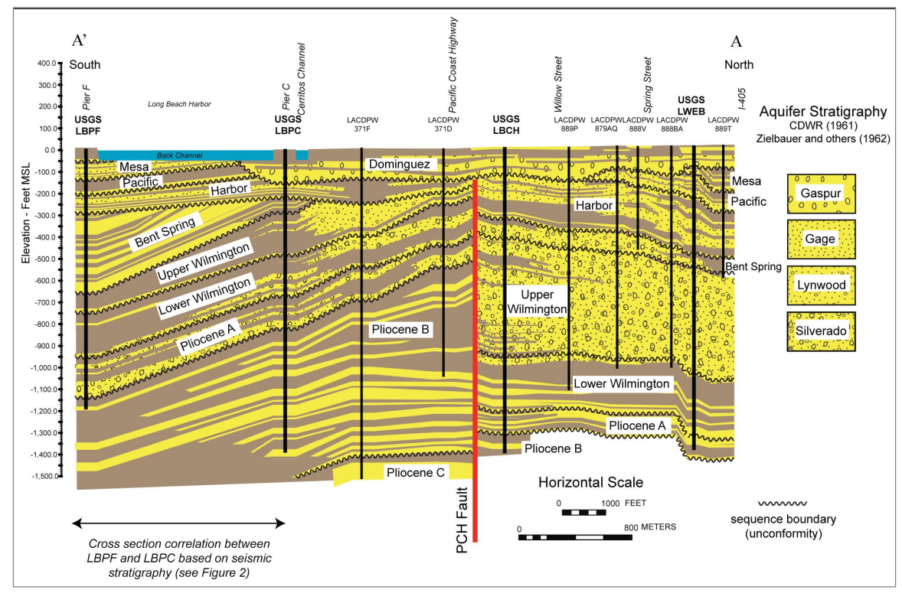
Layering in Hydrogeologic Units
Notes:
https://www.searchanddiscovery.com/documents/2017/80599ehman/ndx_ehman.pdf

Slide 3
Layered Systems
K₁
H₁
K₂
H₂
H
K₃
H₃
It is often useful to compute an equivalent k for a layered system so that Darcy’s Law can be applied directly to the system as a whole.

Slide 4
Flow Parallel to Layering
V
For this case, the following must hold:
1. Head loss is the same through each layer
i₁ = i₂ = i₃
2. Flow equals sum of individual flows
q_{total} = q₁ + q₂ + q₃

Slide 5
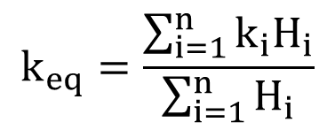
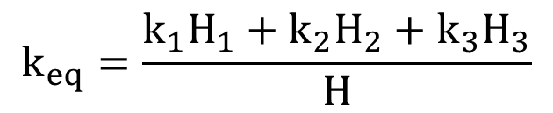
Parallel Flow, cont.
Thus,
q = q₁ + q₂ + q₃
vH = v₁H₁ + v₂H₂ + v₃H₃ (width = 1)
k_{eq}i_{eq}H = k₁i₁H₁ + k₂i₂H₂ + k₃i₃H₃
since i's are the same, divide by i:
k_{eq}H = k₁H₁ + k₂H₂ + k₃H₃
$$k_{eq}=\frac{k_{1}H_{1}+k_{2}H_{2}+k_{3}H_{3}}{H}$$
$$k_{eq}=\frac{\sum_{i=1}^{n}{k_{i}H_{i}}}{\sum_{i=1}^{n}{H_{i}}}$$

Slide 6
Flow Perpendicular to Layering
V
For this case, the following must hold:
1. q will be the same through each layer
2. Δh_{total} = Δh₁ + Δh₂ + Δh₃

Slide 7
Perpendicular Flow, cont.
q = q₁ = q₂ = q₃
v = v₁ = v₂ = v₃
k_{eq}i_{eq} = k₁i₁ = k₂i₂ = k₃i₃
k_{eq}(Δh/H) = k₁i₁ = k₂i₂ = k₃i₃
Δh = Δh₁ + Δh₂ + Δh₃
Δh = H₁i₁ + H₂i₂ + H₃i₃

Slide 8
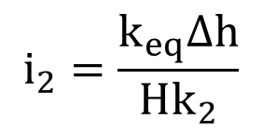
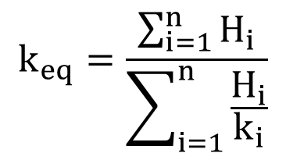
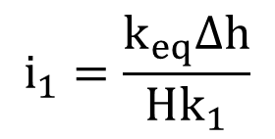
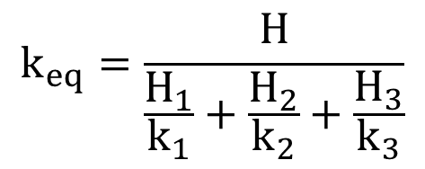
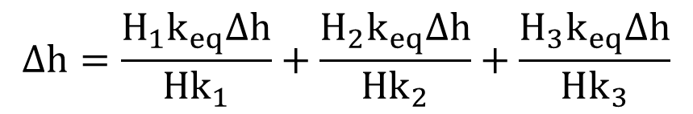
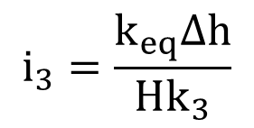
Perpendicular Flow, cont.
$$i_{1}=\frac{k_{eq}Δh}{Hk_{1}}$$
$$i_{2}=\frac{k_{eq}Δh}{Hk_{2}}$$
$$i_{3}=\frac{k_{eq}Δh}{Hk_{3}}$$
$$Δh=\frac{H_{1}k_{eq}Δh}{Hk_{1}}+\frac{H_{2}k_{eq}Δh}{Hk_{2}}+\frac{H_{3}k_{eq}Δh}{Hk_{3}}$$
Divide by Δh and solve for k_{eq}:
$$k_{eq}=\frac{H}{\frac{H_{1}}{k_{1}}+\frac{H_{2}}{k_{2}}+\frac{H_{3}}{k_{3}}}$$
$$k_{eq}=\frac{\sum_{i=1}^{n}{H_{i}}}{\sum_{i=1}^{n}{\frac{H_{i}}{k_{i}}}}$$

