Slide 1
Darcy’s Law in Multiple Dimensions
CE 547 – BRIGHAM YOUNG UNIVERSITY

Slide 2
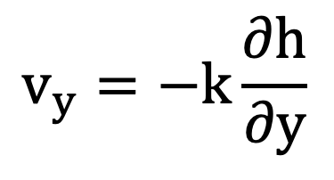
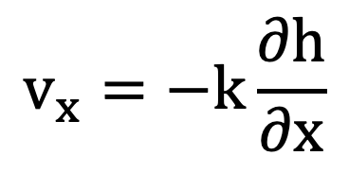
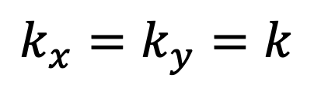
Darcy’s Law in 2D
Isotropic medium – simple case
$$k_{x}=k_{y}=k$$
$$v_{x}=−k\frac{∂h}{∂x}$$
y
$$v_{y}=−k\frac{∂h}{∂y}$$
x

Slide 3
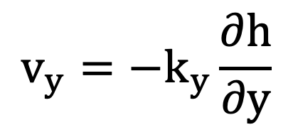
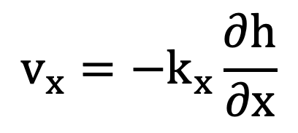
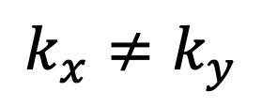
Darcy’s Law in 2D
Anisotropic medium – simple case
Bedding Planes
$$v_{x}=−k_{x}\frac{∂h}{∂x}$$
y
$$k_{x}≠k_{y}$$
$$v_{y}=−k_{y}\frac{∂h}{∂y}$$
x

Slide 4
Darcy’s Law in 2D
Anisotropic medium – general case
y
s
k_{min}
x
k_{max}
r
Bedding Planes
We need k in terms of x & y (k_{x}, k_{y}).

Slide 5
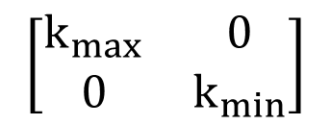
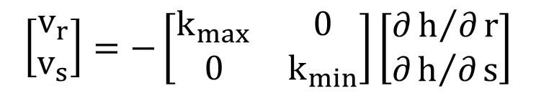
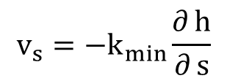
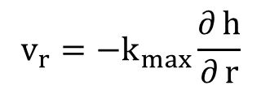
Anisotropic Medium – General Case
s
k_{min}
$$\left[\begin{matrix}v_{r} \\ v_{s}\end{matrix}\right]=−\left[\begin{matrix}k_{max} & 0 \\ 0 & k_{min}\end{matrix}\right]\left[\begin{matrix}∂h/∂r \\ ∂h/∂s\end{matrix}\right]$$
k_{max}
r
$$\left[\begin{matrix}k_{max} & 0 \\ 0 & k_{min}\end{matrix}\right]$$
= "conductivity matrix" or "conductivity tensor"
$$v_{r}=−k_{max}\frac{∂ h}{∂ r}$$
$$v_{s}=−k_{min}\frac{∂ h}{∂ s}$$
r & s may or may not coincide with x & y

Slide 6
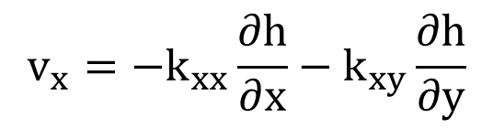
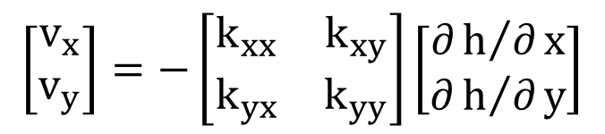
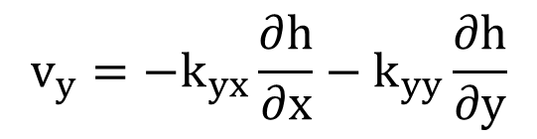
Coordinate Transformation
y
$$v_{x}=−k_{xx}\frac{∂h}{∂x}−k_{xy}\frac{∂h}{∂y}$$
s
r
α
x
$$v_{y}=−k_{yx}\frac{∂h}{∂x}−k_{yy}\frac{∂h}{∂y}$$
$$\left[\begin{matrix}v_{x} \\ v_{y}\end{matrix}\right]=−\left[\begin{matrix}k_{xx} & k_{xy} \\ k_{yx} & k_{yy}\end{matrix}\right]\left[\begin{matrix}∂h/∂x \\ ∂h/∂y\end{matrix}\right]$$

Slide 7
Coord. Transformation, cont.
Solving in terms of k_{r} and k_{s}:

Slide 8
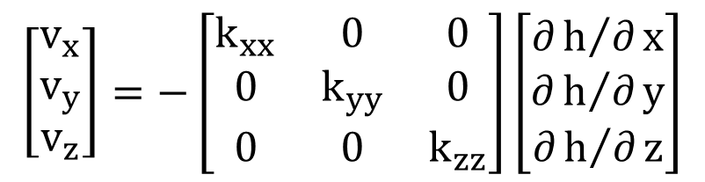
Darcy’s Law in 3D
v_{z}
z
v_{x}
x
v_{y}
y
If x, y, and z axes coincide with principal axes of permeability:
$$\left[\begin{matrix}v_{x} \\ v_{y} \\ v_{z}\end{matrix}\right]=−\left[\begin{matrix}k_{xx} & 0 & 0 \\ 0 & k_{yy} & 0 \\ 0 & 0 & k_{zz}\end{matrix}\right]\left[\begin{matrix}∂h/∂x \\ ∂h/∂y \\ ∂h/∂z\end{matrix}\right]$$
In most cases
k_{xx} = k_{yy}
k_{xx} > k_{zz}

Slide 9
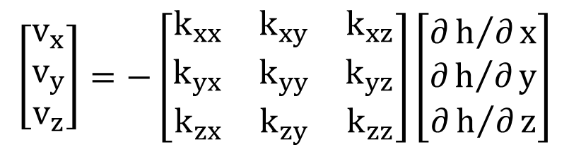
Darcy’s Law in 3D, cont.
General case:
$$\left[\begin{matrix}v_{x} \\ v_{y} \\ v_{z}\end{matrix}\right]=−\left[\begin{matrix}k_{xx} & k_{xy} & k_{xz} \\ k_{yx} & k_{yy} & k_{yz} \\ k_{zx} & k_{zy} & k_{zz}\end{matrix}\right]\left[\begin{matrix}∂h/∂x \\ ∂h/∂y \\ ∂h/∂z\end{matrix}\right]$$
The tensor is symmetric, i.e.:
k_{yx} = k_{xy}
k_{zx} = k_{xz}
k_{zy} = k_{yz}

