Slide 1
Governing Equations 2D Areal Flow Modeling
CE EN 547 – BRIGHAM YOUNG UNIVERSITY

Slide 2
2D Flow in a Confined Aquifer
Assume horizontal flow, problem is then defined in terms of x and y.

Slide 3
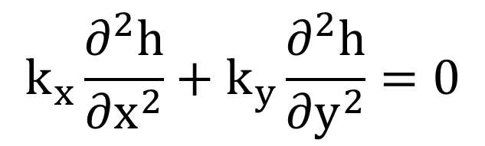
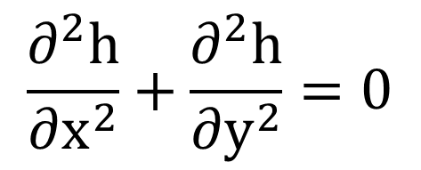
Steady State Flow
$$k_{x}\frac{∂^{2}h}{∂x^{2}}+k_{y}\frac{∂^{2}h}{∂y^{2}}=0$$
if k_{x} = k_{y}:
$$\frac{∂^{2}h}{∂x^{2}}+\frac{∂^{2}h}{∂y^{2}}=0$$

Slide 4
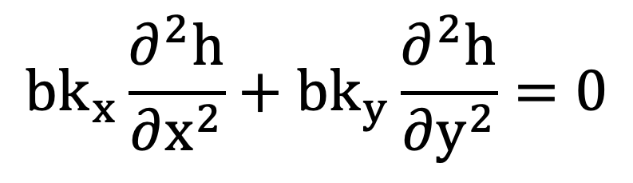
Aquifer Thickness
For the general case, we assumed a unit volume of the aquifer (1x1x1). To account for a variable aquifer thickness and to get the correction cross-sectional area of flow, we multiply both sides of the equation by b.
b
$$bk_{x}\frac{∂^{2}h}{∂x^{2}}+bk_{y}\frac{∂^{2}h}{∂y^{2}}=0$$
1
1

Slide 5
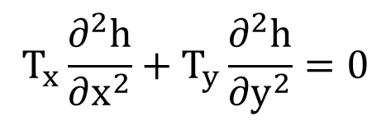
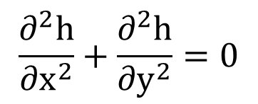
Steady State, Confined, cont.
Substituting:
Define a new term, transmissivity:
$$T_{x}\frac{∂^{2}h}{∂x^{2}}+T_{y}\frac{∂^{2}h}{∂y^{2}}=0$$
T = b k
T_{x} = b k_{x}
T_{y} = b k_{y}
Typically, T_{x} = T_{y} and:
$$\frac{∂^{2}h}{∂x^{2}}+\frac{∂^{2}h}{∂y^{2}}=0$$

Slide 6
2D Flow in an Unconfined Aquifer
The upper boundary is now a free surface, and we have both vertical and horizontal flow.

Slide 7
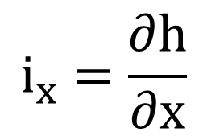
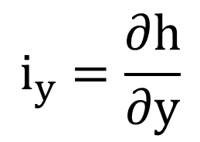
Unconfined, cont.
In order to simplify the problem to two dimensions we use the Dupuit assumptions:
$$i_{x}=\frac{∂h}{∂x}$$
$$i_{y}=\frac{∂h}{∂y}$$
i_{x}, i_{y} = constant along vertical line (i.e. horizontal flow)
Using the bottom of the aquifer as the datum, we can say that the thickness of the saturated region of the aquifer is equal to the total head, h (which is what we want to solve for).

Slide 8
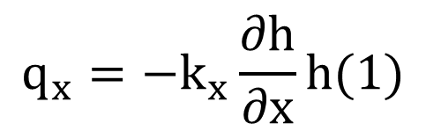
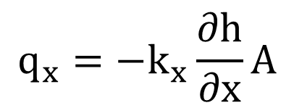
Steady State Flow
Based on these assumptions we can re-derive our governing equation:
$$q_{x}=−k_{x}\frac{∂h}{∂x}A$$
$$q_{x}=−k_{x}\frac{∂h}{∂x}h(1)$$

Slide 9
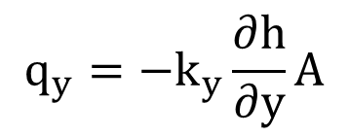
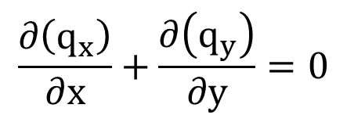
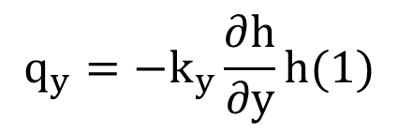
Steady State Unconfined, cont.
Likewise:
$$q_{y}=−k_{y}\frac{∂h}{∂y}A$$
$$q_{y}=−k_{y}\frac{∂h}{∂y}h(1)$$
From conservation of mass:
$$\frac{∂\left(q_{x}\right)}{∂x}+\frac{∂\left(q_{y}\right)}{∂y}=0$$

Slide 10
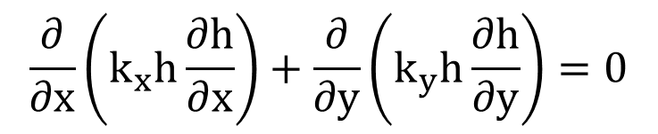
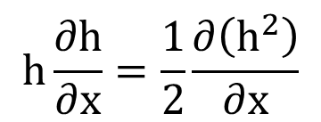
Steady State Unconfined, cont.
Substituting:
$$\frac{∂}{∂x}\left(k_{x}h\frac{∂h}{∂x}\right)+\frac{∂}{∂y}\left(k_{y}h\frac{∂h}{∂y}\right)=0$$
Recall that:
$$h\frac{∂h}{∂x}=\frac{1}{2}\frac{∂\left(h^{2}\right)}{∂x}$$

Slide 11
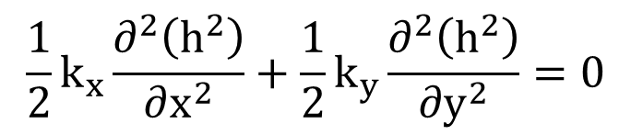
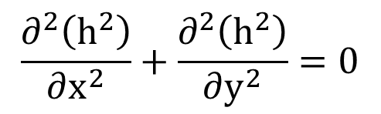
Steady State Unconfined, cont.
Substituting:
$$\frac{1}{2}k_{x}\frac{∂^{2}\left(h^{2}\right)}{∂x^{2}}+\frac{1}{2}k_{y}\frac{∂^{2}\left(h^{2}\right)}{∂y^{2}}=0$$
For k_{x} = k_{y}:
$$\frac{∂^{2}\left(h^{2}\right)}{∂x^{2}}+\frac{∂^{2}\left(h^{2}\right)}{∂y^{2}}=0$$

