Slide 1
Governing Differential Equations
CE EN 547 – BRIGHAM YOUNG UNIVERSITY

Slide 2
Background
All of the flow conditions we have seen so far have been simple, 1-D problems where we could use Darcy’s Law directly. In most applications, however, the geometry and soil properties are more complex, and a more complete governing equation is needed.
The following derivation is a general form of the 3D case.

Slide 3

Assumptions
Soil is saturated
We could derive the equations to describe unsaturated flow, but we will stick to saturated flow in this class.
Darcy's law is valid
Mass is conserved
i.e., what goes in must come out or be stored based on conservation of mass.
$$inflow−outflow=\frac{Δstorage}{Δt}+sources,sinks$$

Slide 4
Steady State Saturated Flow
First, we will consider a special case where we have steady state conditions (system is in equilibrium - no change with time) and no sources/sinks. Thus, the two terms on right will be set to zero.
inflow - outflow = 0

Slide 5
Steady State Saturated Flow
inflow - outflow = 0
mass flow rate = ρ v

Slide 6
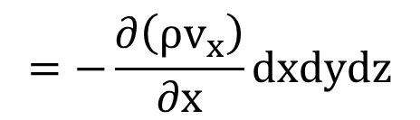
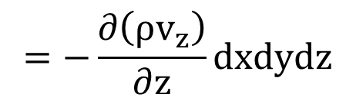
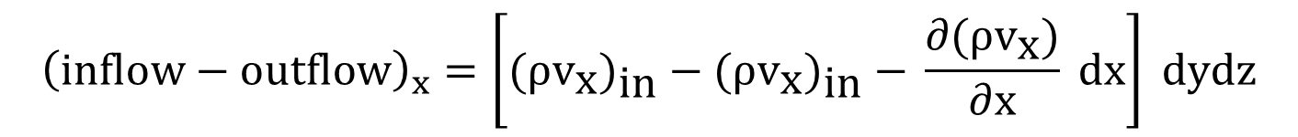
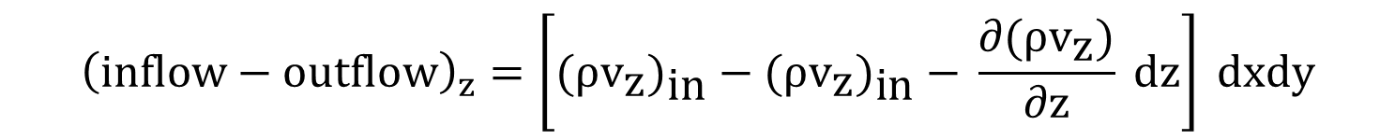
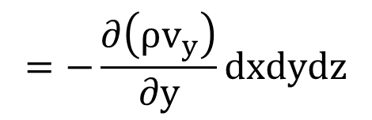
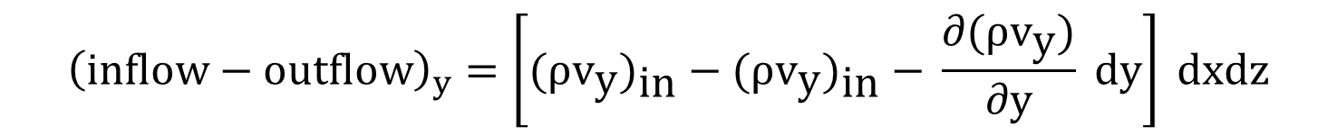
$${\left(inflow−outflow\right)}_{x}=\left[{\text{(}ρ{\text{v}}_{\text{x}}\text{)}}_{\text{in}}\text{ − (}ρ{\text{v}}_{\text{x}}{\text{)}}_{\text{in}}\text{ − }\frac{∂\text{(}ρ{\text{v}}_{\text{x}}\text{)}}{∂\text{x}} \text{dx}\right] \text{dydz}$$
$$=−\frac{∂\left(ρv_{x}\right)}{∂x}dxdydz$$
$${\left(inflow−outflow\right)}_{y}=\left[{\text{(}ρ{\text{v}}_{\text{y}}\text{)}}_{\text{in}}\text{ − (}ρ{\text{v}}_{\text{y}}{\text{)}}_{\text{in}}\text{ − }\frac{∂\text{(}ρ{\text{v}}_{\text{y}}\text{)}}{∂\text{y}} \text{dy}\right] \text{dxdz}$$
$$=−\frac{∂\left(ρv_{y}\right)}{∂y}dxdydz$$
$${\left(inflow−outflow\right)}_{z}=\left[{\text{(}ρ{\text{v}}_{\text{z}}\text{)}}_{\text{in}}\text{ − (}ρ{\text{v}}_{\text{z}}{\text{)}}_{\text{in}}\text{ − }\frac{∂\text{(}ρ{\text{v}}_{\text{z}}\text{)}}{∂\text{z}} \text{dz}\right] \text{dxdy}$$
$$=−\frac{∂\left(ρv_{z}\right)}{∂z}dxdydz$$

Slide 7
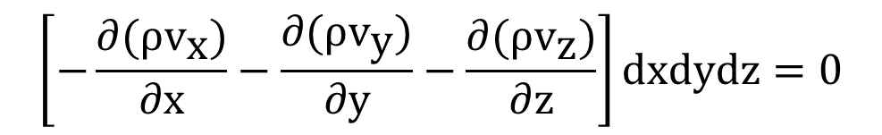
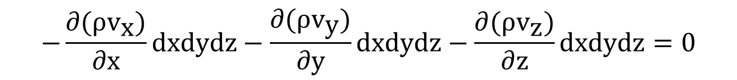
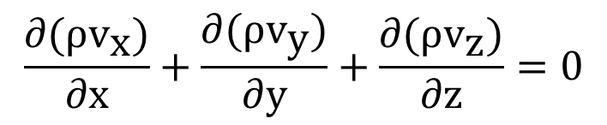
(inflow - outflow)_{total} = (inflow - outflow)_{x}
+ (inflow - outflow)_{y}
+ (inflow - outflow)_{z} = 0
$$−\frac{∂\text{(}ρ{\text{v}}_{\text{x}}\text{)}}{∂\text{x}}dxdydz−\frac{∂\text{(}ρ{\text{v}}_{\text{y}}\text{)}}{∂\text{y}}dxdydz−\frac{∂\text{(}ρ{\text{v}}_{\text{z}}\text{)}}{∂\text{z}}dxdydz=0$$
$$\left[−\frac{∂\text{(}ρ{\text{v}}_{\text{x}}\text{)}}{∂\text{x}}−\frac{∂\text{(}ρ{\text{v}}_{\text{y}}\text{)}}{∂\text{y}}−\frac{∂\text{(}ρ{\text{v}}_{\text{z}}\text{)}}{∂\text{z}}\right]dxdydz=0$$
$$\frac{∂\text{(}ρ{\text{v}}_{\text{x}}\text{)}}{∂\text{x}}+\frac{∂\text{(}ρ{\text{v}}_{\text{y}}\text{)}}{∂\text{y}}+\frac{∂\text{(}ρ{\text{v}}_{\text{z}}\text{)}}{∂\text{z}}=0$$

Slide 8
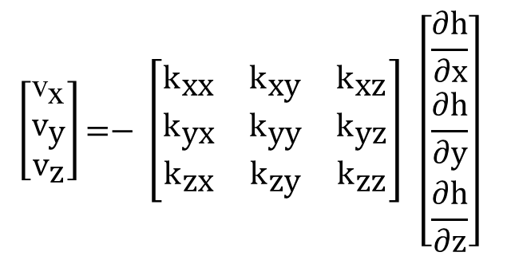
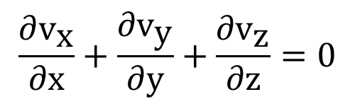
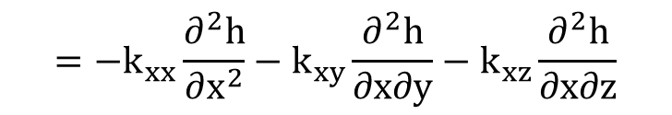
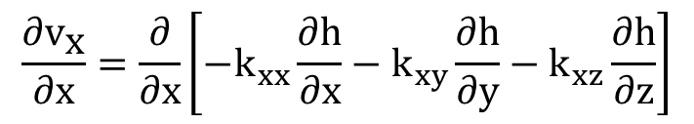
Assume that the fluid density is constant:
$$\frac{∂{\text{v}}_{\text{x}}}{∂\text{x}}+\frac{∂{\text{v}}_{\text{y}}}{∂\text{y}}+\frac{∂{\text{v}}_{\text{z}}}{∂\text{z}}=0$$
Use Darcy's law to express velocity:
$$\left[\begin{matrix}{\text{v}}_{\text{x}} \\ {\text{v}}_{\text{y}} \\ {\text{v}}_{\text{z}}\end{matrix}\right]\text{=− }\left[\begin{matrix}{\text{k}}_{\text{xx}} & {\text{k}}_{\text{xy}} & {\text{k}}_{\text{xz}} \\ {\text{k}}_{\text{yx}} & {\text{k}}_{\text{yy}} & {\text{k}}_{\text{yz}} \\ {\text{k}}_{\text{zx}} & {\text{k}}_{\text{zy}} & {\text{k}}_{\text{zz}}\end{matrix}\right] \left[\begin{matrix}\frac{∂\text{h}}{∂\text{x}} \\ \frac{∂\text{h}}{∂\text{y}} \\ \frac{∂\text{h}}{∂\text{z}}\end{matrix}\right]$$
$$\frac{∂{\text{v}}_{\text{x}}}{∂\text{x}}=\frac{∂}{∂x}\left[−k_{xx}\frac{∂h}{∂x}−k_{xy}\frac{∂h}{∂y}−k_{xz}\frac{∂h}{∂z}\right]$$
$$=−k_{xx}\frac{∂^{2}h}{∂x^{2}}−k_{xy}\frac{∂^{2}h}{∂x∂y}−k_{xz}\frac{∂^{2}h}{∂x∂z}$$

Slide 9
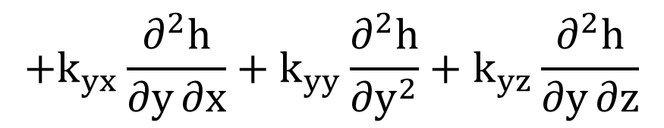
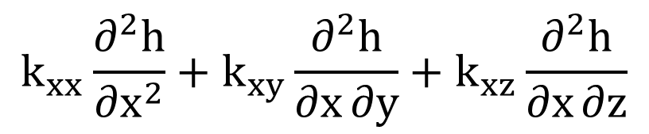
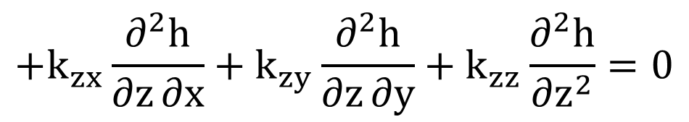
Substituting v_{x}, v_{y}, and v_{z}:
$$k_{xx}\frac{∂^{2}h}{∂x^{2}}+k_{xy}\frac{∂^{2}h}{∂x∂y}+k_{xz}\frac{∂^{2}h}{∂x∂z}$$
$$+k_{yx}\frac{∂^{2}h}{∂y∂x}+k_{yy}\frac{∂^{2}h}{∂y^{2}}+k_{yz}\frac{∂^{2}h}{∂y∂z}$$
$$+k_{zx}\frac{∂^{2}h}{∂z∂x}+k_{zy}\frac{∂^{2}h}{∂z∂y}+k_{zz}\frac{∂^{2}h}{∂z^{2}}=0$$

Slide 10
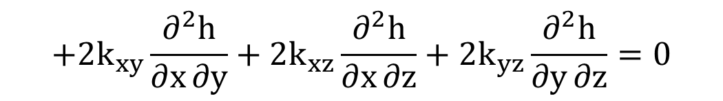
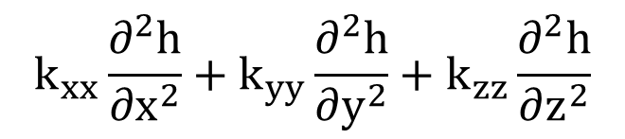
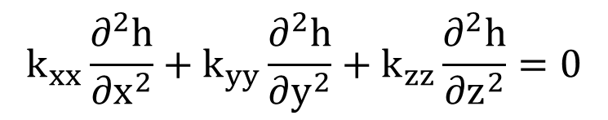

Combining terms:
$$k_{xx}\frac{∂^{2}h}{∂x^{2}}+k_{yy}\frac{∂^{2}h}{∂y^{2}}+k_{zz}\frac{∂^{2}h}{∂z^{2}}$$
$$+2k_{xy}\frac{∂^{2}h}{∂x∂y}+2k_{xz}\frac{∂^{2}h}{∂x∂z}+2k_{yz}\frac{∂^{2}h}{∂y∂z}=0$$
If x, y, and z correspond to principal axes of permeability:
$$k_{xy}=k_{xz}=k_{yz}=0$$
$$k_{xx}\frac{∂^{2}h}{∂x^{2}}+k_{yy}\frac{∂^{2}h}{∂y^{2}}+k_{zz}\frac{∂^{2}h}{∂z^{2}}=0$$

Slide 11
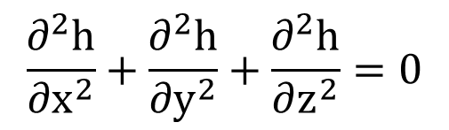
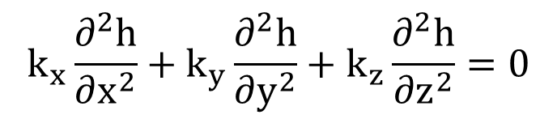
More commonly written as:
$$k_{x}\frac{∂^{2}h}{∂x^{2}}+k_{y}\frac{∂^{2}h}{∂y^{2}}+k_{z}\frac{∂^{2}h}{∂z^{2}}=0$$
if k_{x} = k_{y} = k_{z}:
$$\frac{∂^{2}h}{∂x^{2}}+\frac{∂^{2}h}{∂y^{2}}+\frac{∂^{2}h}{∂z^{2}}=0$$
"Laplace Equation"
The solution to any of these equations is a function describing h in terms of x, y, and z
h(x, y, z)

Slide 12
Boundary Conditions
As with any differential equation, before we can solve for h(x, y, z), we must define some boundary conditions.
The following slides illustrate how boundary conditions are determined on some typical problems.

Slide 13
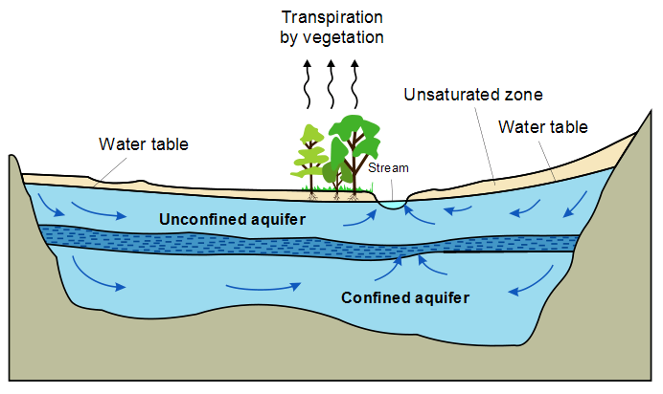

Slide 14
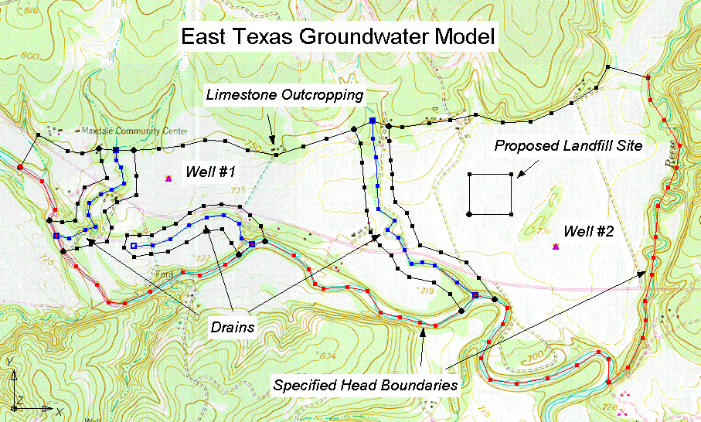

Slide 15
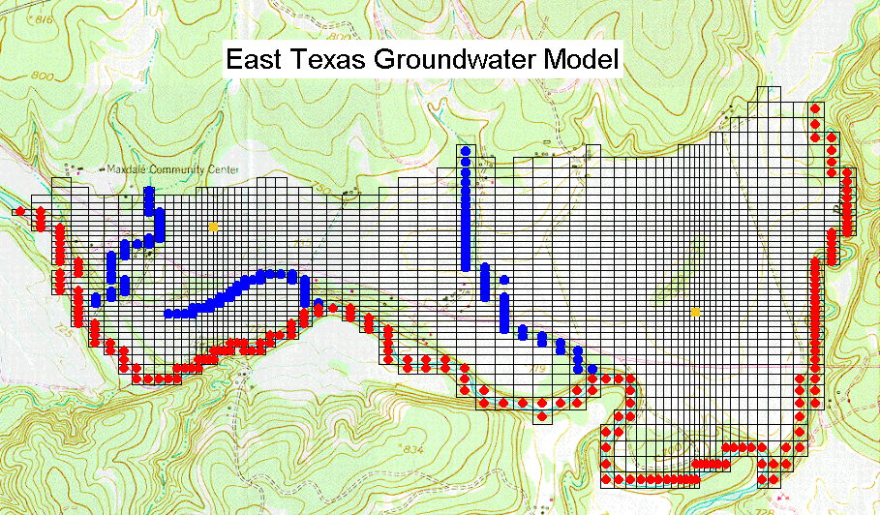

Slide 16
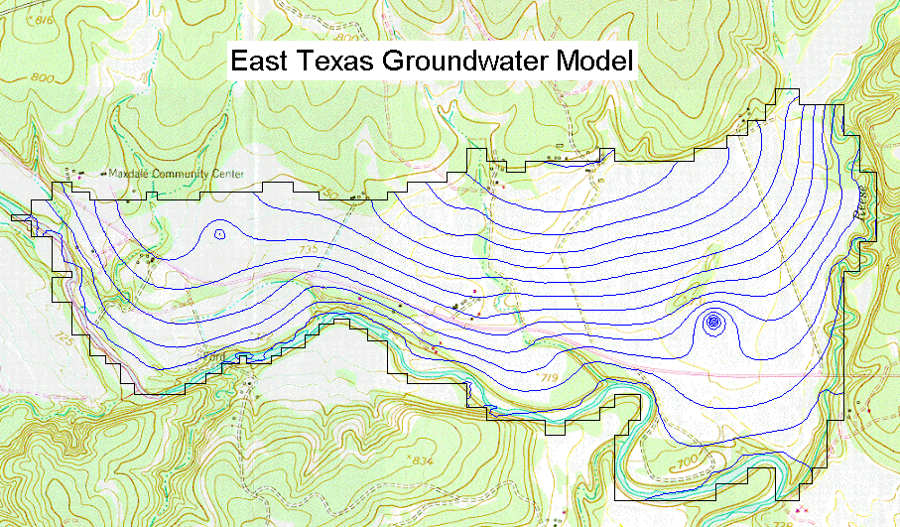

Slide 17
Solution
For simple cases we can solve for an analytical solution.
For more general (complicated) cases, we use a graphical solution (flow net) or a numerical solution (finite difference or finite element).

Slide 18

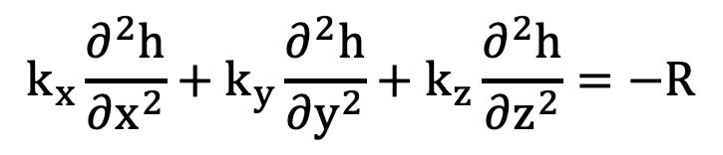
Sources and Sinks
Sources/sinks = wells, rivers, recharge, etc.
Changes mass balance of governing equation:
$$inflow−outflow=∆Q_{sources,sinks}$$
Re-derivation leads to:
$$k_{x}\frac{∂^{2}h}{∂x^{2}}+k_{y}\frac{∂^{2}h}{∂y^{2}}+k_{z}\frac{∂^{2}h}{∂z^{2}}=−R$$
Where R = $∆Q from sources,sinks$

Slide 19
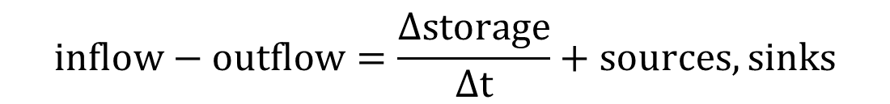
Transient Flow
The amount of water in the representative element may change over time due to expansion and contraction of the porous media.
$$inflow−outflow=\frac{Δstorage}{Δt}+sources,sinks$$
represents the change in mass stored in the system.

Slide 20
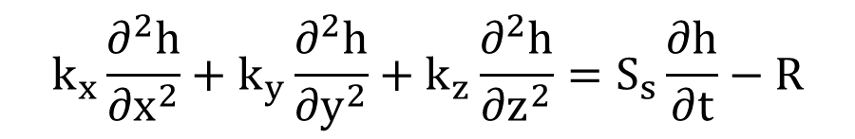
Transient Flow
Following a similar strategy, we can derive the following governing equation:
$$k_{x}\frac{∂^{2}h}{∂x^{2}}+k_{y}\frac{∂^{2}h}{∂y^{2}}+k_{z}\frac{∂^{2}h}{∂z^{2}}=S_{s}\frac{∂h}{∂t}−R$$
where:
S_{s} = specific storage
We will review a full derivation of the transient terms later in the semester

