Slide 1
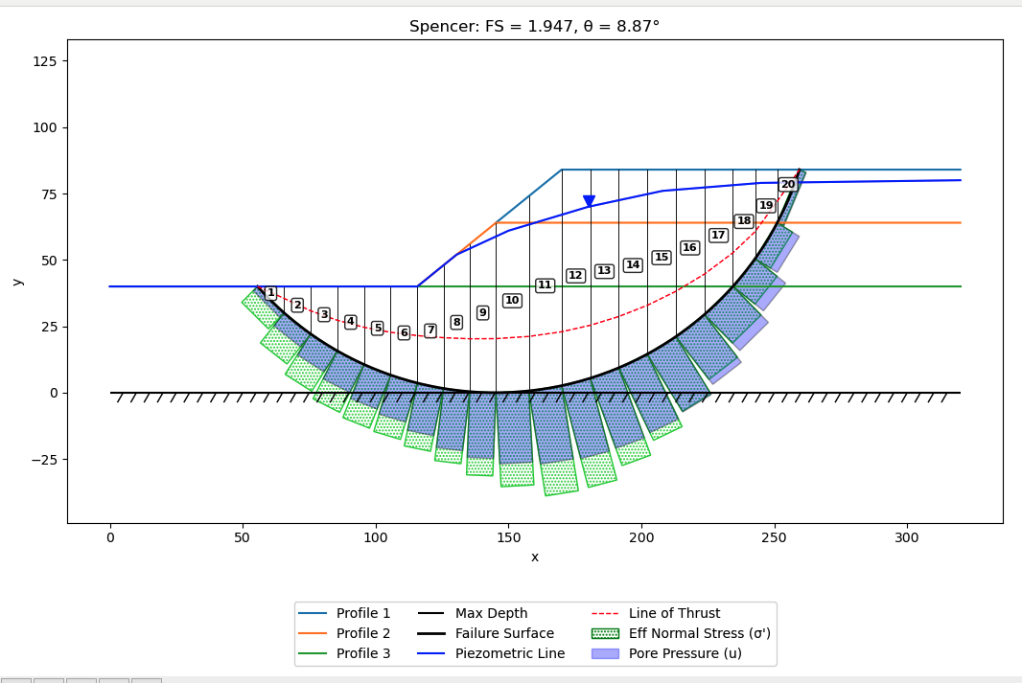

Slide 2
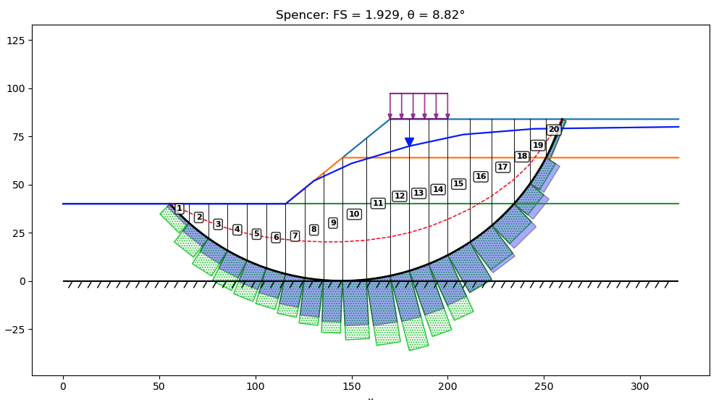
Dload = 1000

Slide 3
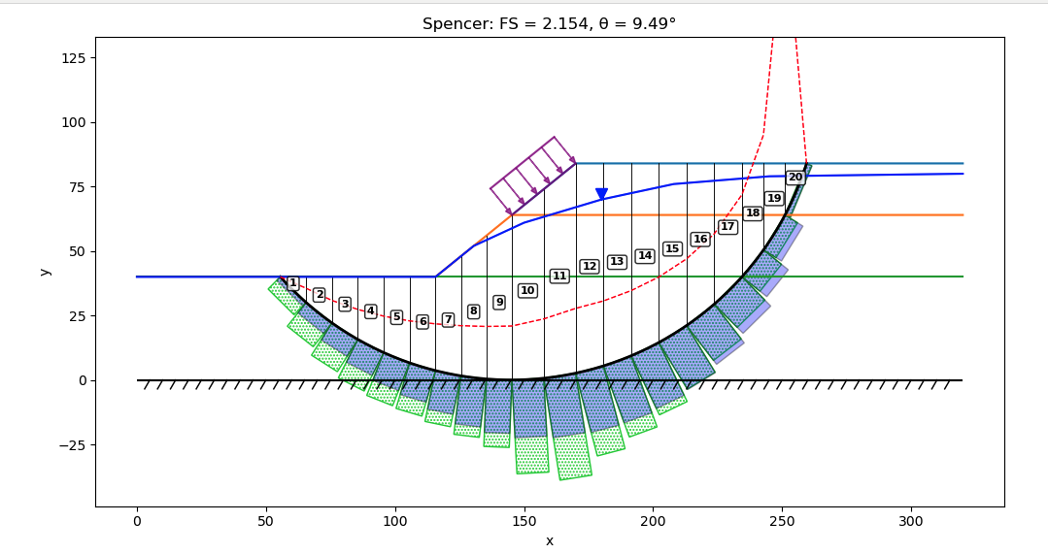
Converges as you increase dload up to about 500. Then it crashes.
dload magnitude = 1000 psf
UTEXAS: FS = 2.041, theta = 6.948

