Slide 1
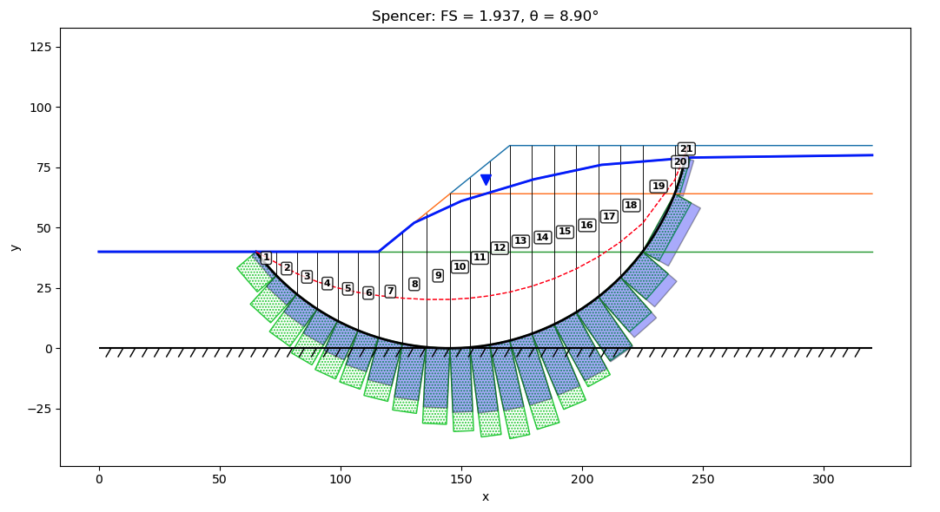

Slide 2
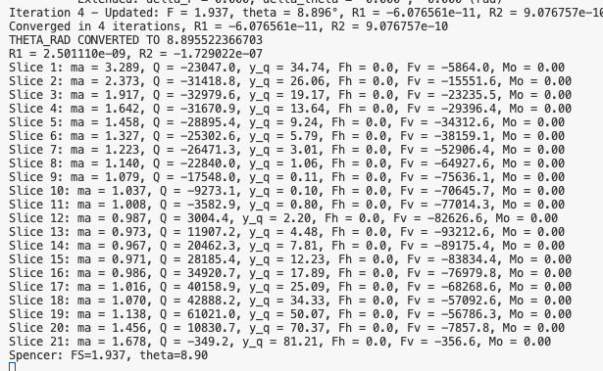

Slide 3
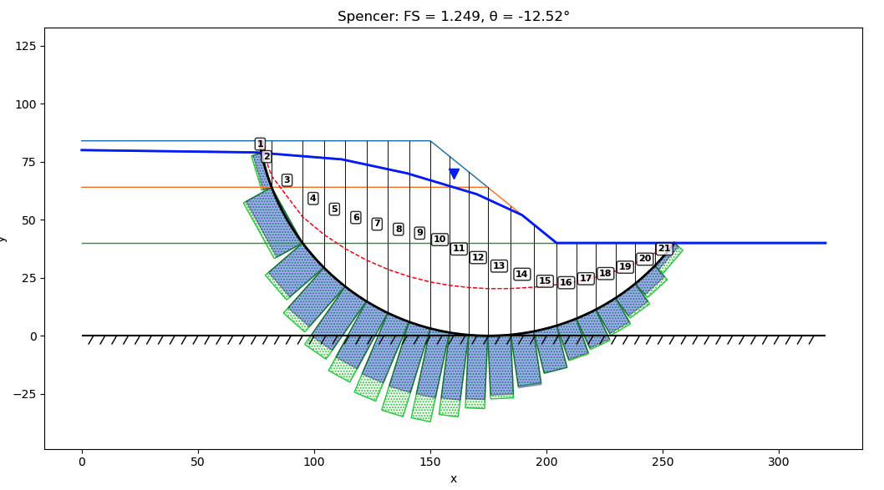

Slide 4
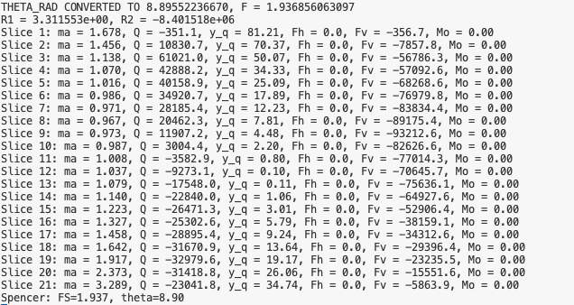

Slide 5
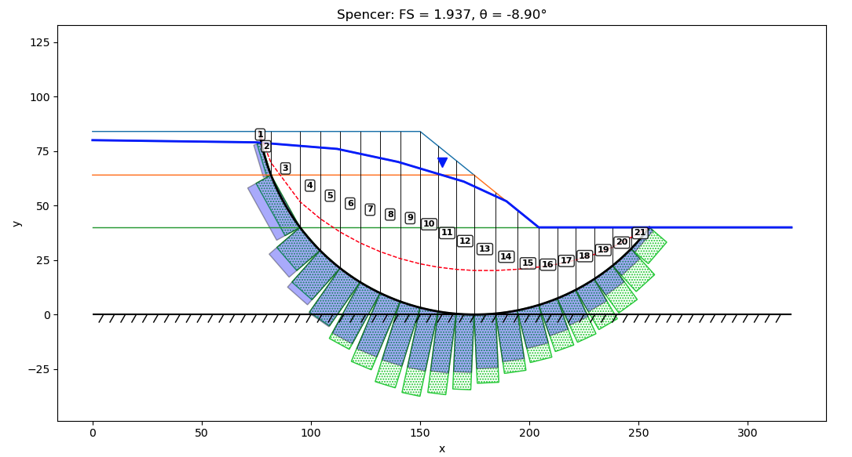
I got this by flipping the sign on:
alpha (reverts to the true angle)
c and tan(phi). This ensures that the shear force is going in the proper direction against the sliding angle of the slope.

