Slide 1
An Efficacy Rating for March Madness Tournament Seeding
Dr. Joe DeMaio and Nathalie Jones
Notes:
Goodmorning everyone, thank you for coming to my session.
My name is Nathalie Jones.
I will be presenting an efficacy rating for team seedings in the March Madness basketball tournament.

Slide 2


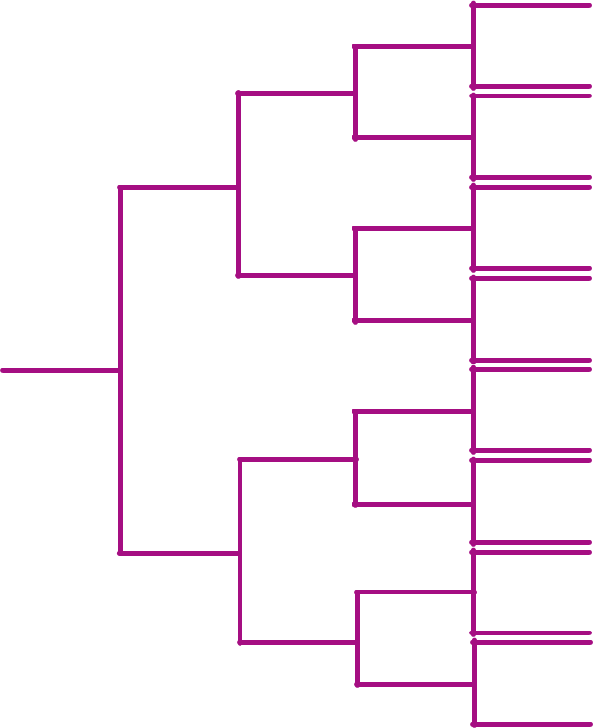

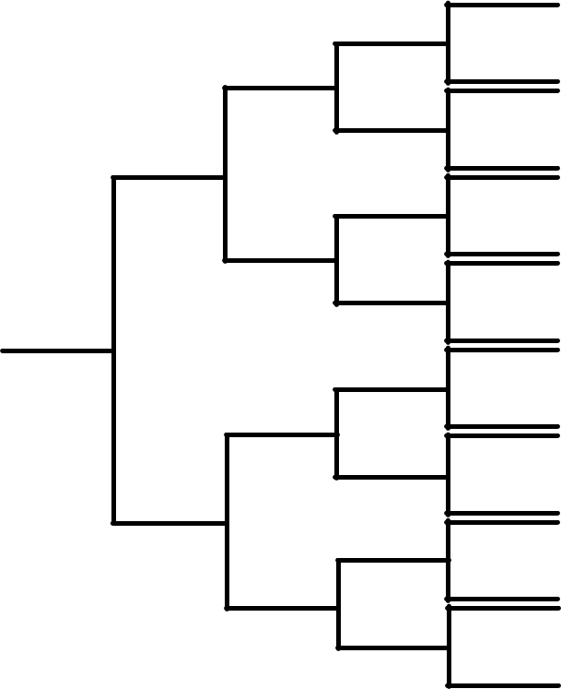

background
March Madness & NCAA Seeding
Tournament began seeding in 1979
Initially, 32 Team bracket
64-team bracket began in 1985:
Teams split into 4 regions
Ranked 1 – 16 within each region
Lower seeds expected to place higher in the tournament
West
South
East
Midwest
Notes:
The March Madness tournament began seeding teams in 1979, beginning with a 32-team bracket.
In 1985, the men’s tournament began using a 64-team bracket, while the women’s tournament followed suit in 1994.
[CLICK] These 64 teams are split into 4 groups based on region. [CLICK]
Then, for each region, teams receive a ranking from 1 – 16 based on their expected tournament placement.
The team seeded 1st is expected to win the tournament, while the team seeded 2nd is expected to lose to the first seed in the Championship round, and so on.

Slide 3
background
March Madness & NCAA Seeding
Tournament began seeding in 1979
Initially, 32 Team bracket
64-team bracket began in 1985:
Teams split into 4 regions
Ranked 1 – 16 within each region
Lower seeds expected to place higher in the tournament
1
1
16
1
8
8
9
1
5
5
12
4
4
4
13
6
1
6
11
3
3
3
14
7
2
7
10
2
2
15
2
Notes:
Then, for each region, teams receive a ranking from 1 – 16 based on their expected tournament placement. [CLICK]
The team seeded 1st is expected to win the tournament, while the team seeded 2nd is expected to lose to the first seed in the Championship round, and so on.
Here is an example of what a “perfect” bracket would be expected to look like for one region.
Where the lower number seed wins, making the team seeded 1st the overall winner for our region.

Slide 4
Project purpose
How accurate are team seedings?
Has seeding efficacy increased or decreased over time?
What influential factors exist?
Does seeding efficacy vary across tournaments?
Notes:
For this project, we wanted to answer these four questions:
How accurately do team seedings reflect actual tournament results?
How has seeding efficacy changed over the years? Has it increased or decreased?
What factors influence the efficacy of team seedings?
Does seeding efficacy vary between men’s and women’s tournaments?

Slide 5
About the data
Data Collected
NCAA bracket information
1985 – 2023 Men’s tournament
1994 – 2023 Women’s tournament
Player Salaries
36 years of NBA player salaries
5 years of WNBA player salaries
Early Entrant Players
38 years of NBA early entrant players
2 years of WNBA early entrant players
Notes:
Data collected.
We collected NCAA bracket information for the men’s and women’s teams from 1985 – 2023.
This included tournament results, which includes team seedings, game score, team names, round, and region.
Since the Women’s tournament did not start using a 64-team bracket until 1994, we excluded any Women’s bracket data prior to that year.
In addition, we collected player salaries and early entrant players for the NBA and WNBA
there is a major difference in the availability of WNBA data.
36 years of player salaries can be found for the NBA, but only 5 years of WNBA salaries are publicly available.
Furthermore, 38 years of NBA early entrants is available but only two years of WNBA early entrant data can be found

Slide 6
About the data
Data Scraping Methods
Python libraries: “requests,” “beautifulsoup”
NBA data available but scattered across various websites and webpages
Wikipedia
ESPN
Basketballreference.com
Limited sources of WNBA data
Spotrac (player salaries)
DraftKings (early entrants)
Notes:
Data scraping methods.
To collect this data, we web scraped using a variety of both automated and manual methods in Python.
This was made tedious by how scattered the data is across various websites and webpages.
Each tournament bracket can be found on its own Wikipedia page, and each page has a unique set of HTML tags tied to the data to be collected.
NBA player salaries is available on several websites such as ESPN and Basketballrerefence.com, which further complicates the scraping process due to these websites not wanting their data to be scraped.
In contrast, WNBA data is very limited and hard to find.
Player salaries and early entrant data can only be found from two sources, Spotrac and DraftKings.

Slide 7

Proposed Metric
Proposed metric sums seed value for each team at a fixed round, i:
$$E(year, gender)=\sum_{i}{R(year, round(i), gender)}$$
The error rate can then be calculated by:
$$e=\frac{E(year, gender)−Best Score}{Worst Score−Best Score}$$
Notes:
We propose a metric that sums the seed values for each team at a fixed round in a fixed year.
And we can calculate an error rate by the difference between the actual and best cases divided by the difference between the worst and best cases.

Slide 8
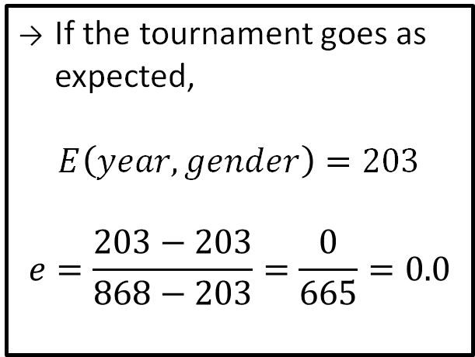
Measuring Team Seeding Efficacy
(
36
+
10
+
3
+
1
)
x
4 Regions
+
1
+
1
+
1
=
203
1
If the tournament goes as expected,
$$E\left(year, gender\right)=203$$
$$e=\frac{203−203}{868−203}=\frac{0}{665}=0.0$$
1
16
1
8
+
8
9
+
1
5
+
Final Four
5
West
South
12
4
+
4
4
13
6
+
+
+
1
1
1
1
6
11
3
+
3
3
East
Midwest
14
+
7
+
2
7
10
+
2
2
2
15
Notes:
[ C L I C K ] if the tournament goes as expected, then output of this function would be 203.
This is found by summing the seed values in each round as shown at the top of the slide.
Since this is expected to happen for each region, [ C L I C K ] we can multiply this value by 4.
Finally, [ C L I C K ] we need to add up the sums from the results of the Final Four bracket.
In the best case where the lower number beats the higher number, we should have the teams seeded 1st from each region in the Final Four.
So, we add 1 + 1 + 1 and we see a total seed sum of 203 and an error rate of zero.

Slide 9
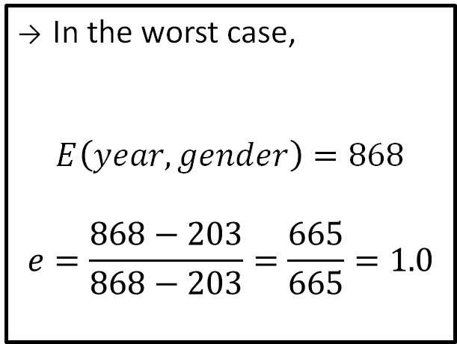
Measuring Team Seeding Efficacy
(
100
+
58
+
31
+
16
)
x
4 Regions
+
16
+
16
+
16
=
868
1
In the worst case,
$$E\left(year, gender\right)=868$$
$$e=\frac{868−203}{868−203}=\frac{665}{665}=1.0$$
16
16
16
8
+
9
9
+
16
5
+
Final Four
12
West
South
12
4
+
13
13
13
6
+
+
+
16
16
16
16
11
11
3
+
14
14
East
Midwest
14
+
7
+
15
10
10
+
2
15
15
15
Notes:
[ C L I C K ] In the worst case where the higher seeds beat the lower seeds, the output of the function would be 868.
Like before, we sum the seeds of each round, multiply this value by 4, and add the seeds from the results of the Final Four bracket to get this value and an error rate of 1.

Slide 10
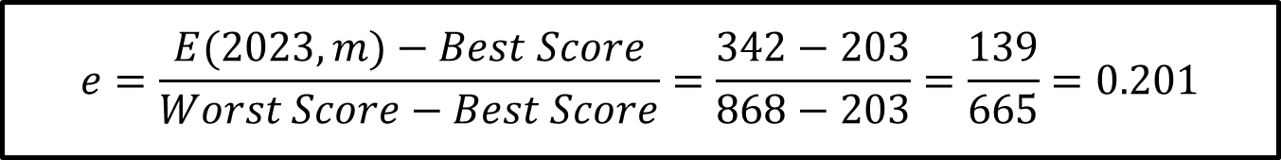
Error rate example
Round Number | 𝐸(2023, m) | Best Score | Worst Score
1 | 191 | 144 | 400
2 | 78 | 40 | 232
3 | 37 | 12 | 124
4 | 23 | 4 | 64
5 | 9 | 2 | 32
6 | 4 | 1 | 16
Sum Total | 342 | 203 | 868
$$e=\frac{E(2023, m)−Best Score}{Worst Score−Best Score}=\frac{342−203}{868−203}=\frac{139}{665}=0.201$$
Notes:
Table.
In this table, we have an example of how the error rate is calculated for the 2023 Men’s tournament.
The second column contains the actual values for this tournament while the third and fourth columns contain what would be expected from the best and worst cases.
Equation.
In this case, the error rate is about 20.1%.
And we can see that starting in round 1, the seed sums started deviating from the best possible, and continued to do so for each round.

Slide 11
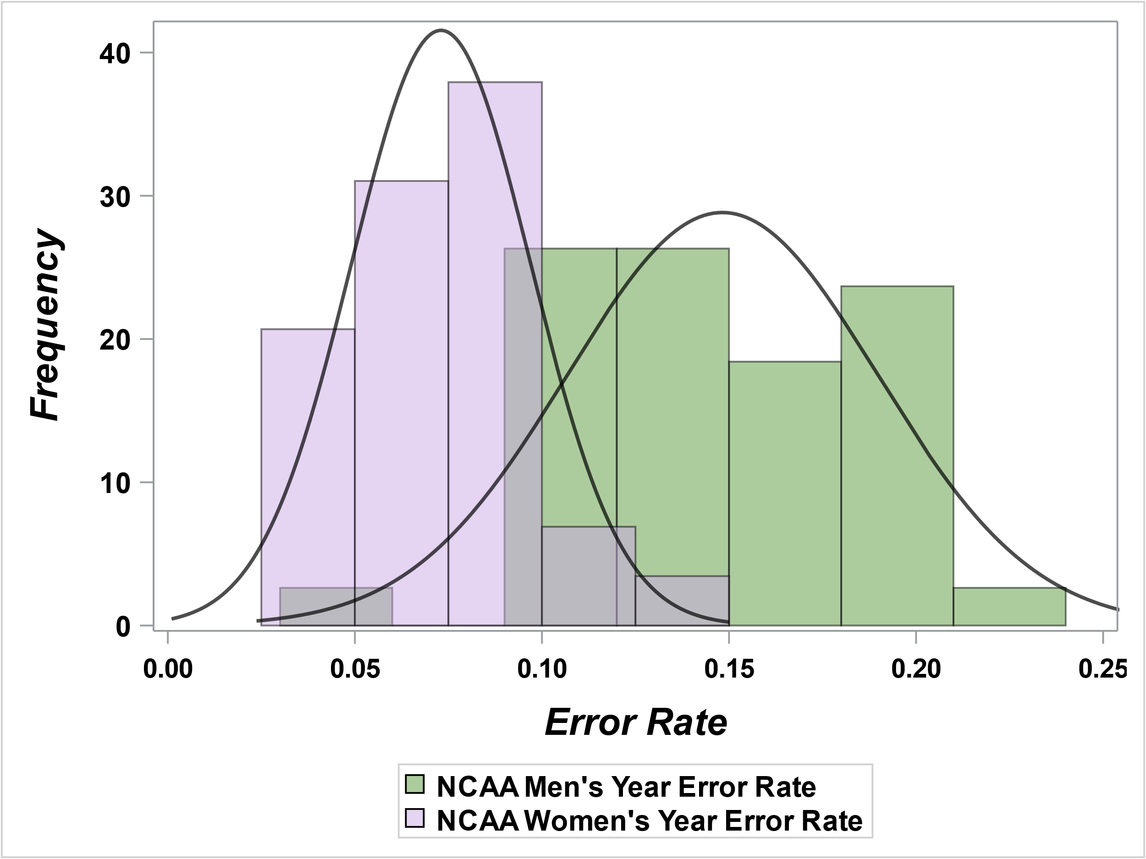
error rate across tournaments
Average Error Rates Overall
Men’s | Women’s
15 % | 7 %
Slightly less variation in women’s tournaments error rates
Distribution of Year Error Rates for NCAA Men’s & Women’s Leagues
Notes:
This figure displays the distribution of the error rates, with Men’s error rates in green and Women’s error rates in purple.
We can see that these rates vary across the two distributions, with greater variation within the green as opposed to the purple.
Overall, the Men’s tournaments had an average error rate of 15% while the women’s tournament produces 7% error rate.

Slide 12
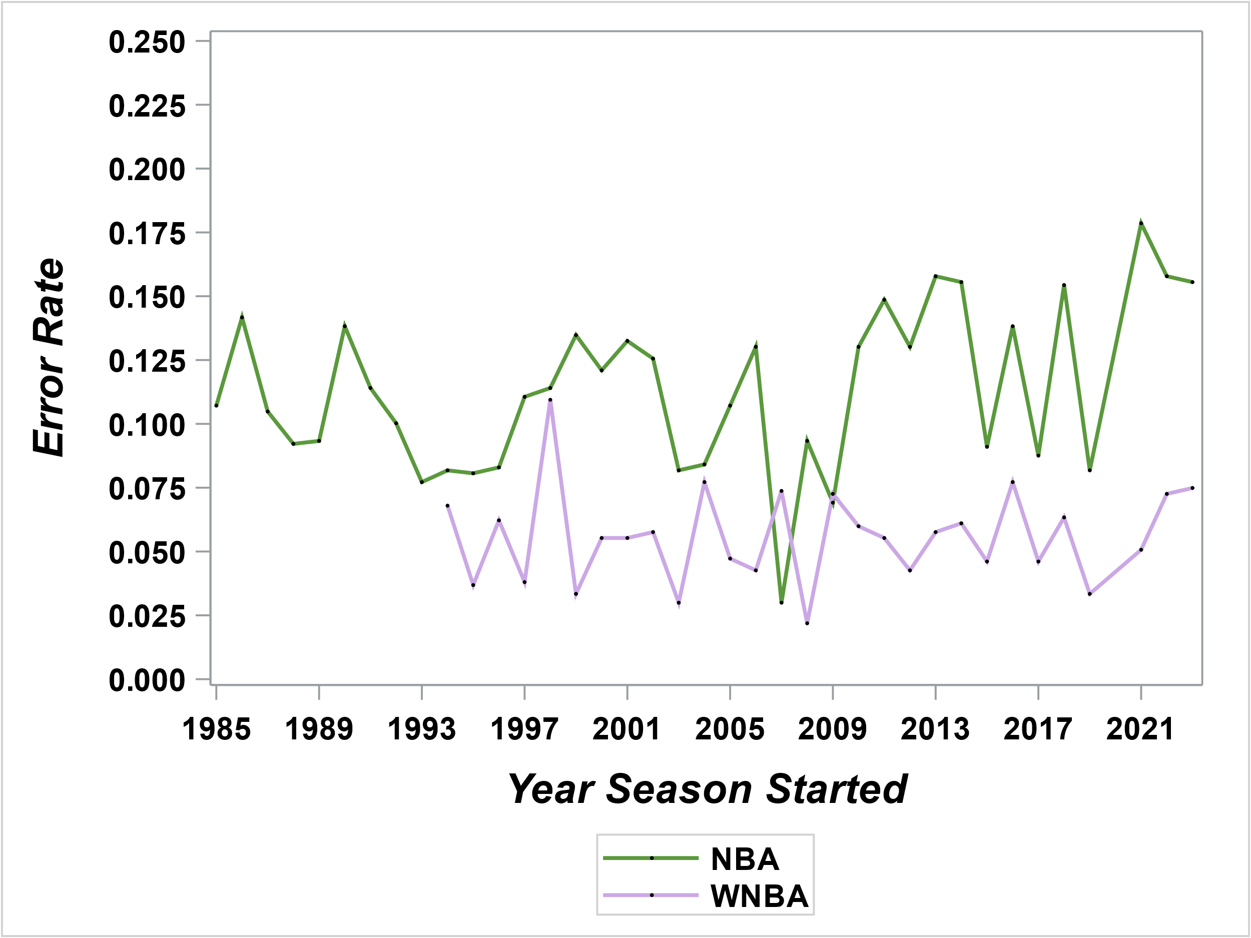
error rate By Gender Over Time
Lower error rate in women’s tournaments every year except 2006
Slight overall increase in men’s tournaments
1998 Largest error rate in women’s history
Harvard (16) vs. Stanford (1), 1998
Year Error Rates for Men’s & Women’s Tournaments Over Time
Notes:
Another interesting finding came from looking at the error rates over time.
You’ll notice that the data for the Women’s tournament does not start until 1994.
This is because while the Men’s tournament started using a 64-team bracket in 1985, it was not until 1994 that the Women’s tournament followed suit.
We can see that the Women’s error rate remains lower than the Men’s every year except 2006, where the Men’s error rate drops drastically.
Additionally, we can see that spike in the Women’s tournament around 1998 where Harvard beat Stanford, but still the error rate remains lower than the Men’s tournament for that year.
While the Women’s tournament error rate remains relatively steady, the Men’s tournament error rate exhibits an overall increase over time for the most recent years.
So, the natural question is what is influencing this relationship?

Slide 13
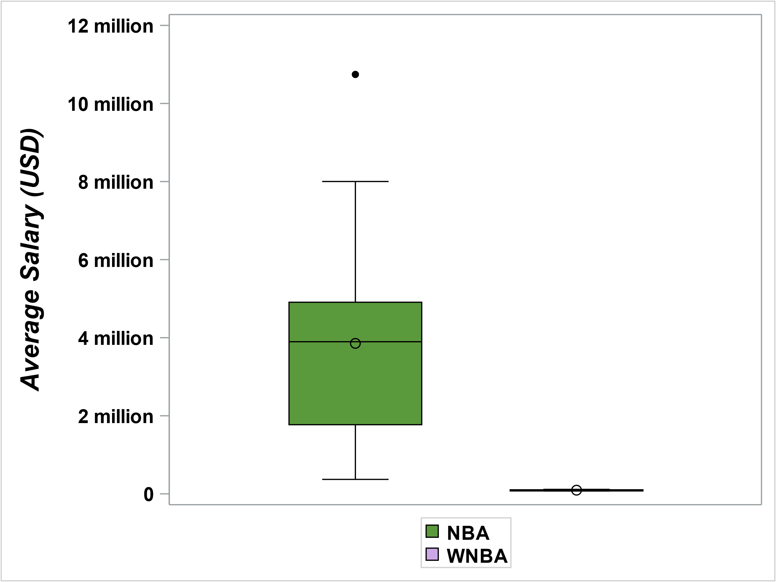
Average Salary for NBA and WNBA Players
Extreme Pay Disparity
Notes:
This may be due to the extreme difference in NBA and WNBA salaries which we can see from this graph.
The average NBA salary is 84x the average WNBA salary and
Most NBA players earn way more than some of the highest paid WNBA players.

Slide 14
Influencing Factors: Salary
Name | Position | 2022 Salary
 | Average WNBA Player | $97,381
 | Average NBA Player | $8.2 Million
Steph Curry | Highest paid NBA player | $51.9 Million
Diana Taurasi | Highest paid WNBA player | $235,936
Rocky the Mountain Lion | NBA Mascot | $625K
Harry the Hawk | NBA Mascot | $600K
Benny the Bull | NBA Mascot | $400K
Go the Gorilla | NBA Mascot | $200K
Notes:
In fact, some NBA mascots earn more than WNBA players.
Which may influence the decision of some women basketball players in the NCAA in entering the WNBA early and instead opt into finish a degree that will guarantee a higher income.

Slide 15
Conclusion
Project Purpose | NCAA March Madness Tournament
 | Women’s Tournament | Men’s Tournament
How Accurate are Team Seedings? | 7% error rate (overall) | 15% error rate (overall)
Has Seeding Efficacy Increased or Decreased Over Time? | Relatively steady | Slightly increasing
What Influential Factors Exist? | Men’s & Women’s salaries significantly disparate
Does Seeding Efficacy Vary Across Leagues? | Women’s error rate significantly lower
Notes:
To sum up the questions we asked at the beginning:
Overall, Women’s tournament seedings exhibited an average error rate of 7%, and men’s tournament seedings exhibited an average error rate of 15%.
Over time, efficacy seems to remain steady for the Women’s tournament, while error rate slightly increases for the Men’s.
We also found that salary disparity may play a role in seeding efficacy.
If anyone is interested in hearing more about the influencing factors, I do have some extra slides prepared for that.
Finally, we found that seeding efficacy does vary across tournaments, with Women’s tournament error rates appearing significantly lower than Men’s tournament error rates.

Slide 16
QUESTIONS

Slide 17
Thank you!

Slide 18
Appendix

Slide 19
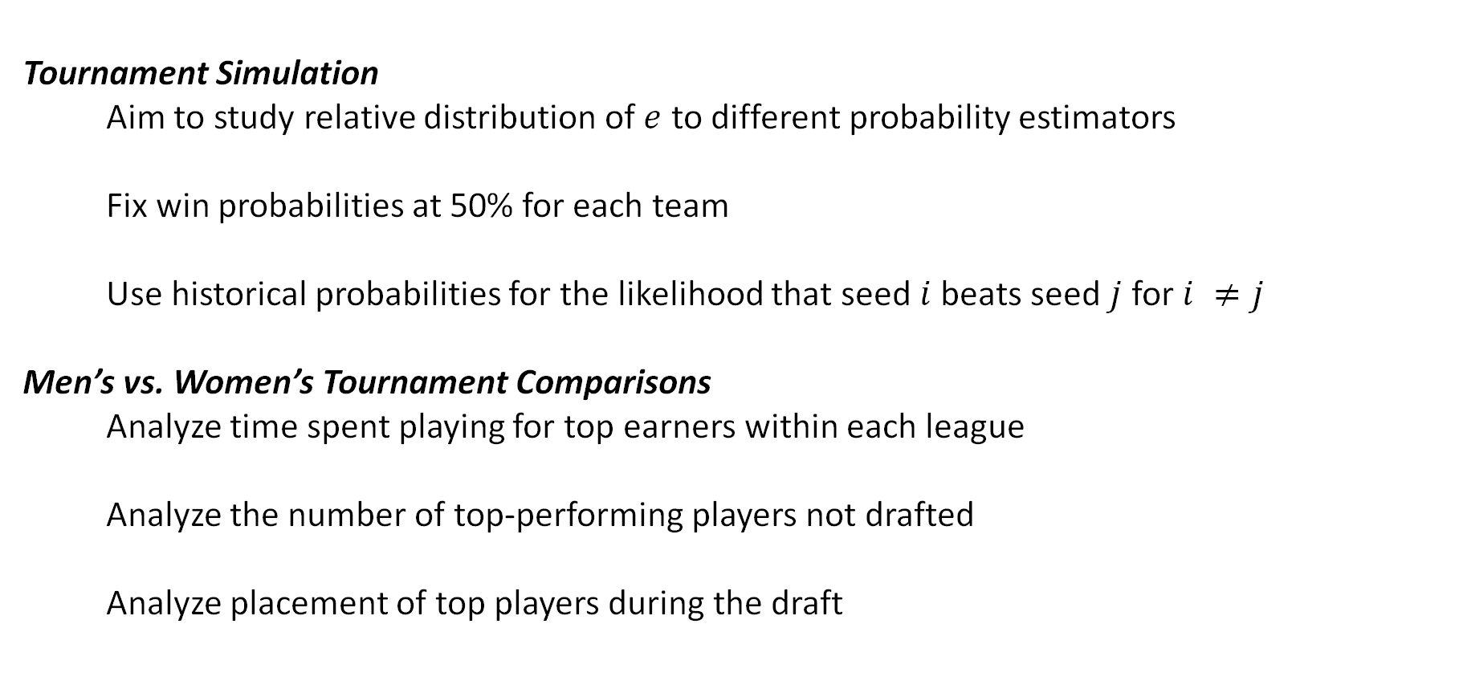
Future Work
Tournament Simulation
Aim to study relative distribution of $e$ to different probability estimators
Fix win probabilities at 50% for each team
Use historical probabilities for the likelihood that seed $i$ beats seed $j$ for $i ≠j$
Men’s vs. Women’s Tournament Comparisons
Analyze time spent playing for top earners within each league
Analyze the number of top-performing players not drafted
Analyze placement of top players during the draft
Notes:
Next steps could include the following:
Tournament simulation.
Studying the relative distribution of error rates to different probability estimators.
For instance, we could fix win probabilities at 50% for each team.
Another option would be to use historical probabilities to calculate the likelihood that seed i beats seed j for i ≠ j.
Men’s vs. women’s tournament comparisons.
Since we found a difference in salaries between the two tournaments, it may be interesting to compare other metrics across tournaments.
These include the time spent playing by the top earners in each tournament, the number of top-performing players not drafted, top players’ draft placements.

Slide 20
NBA & WNBA Salaries

Slide 21
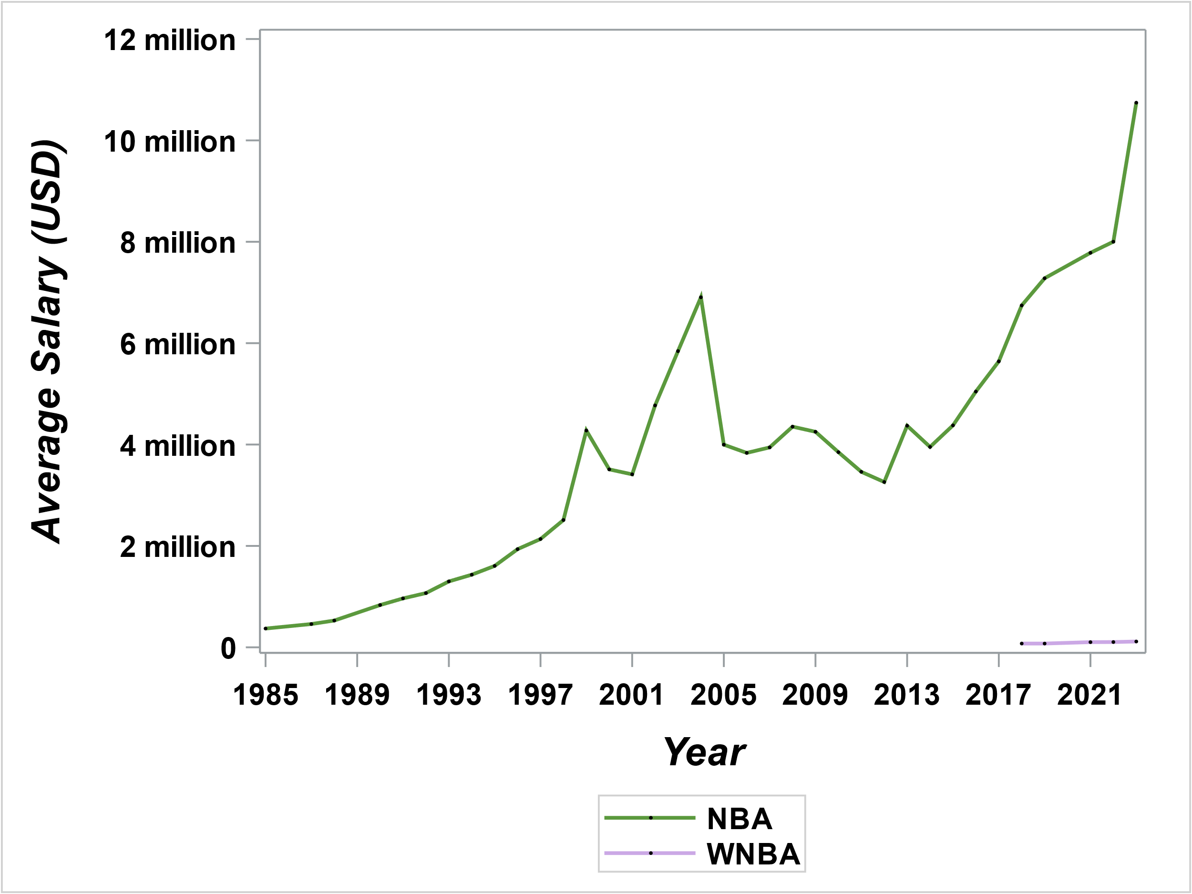
Average NBA Player Salary (1985 – 2023)
Little data on WNBA players, only 5 years publicly available
NBA player salaries display a positive, increasing relationship
Time accounts for 72.27% of the variation in NBA player salaries
Salaries should increase by $176,262 – $213,890 per year
Average Salary for NBA and WNBA Players Over Time

Slide 22
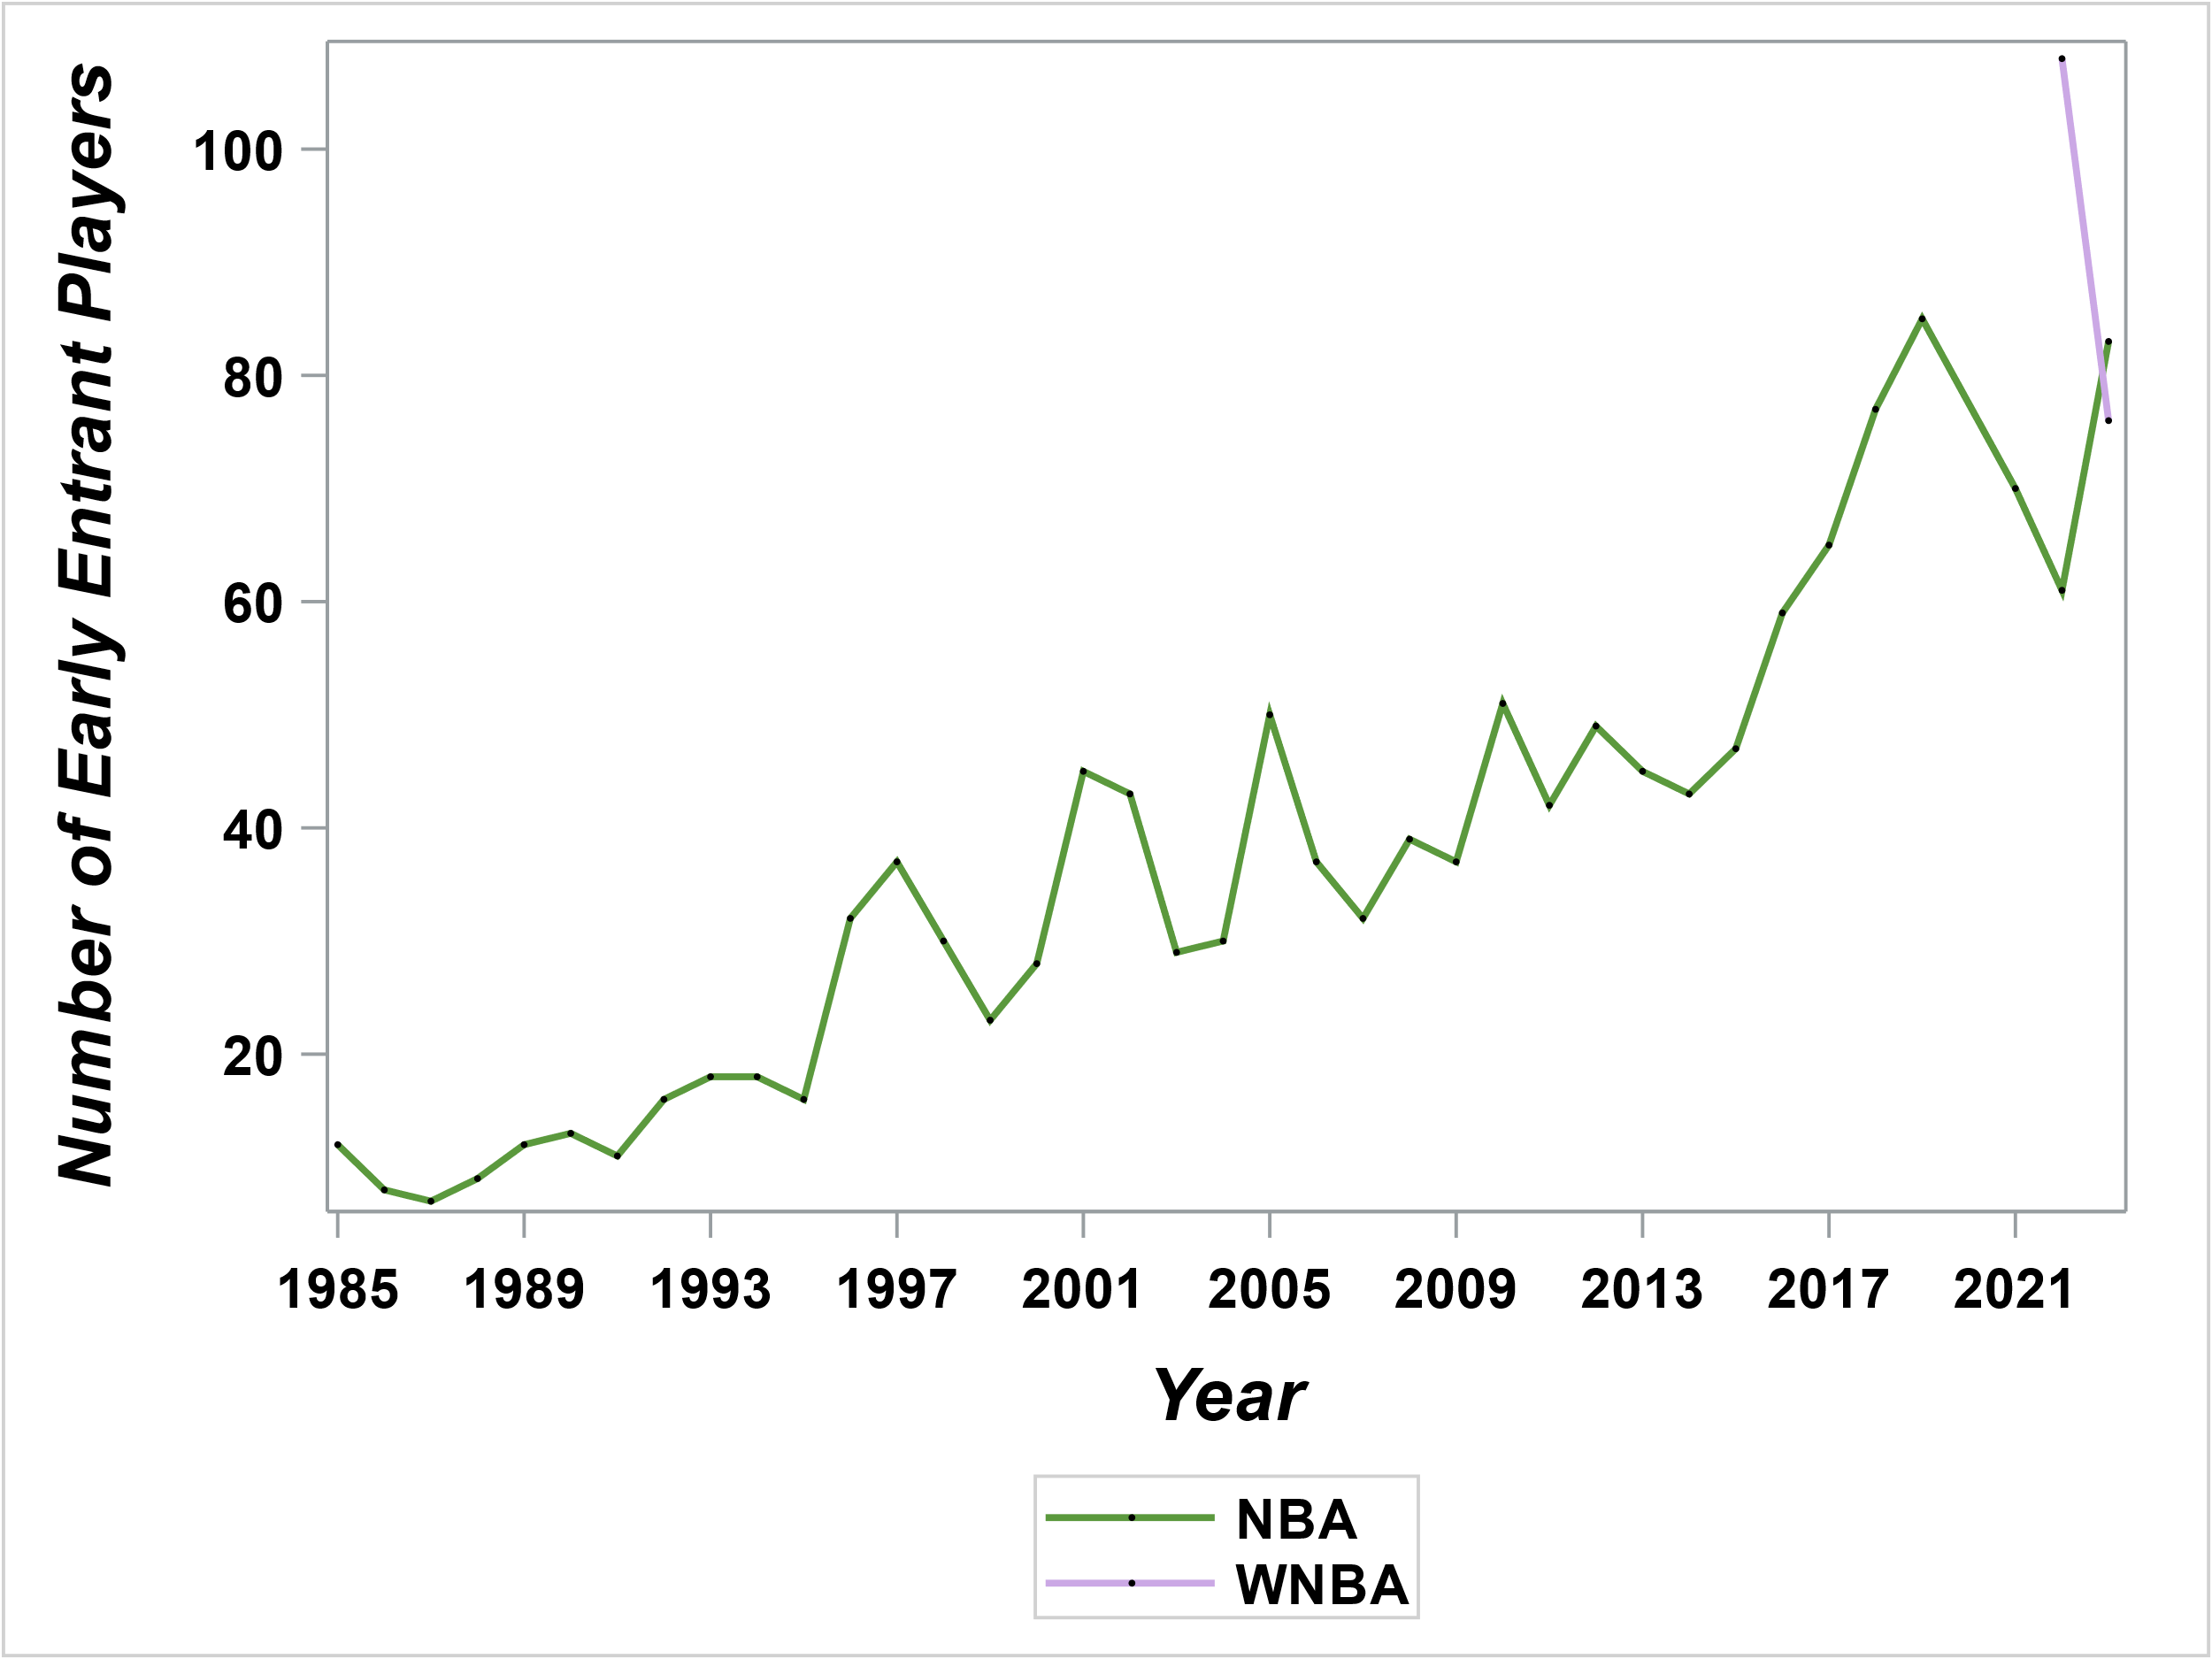
Number of Early Entrant Players
Little data on WNBA early entrant players
Positive, increasing relationship
The number of early NBA entrants should increase by 1 – 2 players each year
Notes:
Players leaving the NCAA early to join the NBA or WNBA may play a role.
The NBA has allowed players to do this so long as they are 18 years old and not on a college team.
The number of early entrants into the NBA has been increasing over time and should continue to increase by 1 or 2 players each year
Until recently, the WNBA did not let women NCAA players enter early and even today their rules are much stricter than the NBA.
But from the two years of data I was able to find, the number of early entrants into the WNBA is comparable to the NBA.
We can’t tell if it will remain comparable in the future,

Slide 23
Relationship between factors

Slide 24
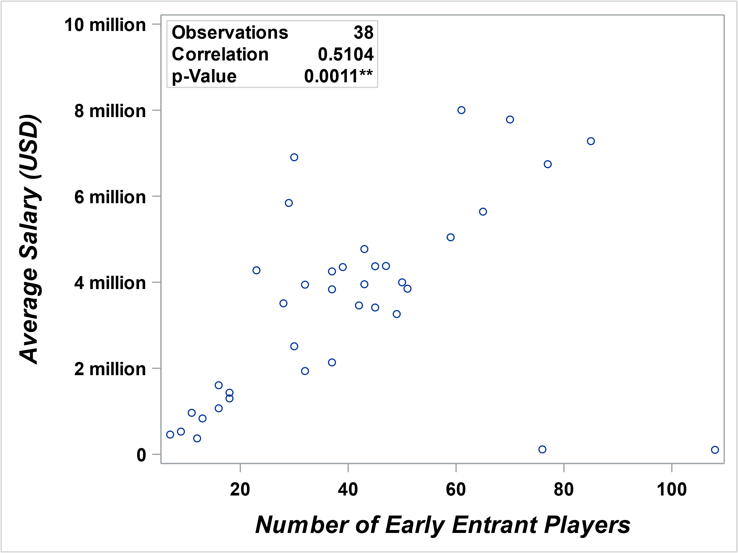
Influencing Factors’ Relationship
Correlation: 51%, p-value: 0.0011**
Relatively strong, positive relationship
As salaries increase, so should the number of NBA early-entrant players
Correlation Between Average NBA Salaries and Number of NBA Early Entrants

Slide 25
Code Used

Slide 26
ODS _all_ close; ODS html path = "&filepat" file = "visuals.html"; ODS graphics / outputfmt = svg;
PROC sgplot DATA = out.yr_clean; HISTOGRAM NBA_YEAR_ERROR / fillattrs = (color = "#5B993D") transparency = 0.5 name = "men" legendlabel = "NCAA Men's Year Error Rate"; HISTOGRAM WNBA_YEAR_ERROR / fillattrs = (color = "#CBA8E5") transparency = 0.5 name = "women" legendlabel = "NCAA Women's Year Error Rate"; DENSITY NBA_YEAR_ERROR / lineattrs = (color = black) transparency = 0.3; DENSITY WNBA_YEAR_ERROR / lineattrs = (color = black) transparency = 0.3; KEYLEGEND "men" "women" / autoitemsize down = 2 valueattrs = (size = 12 weight = Bold); XAXIS label = "Error Rate" values = (0.00 to 0.25 by 0.05) labelattrs = (size = 16 style = Italic weight = Bold) valueattrs = (size = 11 weight = Bold); YAXIS label = "Frequency" labelattrs = (size = 16 style = Italic weight = Bold) valueattrs = (size = 12 weight = Bold); RUN;
ODS html close; ODS listing;
Distribution of Year Error Rates for NCAA Men’s & Women’s Leagues
Error Rate Across Tournaments
Notes:
This may be due to the extreme difference in NBA and WNBA salaries which we can see from this graph.
The average NBA salary is 84x the average WNBA salary and
Most NBA players earn way more than some of the highest paid WNBA players.

Slide 27
ODS _all_ close; ODS html path = "&filepat" file = "visuals.html"; ODS graphics / outputfmt = svg;
PROC sgplot DATA = out.yrlg_clean; STYLEATTRS datacontrastcolors = ("#5B993D“ "#CBA8E5"); SERIES x = YEAR y = YEAR_ERROR / group = LEAGUE_ID markers lineattrs = (thickness = 2) name = "lines“ markerattrs = (symbol = circlefilled color = black size = 3); KEYLEGEND "lines" / down = 2 valueattrs = ( size = 12 weight = Bold); XAXIS label = "Year Season Started“ values = (1985 to 2023 by 1) labelattrs = (size = 16 style = Italic weight = Bold ) valueattrs = (size = 12 weight = Bold); YAXIS label = "Error Rate“ values = (0.000 to 0.250 by 0.025) labelattrs = (size = 16 style = Italic weight = Bold) valueattrs = (size = 12 weight = Bold); RUN;
ODS html close; ODS listing;
Year Error Rates for Men’s & Women’s Tournaments Over Time
Error By Gender Over Time
Notes:
This may be due to the extreme difference in NBA and WNBA salaries which we can see from this graph.
The average NBA salary is 84x the average WNBA salary and
Most NBA players earn way more than some of the highest paid WNBA players.

Slide 28
ODS _all_ close; ODS html path = "&filepat" file = "visuals.html"; ODS graphics / outputfmt = svg;
PROC sgplot DATA = out.yrlg_clean; SCATTER x = EARLY_ENTRANT_PLAYERS y = NBA_AVG_SALARY;
INSET ("Observations" = "38“ "Correlation" = "0.5104“ "p-Value" = "0.0011**") / border position = NW textattrs = (size = 12 weight = Bold); XAXIS labelattrs = (size = 16 style = Italic weight = Bold) valueattrs = (size = 12 weight = Bold); YAXIS values = (0 2000000 4000000 6000000 8000000 10000000) valuesdisplay = ("0“ "2 million“ "4 million“ "6 million“ "8 million“ "10 million") labelattrs = (size = 16 style = Italic weight = Bold) valueattrs = (size = 12 weight = Bold); RUN;
ODS html close; ODS listing;
Correlation Between Average NBA Salaries and Number of NBA Early Entrants
Influencing Factors’ Relationship
Notes:
This may be due to the extreme difference in NBA and WNBA salaries which we can see from this graph.
The average NBA salary is 84x the average WNBA salary and
Most NBA players earn way more than some of the highest paid WNBA players.

Slide 29
references

Slide 30
References
ESPN Internet Ventures. (n.d.). NBA Player Salaries - 2023-2024. ESPN. https://www.espn.com/nba/salaries
HoopsHype. (n.d.). NBA Salaries. HoopsHype. https://hoopshype.com/salaries/
McDermott, G. (2023, April 10). Which NCAA players have declared for the 2023 WNBA draft?. DraftKings Network. https://dknetwork.draftkings.com/2023/4/10/23674042/ wnba-draft-player-list-2023-early-entrants-eligibility-criteria-ncaa-renounce
NCAA.com. (2023, April 4). Latest bracket, schedule and scores for 2023 NCAA Men’s Tournament. https://www.ncaa.com/news/basketball-men/mml-official- bracket/2023-04-04/latest-bracket-schedule-and-scores-2023-ncaa-mens- tournament

Slide 31
References
Sporting News Editorial Team. (2021, September 18). How to get free lunch at Little Caesars Today for UMBC’s historic win. Sporting News. https://www.sportingnews.com/us/ncaa-basketball/news/free-lunch-little-caesars- april-2-umbcs-march-madness-win/1bybkpmaoo2a91b05myvtornhy
Spotrac.com. (n.d.). WNBA rankings. Spotrac.com. https://www.spotrac.com/wnba/rankings/
Wikimedia Foundation. (2023a, October 7). NCAA Division I men’s basketball tournament. Wikipedia. https://en.wikipedia.org/wiki/ NCAA_Division_I_men%27s_basketball_tournament
Wikimedia Foundation. (2023b, October 5). 2023 NBA draft. Wikipedia. https://en.wikipedia.org/wiki/2023_NBA_draft

Slide 32
References
Wikimedia Foundation. (2023c, October 5). 2023 NBA draft: Early Entrants. Wikipedia. https://en.wikipedia.org/wiki/2023_NBA_draft#Early_entrants
Wikimedia Foundation. (2023d, September 27). NCAA Division I women’s basketball tournament. Wikipedia. https://en.wikipedia.org/wiki/ NCAA_Division_I_women%27s_basketball_tournament

