Slide 1
Classification of Pell institutions
Nathaniel Jones
STAT 4310

Slide 2
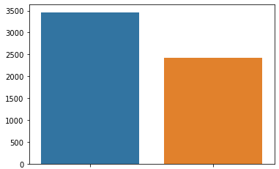
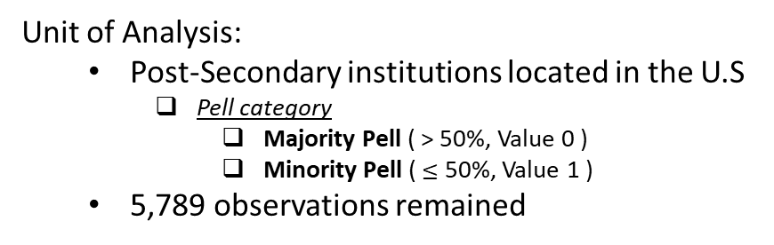
Introduction
CollegeScoreCard dataset:
Released by the U.S. Department of Educations’ Integrated Post-secondary Education Data System (IPEDS)
Most recent school year 2017-18
6,806 observations with 2,384 variables.
Pell Category count
Unit of Analysis:
Post-Secondary institutions located in the U.S
Pell category
Majority Pell ( > 50%, Value 0 )
Minority Pell ( $≤$ 50%, Value 1 )
5,789 observations remained
Data Munging:
1,419 variables contained no data, or the data was suppressed.
16 variables were not useful to this project
URLs, FSA ID, alias, program descriptions
523 variables with data also had missing values
Imputed with the median
783 variables remained
3463
2416
Majority Pell institution
Minority Pell institution

Slide 3
Data Subgroupings
Identity and Geolocation
Target encoding
One-Hot encoding
Program Offerings
Principal component analysis (PCA)
38 components (80%)
Institutional Demographics
Target encoding
One-Hot encoding
Student Demographics
One-Hot encoding
Academic outcomes
PCA
5 components (82%)
Loan outcomes
PCA
3 components (81%)

Slide 4
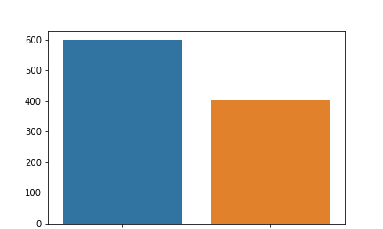
Model Preprocess
Test set target variable counts
Train-Test-Valid split
Training set: 3879 observations
Testing set: 1000 observations
599 Majority Pell
401 Minority Pell
Validation set: 1000 observations
Majority Pell institution
Minority Pell institution

Slide 5
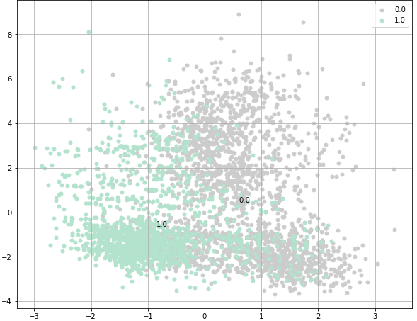
Modelling Process
Logistic Regression
Best test scores: 82% (Accuracy), 92.2% (AUC)
Correct majority Pell classifications: 514
Correct minority Pell classifications: 349
Logistic Regression with PCA
Best test scores: 87% (Accuracy), 95% (AUC)
Correct majority Pell classifications: 511
Correct minority Pell classifications: 354
XGBoost
Best test scores: 81% (Accuracy), 92% (AUC)
Correct majority Pell classifications: 494
Correct minority Pell classifications: 338
k-Nearest Neighbors with PCA
Best test scores: 87% (Accuracy), 95% (AUC)
Correct majority Pell classifications: 511
Correct minority Pell classifications: 354
Principal Component Analysis (PCA)
80 Components accounted for 80% of the explained variance
PC1: Total outstanding federal DIRECT Loan balance
PC3: Total outstanding Parent PLUS Loan balance
PC1
(54% Explained Variance)
PC3 (13.5% Explained Variance)

Slide 6
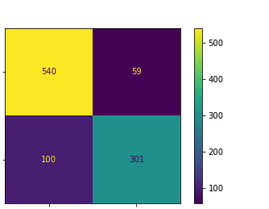
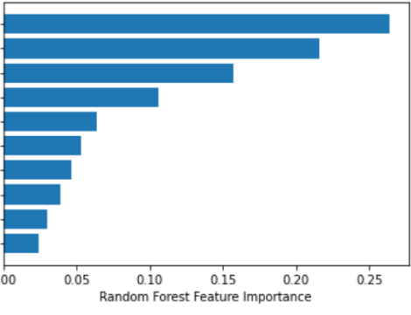
Best Overall Model
Random Forest
Best train score: 86% (Accuracy), 94% (AUC)
Best test score: 84% (Accuracy), 92% (AUC)
Best validation score: 83% (Accuracy), 92% (AUC)
Most Important features
Percent of Federal Loan Borrowers
Accrediting Agency
Actual
Majority Pell institution
Percent federal loan borrowers
Accrediting Agency
2-year cohort Proportion in forbearance
2-year completers cohort proportion in forbearance
Out-of-State Tuition & Fees
10-year borrower repayment rate
In-State Tuition & Fees
Number of non-Pell students in the debt cohort
10-year monthly repayment amount for a completer
Number of males in the debt cohort
Actual
Minority Pell institution
Predicted
Majority Pell institution
Predicted
Minority Pell institution

Slide 7
Discussion
Future research projects
Short-term goals
Regress the number of federal loan borrowers
Study the differences between accrediting agencies
Long-term goals
Define institutional stewardship
Categorized institutions based on their stewardship
Any Questions?

