Slide 1




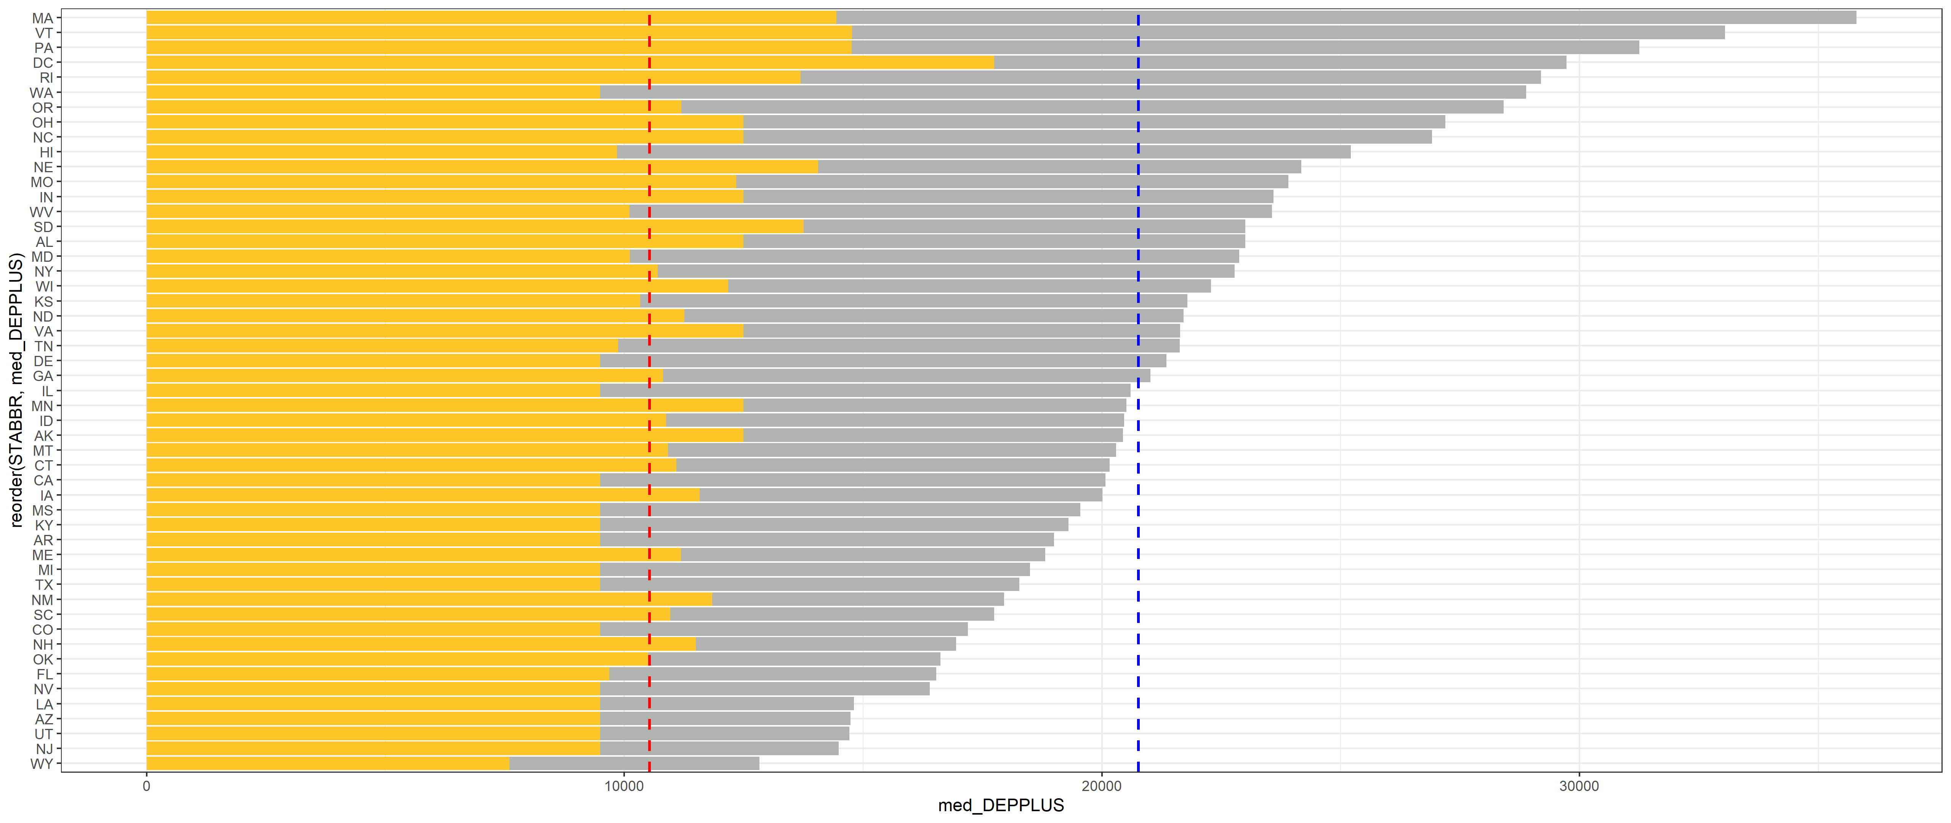
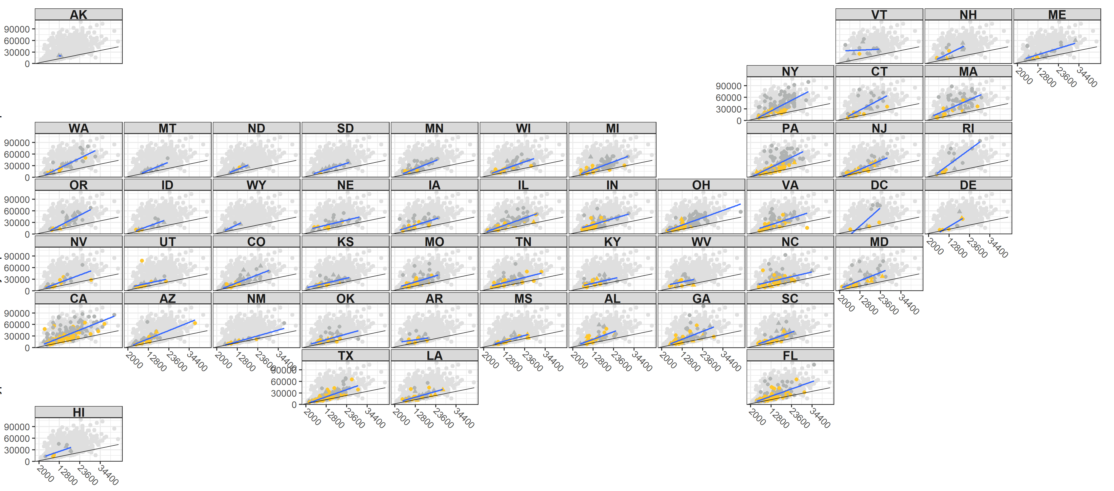



DOES THE PELL GRANT COME WITH A PRICE?
Nathaniel Jones
INTRODUCTION
METHODS
CONCLUSIONS
The goal of this research is to use the CollegeScorecard dataset to determine which post-secondary schools and states are helping low-income students succeed. This success is measured by the institution’s student graduation rate, loan default rate two years after graduation, dropout rate, and the typical amount of debt acquired by an independent student or a dependent student with their parent as they exit the institution, either by graduating or dropping out. The proportion of students still trying to finish their degree 8 years after their first enrollment is 0.4%, I am one of those 0.4%. I had to learn the implications of the dependency status the hard way. I had to find a way to attend school, even when I was homeless, had medical issues, and could not afford food. I had to learn financial and life lessons that are usually taught by the family.
I propose that an educational institution provide mandatory training on the implications of dependent and independent status, as to whether the student will receive any of the parental loans that are taken out in their behalf. In addition, institutions, which have the majority of their student populations receiving a Pell grant, have lower graduation rates and higher dropout rates, resulting in higher loan default rates 2 years after the student leaves the institution. Educational institutions need to take their stewardship of Pell grant recipients seriously by providing coaching that will help them with academic success—skills that a high-income family generally provide for their children. By meeting the needs of Pell grant recipients, they will better meet the needs of all students at their institutions.
Coding Methods: I used tidyverse to pipe functions (e.g. mutate, filter, select, and lapply). I used packages that include stringr, pplyr, dplyr, magrittr, ggplot, ggpubr, ggh4x, geofacet, sf, sp, and tidycensus. My favorite package is magrittr because of the assignment pipe %<>%.
Data Wrangling: For the CollegeScorecard dataset, I created an anonymous function that checks each column for missing values, and then I dropped all columns with zero entries. Observations that were missing their institutions name, proportion of Pell recipients in their student population, their longitude and latitude, and their state were dropped. This left a total of 952 variables and 6186 observations. As I did my analyses, I created multi-layer filters to create the needed subsets.
Spatial Analysis: The census shapefiles and data from the packages tigris and tidycensus were used to create maps of the institutional locations by state. I joined together the polygons of the states that are provided in the shapefile with the latitude and longitude of each school from the CollegeScorecard data.
Nonparametric Binomial Distribution Test and Confidence Intervals: The binomial test was used to verify the National Center for Education Statistics’ claim that the average net price at a 4-year institution is $18,500.
K-sample Permutation Tests: The K-sample Permutation Test was used to analyze whether graduation rate quartiles predicted the loan default rate.
Permutation Tests on the Median: For majority and minority Pell schools, I tested to see if there was a difference between the median dropout rate, graduation rate, and the 2-year loan default rate.
Permutation test on the slope: The permutation test on the slope was used to determine if there was a relationship between independent and dependent student debt.
Geom_smooth: This function in ggplot was used to map the slope of independent student debt by dependent student debt over the state of the institution.
Graphics: Stratified waffle charts, stratified histograms, a stratified vertical bar chart, and a geofaceted map were used to visualize the findings.
Independent and Dependent Student Debt US Map: The relationship between the typical amount of debt a dependent student receives with their parents (Y) and the typical amount of debt an independent student receives (X) is displayed for each state. The black line is the relationship for whole dataset including all states if the two amounts were equal. It is the same and standardizes the graph for all states. The blue line is the relationship between independent and dependent student debt for just the institutions in each state. For example, according to Georgia’s blue line the typical amount of debt a dependent student and their parents accumulates by the time they exit the institution exceeds the amount an independent student accumulates.
Independent and Dependent Student Debt Vertical Stratified Bar Chart: The height of the gold bar represents the median independent student debt for each state. The height of the grey bar represents the median dependent student debt with their parents for each state. The height of the gold bar is superimposed over the grey bar and both bar heights start from zero. Unanimously, dependent students with their parents accumulate more debt than independent students across the states. The red line corresponds to the median debt for independent students as they exit the institutions they attended for all institutions in the dataset. The blue line corresponds to the median debt for dependent students and their parents as they exit the institutions they attended for all institutions in the dataset.
Breakdown of Pell, Years, and Control Waffle Charts: The number minority Pell institutions exceed the number of majority Pell institutions. Within the majority Pell institutions, one can see that number of private institutions greatly exceed the number of public institutions for both 2-year and 4-year schools. Private institutions have high graduation rates as seen in the graduation graphic below. It appears that private schools are cognizant of bringing in low-income students and facilitating their graduation.
Default Rate Stratified by Graduation Rate: The 2-year loan default rate for majority Pell schools is 3.5% to 4.2% higher than minority Pell schools. The default rates for institutions with graduation rates of 50% or less are 12.56% and 10.07% In contrast, the default rates for institutions with graduation rates greater than 50% are 5.67% and 5.28%. There is a large benefit to increase graduation rates.
The data showed that the true difference in the center of the two distributions is between 4.81% and 5.42%. For institutions with a graduation rate greater than 50% the median 2-year default rate is 5.67% while for institutions with a graduation rate of 50% or less the median 2-year default rate is 11.09%
Student Dropout Rate Stratified by combinations of Control and Majority/Minority Pell Status: The dropout rate for 4-year minority Pell institutions is much lower (16%) than other combinations (42% and 36%). Notably, 2-year minority Pell institutions have the highest dropout rate of 42% of all combinations. In addition, 2-year minority Pell institutions are visually less variable than the majority Pell institutions. Thus, 2-year minority Pell institutions have consistently higher dropout rates compared to majority Pell institutions. An article I read suggested that students at 2-year institutions do not realize that they can use the Pell grant for a 2-year institution. Possibly, by informing their students about the Pell grant opportunity, some of the minority Pell institutions may be able to switch to the majority Pell classification and lower their dropout rate.
Student Graduation Rate Stratified by combinations of Control and Majority/Minority Pell Status: As mentioned earlier, private 2-year majority Pell institutions have the highest graduation rate. There is a huge discrepancy between the graduation rate for minority Pell institutions (28% vs. 58%). In addition, the overall 2-year minority Pell graduation rate (28%) is half the overall 2-year majority Pell graduation rate (56%). Again, informing 2-year minority Pell institution students about the Pell grant opportunity may improve graduation rates.
The CollegeScorecard dataset includes measurements of the following parameters for 6,654 post-secondary institutions:
INSTNM: The name of the school.
STABBR: The state abbreviation.
LATITUDE & LONGITUDE: The latitude and longitude of the school.
PCTPELL: The percent of the student's population that receive a Pell grant.
ICLEVEL: The institutional class level (either 2-year or 4-year institution).
CONTROL: Whether the control of the institution is public or private.
OMENRUP_ALL: The 8-year outcome status measured as the proportion of students that did not receive an award (either a training certificate, associate, bachelor, or graduate degree) within 8 years of entry and their status is unknown.
OMAWDP8_ALL: The 8-year outcome status measured as the proportion of students that did receive an award (either a training certificate, associate, bachelor, or graduate degree) within 8 years of entry.
BBRR2_FED_UG_DFLT: The Borrower-based Repayment Rate measured as the percentage of undergraduate federal student loan borrowers in default after 2 years. Loans need to be paid back as compared to a Pell grant, which does not. These loans are either government-subsidized (interest starts accruing after graduation) or unsubsidized (interest starts accruing at the time the loan is taken) loans.
IND_DEBT_MDN: The median amount of direct loans (government-subsidized and unsubsidized) an independent student receives while attending that university.
DEP_DEBT_MDN: The median amount of direct loans (government-subsidized and unsubsidized) a dependent student receives while attending that university.
PLUS_DEBT_INST_MD: The median Parent Loan for Undergraduate Students (PLUS) loan debt disbursed at the school for all students.
PELLCAT: Indicator for majority Pell institution, where a majority Pell institution has over 50% of their students receiving a Pell grant.
Combining the latitude and longitude in the CollegeScorecard dataset with the United States Census shapefiles, I created a United States map for my analysis of the relationship between the typical amount of debt an independent student receives and the typical amount of debt a dependent student with their parents' debt receives while attending school.
RESULTS
Dependent and Independent Student Debt by State.
Dependent and Independent Student Debt by State.
Typical Dependent Student Debt with Parent Debt
STATE
Typical Independent Student Debt
Breakdown of Pell, Years, and Control
Dependent and Independent Student Debt by State.
$10,927
$20,000
GitHub
1 Block = 20 schools

