Slide 1

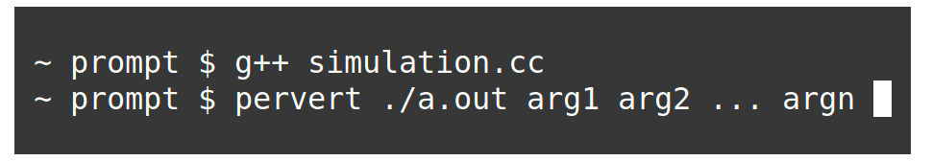
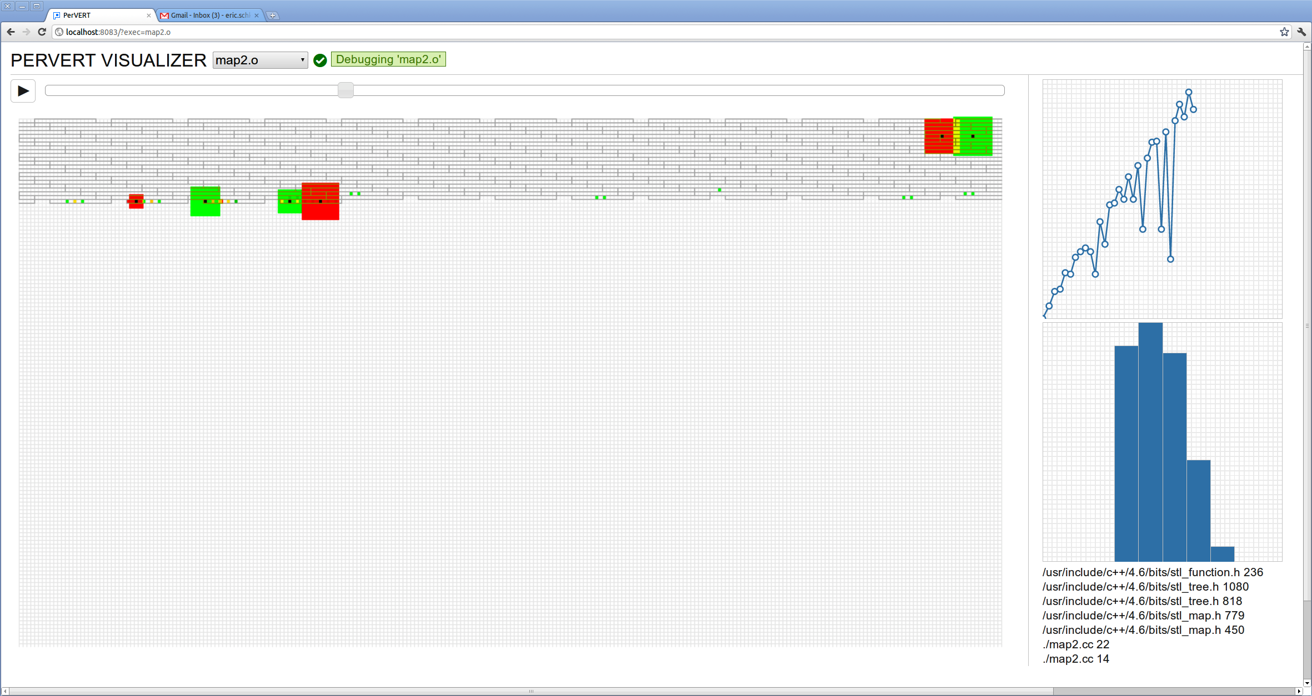
Performance Visualization and Error Remediation Toolkit
PerVERT:
Niels Joubert and Eric Schkufza
Performance tuning is an important step in the development of large software systems. Examples include web-servers which routinely handle thousands of simultaneous content requests, and supercomputers which perform simulations that span tens of thousands cores.
As improvements in clock frequency slow and hardware trends continue towards increased parallelism, the runtime performance of these and similar systems will become primarily a function of memory efficiency.
Unfortunately, the ability to reason effectively about this phenomenon using existing control flow-based tools such as valgrind, gprof, or gdb, through a text-based interface, is limited, and tedious at best.
PerVERT solves this problem. It is an instrumentation framework for logging a process's virtual memory traffic and a visualization suite for reasoning about common memory performance bugs:
Are memory accesses coherently organized temporally and spatially?
To what extent do these patterns differ based on program inputs or changes in source code?
1. Compile and run your code using PerVERT
2. Open PerVERT in a web browser
A byte-accurate visualization of virtual memory
Animated video of mallocs, frees, reads, and writes
Access summary for the current instruction
Frame-by-frame stack trace

