Slide 1


X
CAPTION HERE

Slide 2


WHY PARTNER WITH PEACE BY PIECE?
We help you GIVE SUSTAINABLY & IMPACTFULLY
Together, we create dignified work for 30+ underserved communities in the US and globally
Our gifts impact the lives of 400+ individuals
We are Silicon Valley-based
We are women-owned/WBENC-certified
CORPORATE GIFTING DONE RIGHT

Slide 3
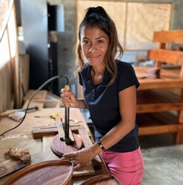
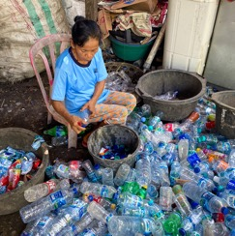
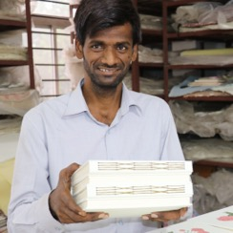
OUR THREE IMPACT TRACKS
SUSTAINABILITY
Prioritizing eco-friendly materials, ethical production, and lasting social & environmental impact
WOMEN'S EMPOWERMENT
Creating opportunities & safe spaces for women through dignified work, economic independence, and leadership development
POVERTY ALLEVIATION
Breaking cycles of poverty with fair wages, skill-building, and community support. Each individual life impacted can impact the lives of 5 of more individuals

Slide 4

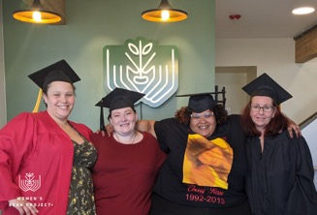
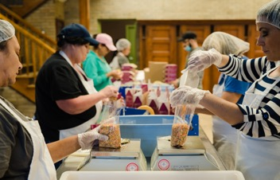
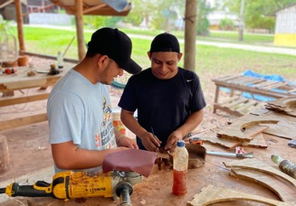
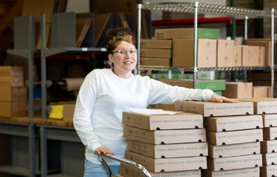
OUR PARTNER CRITERIA
1.
A SAFE & WELCOMING WORK ENVIRONMENT
2.
TRAINING & SKILLS DEVELOPMENT
3.
A COMMERCIAL STRUCTURE
CREATING DIGNIFIED WAGES

Slide 5

GIVE WHILE GIVING
You can
Peace by Piece International is a corporate gifts company on a mission to make real social & environmental impact.
Through partnerships with organizations like yours, we provide a lifeline to women makers and underserved communities who have faced homelessness, incarceration, sex trafficking, and the challenges of economic disenfranchisement. Our goal is to support them directly on their journey to rebuild their lives, and to foster their creativity, entrepreneurship, and self-worth.
Every gift you purchase directly empowers these talented makers.
Join us in spreading hope and dignity, one gift at a time.
Lauri Jones Pastrone, Founder & CEO
Peace by Piece International

Slide 6
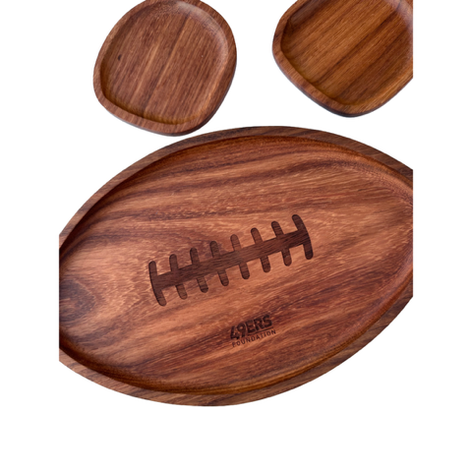
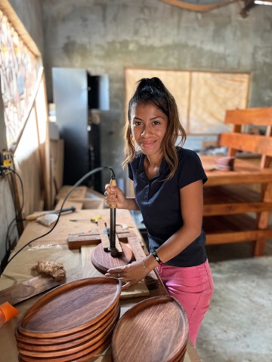
SOME IDEAS FOR YOU TO CONSIDER
On the slides that follow, we present ideas for your consideration. Our hope is that you will see the talent and capabilities of our makers.
After each group of gift slides, you will see a slide that shares a bit about the maker community.
In the photos to the left, you can see a “football” tray and coasters that we recently created for the 49er’s Foundation. This project provided over 600 hours of dignified work in Northern Guatemala.
We hope you will come to us with your ideas. They can truly change lives!

Slide 7

















SOME OF OUR PARTNERSHIPS FOR CHANGE
Peace by Piece international products are beautifully crafted and sourced from artisans in disenfranchised areas around the world. Purchasing one of these products will both make the recipient happy and will help hard working people.
- C. Callaud; Senior Director, Apple Computer
The gifts are high quality, unique, and purposeful. It's great to know that we are helping communities and giving back to people that need and appreciate the work.
- B. Faxon; EA & Business Partner to CEO, Lattice Semiconductor
Everybody loves to get a gift but everybody loves it a little bit more and it hits a little bit differently when you know that the gift was made with passion, purpose, and intention. What we created with Peace by Piece is really a 1-of-a-1 item and I think our guests felt that.
- J. Prettyman; Executive Director, 49ers Foundation

Slide 8
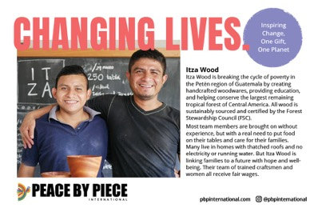

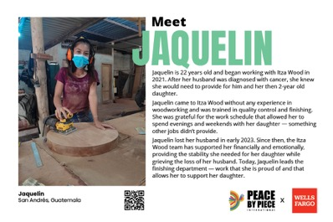
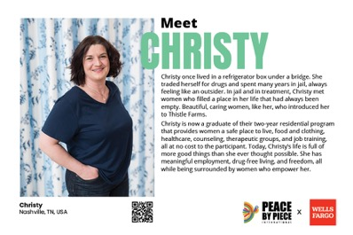
IMPACT CARDS -- BEHIND EVERY GIFT IS A STORY
We make sure your recipients feel the joy of your gift choice!

Slide 9


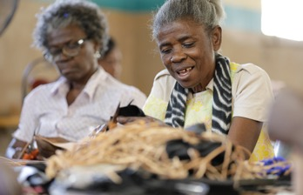
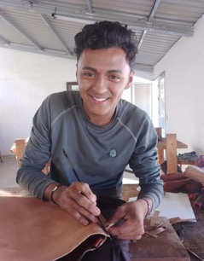

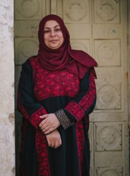

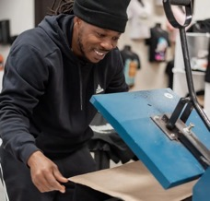
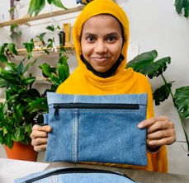
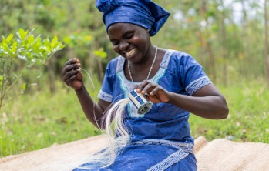

THIS IS THE POWER OF DIGNIFIED WORK.
THESE ARE THE FACES OF CHANGE.

Slide 10
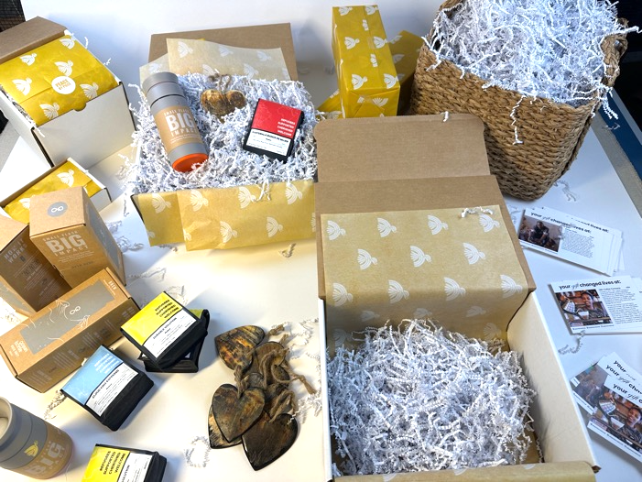
PRICING FOR CARDS & KITTING
Impact Cards (about maker communities): No Charge
Custom Message Cards: $65 set up/$1.50 per card
Insertion of a card you provide: No Charge
Kitting for domestic shipments: $10.50/box
Kitting for international shipments: $19.00/box
Label making & shipping coordination: $2/box
*kitting includes shipping logistics but does not include actual shipping charges
*international kitting includes customs documentation, etc.

Slide 11
TERMS AND CONDITIONS
Drop shipping and kitting are available
For shipments to California zip codes, sales tax will be added
Payment terms
50% to initiate a custom order
50% upon shipment
Customs charges for gifts shipped internationally will be billed to client, which may take up to 120 days post shipment
Due to the current uncertainty around US-imposed tariffs, Peace by Piece will bill client for any charges, which may take up to 120 days post shipment
No cancellations will be accepted after any custom order has been initiated
Gifts returned to Peace by Piece due to incorrect recipient information will incur a $20 fee plus any additional returned shipping charges from the carrier. If a new address is not provided within 30 days of the gift's return, the gift will be shipped back to the client for distribution

Slide 12

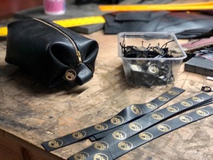


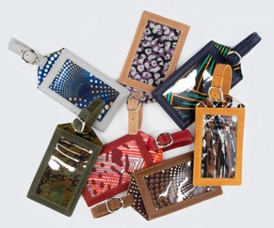
LET’S GET STARTED!
pbpinternational
Lauri Jones Pastrone
Lauri@pbpinternational.com
peace-by-piece-international
pbpinternational
+1-408-684-8004
Heide Lindgren
Heide@pbpinternational.com
hello@pbpinternational.com
Los Gatos, CA USA

