Slide 1
About the game
A fun way for students to test their knowledge of conditional statements in Python
Based on the game Bingo
Students can work individually or in groups (depending on class size)
Created by Tirath Singh, Queen Mary University of London

Slide 2
Playing If Bingo

Slide 3
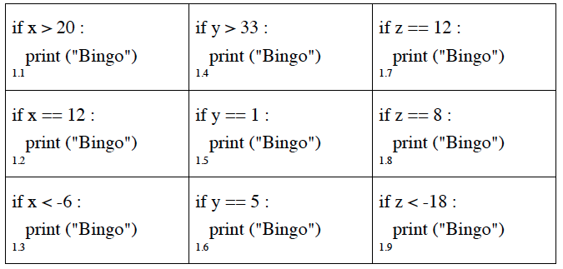
The If-Bingo Ticket
3 Variables
X
Y
Z

Slide 4
Rules of the Game
A game has many rounds
For each round:
The teacher will call out 3 statements, such as
Are any conditions true?
Cross them off
x = 7 y = -2 z = 12

Slide 5
Rules of the Game
Is 7 greater than 20?
x = 7 y = -2 z = 12
NO!

Slide 6
Rules of the Game
Is -2 greater than 33?
x = 7 y = -2 z = 12
NO!

Slide 7
Rules of the Game
Is 12 equal to 12?
x = 7 y = -2 z = 12
YES!

Slide 8
Rules of the Game
Is 12 equal to 12?
x = 7 y = -2 z = 12
CROSS IT OFF!

Slide 9
Rules of the Game
Shout “Bingo!”
When all your squares are crossed-off

Slide 10
Example
x = 6 y = 5 z = 1
if x == 6 :
print(“Bingo!”)
If y == 12 :
print(“Bingo!”)
If z > 30 :
print(“Bingo!”)
if x > 32 :
print(“Bingo!”)
If y == 5 :
print(“Bingo!”)
If z == 12 :
print(“Bingo!”)
if x == 12 :
print(“Bingo!”)
If y < -5 :
print(“Bingo!”)
If z == 2 :
print(“Bingo!”)

Slide 11
Example
x = 6 y = 5 z = 1
if x == 6 :
print(“Bingo!”)
If y == 12 :
print(“Bingo!”)
If z > 30 :
print(“Bingo!”)
if x > 32 :
print(“Bingo!”)
If y == 5 :
print(“Bingo!”)
If z == 12 :
print(“Bingo!”)
if x == 12 :
print(“Bingo!”)
If y < -5 :
print(“Bingo!”)
If z == 2 :
print(“Bingo!”)

