Slide 1
GCSE Python Bingo Game
Tirath Singh

Slide 2


Slide 3
Findings of the report
Broad Curriculums
Shortage of high skilled teachers
Lack of teacher training
Inadequate facilities in schools
Greater recognition for Computer Science needed

Slide 4
What happened next?
‘Harmful’ ICT curriculum set to be dropped to make way for rigorous computer science
Gove announces the scrapping the existing ICT curriculum to introduce new courses of study in computer science.
January 2012

Slide 5





What happened next?

Slide 6
What is If Bingo?
if x == 5 :
print(“Bingo!”)
if y == 12 :
print(“Bingo!”)
if z > 30 :
print(“Bingo!”)
if x > 32 :
print(“Bingo!”)
if y == 6 :
print(“Bingo!”)
if z == 12 :
print(“Bingo!”)
if x == 12 :
print(“Bingo!”)
if y < -5 :
print(“Bingo!”)
if z == 2 :
print(“Bingo!”)
Concept from Guide to Teaching Computer Science: An Activity-Based Approach by Hazzan, O., Lapidot T. and Ragonis N.

Slide 7
What is If Bingo?
Challenge players with more complex conditions!
if x != 5 :
print(“No Bingo!”)
else :
print(“Bingo!”)
if y >10 and y < 12 :
print(“Bingo!”)
if z > 30 :
print(“Bingo!”)
if x >= 32 :
print(“Bingo!”)
if y < 12 :
if y == 6 :
print(“Bingo!”)
if z > 11 and z < 13 :
print(“Bingo!”)
if x > 6 :
if x== 12 :
print(“Bingo!”)
if y <= -5 :
print(“Bingo!”)
if z != 2 :
print(“No Bingo!”)
else :
print(“Bingo!”)

Slide 8
What is If Bingo?
Calling Card must be modified
Each calling card assigns a new value to each variable
x = 7 y = -2 z = 12

Slide 9
Why Python?
Python | Java
if y < 10 : if x > 2 : a = 1 | if(y > 0){ while(x > 10){ int a = 5; } }
print(a) | System.out.println(a);
Intuitive syntax
Indentation rather than curly bracket
No variable declaration

Slide 10
Requirements
Randomness
Game Winner
Calling Card
Unique Tickets

Slide 11
Requirements
Unique Tickets
Numbers
Ticket Structure
x
2
4
5
11
19
y
1
2
5
7
12
z
3
8
9
13
20
> | == | >
== | == | ==
< | < | ==
= | > | >
= | = | =
< | < | =

Slide 12
Requirements
Randomness
Random… but not too random!
Things to avoid:
Overlapping values on single ticket
Duplicate squares
Uneven distribution of variables

Slide 13
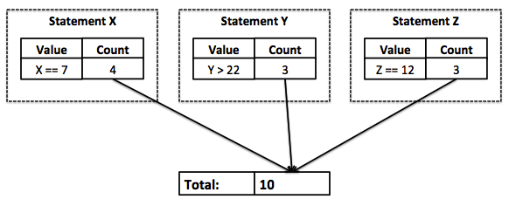
Requirements
Calling Card
Controls the length of the game
Not too short…but not too long either!

Slide 14
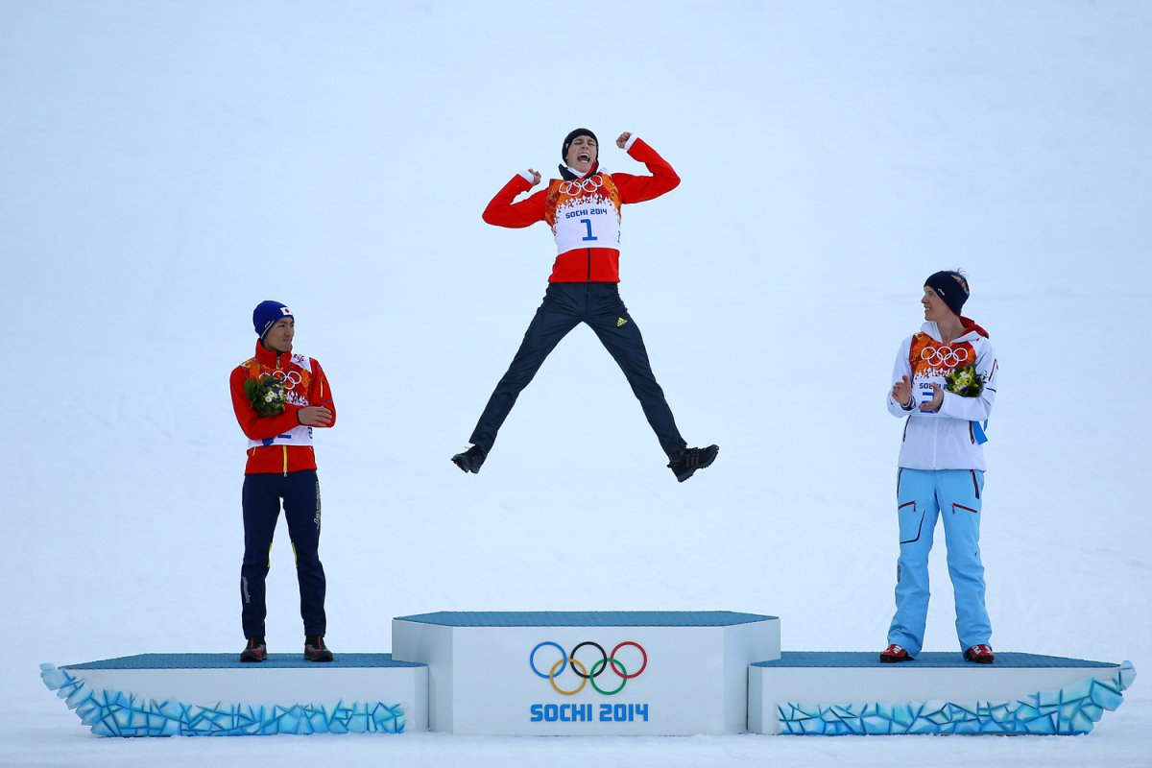
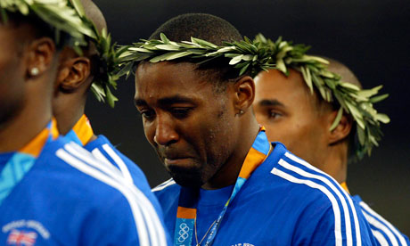
Requirements
Game Winner

Slide 15
How was it implemented?
Generate a PDF document, with 2 tickets per page
Include some basic game rules on each ticket
Teacher can print tickets and distribute to students
Generate Calling Card sequence for teacher to use

Slide 16
What do teachers think?
Once approved by the Research Ethics Committee, we sent some sample games to teachers.
The resources provided to teachers were:
PDF with 10 basic tickets and calling sequence
PowerPoint Presentation to explain rules of the game
Answer spreadsheet of the progress (cumulative & incremental) for all tickets after each calling card.

Slide 17
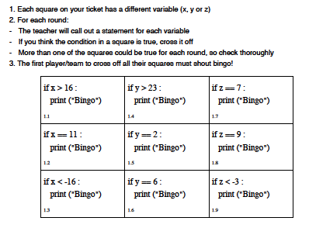
Example Ticket

Slide 18
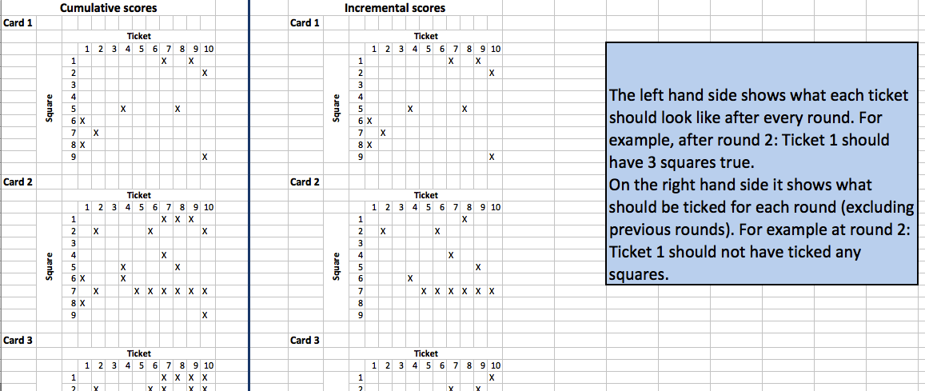
Example Answer Sheet

Slide 19
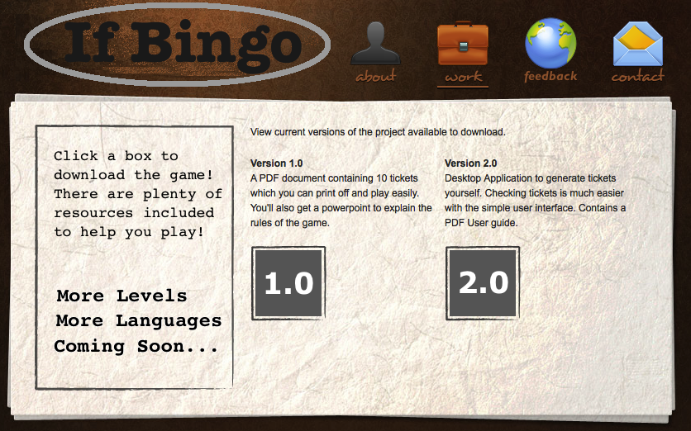
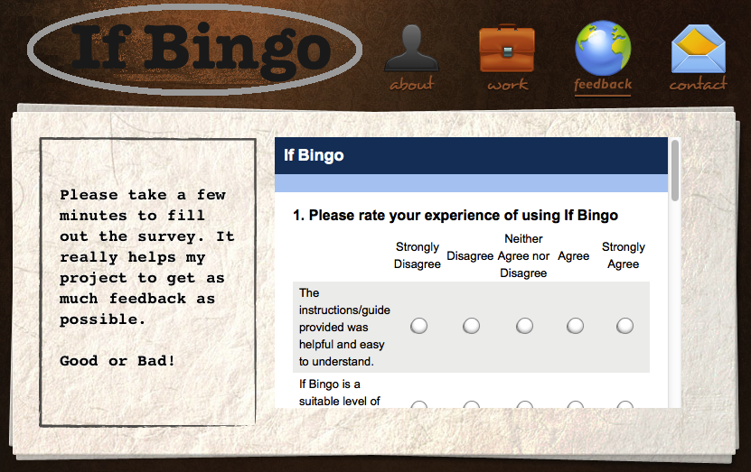
What do teachers think?
Website created and survey added to get feedback

Slide 20
What do teachers think?
Feedback from 3 teachers:
Instructions were helpful and easy to understand
Suitable level of difficulty for GCSE students
Students found the game engaging
Would use If Bingo in the future
X Found the answer sheet confusing

Slide 21
How can it be improved?
Better Feedback
A tool to check a ticket at any point during the game
More Flexibility
Let teachers choose number of tickets, difficulty & programming language
Same tickets, different calling cards
Save a set of tickets, to use again in future but with a different calling card sequence.

Slide 22
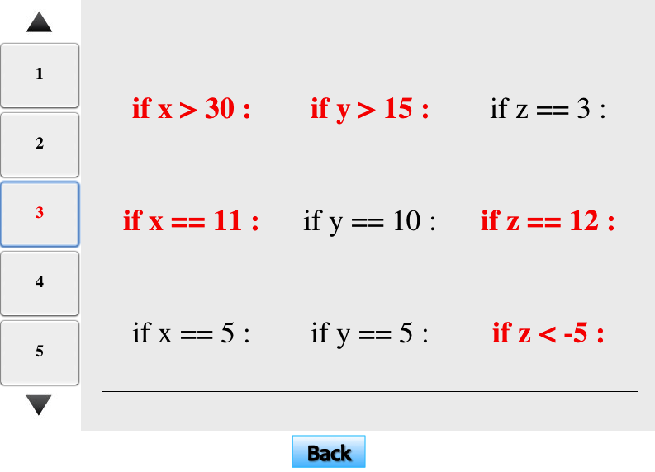
How was it improved?
Feedback
Quick and easy way to check a ticket

Slide 23
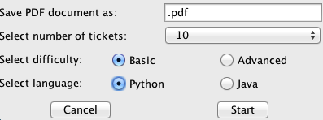
How was it improved?
Flexibility
Pop-up window to select number of tickets, difficulty & programming language

Slide 24
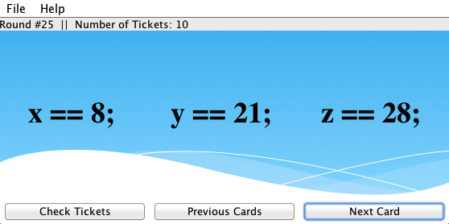
How was it improved?
Flexibility
Let teachers decide how many calling cards to generate with simple interface.

Slide 25
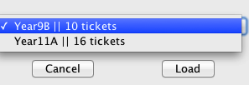
How was it improved?
Reusability
Save a set of tickets - provide a file name
Generate a new Calling Card sequence for a saved game by selecting from list.

Slide 26
Future Improvements
Variable Assignments
Basic | Advanced
y = x + 2 if y < 2 : print(“Bingo!”) | x = x*y y = x+7 if y < 2 : print(“Bingo!”)
For Loops
for a in range(1, 4): if y == a : print(“Bingo!”) | for a in range(1, 4): y += 2 if y < 2 : print(“Bingo!”) | for a in range(1, 4): for b in range(1, 4): y = y + a + b if y > 12 : print(“Bingo!”)

Slide 27
Thank you for listening
Any questions?
References:
https://www.gov.uk/government/news/harmful-ict-curriculum-set-to-be-dropped-to-make-way-for-rigorous-computer-science

