Slide 1

Pygame Simplified
Fatima Abukar
Project Supervisor: Dr William Marsh

Slide 2
Overview
Problem description
Programming at GCSE
Current resources for teachers
Pygame
Turtle Graphics
Greenfoot
Pygame Simplified
Demonstration of Pygame Simplified
Conclusion

Slide 3
Programming at GCSE
Problem description
New GCSE Computer Science curriculum in 2012
CAS (Computing at School) forum for teachers
TLCP (Teaching London Computing Project)- workshop for teachers
“…It’s (Python) natural syntax means it is easy to understand - you can’t get any easier than “print ‘hello world!…Having taught Python, I can see why it is an easy choice for teachers!”. Simon Johnson, Computing teacher (CAS, 2013).

Slide 4
Programming at GCSE
A question asked on Computing At School website to teachers in an aim to identify the problems students face in programming:
“Why may it be difficult to engage GCSE students into programming?”.
21 teachers commented with their thoughts
I have a significant member of pupils in my GCSE classes that think it (programming) is hard…Most of the tutorials they find online are harder to follow when they struggle to engage with the real world problem.”. Rick Barnes, a Computing teacher at Bedale High School (CAS, 2014)
Notes:
Explain what GCSE constructs are.
In the analysis of Python limitations were drawn – data structure

Slide 5
Current resources available
Three main teaching resources:
Turtle Graphics (a library for Python): simple but limited
Pygame (a library for Python): Object Oriented Programming is required, this is not a GCSE construct
Greenfoot: An API for Java. To make interesting programs Object Oriented Programming is required
Notes:
Greenfoot has good API design but its for Java cannot be used by Python developers

Slide 6
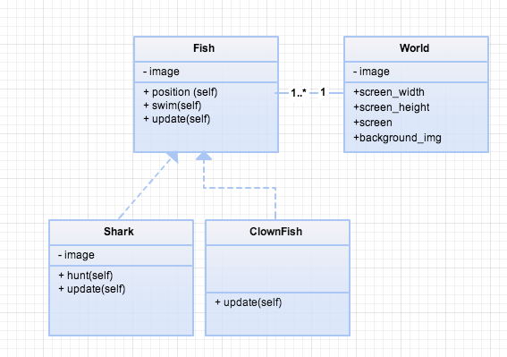
Pygame
Good:
Computer games are engaging for GCSE students
Game logic is simplified
Limitation:
To write well structured programs Object Oriented Programming is required
Solution: Pygame Simplified
A teacher of Computing agrees with Pygame’s complexity by commenting on CAS: “I’m trying to avoid using it (Pygame) this year as I think it might be too complicated for some of my students who’ve done less than 6 months programming”. (Ames,2013).
Notes:
Pygame needs to be simplified

Slide 7
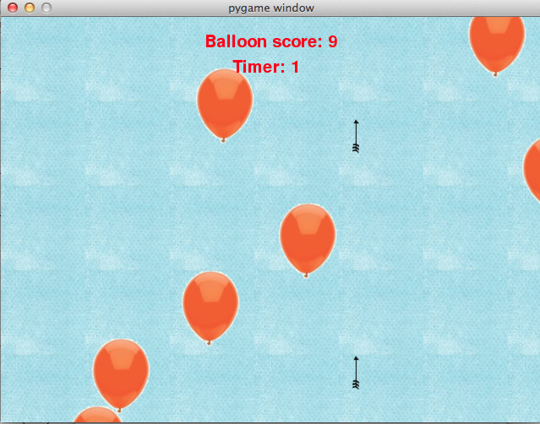
Pygame Simplified API design
Analysis of sample game (balloon game)
Pygame
Compared with Greenfoot
Goals drawn:
Readable program code
Minimal OO required
GCSE constructs easy to apply
Simple structure to minimise need for Pythons data structures
Provide game logic
Notes:
A game using Pygame Only using GCSE constructs is made and compared with Greenfoot.
Once goals were drawn, requirements were set for implementation.

Slide 8
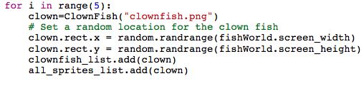
Implementation
Before:
from Pygame Simplfied.World import *
from Pygame Simplfied.Actor import *
……
After :
from PGS.PygameSimplified import *
Façade
Singleton
Simplifying Pygame
Notes:
Façade simplified importation from six lines of code to one
Mention versions of API – PGS I and PGS II
Singleton reduced errors for users of PGS version I

Slide 9
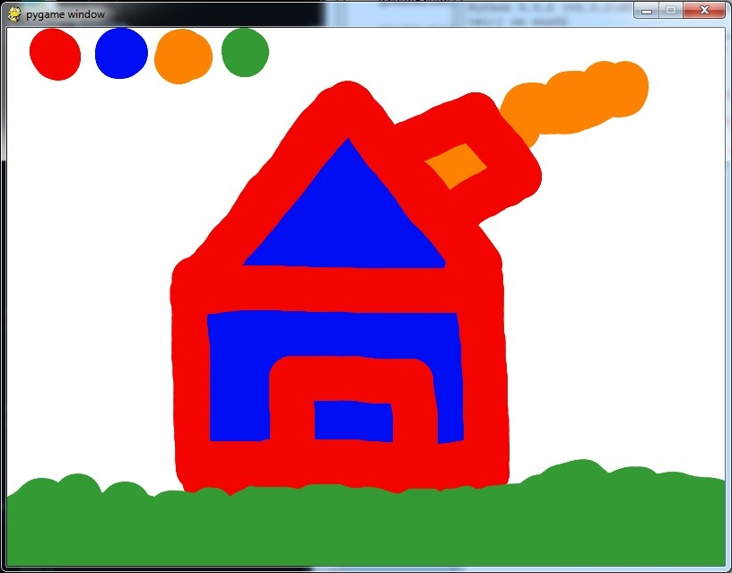
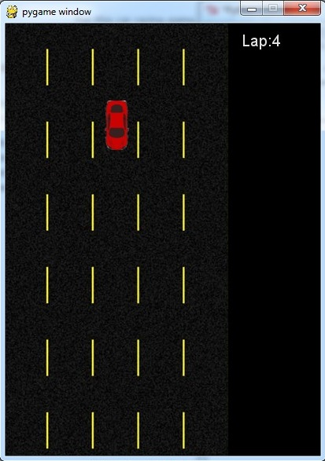
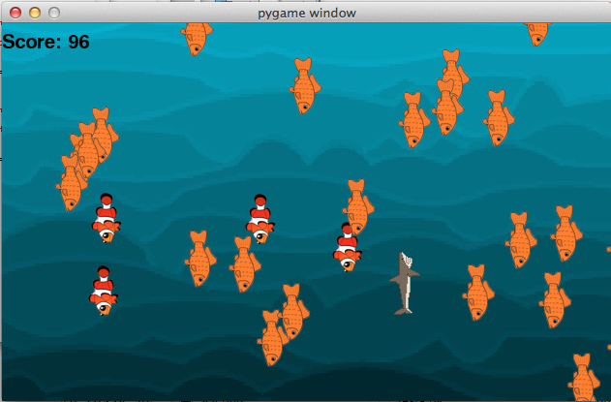
Resources for Teachers
Resources to help teachers available on the Pygame Simplified Website:
Installation instructions
Documentation
Tutorials
Example games
Blog
Worksheets:
Worksheets
Paint game
Car Game
‘Catch A Catch Fish’
Notes:
3 worksheets which vary. Paint game and car game for version I Catch A Fish for version II

Slide 10
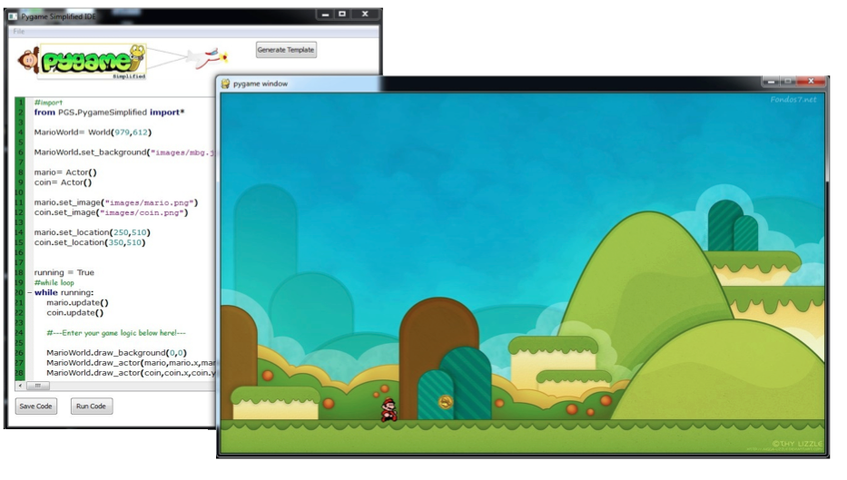
Program code generator
Teachers have tested the Pygame Simplified API
George Dong, a teacher at Haringey School suggested Pygame Simplified could have: “A simple GUI allowing adding actors to the world, then open the code view to add code controlling the actors etc. This make shift solution will definitely put Python in a secure position with GCSE and KS3.”
Notes:
Don’t need to use API it’s a choice, works with second API which is complete
Singleton removed because errors reduced in program code generator.

Slide 11
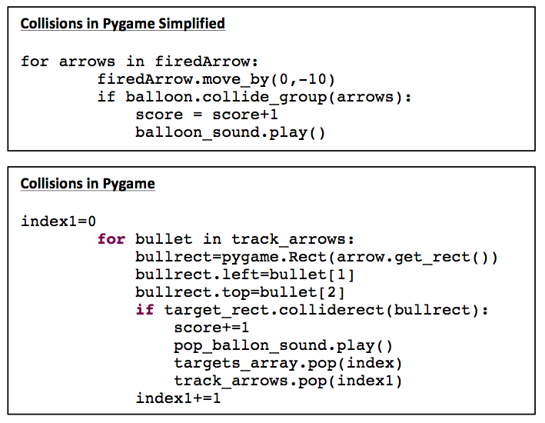
Comparison of Pygame and Pygame Simplified
Notes:
50% less lines of program code
OO minimised
Data structure used minimised
Program code generator means only game logic is required.

Slide 12
Evaluation
Research ethics
Tested by Computer Science students
Tested by teachers
Resources posted on CAS
Teachers TLCP volunteered to evaluate Pygame Simplified

Slide 13
Questionnaire:
https://www.surveymonkey.com/s/FMK2SW9
Problems were highlighted
Teachers asked if versions Pygame – Python were compatible with Pygame Simplified

Slide 14
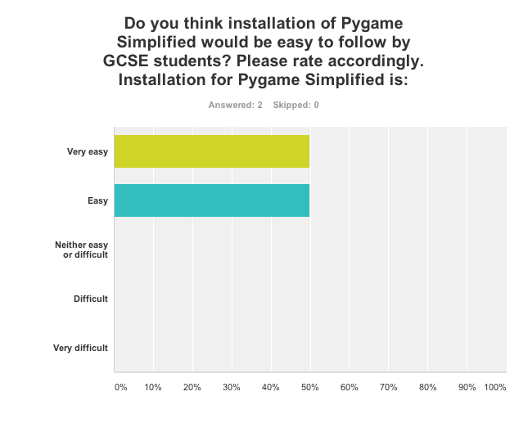

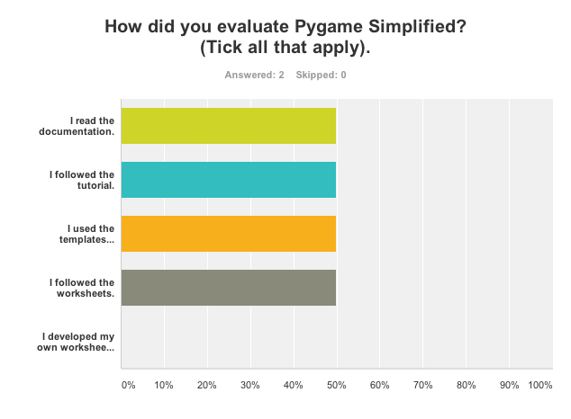
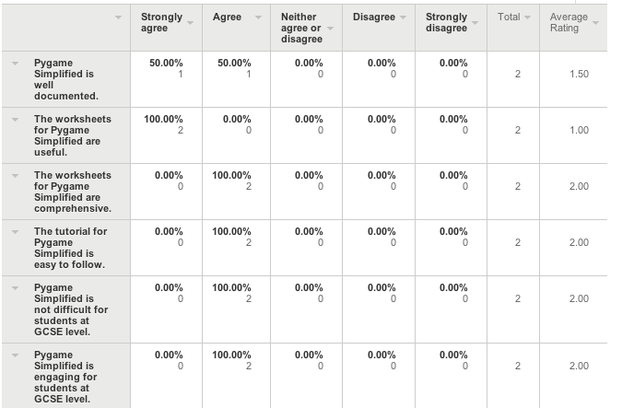
Results from questionnaire

Slide 15
Feedback from teachers
The feedback from evaluators of Pygame Simplified has been good. Suggestions and improvements have been made to Pygame Simplified:
Andy Diament, a computing lecturer at Penwith College: “I don’t know Pygame, but ive been meaning to try but this seems to reduce it to four classes and seems an easy route into making a game...this is less daunting…I teach in a college and this may be useful for my weakest students to learn some programming…Will be interested to see how this progresses... These are very useful modules. Thanks”
Rosaleen Moore, an ICT teacher: “I haven’t used Pygame to any great depth but this looks like a great tool to introduce events & classes at an engaging level”.
Javier de Las Heras an ICT Co-ordinator: “…It looks great. I am going to try it myself, then with a group of year 10 students”.
Geroge Dong, an ICT teacher at Haringey School: ”I have followed your "cargame" worksheet and made it to the end! Well done! It is so much easier to use than pygame! A good problem identification skill and a good solution too.”
John Andrews, a teacher of Computer Science at St Gregory the Great Catholic School Oxford: “…As my Y10 students are doing GCSE coursework now and 'simplified' may make their hangman games more involving. “

Slide 16
Feedback from students
Megan Ryan, a student: “That was fun!...I have not used Python before and found it really good fun to use. The examples at the end of the worksheet were really useful, reinforced what you had explained in the main text and got me interested in further enhancing what I had already created. The installation guide was really easy to follow, screenshots were useful. The examples you provide in the tutorial page are useful also, helped me understand the concepts I was reading about”.
Maximilian Droog Hayes, a student: “In very few lines of code you could actually see an interesting, moving output. I remember when I first started to program; it would take a lot more confusing programming to see something appear on the screen. The guide clearly talks you through how to get something initially working; something you can easily mess about with and alter in order to see what each bit of code does and change the output on the screen. I found it very engaging to be able to make a game so quickly and expand on it with limitless possibilities!”

Slide 17
Demonstrating Pygame Simplified
I will give a short demonstration of the Pygame Simplified API and program code generator

Slide 18
Conclusion
Goals and Requirements are met
Object Oriented Programming is minimised
Teachers find it engaging and useful
Simple compared to Pygame

Slide 19
Questions?

