Slide 1


Welcome
Federated Cloud: Collaboration Beyond Borders
Nishiel Bhavsar 16010122022
Indervir Duggal 16010122050
2

Slide 2
1. Introduction
Understanding what is Federated Cloud?
A Federated Cloud is a connected cloud framework where various cloud service providers work together to share resources, services, and workloads. Unlike a cloud setup managed by a single provider, a federated cloud allows smooth data exchange, balanced workload distribution, and interoperability across diverse cloud platforms.
2

Slide 3
Why Federated Cloud?
Overcomes vendor lock-in by allowing organizations to utilize multiple providers.
Provides scalability, as users can access resources from various clouds dynamically.
Enhances fault tolerance and reliability through resource redundancy.
Supports diverse workload requirements across different cloud platforms.
Encourages cost optimization by leveraging the best-priced services among providers.
2

Slide 4
2. Federated Cloud Architecture
Key Components:
Cloud Providers: Companies that deliver cloud-based services and contribute their infrastructure and resources to the federation
Federation Manager The central authority that manages coordination, enforces shared policies, and oversees agreements among the participating cloud providers.
Resource Broker: An intelligent system that distributes workloads efficiently by matching resource availability with application or user demands.
Clients: End-users or applications that access and consume services from the federated cloud network.
2

Slide 5
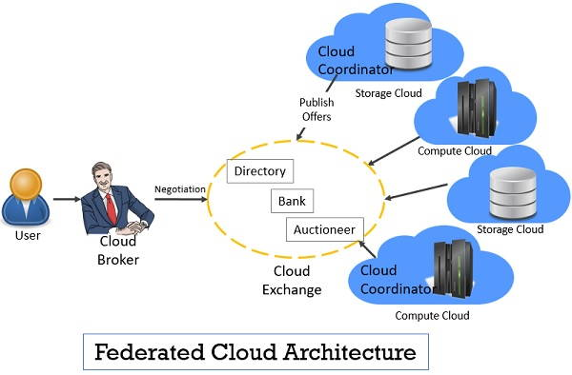
2

Slide 6
3. Working of Federated Cloud
How it Operates:
Resource Discovery: The federation manager identifies available resources from multiple cloud providers.
Resource Allocation: The broker distributes workloads to the most suitable cloud provider based on performance, cost, or compliance requirements.
Service Composition: Combines services from multiple clouds to create a unified environment.
Security & Compliance Handling: Ensures data privacy, access control, and compliance with regulations across different cloud providers.
2

Slide 7
4. Benefits of Federated Cloud
Key Advantages:
Enhanced Scalability: Businesses can effortlessly expand their computing resources by tapping into multiple cloud providers, avoiding the limitations of a single vendor.
Optimized Cost Management: Organizations can reduce expenses by choosing services from providers offering the best pricing and performance balance at any given time.
Optimized Performance: Workloads can be deployed in geographically closer or technically superior environments for improved speed and efficiency.
Resource Diversity: Access to a wide variety of specialized tools, platforms, and cloud services from different providers.
2

Slide 8
5. Challenges in Federated Cloud
Potential Issues:
Interoperability Concerns: Different cloud providers use varying technologies, making seamless integration difficult.
Security Risks: Ensuring data protection across multiple clouds requires robust security mechanisms.
Management Complexity: Coordinating multiple service providers can be challenging.
Data Sovereignty: Legal regulations regarding data storage locations may limit cross-border data sharing.
2

Slide 9
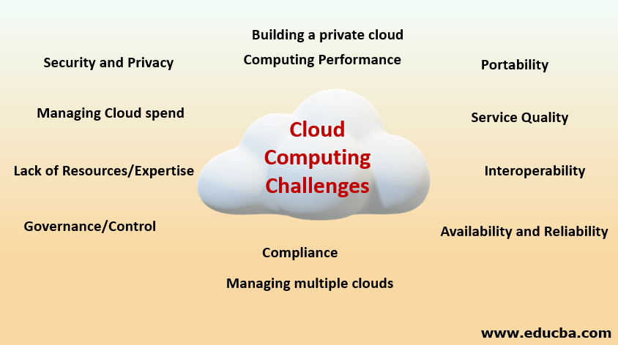
2

Slide 10
6. Use Cases of Federated Cloud
Autonomous Vehicle Applications (Federated Cloud):
Collaborative Model Training: Enables multiple car manufacturers and tech companies to collaboratively train AI driving models on decentralized data — improving accuracy while maintaining data privacy and compliance.
Real-Time Data Sharing: Facilitates secure exchange of traffic, environmental, and sensor data between vehicles and cloud systems, enhancing autonomous navigation and hazard detection without centralized bottlenecks.
Edge-Cloud Integration: Balances computational workloads between vehicle edge devices and federated cloud resources to ensure fast decision-making, optimized route planning, and seamless software updates across fleets.
2

Slide 11
7. Future Trends in Federated Cloud
Emerging Innovations:
AI-Driven Cloud Federation: Artificial intelligence is being used to automate workload distribution and optimization across federated clouds.
Decentralized Cloud with Blockchain: Blockchain-based cloud federations ensure secure, tamper-proof transactions between different providers.
Edge Computing & Federated Learning: Enables real-time data processing closer to the source, reducing latency and bandwidth costs.
2

Slide 12
8. Conclusion
Federated Cloud offers a scalable and flexible solution for modern data-driven industries, fostering secure collaboration without centralized dependencies.
It empowers organizations to leverage diverse cloud ecosystems, minimizing risks of vendor lock-in and optimizing resource utilization.
With continuous advancements in distributed computing, security, and regulatory frameworks, federated cloud is poised to become a cornerstone of future cloud strategies.
2

