Slide 1
KiroCrew on ARM
Remote execution and
client–server observability
CloudFormation in us-east-1
Direct MCP and AWS checks passed.
Native Kiro CLI sign-in and session pending.
Notes:
00:00–00:20. The Mac runs the desktop client. A t4g.xlarge EC2 host runs the Gateway, Kiro CLI installation, workspace and separate MCP service. The local Gateway is off. Direct MCP and AWS checks passed on ARM. Native Kiro CLI authentication and a verified backend session remain pending. The observability walkthrough distinguishes native Gateway metrics from custom Mac and EC2 samples. Native Gateway metric collection and the custom client/server app are active. Collection events show a controlled Mac client quit and restart while the server Gateway remained running. Sources: evidence/aws/arm-20260913/final-cloud-verification.json; evidence/aws/arm-20260913/mcp-live-receipt.json; evidence/aws/arm-20260913/client-runtime-receipt.json; evidence/aws/arm-20260913/observability-runtime-receipt.json.

Slide 2

One execution host
Local mode
Developer endpoint
Remote mode
Gateway, backend and workspace
on the EC2 instance
Reference map.
Verified here: remote client,
MCP grants and S3 IAM checks.
Notes:
00:20–00:55. The enclosure maps controls around the execution host. In remote mode, the Gateway, selected backend and workspace run on the same host. The reference includes enterprise controls and Crew capabilities beyond this demo. The desktop is connected to the ARM host with the local Gateway off. The ARM probe verifies direct MCP grants and S3 IAM outcomes. Native backend enforcement and sandbox behavior remain pending. The reference cites the September 11 baseline. Sources: kirocrew-security-layers.html; evidence/nightly/baseline-verification.json; evidence/aws/arm-20260913/client-runtime-receipt.json; evidence/aws/arm-20260913/mcp-live-receipt.json.

Slide 3
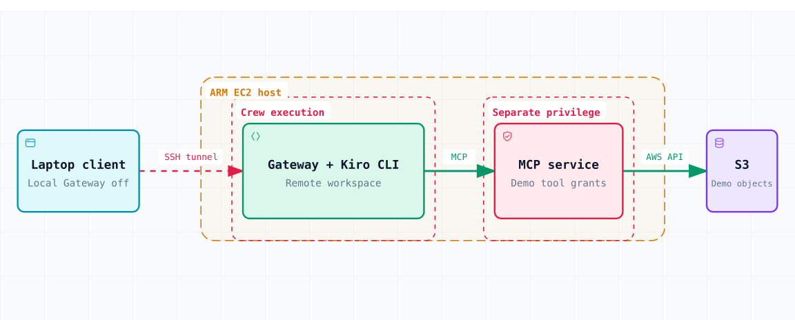
ARM execution in us-east-1
t4g.xlarge · 4 vCPUs · 16 GiB RAM · 40 GiB gp3 · SSH from the client IP /32
Notes:
00:55–01:35. CloudFormation now directs the demo to a t4g.xlarge: four vCPUs, 16 GiB RAM and 40 GiB encrypted gp3 storage. The security group admits TCP 22 only from the client IPv4 /32. SSH forwards laptop port 5599 to EC2 loopback port 5476. The Gateway, Kiro CLI installation and workspace share the Crew execution boundary. The MCP service uses a separate UID and listens on loopback port 8001. IMDSv2 is required with a hop limit of one. The original x86 instance is stopped and remains available for rollback. Its 24 GiB disk remains billable. Cloud verification passed at 2026-09-13T14:22:25Z. The resource check does not establish native backend authentication or telemetry health. Sources: infrastructure/ec2-demo.json; evidence/aws/arm-20260913/final-cloud-verification.json; evidence/aws/arm-20260913/host-checks.txt.

Slide 4
Host identities and AWS credentials
Identity | Execution and authority
crew | Gateway, Kiro CLI and workspace Firewall blocks metadata for the crew UID
mcp-demo | Fixed MCP tools and S3 reads Instance role through IMDSv2 Two S3 prefixes + SSM core permissions
root / administrator | Installs code and manages services Trusted host administration
The MCP service uses the instance role for fixed S3 calls.
Notes:
01:35–02:10. Root owns the core Gateway and MCP runtime files and service definitions. The custom App Kit backend runs with Crew authority; its installed app files are Crew-writable. The crew user runs the Gateway, backend and workspace. An owner-based firewall rule blocks metadata requests from the crew UID, and the Gateway requires that guard service. The mcp-demo UID can obtain the instance role through IMDSv2. That role permits reads under two demonstration S3 prefixes, explicitly denies GetObject under denied/, and includes the SSM core managed policy. The MCP service exposes four fixed tools. Root remains a trusted administrator. The operator’s IAM user keys remain local. Crew owns and can edit its configuration. The desktop uses the existing administrator account to invoke the verified owner-token helper; the helper enters the Gateway mount namespace and then drops to crew for the stock token mint. Crew has no new sudo permission. Sources: infrastructure/bootstrap.sh; infrastructure/kirocrew-demo.service; infrastructure/kirocrew-mcp-demo.service; infrastructure/mcp-enforcement/server.py; infrastructure/ec2-demo.json; evidence/aws/arm-20260913/observability-runtime-receipt.json; evidence/aws/arm-20260913/client-runtime-receipt.json.

Slide 5
Four calls, three denial boundaries
Tool | Expected result | Stopping point
read_allowed | Digest of allowed object | S3 completes the read
crew_denied | Configured tool denial | Crew, before MCP dispatch
mcp_denied | tool_grant_denied | MCP, before AWS dispatch
iam_denied | S3 AccessDenied (403) | AWS IAM
The direct probe covers three tools. Native Crew denial remains pending.
Notes:
02:10–02:45. The direct probe verified read_allowed, mcp_denied and iam_denied. Native Crew denial is pending. read_allowed returns the object length and digest. The MCP service grants crew_denied so the Crew hook can block it before dispatch. Its configured rule names @aws-enforcement/crew_denied. mcp_denied appears in discovery, but the service rejects the call before loading AWS credentials or invoking the SDK. iam_denied passes the MCP grant and attempts GetObject on an existing object under denied/, where IAM applies the explicit deny. After native sign-in, inspect each request and approve the three routed calls once. crew_denied must stop automatically before an approval card or MCP dispatch. An operator rejection cannot count as that proof. Sources: infrastructure/configure-demo.py; infrastructure/mcp-enforcement/server.py; evidence/aws/iam-demo-policy.json; evidence/aws/fixture-hashes.json; evidence/aws/arm-20260913/mcp-live-receipt.json.

Slide 6
ARM: MCP and AWS results
Direct probe on the ARM host
direct_mcp_service_probe, 2026-09-13 14:07:16 UTC
Call | Receipt output
read_allowed | 55 bytes SHA256 34ebbefeb5f66527…
mcp_denied | tool_grant_denied MCP stops the call before AWS
iam_denied | S3 AccessDenied, HTTP 403 Request ID 5NMQFXT3FYT6A0A9
Unauthenticated request: 401. Discovery returned four tools.
Native Crew session pending.
Notes:
02:45–03:20. The direct_mcp_service_probe passed on the ARM host at 2026-09-13T14:07:16Z and records native_crew_backend_verified=false. An unauthenticated request returned 401, and discovery returned four tools. read_allowed returned 55 bytes and the expected SHA256, with AWS request ID 5NMYCQ5YF956H52H. mcp_denied returned tool_grant_denied at the MCP boundary. iam_denied returned S3 AccessDenied, HTTP 403, and request ID 5NMQFXT3FYT6A0A9. This probe directly exercises MCP and AWS; it does not establish native Crew execution or the configured Crew hook denial. Sources: evidence/aws/arm-20260913/mcp-live-receipt.json; infrastructure/mcp-enforcement/server.py.

Slide 7
Client and server nightly baselines
Mac client · September 13
0.7.0-nightly.20260913t061222
48 selected RECORD checks passed across two bundle lanes
EC2 server · frozen September 12
0.7.0-nightly.20260912t060850
Custom ARM64 repack; 24 selected control modules match
Selected backend: Kiro CLI 2.21.4
Kiro CLI is not logged in. Native session remains pending.
Notes:
03:20–03:50. The installed Mac client is 0.7.0-nightly.20260913t061222. Its 24 selected paths passed RECORD hash and size checks in both bundled architecture lanes, 48 checks in total. Three selected paths differ from the September 12 baseline; that comparison does not establish behavioral equivalence. The EC2 server remains the custom Linux ARM64 repack of 0.7.0-nightly.20260912t060850, with 48 locked dependencies. Its 24 selected control modules match the frozen installed nightly source and are root-owned without group or world write access. The server was not upgraded when the Mac app changed. Kiro CLI 2.21.4 is installed separately from the official ARM artifact. It is the selected agent backend, but whoami reports unauthenticated and ACP startup exits with 'not logged in'. Full native-session performance remains unverified. Local-model downloads remain off. Sources: evidence/nightly/client-20260913-verification.json; evidence/aws/arm-20260913/runtime-preparation.json; evidence/aws/arm-20260913/source-verification.json; evidence/aws/arm-20260913/install-services.log; infrastructure/kirocrew-demo.service; output/admin-console/07-agent-backend.jpg; output/admin-console/10-native-auth-log.jpg; evidence/aws/arm-20260913/client-runtime-receipt.json; evidence/aws/arm-20260913/observability-runtime-receipt.json.

Slide 8
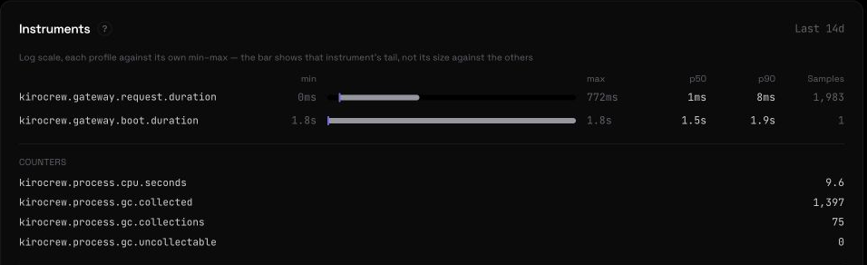
Native Gateway telemetry
Developer → Telemetry → Latency
Local export: 10 s · 7 days · 64 MiB target · no OTLP · beacon off
Gateway metrics are present. Native model-session metrics remain pending.
Notes:
03:50–04:25. In the admin portal, open Developer → Telemetry and select Latency. The screenshot shows Gateway request and boot duration instruments, process CPU and garbage-collection counters. The API readback at 14:50:25 UTC confirms collection enabled, no environment pin, two local metric shards and no OTLP endpoint. Native local export is configured for ten-second intervals, seven-day retention and a 64 MiB target. Active writers can temporarily keep the directory above that target. Anonymous usage beacons are disabled. Model turn statistics remain empty because native Kiro CLI authentication has not succeeded; a displayed zero turn latency is not a measured zero-latency model session. The metrics directory is /var/lib/kirocrew/metrics. This pane reports native Gateway instrumentation. The custom Mac and EC2 samples appear in Demo Observability. Sources: evidence/aws/arm-20260913/observability-api-readback.json; infrastructure/set-demo-telemetry.py; output/admin-console/08-telemetry-controls.jpg; output/admin-console/09-native-telemetry.jpg; evidence/aws/arm-20260913/observability-runtime-receipt.json; .build/installed-nightly/kiro_crew/metrics/local_exporter.py.

Slide 9
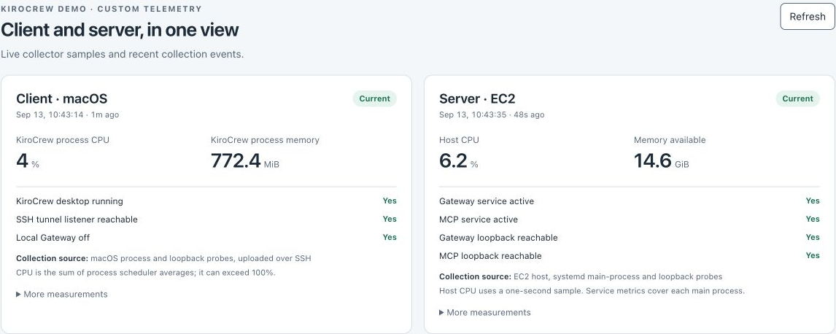
Client and server in Demo Observability
Collect: 60 s · Refresh: 15 s · Stale: 180 s · Retain: 240 samples per source
Custom host and process samples; native Gateway metrics use the Telemetry pane.
Notes:
04:25–05:00. Open Apps → Demo Observability. The App Kit page reads the custom collectors through the authenticated Gateway proxy; its snapshot returned HTTP 200. The screenshot shows the Mac sample at 14:43:14 UTC: four percent aggregate process CPU and 772.4 MiB RSS. Its EC2 sample at 14:43:35 UTC shows 6.2 percent host CPU and about 14.6 GiB available memory. The later API readback at 14:50:25 UTC independently confirms both sources current; its values differ as the processes continue running. These are snapshots, not a performance benchmark. The Mac checks confirm the desktop is running, the local SSH tunnel listener accepts a connection and the local Gateway is off. A reachable local tunnel listener alone does not prove a remote Gateway response. EC2 checks separately confirm Gateway and MCP services active and both loopback ports reachable. Both collectors run every 60 seconds. The UI refreshes every 15 seconds, marks samples stale after 180 seconds, and displays missing values as unknown. Each source retains at most 240 samples, about four hours with uninterrupted collection. Collection events are capped at 200. The custom app is version 1.0.1; its loopback backend runs on port 9102 behind the Gateway proxy. Sources: evidence/aws/arm-20260913/observability-api-readback.json; evidence/aws/arm-20260913/observability-update.json; infrastructure/observability/app/app.json; infrastructure/observability/app/backend/server.py; infrastructure/observability-collector/collector.py; output/admin-console/11-client-server-telemetry.jpg; evidence/aws/arm-20260913/observability-runtime-receipt.json.

Slide 10
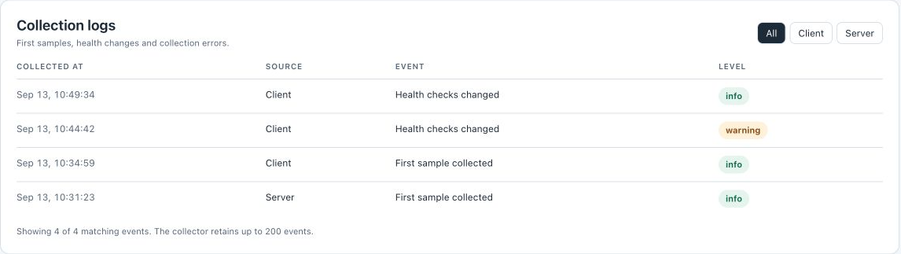
Close the client; the server keeps running
Client stopped: 14:44:42 UTC · Relaunched: 14:49:34 UTC
EC2 Gateway PID 4991 stayed running through the client restart.
Fixed collection events. Active model-session continuity remains unverified.
Notes:
05:00–05:30. In the controlled check, quit the Mac desktop and keep the browser admin portal open through the existing SSH tunnel. The client collector recorded the desktop stopped and the collection log added a warning at 14:44:42 UTC. The stopped-client screenshot shows zero client processes while Gateway and MCP service checks stay active. Relaunch the desktop. The client log recorded an informational recovery at 14:49:34 UTC. The server Gateway remained PID 4991, started at 14:26:10 UTC, across the client quit and relaunch. These observations demonstrate independent client and Gateway lifetimes. They do not establish survival of an active model session, because native Kiro CLI authentication is pending. The displayed log timestamps are local Eastern time, four hours behind UTC. The page exposes fixed collection events, not raw application logs, prompts or chat contents. Use the Client and Server filters to inspect each source. Sources: output/admin-console/12-collection-logs.jpg; output/admin-console/13-client-stopped.jpg; infrastructure/observability-collector/collector.py; evidence/aws/arm-20260913/observability-runtime-receipt.json; evidence/aws/arm-20260913/client-runtime-receipt.json.

Slide 11
Desktop-to-EC2 walkthrough
1 Confirm the remote client and workspace
2 Run the three-call MCP probe in WALKTHROUGH.md
3 Check the digest, MCP refusal and S3 403
Native sequence pending sign-in
Approve the three routed calls once.
crew_denied must stop automatically before MCP dispatch.
Notes:
05:30–07:00. Show the native desktop connected on port 5599 and the remote workspace at /srv/kirocrew-demo/workspace. Confirm that local port 5476 has no listener. Run the direct MCP command from WALKTHROUGH.md as mcp-demo on EC2. The bearer token stays on the instance. Show the 55-byte digest, tool_grant_denied and S3 AccessDenied 403 with a new AWS request ID. The receipt must report direct_mcp_service_probe, passed=true and native_crew_backend_verified=false. This direct path is available while Kiro CLI authentication remains pending. After successful authentication through scripts/ec2-login.py, use native-demo.sh to test four native turns in a dedicated session. Inspect the real request card and approve read_allowed, mcp_denied and iam_denied once each. crew_denied must stop automatically before any approval card or MCP arrival. An approval card on that turn fails the test, even if the runner rejects it. The runner correlates callback IDs and MCP/AWS traces. The Crew-denial SEL record lacks a direct trace ID, so the correlation uses the dedicated session and isolated turn interval. Sources: WALKTHROUGH.md; scripts/native-backend-demo.README.md; scripts/EC2-LOGIN.md; evidence/aws/arm-20260913/mcp-live-receipt.json; evidence/aws/arm-20260913/client-runtime-receipt.json.

Slide 12
Running cost and rollback
$0.139 per running hour
Compute + IPv4. ARM storage adds $3.20 per month.
The stopped rollback disk adds $1.92 per month.
About $107 per month if always on
Includes both disks; excludes S3, transfer, model use and tax.
Stop the ARM host after the demo. EBS remains billable.
The x86 host stays stopped for rollback.
Refresh the SSH address after restart.
Notes:
07:00–07:30. The AWS Pricing API lists On Demand Linux t4g.xlarge at $0.1344 per hour in us-east-1. Public IPv4 adds $0.005 per hour, for $0.1394 per running hour, rounded to $0.139. At $0.08 per GB-month, the active 40 GiB gp3 disk costs $3.20 per month. The stopped x86 rollback host retains a 24 GiB gp3 disk at $1.92 per month. Together the disks cost $5.12 per month while rollback is retained. At 730 running hours, compute, IPv4 and both disks total $106.882, or about $107 per month. S3, transfer, model usage and taxes add charges. The instances use standard credits, and there is no NAT gateway or load balancer. The older x86 instance is stopped. Stop the active ARM instance after the demo with scripts/demo-cloud.py; inspect its dry-run plan first. Stopping releases the ephemeral IPv4 address and stops compute billing; EBS remains billable. Refresh the SSH address after restart. Keep the stopped x86 rollback host until it is no longer needed. Sources: evidence/aws/arm-20260913/price.json; evidence/aws/gp3-pricing.json; https://aws.amazon.com/vpc/pricing/ ; evidence/aws/arm-20260913/final-cloud-verification.json; scripts/demo-cloud.py.

