Slide 1
KiroCrew
Governance around managed
coding-agent execution
Kiro CLI, Codex and Claude Code
Usable backends depend on installation, authentication and governance.
Notes:
00:00–00:30. Crew is a persistent workspace and Gateway around coding-agent execution. It manages sessions, context, approvals and policy on the execution host. The reviewed public backend registry registers Kiro CLI, Codex and Claude Code alongside KAS. A registered provider still needs its executable, authentication and governance admission to be usable. This rehearsal does not start a backend. Sources: https://github.com/kirodotdev/KiroCrew/blob/fa0d8cf3c241b3b53b81fe4115ab70a30c1ca482/src/kiro_crew/agent_sdk/backends.py ; https://github.com/kirodotdev/KiroCrew/blob/fa0d8cf3c241b3b53b81fe4115ab70a30c1ca482/src/kiro_crew/agent_backend_governance.py . Diagram and pinned-link baseline: 0.7.0.dev20260911060948. Rehearsal: user-installed 0.7.0-nightly.20260912t060850, copied and fingerprinted locally. The CDN latest feed remains inaccessible; latest is user-reported.

Slide 2

One execution host
The box follows execution.
Local mode
Developer endpoint
Remote mode
Gateway, backend and workspace
on the same execution host
Independent laptop agents stay outside
a remote Crew service.
Notes:
00:30–01:15. Keep this one box intact. In local mode it is the developer machine. In remote mode Crew Gateway, selected backend and workspace run together on the server. EDR and OS controls belong to the enterprise. L0–L5 and policy apply at their covered Crew/backend boundaries. Switch to Security layers in the viewer to trace the outside actors. Source image: evidence/browser/endpoint-slide.png, browser screenshot of the unchanged accepted endpoint SVG. Sources: HANDOFF.md; https://github.com/kirodotdev/KiroCrew/blob/fa0d8cf3c241b3b53b81fe4115ab70a30c1ca482/src/kiro_crew/security_posture.py .

Slide 3
Control ownership
Owner | Decision | Evidence
Enterprise / OS | Host posture and isolation | Effective sandbox, EDR, egress
Crew | Policy, paths and tool requests | Gate verdict and covered SEL events
MCP service / gateway | Caller and tool grants | Denied call before target execution
Target service | Resource authorization | IAM or SaaS denial
Prevention depends on the actual backend reaching the Crew gate.
Notes:
01:15–02:00. The numbered layers are a control map. A tool must reach a pre-execution hook or permission callback for prevention. An event received after execution only supports observation. The same local or remote host still needs enterprise protection. Sources: https://github.com/kirodotdev/KiroCrew/blob/fa0d8cf3c241b3b53b81fe4115ab70a30c1ca482/src/kiro_crew/hooks.py ; https://github.com/kirodotdev/KiroCrew/blob/fa0d8cf3c241b3b53b81fe4115ab70a30c1ca482/src/kiro_crew/security/paths.py ; https://github.com/kirodotdev/KiroCrew/blob/fa0d8cf3c241b3b53b81fe4115ab70a30c1ca482/src/kiro_crew/sel.py ; https://docs.litellm.ai/docs/mcp_control .

Slide 4
MCP identity and tool access
Caller identity
Tool and resource authority
User consent: OAuth with PKCE
Service identity: client credentials
Delegated identity: Entra OBO
Explicit server and tool grants
Downstream IAM or SaaS scope
Separate service credentials
Only routed MCP calls reach this gateway.
LiteLLM integration remains proposed. Direct shell, SDK and network routes need their own controls.
Notes:
02:00–02:45. Proposed external integration. Caller authentication, tool permission and downstream resource authority are separate checks. LiteLLM documents server/tool restrictions and several OAuth flows. Interactive authorization-code PKCE is for user consent; client credentials is for service identities. Entra delegation uses its OBO profile, with caller token audience for the LiteLLM app registration. SigV4 uses separate AWS workload credentials. Pin and rehearse the deployed LiteLLM version before using exact configuration. Current docs accessed September 12 EDT / September 13 UTC, 2026. Sources: https://docs.litellm.ai/docs/mcp_control ; https://docs.litellm.ai/docs/mcp_oauth ; https://docs.litellm.ai/docs/mcp_obo_auth ; https://docs.litellm.ai/docs/mcp_aws_sigv4 .

Slide 5
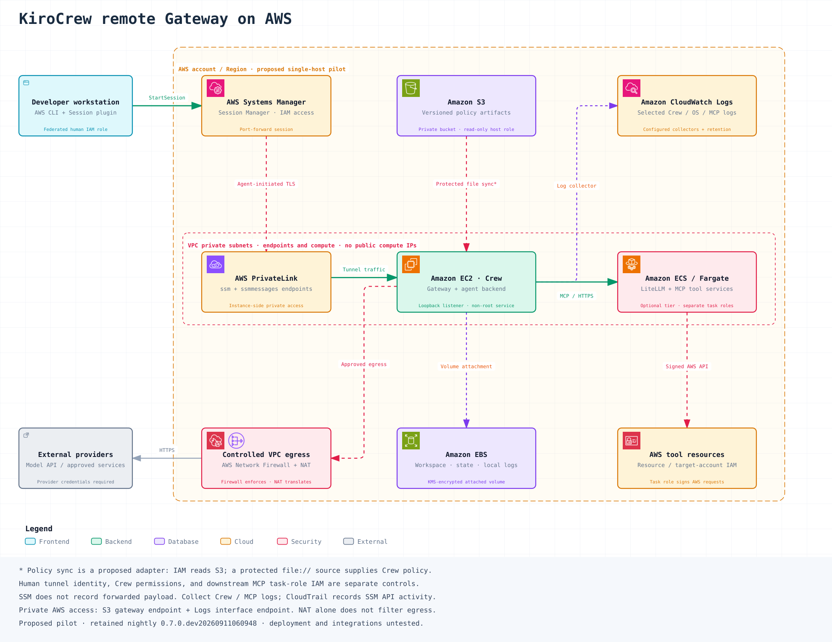
Proposed remote service on AWS
Private EC2 + SSM
Crew runs unprivileged.
Privileged sync writes policy
to a protected local file.
MCP roles and log collection
remain separate work.
Notes:
02:45–03:30. Open the AWS deployment tab after this slide for the readable full topology. The private EC2 host is the retained design. SSM controls transport access. A privileged sync adapter would write S3 policy artifacts to a protected local file while Crew runs unprivileged. Broad instance-profile credentials must be unavailable to agent processes through an effective boundary. The optional MCP tier and collector need their own roles and configuration. CloudTrail records Session Manager API activity; SSM does not record port-forwarded payloads. No resources deployed here. Sources: accepted kirocrew-aws-deployment-preview.png; kirocrew-aws-deployment-notes.md; https://docs.aws.amazon.com/systems-manager/latest/userguide/session-manager.html ; https://docs.aws.amazon.com/systems-manager/latest/userguide/session-manager-auditing.html .

Slide 6
Live control evidence
./demo.sh --interactive
Allow, then pause for approval
Deny a tool and protect a policy path
Classify a synthetic exfiltration command
Redact a fake credential
Verify SEL and detect a changed entry
Actual Crew functions in a synthetic callback harness.
Backend, MCP and AWS enforcement remain separate demonstrations.
Notes:
03:30. Switch to terminal in this project and run ./demo.sh --interactive. Expect about one minute on this Mac, with the intentional approval pause. Explain the scope before running: real functions from the frozen user-installed September 12 nightly package, with synthetic tool requests, no ACP backend and no cloud calls. ReadDemo auto-approves. WriteDemo returns normal handling and the harness asks the presenter to type APPROVE. DenyDemo never executes. The protected-policy fixture stays unchanged. The exfiltration-shaped command is classified but never sent to a shell. Policy/Profile identifies the limiting level. The fake credential redacts. Seven SEL entries verify, then a changed record fails and the restored log passes. Source and runnable evidence: scripts/run-live-demo.py; evidence/live/latest.json.

Slide 7
Crew denial, MCP denial and IAM denial
Decision boundary | Proof to present | Current evidence
Crew hook | Denial before synthetic handler | Rehearsed locally
MCP gateway | Tool grant denies before target call | Requires deployed gateway
AWS IAM | MCP permits, target API denies | Requires approved AWS environment
SEL integrity covers recorded events. External retention and complete capture need separate evidence.
Notes:
After the terminal demonstration, return here for 30 seconds. The local harness shows controls from installed nightly 0.7.0-nightly.20260912t060850. Package bytes are recorded in evidence/nightly/installed-nightly-verification.json; no source commit is claimed for that package. The MCP and IAM rows are acceptance criteria for a future deployment, not observed outcomes. Use one request identifier across the service boundary. An MCP denial should show the target handler was not invoked. For IAM denial, first prove the MCP grant permitted the call, then show the AWS error and target evidence. Never fabricate a cloud receipt. Source: HANDOFF.md; https://docs.litellm.ai/docs/mcp_control ; https://docs.aws.amazon.com/systems-manager/latest/userguide/session-manager-auditing.html .

