Slide 1
Spark Streaming and Windowing

Slide 2
What is Spark Streaming?
Spark Streaming is a real-time data processing engine built on Apache Spark.
It allows processing of continuous data streams in micro-batches.
Supports data sources like Kafka, Flume, HDFS, and more.

Slide 3
PySpark Code: Kafka → JSON Parsing → Parquet
from pyspark.sql import SparkSession
from pyspark.sql.functions import from_json, col
from pyspark.sql.types import StructType, StringType, IntegerType
# Step 1: Create Spark session
spark = SparkSession.builder \
.appName("KafkaJSONToParquet") \
.getOrCreate()
# Step 2: Define JSON schema (based on expected Kafka message structure)
schema = StructType() \
.add("id", IntegerType()) \
.add("name", StringType()) \
.add("city", StringType())
# Step 3: Read from Kafka
kafka_df = spark.readStream \
.format("kafka") \
.option("kafka.bootstrap.servers", "localhost:9092") \
.option("subscribe", "test-topic") \
.load()
Step 4: Extract value as STRING and parse JSON
json_df = kafka_df.selectExpr("CAST(value AS STRING) as message") \
.withColumn("data", from_json(col("message"), schema)) \
.select("data.*") # Optional: Expand fields directly
# Step 5: Write to Parquet
query = json_df.writeStream \
.format("parquet") \
.option("path", "/path/to/output/parquet") \
.option("checkpointLocation", "/path/to/checkpoint/dir") \
.outputMode("append") \
.start()
query.awaitTermination()

Slide 4
Checkpointing in Spark Streaming
Checkpointing is the process of saving the intermediate state and progress of a streaming application to reliable storage, enabling recovery from failures.
Why is it Needed?
Recover from driver/node failures
Maintain state across batches
Support stateful ops like windowing, aggregation
Ensure exactly-once guarantees
Types of Checkpointing
Type | Purpose
Metadata | Saves query info (DAG, offsets, config)
Data (RDD) | Stores data lineage for recomputation
State | Saves state info for stateful aggregations

Slide 5
How to enable Checkpointing in Spark Streaming?
Step-by-Step Setup
Choose a persistent storage path
  Recommended: HDFS, Azure Data Lake (ADLS), Amazon S3, or other
  distributed file systems
  Avoid: local filesystem (not fault-tolerant)
Add .option("checkpointLocation", "/path") in writeStream
Sample Code (Kafka to Parquet with checkpointing)
query = parsed_df.writeStream \
.format("parquet") \
.outputMode("append") \
.option("path", "/output/parquet/") \
.option("checkpointLocation", "/checkpoint/my_stream/") \
.start()
Mandatory for:
Aggregations
Windowed queries
Joins
mapGroupsWithState or flatMapGroupsWithState
Best Practices
Use durable storage: HDFS / ADLS / S3
Don’t delete checkpoint folder manually
Keep path unique for each stream

Slide 6
What is Windowing in Spark Streaming?
Windowing allows processing of data within a specific time range.
Helps in analyzing time-based events efficiently.
Commonly used for aggregations, trend analysis, and pattern detection.

Slide 7
Types of Windowing in Spark Structured Streaming
1. Tumbling Window
2. Sliding Window
3. Session Window
4. Watermarking (Not a window type but related)
Helps handle late data.
Defines how long Spark waits for late data before finalizing a window.
df.withWatermark("timestamp", "10 minutes")

Slide 8
Tumbling Windows
Fixed-size, non-overlapping time intervals.
Each window processes events occurring within that time frame.
Example: Counting events every 10 seconds.
Example Code:
windowed_df = df.groupBy(window("timestamp", "10 seconds")).count()

Slide 9
Sliding Windows
Fixed-size windows that slide at a defined interval.
Overlapping time windows allow event processing multiple times.
Example: Counting events every 10 seconds with a slide interval of 5 seconds.
Example Code:
windowed_df = df.groupBy(window("timestamp", "10 seconds", "5 seconds")).count()

Slide 10
Session Windows
Dynamic-sized windows based on user activity.
A session window closes when there is inactivity beyond a threshold.
Example: Tracking user sessions with a timeout of 30 minutes.
Example Code:
windowed_df = df.groupBy(session_window("timestamp", "30 minutes")).count()

Slide 11
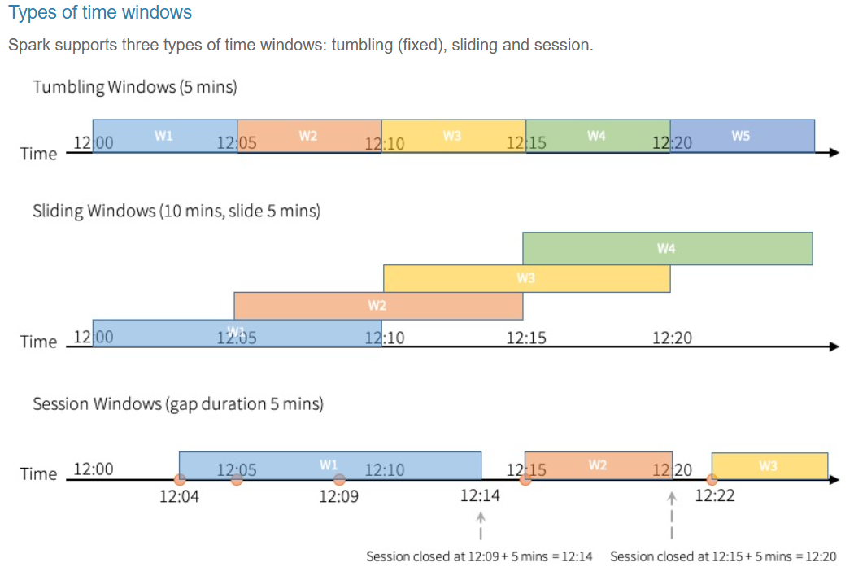

Slide 12
Tumbling windows are a series of fixed-sized, non-overlapping and contiguous time intervals. An input can only be bound to a single window.
Sliding windows are similar to the tumbling windows from the point of being “fixed-sized”, but windows can overlap if the duration of slide is smaller than the duration of window, and in this case an input can be bound to the multiple windows.
Tumbling and sliding window use window function, which has been described on above examples.
Session windows have different characteristic compared to the previous two types. Session window has a dynamic size of the window length, depending on the inputs. A session window starts with an input, and expands itself if following input has been received within gap duration. For static gap duration, a session window closes when there’s no input received within gap duration after receiving the latest input.
Session window uses session_window function. The usage of the function is similar to the window function.

Slide 13
Use Cases of Windowing
Fraud detection in real-time transactions.
Log analysis and monitoring.
Real-time user engagement tracking.
IoT sensor data processing.

Slide 14
Thank You!
Happy Learning 😊
Feel free to ask any questions!

