Slide 1
Authorship Verification
Text Mining Project
on
Supervisor: Prof. Dr. Jelena Mitrovic
Co-Supervisor: Jörg Schlötterer
Team 11:
Smruti Ranjan Mohapatra
Rohan Sapate
Nilesh Solanki
University of Passau

Slide 2
Motivation
To identify potential suspects to substantiate charges in a criminal case [1]
Identifying the author on social media
PAN2020 Challenge[2]

Slide 3
Introduction
Definition: Authorship verification is the task to determine the authenticity of any document based on the other work of the same author.
Since every author has its own writing style, we can compute the probability of the ownership of the document.
PAN task : Closed-set verification - Given a large training dataset comprising of known authors who have written about a given set of topics, the test dataset contains verification cases from a subset of the authors and topics found in the training data.[2]

Slide 4
Topics Used in the project
Software Management in FIM GIT
Programming in Python
JSONL file Processing, Random Shuffling, DataFrame, Regex, Numpy,
Min-Max Normalisation, Performance Counter
NLTK functions used
Character N-Gram, Word N-Gram, Usage of taggers,
Text Processing - Segmentation, Frequency distribution, Conditional Frequency distribution

Slide 5
Dataset Statistics I
Dataset from PAN organisation
Two datasets: Total 52,601 records
Dataset | Number of Same Authors | Number of Different Authors
Ground Truth Training | 24990 | 22350
Ground Truth Test | 2855 | 2417
Combined Dataset | 27834 | 24767

Slide 6
Dataset Statistics II
Format of training:
{"id": "6cced668-6e51-5212-873c-717f2bc91ce6", "fandoms": ["Guardians of Ga'Hoole", "Hetalia - Axis Powers"], "pair": [ “Text1”, “Text2” ] }\n
{"id": "3c6c188a-db28-59aa-8c09-3d0f799ff579", "fandoms": ["Guardians of Ga'Hoole", "Warriors"], "pair": ["Text1”,”Text2”]}
Format of ground truth:
{"id": "6cced668-6e51-5212-873c-717f2bc91ce6", "same": true, "authors": ["1446633", "1446633"]}\n
{"id": "ae9297e9-2ae5-5e3f-a2ab-ef7c322f2647", "same": false, "authors": ["1535385", "1998978"]}

Slide 7
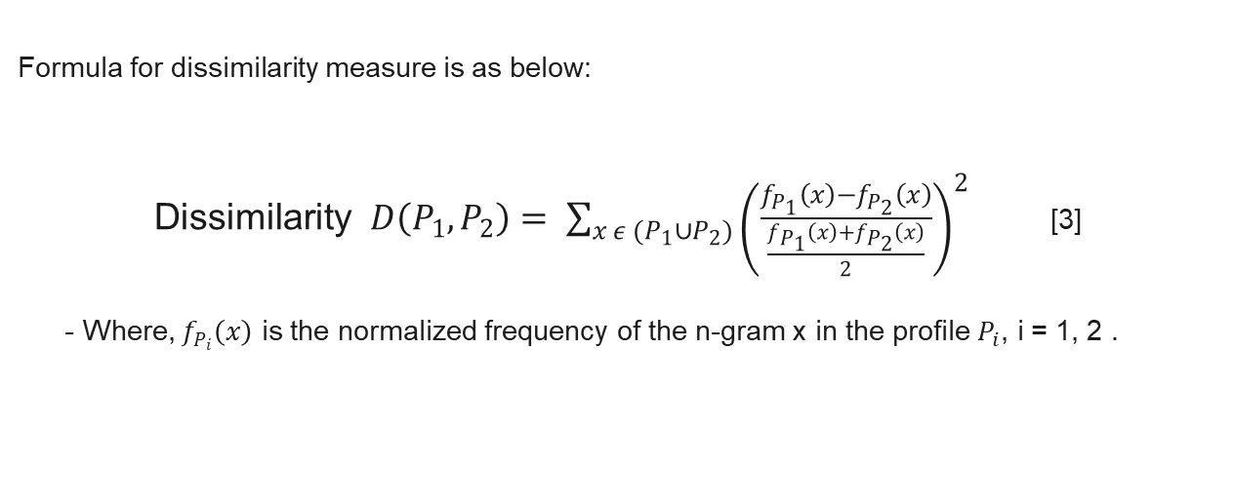
Methodology I
Formula for dissimilarity measure is as below:
Dissimilarity $D\left(P_{1},P_{2}\right)= \sum_{x ε (P_{1}∪P_{2})}{{\left(\frac{f_{P_{1}}\left(x\right)−f_{P_{2}}\left(x\right)}{\frac{f_{P_{1}}\left(x\right)+f_{P_{2}}\left(x\right)}{2}}\right)}^{2}}$ [3]
- Where, $f_{P_{i}}\left(x\right)$ is the normalized frequency of the n-gram x in the profile $P_{i}$, i = 1, 2 .

Slide 8
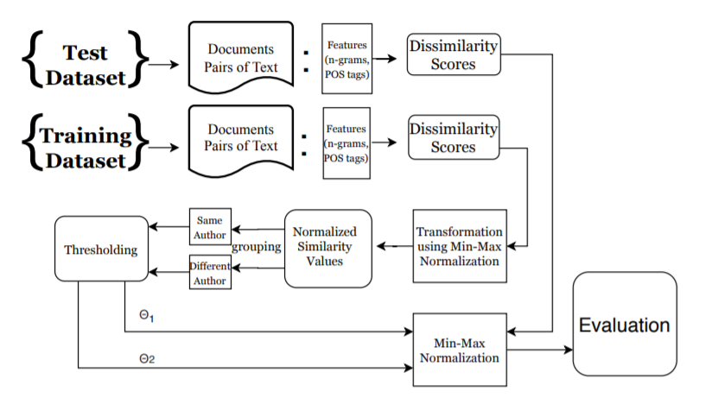
Methodology II ( Program flow )

Slide 9
Features
Word n-gram (unigram, bigram, trigram)
Character n-gram (character 4-gram, character 5-gram, character 6-gram, character 7-gram, character 8-gram)
PosTag Count (Part of Speech)
Total Punctuation Count
Vocabulary strength

Slide 10
Evaluation I
4 performance measures provided in PAN 2020
AUC-ROC - To measure performance of the classification problem at various threshold settings
F1-score - Popular performance measure for classification
F1 = 2 x(Precision * Recall)/ (Precision + Recall)

Slide 11
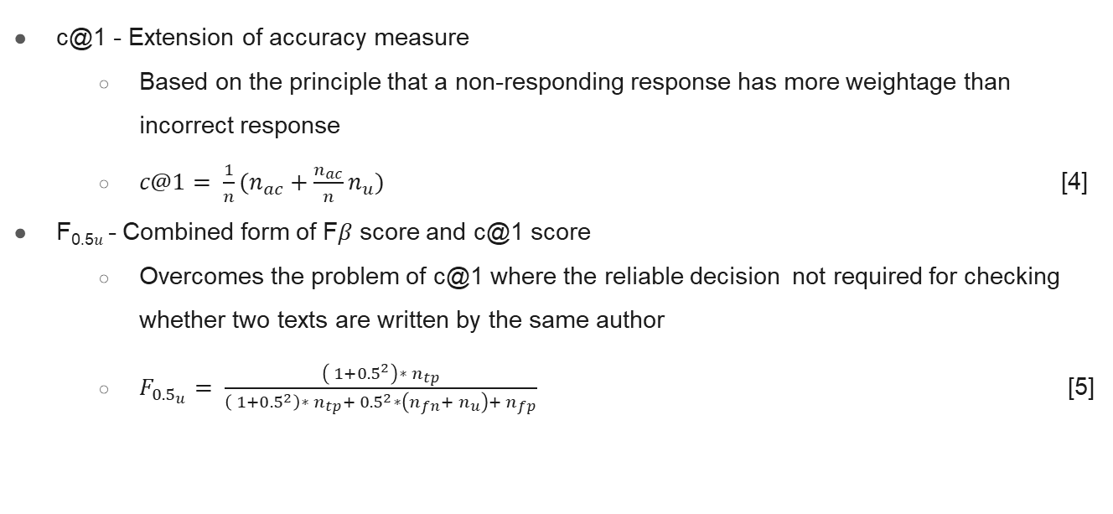
Evaluation II
c@1 - Extension of accuracy measure
Based on the principle that a non-responding response has more weightage than incorrect response
$c@1= \frac{1}{n}(n_{ac}+\frac{n_{ac}}{n}n_{u})$ [4]
F_{0.5𝑢} - Combined form of F𝛽 score and c@1 score
Overcomes the problem of c@1 where the reliable decision not required for checking whether two texts are written by the same author
$F_{{0.5}_{u}}= \frac{\left( 1+{0.5}^{2}\right)∗ n_{tp}}{\left( 1+{0.5}^{2}\right)∗ n_{tp}+ {0.5}^{2}∗\left(n_{fn}+ n_{u}\right)+ n_{fp}}$ [5]

Slide 12
Results I
feature | AUC-ROC | c@1 | F0.5𝑢 | F1-score | Overall
PosTagVerb | 0.571 | 0.633 | 0.655 | 0.697 | 0.639
PosTagNoun | 0.572 | 0.641 | 0.662 | 0.694 | 0.642
PosTagPronoun | 0.678 | 0.558 | 0.596 | 0.775 | 0.652
PosTagAdjective | 0.565 | 0.613 | 0.641 | 0.66 | 0.62
PosTagCount | 0.653 | 0.558 | 0.595 | 0.758 | 0.641

Slide 13
Results II
For profile length 100
feature | AUC-ROC | c@1 | F0.5𝑢 | F1-score | Overall
Word1 | 0.773 | 0.61 | 0.603 | 0.777 | 0.691
Word2 | 0.554 | 0.701 | 0.703 | 0.764 | 0.68
Word3 | 0.554 | 0.701 | 0.703 | 0.764 | 0.68
Character4 | 0.75 | 0.671 | 0.682 | 0.736 | 0.71
Character5 | 0.59 | 0.671 | 0.682 | 0.734 | 0.669
Character6 | 0.58 | 0.67 | 0.683 | 0.73 | 0.666
Character7 | 0.577 | 0.664 | 0.679 | 0.721 | 0.66
Character8 | 0.579 | 0.667 | 0.682 | 0.722 | 0.662

Slide 14
Results III
For profile length 200
feature | AUC-ROC | c@1 | F0.5𝑢 | F1-score | Overall
Word1 | 0.783 | 0.664 | 0.674 | 0.74 | 0.715
Word2 | 0.564 | 0.714 | 0.712 | 0.774 | 0.691
Word3 | 0.586 | 0.689 | 0.699 | 0.742 | 0.679
Character4 | 0.774 | 0.677 | 0.685 | 0.745 | 0.72
Character5 | 0.592 | 0.68 | 0.688 | 0.744 | 0.676
Character6 | 0.562 | 0.677 | 0.687 | 0.74 | 0.667
Character7 | 0.569 | 0.686 | 0.694 | 0.746 | 0.674
Character8 | 0.591 | 0.693 | 0.701 | 0.747 | 0.683

Slide 15
Discussion
Punctuation count, Vocabulary strength, Long-short sentence ratio, Combining features
Normalization technique

Slide 16
Conclusion
Successfully applied POS Tag Features in Dissimilarity algorithm
Implemented automatic thresholding technique rather than manual one.
Result for profile length 200 is better than the result for profile length 100
For POS Tags, the result for pronoun is comparatively better than others.

Slide 17
Future work
Improvement by combining different features with individual features
Improvement on the thresholding technique

Slide 18
References
S. Ehrhardt, “Authorship attribution analysis,” in Handbook of Communication in the Legal Sphere, J. Visconti, Ed. Berlin/Boston: de Gruyter, 2018, pp. 169–200
https://pan.webis.de/clef20/pan20-web/author-identification.html
Magdalena Jankowska, Evangelos Milios, and Vlado Keselj. 2014. Author Verification Using Common N-Gram Profiles of Text Documents. Proceedings of COLING 2014, the 25th International Conference on Computational Linguistics: Technical
Anselmo Peñas and Álvaro Rodrigo. 2011. A Simple Measure to Assess Nonresponse., Vol. 1. 1415–1424.
Janek Bevendorff, Benno Stein, Matthias Hagen, and Martin Potthast. 2019. Generalizing Unmasking for Short Texts. In Proceedings of the 2019 Conference of the North American Chapter of the Association for Computational Linguistics: Human Language Technologies, Volume 1 (Long and Short Papers). Association for Computational Linguistics, Minneapolis, Minnesota, 654–659. https: //doi.org/10.18653/v1/N19-1068

Slide 19
Thank You for your attention

